Slide 1
religion
CJVA103 - 25th March 2020

Slide 2
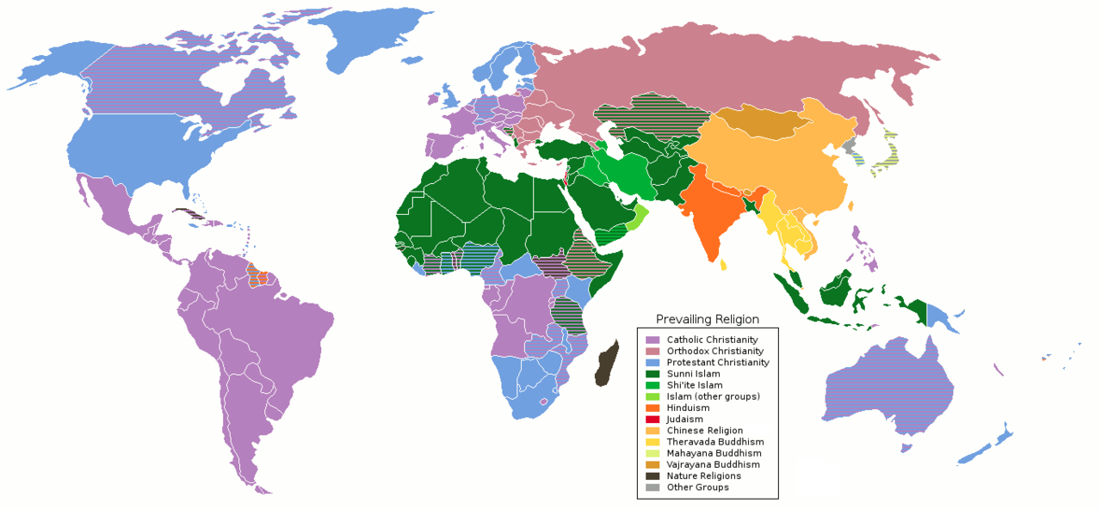
Source: wikipedia

Slide 3
https://www.youtube.com/watch?v=m6dCxo7t_aE

Slide 4
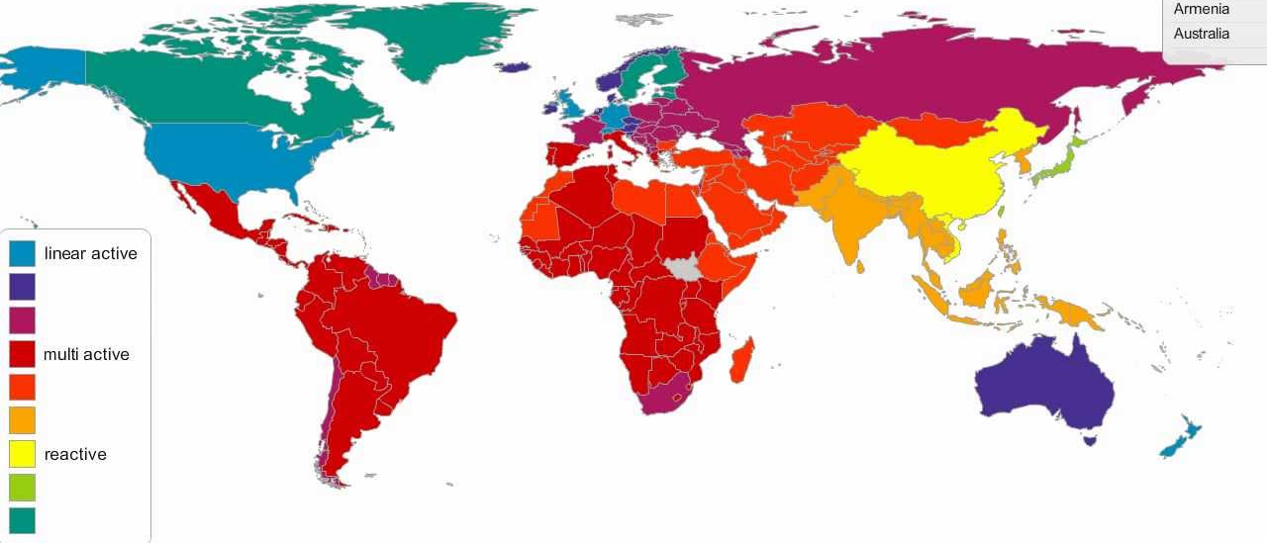

Slide 5
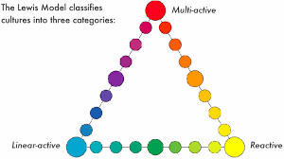
Lewis Model of Cultures

Slide 6
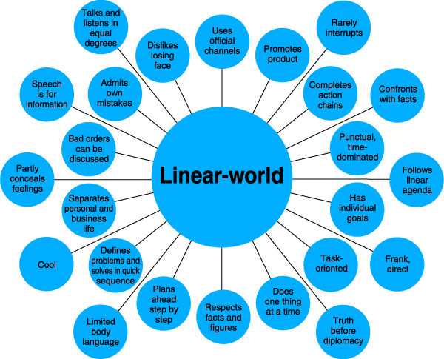
https://www.crossculture.com/about-us/the-model/

Slide 7
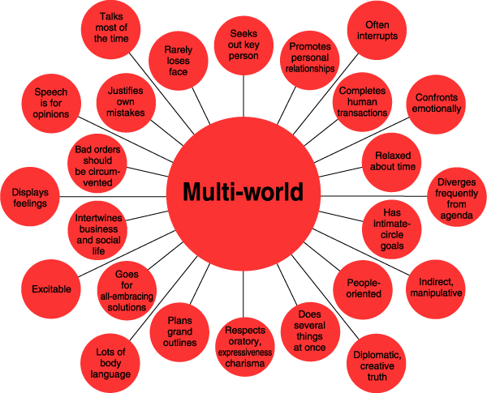
https://www.crossculture.com/about-us/the-model/

Slide 8
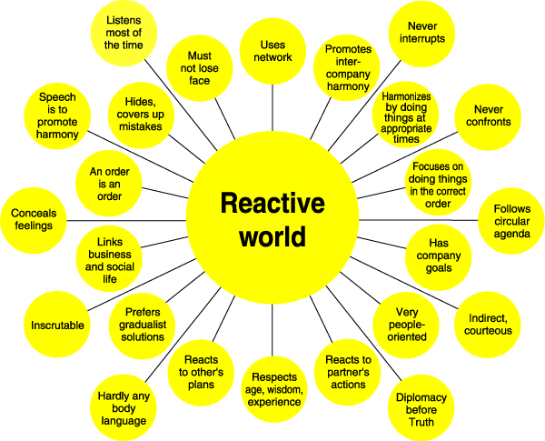
https://www.crossculture.com/about-us/the-model/

Slide 9
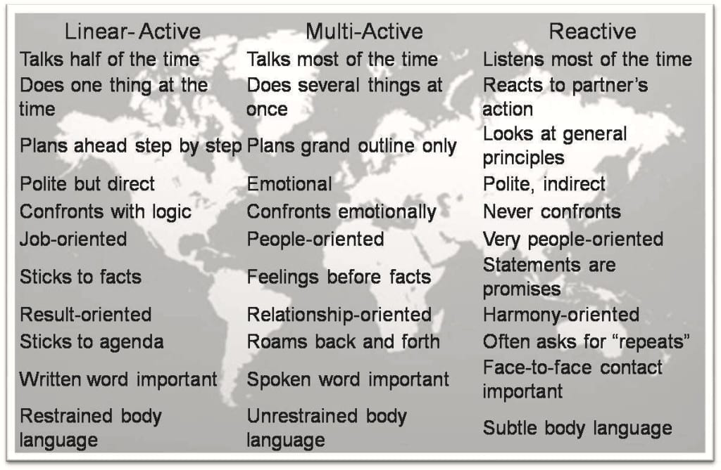

Slide 10
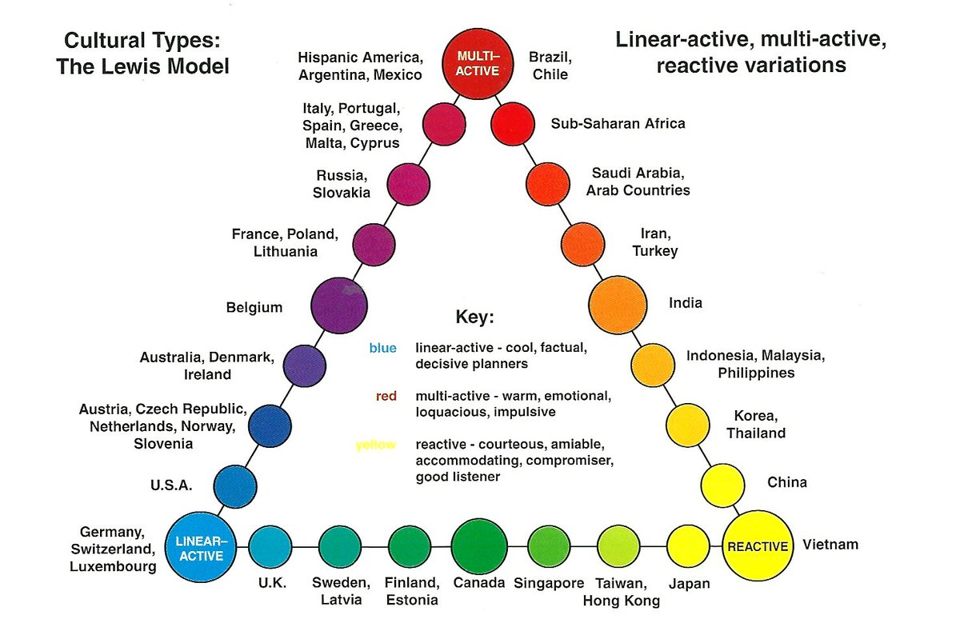
https://www.crossculture.com/the-lewis-model-dimensions-of-behaviour/

Slide 11
Source: wikipedia

