Slide 1
sense of humour
week 5 - 18th March

Slide 2
Kristýna and Renata - presentations

Slide 3
humour and culture
https://www.youtube.com/watch?v=MB6NXzGKMKg
Watch the TED talk and stop when necessary. It´s partly related to the national stereotypes (last week).
list new words and phrases
take notes of interesting points and share them in the discussion forum

Slide 4
nations in jokes
https://www.theguardian.com/world/2016/may/08/crude-but-rarely-nasty-the-jokes-europeans-tell-about-their-neighbours
read the text and list useful / new words…
think of more examples and share them in the discussion forum

Slide 5
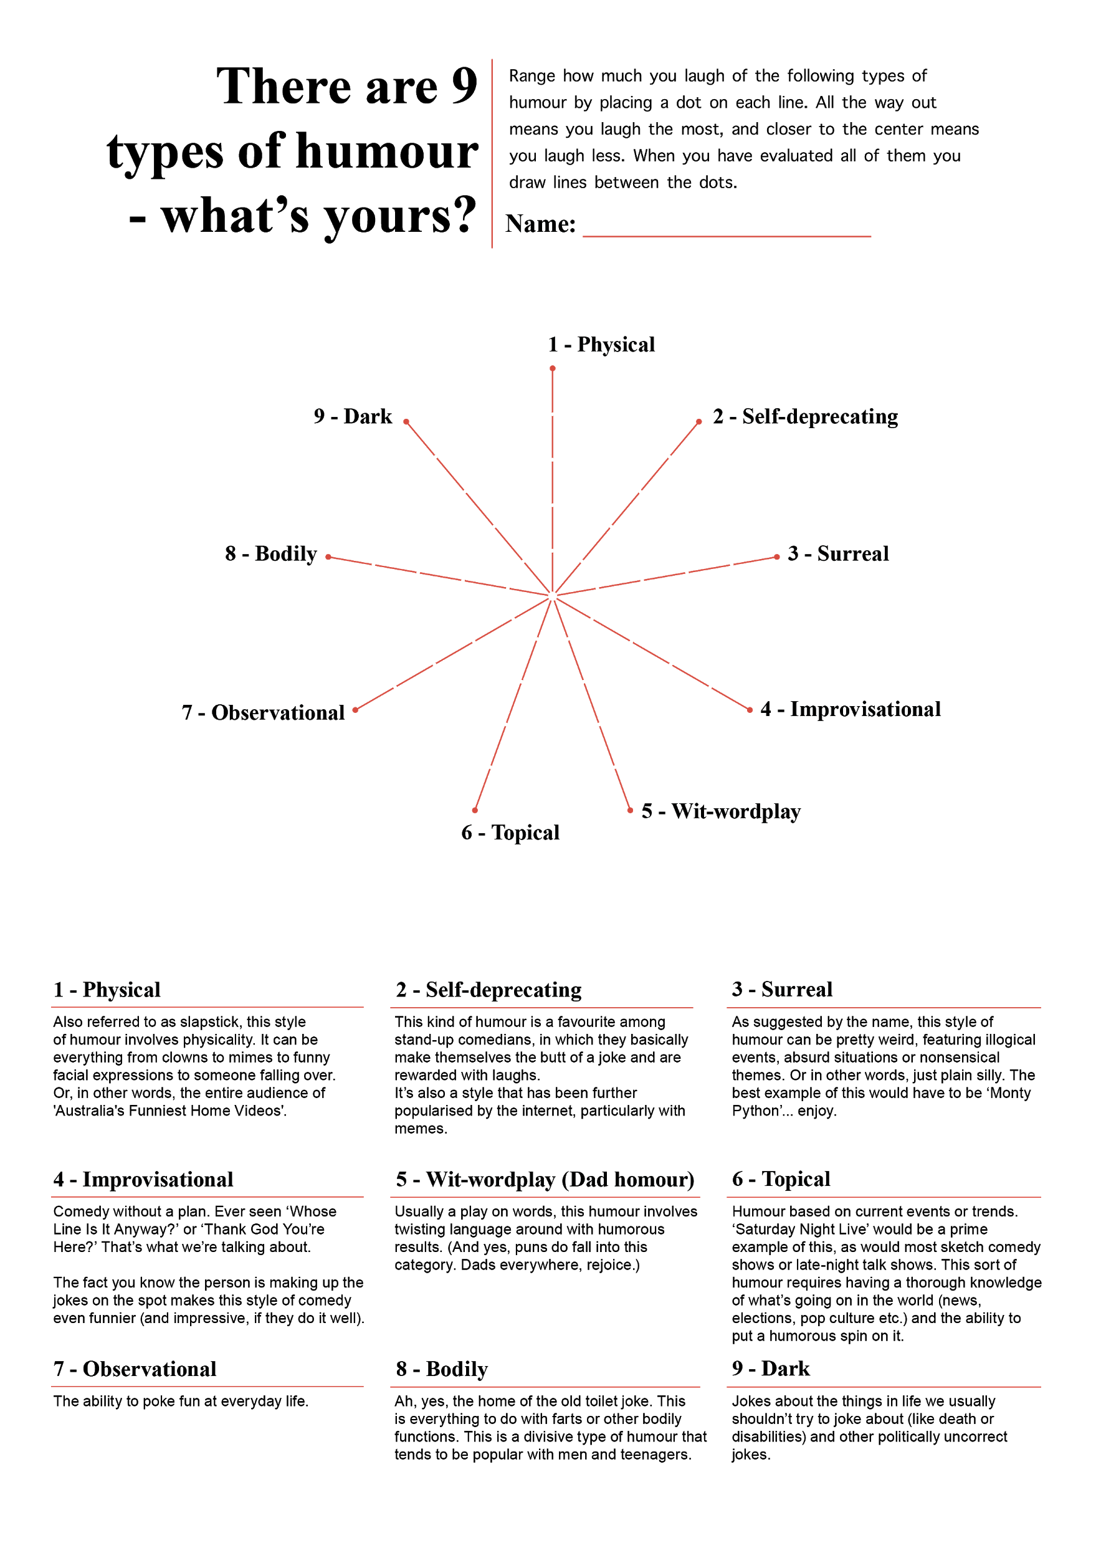
yourself…?
https://medium.com/@jane.pernille/workshop-exercise-humor-mapping-26dfd3b70747

