Slide 1
stereotypes
week 4 (11th March)

Slide 2
outline
history of stereotypes

Slide 3
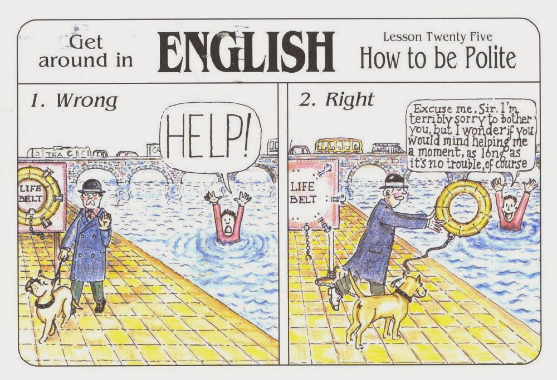
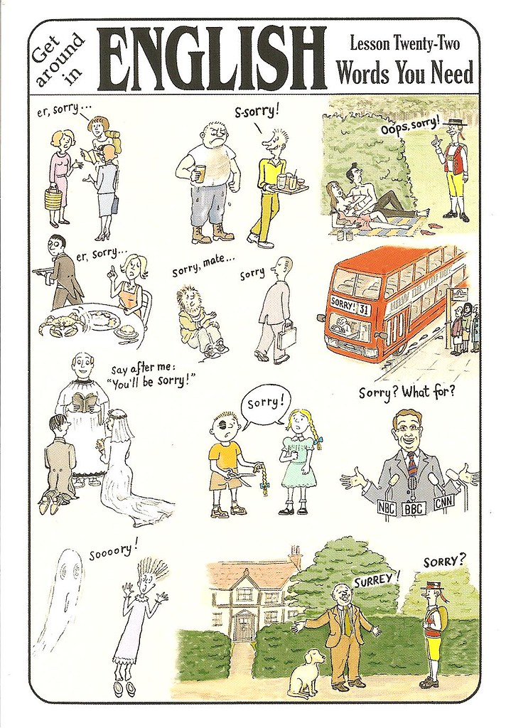
Why are the Brits so polite?
What is your explanation?
Do some research...

Slide 4
your list of stereotypes...
Please, use the thread in the discussion forum of the IS...

Slide 5
What follows is a selection of Yanko Tsvetkov´s maps (Atlas of Prejudice)... Anything interesting?

Slide 6
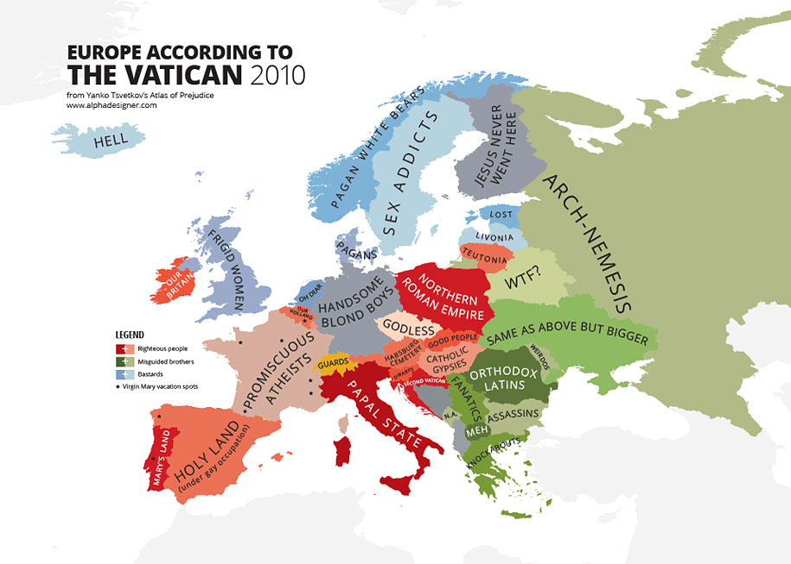

Slide 7
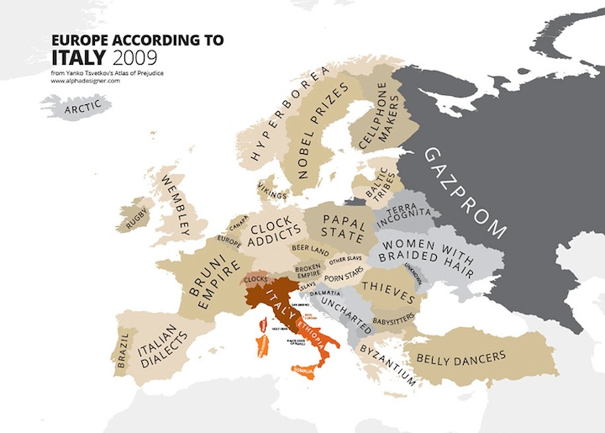

Slide 8
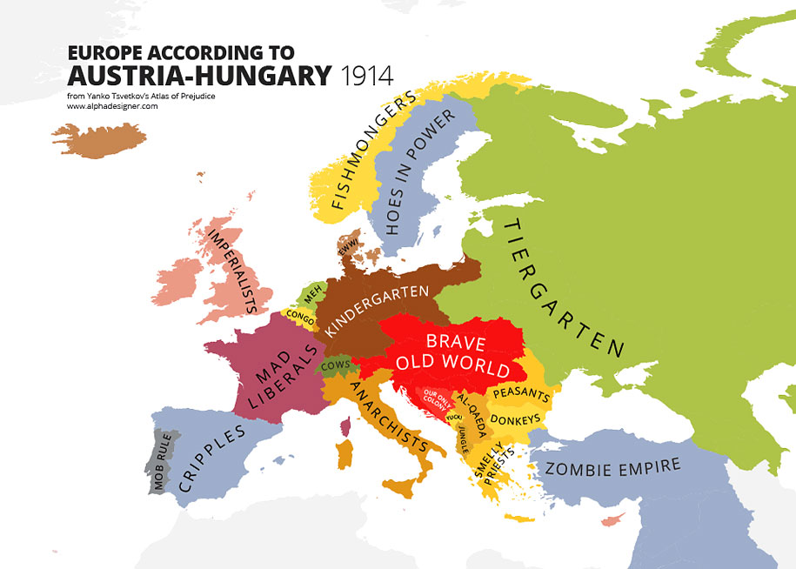

Slide 9
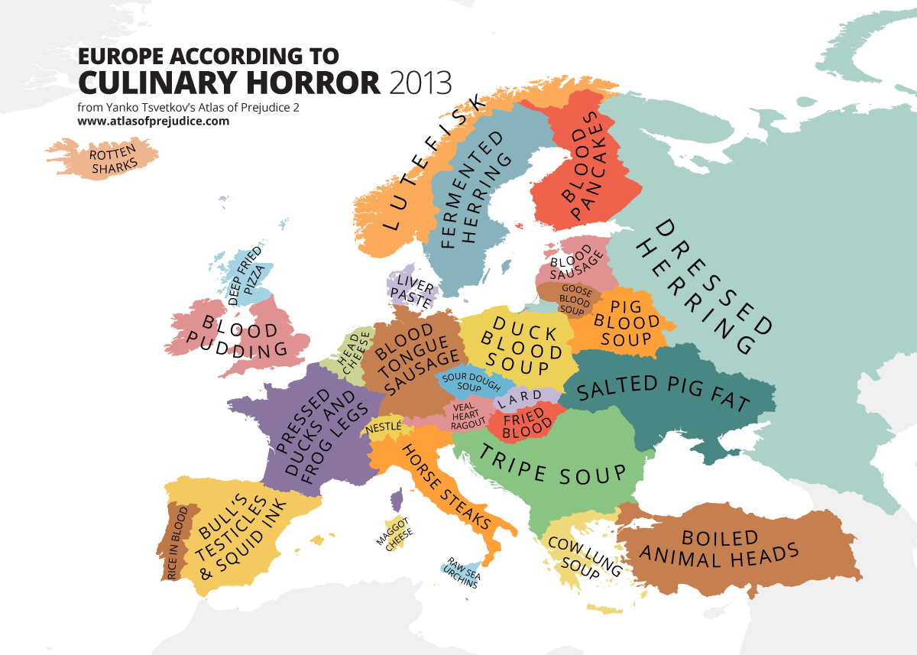

Slide 10
The danger of a single story
Watch the video, take notes and contribute to the IS discussion forum…
https://www.youtube.com/watch?v=D9Ihs241zeg

Slide 11
FYI - a bit of reading...
https://www.thoughtco.com/what-is-the-meaning-of-stereotype-2834956

