Slide 1
Historical roots of contemporary Czech politics
EUP406 Czech Politics

Slide 2
Outline
Finding the Czech political identity: the Austrian-Hungarian Monarch and the foundation of the First Republic
Czech communism and its historical legacy – from a totalitarian regime to a social contract
Class discussion

Slide 3
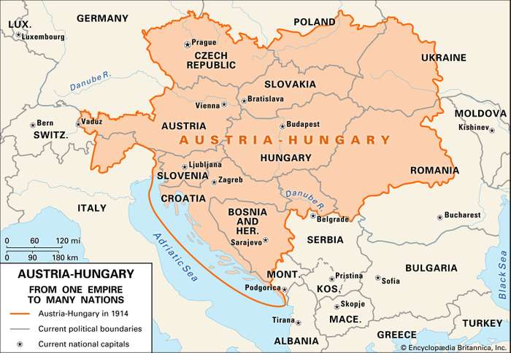
Czech lands under the Austrian rule

Slide 4
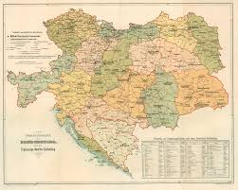
Czech lands under the Austrian rule
The position of the Czech lands
Czech nationalism in the 19th century Habsburg empire – Czech national renescence/revival
Politics of „passive resistence“
The National Theatre, Czech language (Josef Dobrovský, František Palacký, Božena Němcová, …)
Unsuccessful fight for autonomy in a quite liberal multinational monarchy
Establishment of the first political parties (Young Czechs, Old Czechs, Czechoslavonic Social Democratic Party in Austria)

Slide 5
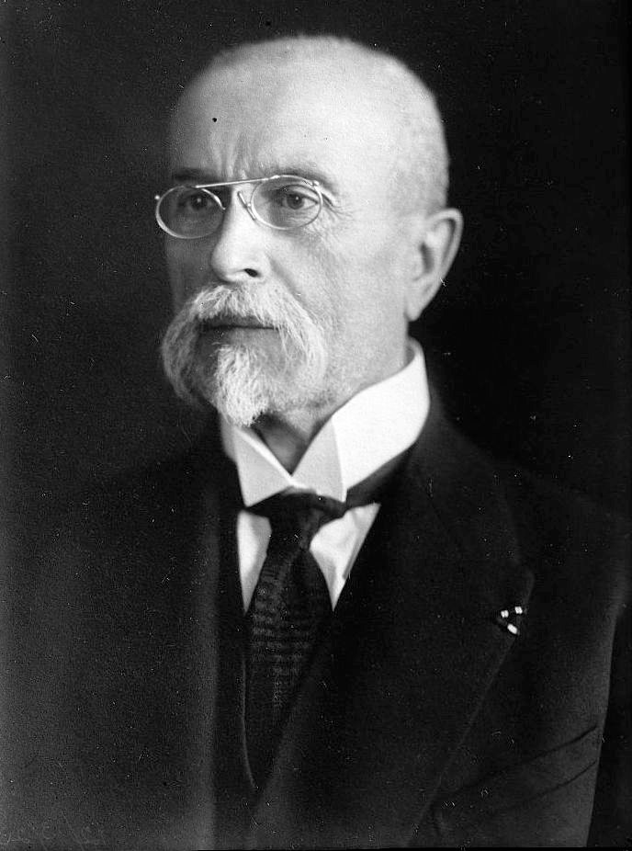
The First Republic (1918 – 1938)
One of the newly-born states after WWI (Pittsburgh
Declaration)
October 28 – Declaration of Czechoslovak Independence
Basic principles of the Czechoslovak state
Multiethnic state
Presidents of Czechoslovakia (TG Masaryk and E. Beneš)
A democratic and economically successful exception of the interwar Central and Eastern Europe – the tale of the First Republic

Slide 6
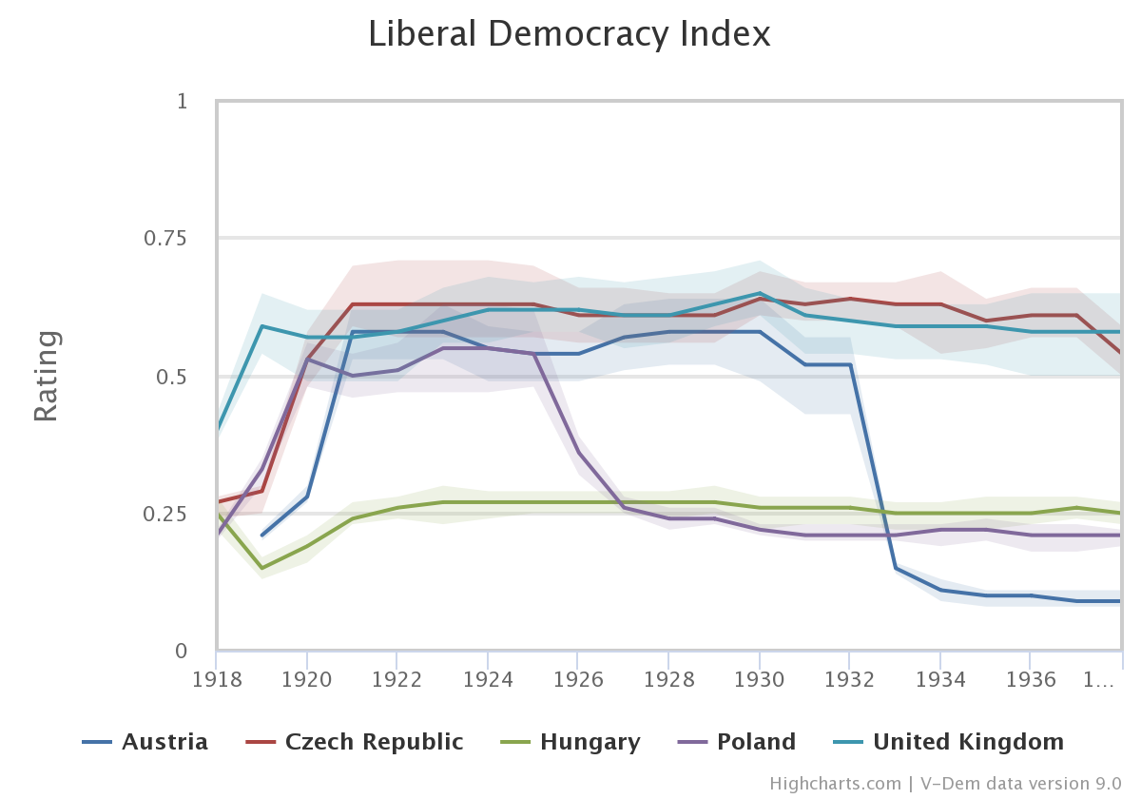

Slide 7
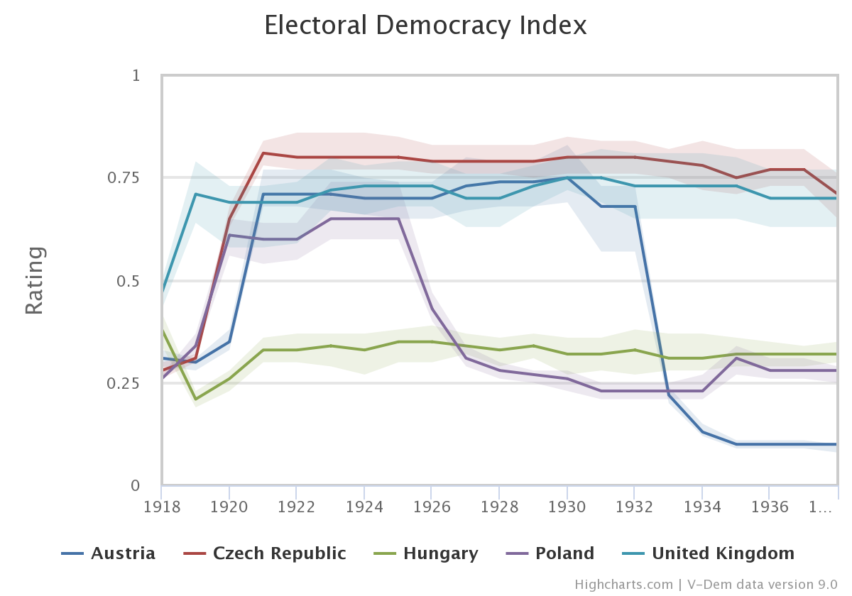

Slide 8
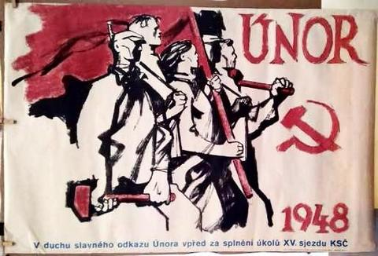
Czechoslovak communism

Slide 9
On the road to totalitarianism (1945-1953)
Democratic backslide since the second half of the 1930s – the Second Republic (1938 – 1939) and the Protectorate of Bohemia and Moravia (1939 – 1945)
Parallel resistence movements
Yalta and Potsdam conferences
Dominant role of the Red Army during liberation
President Beneš´s vision of the political systém and attitudes the First Republic

Slide 10
On the road to totalitarianism (1945-1953)
1946 general election – limited pluralism (the National Front)
KSC winning the election (40% of votes)
1948 – the "victorious February" in Czechoslovakia
Not violent – government crisis
Support from the society (left-leaning attitudes of society and part of the elites, dissapointment with the interwar republic, „Munich betrayal“, liberation, international situation)
Quick installment of a totalitarian regime

Slide 11
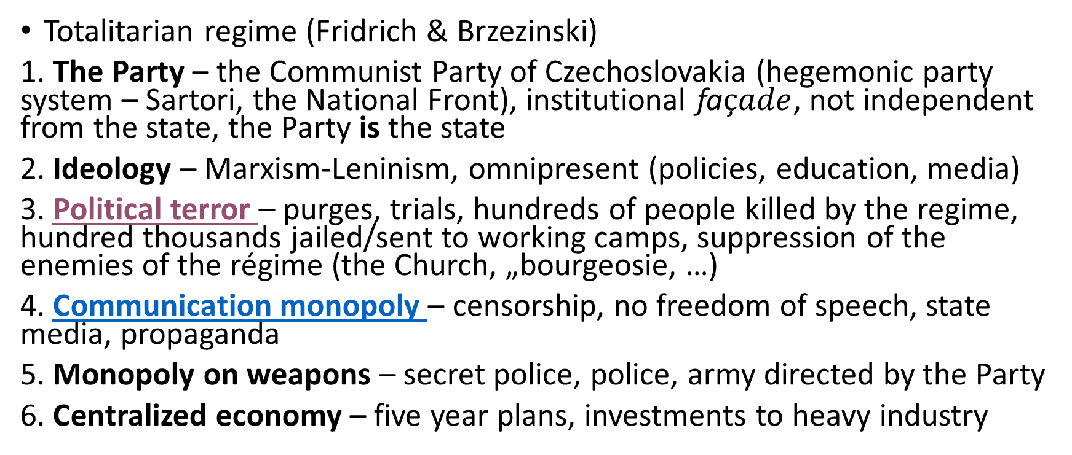
On its way to totalitarianism (1948-1953)
Totalitarian regime (Fridrich & Brzezinski)
1. The Party – the Communist Party of Czechoslovakia (hegemonic party system – Sartori, the National Front), institutional fa$çade$, not independent from the state, the Party is the state
2. Ideology – Marxism-Leninism, omnipresent (policies, education, media)
3. Political terror – purges, trials, hundreds of people killed by the regime, hundred thousands jailed/sent to working camps, suppression of the enemies of the régime (the Church, „bourgeosie, …)
4. Communication monopoly – censorship, no freedom of speech, state media, propaganda
5. Monopoly on weapons – secret police, police, army directed by the Party
6. Centralized economy – five year plans, investments to heavy industry

Slide 12
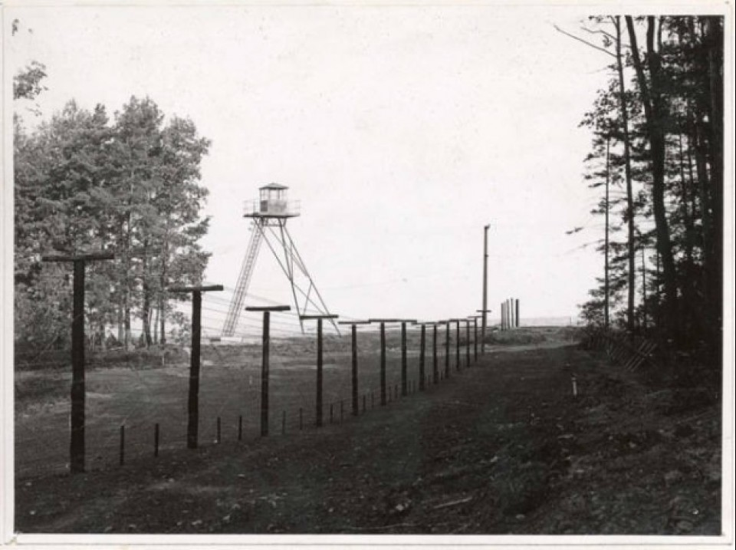

Slide 13
The monetary reform
“Our currency is strong and monetary reform will not take place. Class enemies are merely spreading rumours about it.“ (A. Zápotocký)
Pertaining rationing system, internal indebtness
drastic currency reform that devalued the current Koruna by a factor of 50:1 (depending on type and amount of money)
Uprising in Pilsen brutally repressed
Results – further centralization of the economy, the regime got controll over the last capital in the country

Slide 14
The Prague Spring
1953 – death of Stalin and gradual destalinization
Economic difficulties (monetary „reform“)
Liberalization of the regime since the early 1960s
Partial freedom of press, civil society and arts restored
Plan of an economic reform and possible democratization
August 1968 – invasion of the Warsaw Pact (Brezhnev doctrine)
Popular culture: e.g. Pelíšky (Cosy Dens) movie

Slide 15
„Real socialism“ (1968-1989)
The Prague Spring of 1968 soon followed by so-called "real socialism"/normalisation – a classic example of a frozen post-totalitarian régime (Linz):
  Gradual dissapearance of the ideology from the public sphere
  Intra-party purges
  Lack of mobilization
  Resignation on total control of citizens' lives
  Still/again central planned economy (collectivization)
  so-called silent social contract – political pasivity for decent living standards (BUT need for enormous social capital)
  Weak opposition (Charta 77) and still quite a suppressive regime with almost non-existent political and societal pluralism

Slide 16
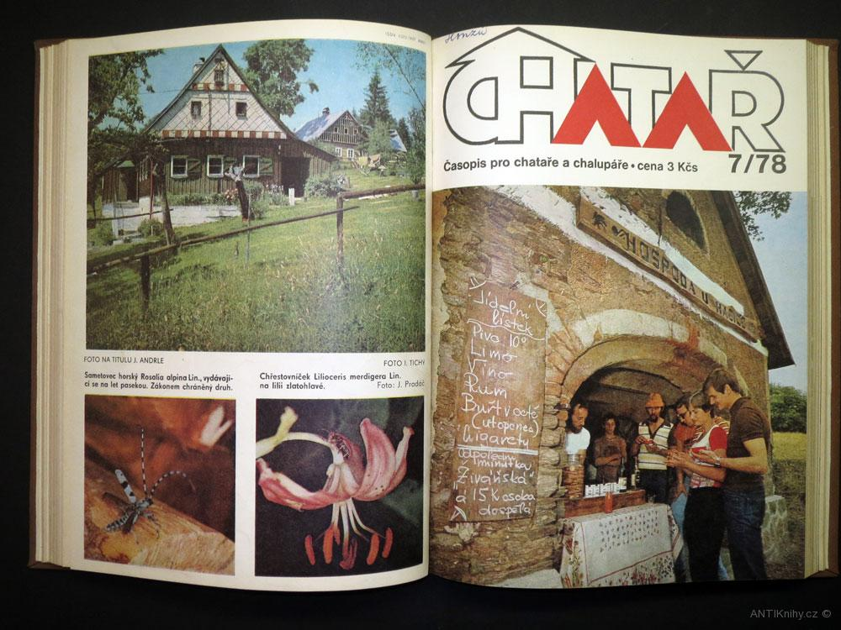
Private escape to the countryside

Slide 17
Charter 77 and the opposition
No legal opposition activities – supression
Limited to a small groups of people
Charter 77 – followed the Helsinky konference
J. Patočka, J. Hájek and V. Havel
Specific approach to opposition activities – dialogue with the regime in the area of human rights
„live within the truth“ and „live within the lie“ – private revolt, no ambitions for anti-regime actions
Anti-political politics

Slide 18
Types of communisms (Kitschelt)
Patrimonial communism (Romania, Post-Soviet Republics)
Based on strong charismatic leadership
Low level of intra-party contestation, high level of clientelism
Severe opposition repressions
National communism (Hungary, Poland)
Intermediate level of political contestation
Economic liberalization
Bureaucratic-authoritarianism
High level of bureaucratic institutionalization
No economic reforms
Czecho(Slovakia) and GDR

Slide 19
Class discussion
What are the most important elements of the past for the contemporary politics in the Czech Republic and why?
What is the Czech national/political identity like?
What do you consider the most important features of the Czech communism? And why?
Was there something potentially good in the Czech communism?
Any other interesting events/features of the pre-1989 Czech politics?

Slide 20
Roots of the transition

Slide 21
While it took 1000 days in Poland, 100 days in Hungary, it took 10 days in Czechoslovakia. T. G. Ash

Slide 22
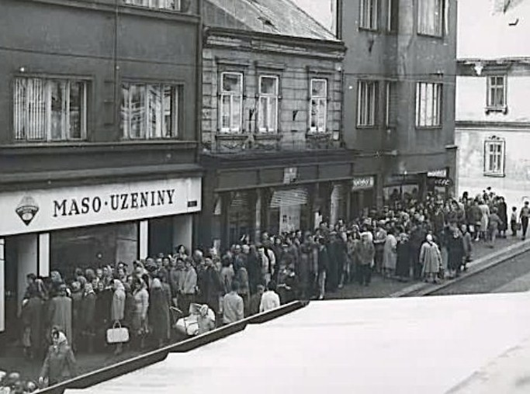
The change of the 1980s
The economy:
Worsening of economic conditions
(supply of even basic things)
Breaking of the social contract
International context:
Perestroika and glasnost in the USSR
Emergence of opposition in the neighbouring countries (Solidarnosć)
Internal opposition
Strenghtening of the opposition and transformation of its goals
Catholic demonstration in Velehrad in 1985 (200.000 people), the candle demonstration in Bratislava

Slide 23
The trigger

Slide 24
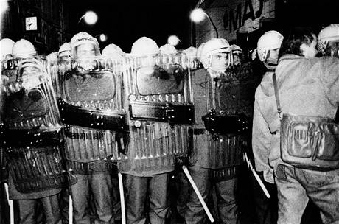
The 17th November 1989
A student demonstration on the 50th anniversary of students' oppresion during the Nazi occupation – approved by the regime
Turned into an anti-regime rally
A violent conflict between the students and the riot police
Rumours about a death of a student
(conspiracy theories) escalated the situation
Public unrest and new demonstration
The drama of Velvet Revolution started

Slide 25
Actors

Slide 26
The Party
The unreformed party – intraparty gerontocracy
Milouš Jakeš - as "the sole picket in a fence" (Jako kůl v plotě)
The lack of "liberal" reformers willing and able to take over power
Completely suprised by the situation
Unable to react (the People's Militia)
Quick disintegration of the National Front (Christian Democrats, the Czechoslovak Socialist Party)

Slide 27

The opposition
Student demonstrations activated the dissent
Joined by artists, philosophers
The leading role of the Charta 77 with Václav Havel as the leader
November 19 – the Civic Forum established
  Broad anti-regime movement – Charta 77, catholic dissent, neoliberal economists, reform communists
  Grassroot movement – hundreds of branches
  Turned into the main opposition platform
  Careful attitude, lack of experience
Roundtable talks

Slide 28
The process of transition
Quick resignation of the old cadres (Jakeš, Lenárt, Biľak, Štěpán, ...)
KSČ pulled by the situation, ready to relinquish power
OF – aim to „control “ the government, not to take over it
Party – opposition talks: 15 + 5 government rejected by the public
A change of the strategy of OF + the emergence of M. Čalfa as the new leader-in-talks of KSČ
A new government led by Čalfa appointed – resignation of President Husák
December 29 – Václav Havel elected unianimously the President of the Country by the Federal Assembly – the first period of transition completed

Slide 29
Political changes
Renewal of political pluralism (small and big laws political parties) – acknowledgment of the existence of several political parties including KSČ (see also later)
Constitutional changes – free mandate instead of the imperative one, abolition of the leading role of the Communist party and the Marxist-Leninist ideology, co-option of MPs on federal, state and local levels, proportional representation introduced
Fair and free elections arranged – the “referendum” about the change

Slide 30
The 1990 election
Landslide victory for the Civic Forum (50 % of votes, 96 % turnout)
Other parties also succesful – Christian Democrats, Moravian regionalists and...
...the Communist Party of Czechoslovakia (13% of votes)
A new government of OF, VPN (Slovakia), Slovak Christian Democrats and the Moravian Movement formed with Čalfa as the Prime Minister

Slide 31
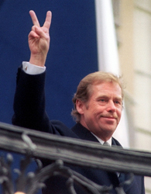
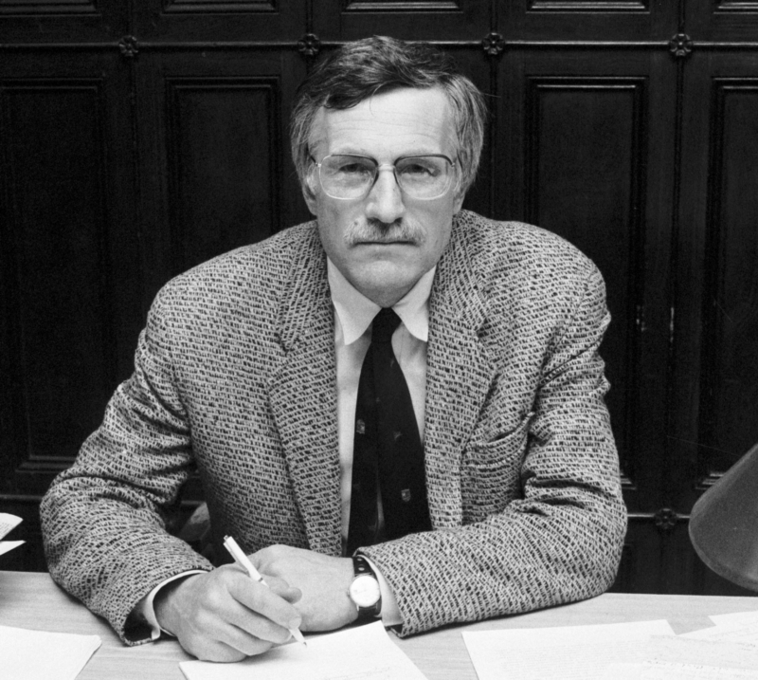
Two Václavs and two approaches to politics
Václav Havel
President (1989-1992, 1993-2003)
Plawriter and dissident during the com. rule (Charter 77)
Critical approach to politics based (solely) on political parties – „non-political politics“
Stress on civic society and human rights
Václav Klaus
Minister of Finance (1990-1992), Prime Minister (1992-1997), President (2003-2013)
Economic during the com. Rule
Indispensible role of political parties and elections
Critical perception of participatory politics
Clear liberal-conservative attitudes and economic perception of politics

Slide 32
Decommunization (and the fate of the Communist Party)

Slide 33
What to do with the communists?
Public demand to abolish the Party X the result
Reasons:
The history – generally leftist public (although not necessarily communist)
KSČ led by pragmaticians (a deal with Havel?)
Havel's approach – rejection of a hard punishment
The notion of the legal continuity
The transition process – legitimation of the Communist Party confirmed by the election
Contradictio ad excludendum

Slide 34
Decommunization
Law on Restitution of the Property of the Communist Party to the Czechoslovak people
Lustration laws – forbiding access of former communists and secret police members (collaborators) to positions in public administration
Law on Crimes of Communism
The Institute for the Study of Totalitarian Regimes (including the period of the communist rule)
But also continuity (justice system, administration, economy,…)
Anti-communism and evolution of the party system

Slide 35
The economic transformation
Conflict of paradigms (gradualists vs radicals)
The Czech Republic vs Slovakia
The radicals won (Václav Klaus) – introduction of reforms inspired by neoliberalism including widespread privatization (voucher privatization) and liberalization of the economy
The breeding ground of the later conflict between the losers and the winners of transition (far right in the 1990s) + the conflict of Czechs and Slovaks

Slide 36
The end of Czechoslovakia
Historical experience (A-H monarchy, First Republic, Communist rule)
the lack of strong Czechoslovak identity
separated party systems
Religious differences
Economy
The hyphen – war, several rounds of negotiations
non-functional federal polity
August 1992 – Declaration of Independence
1993 – the emergence of the independent Czech R. and Slovakia – one of the most peaceful ends of multiethnic states in the history

Slide 37
Class discussion
Given the nature of both the previous and the new regime, the aim is to discuss the attitudes towards the communist past in general and the communist party in particular.
It is closely linked to the question of dealing with the past. Would you ban the party in the beginning of the 1990s? Why?
How would you deal with collaborators with the regime? What are possible and actual outcomes of different approaches?

Slide 38
Political system – institutions I.

Slide 39
Basic principles of the new state
The new constitution – December 1992 (intensive discussions)
Inspiration by the First Republic but also by USA, France…
Basic principles:
  Democracy
  Republicanism
  Unitary state (Moravist movement)
  Representative democracy
  Parliamentary democracy
  Stress on human rights (the Charter of Basic Rights and Freedoms)
  Key role of political parties
Duality of institutions (dynamic vs stable ones)

Slide 40
Basic principles
„As a free and democratic state founded on respect for human rights and on the principles of civic society,
As a part of the family of democracies in Europe and around the world,
Resolved to guard and develop together the natural and cultural, material and spiritual wealth handed down to us,
Resolved to abide by all proven principles of a state governed by the rule of law,
Through our freely-elected representatives, do adopt this Constitution of the Czech Republic.“ (Preamble of the Constitution of the Czech Republic)

Slide 41
Democracy
„The Czech Republic is a sovereign, unitary, and democratic state governed by the rule of law, founded on respect for the rights and freedoms of man and of citizens.“
„All state authority emanates from the people; they exercise it through legislative, executive, and judicial bodies.“
„The political system is founded on the free and voluntary formation of and free competition among those political parties which respect the fundamental democratic principles and which renounce force as a means of promoting their interests.“
„Political decisions emerge from the will of the majority manifested in free voting. The decision-making of the majority shall take into consideration the interests of minorities.“

Slide 42
Institutional setting
GOVERNMENT
Separation of powers
PRESIDENT
PARLIAMENT:
ChoD + Senate
CONSTITUTIONAL COURT
The PEOPLE

Slide 43
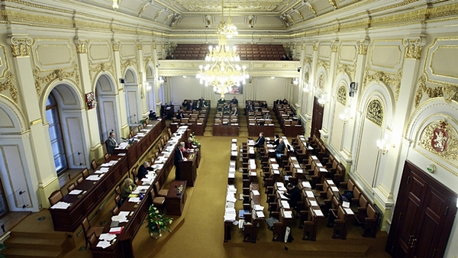
Bicameralism
The Chamber of Deputies and
the Senate
Inspiration by the First Republic
Senate as a stabilization institution
Dominant role of the Chamber of Deputies
  Legislation procedure (state budget)
  Relationship towards the government
  (election of the President)

Slide 44
Chamber of Deputies
200 MPs elected for a 4-year term using the „principle of proportional representation“
Established in 1993 by transformation of the Czech National Council
Organized by resort-oriented commitees
Party groups (at least 10 MPs)
Can be dissolved under strictly defined circumstances
Control power via the government (investiture vote, vote of no-confidence, questioning…)

Slide 45
Senate
81 senators elected for 6 years (1/3 each two years) by a majoritarian system
At least 40 years – „the chamber of wise men“
Established not earlier than in 1996
Struggling with legitimacy (electoral turnout around 15 %)
Not a clear position in the political system
Important but dormant competencies – legislature, approval of constitutional judges, involved in the process of impeachment of the President
Cannot be dissolved

Slide 46
Legislation procedure
Legislative initiative
3 readings in the Chamber of Deputies
Senate – approval, rejection, amendments, neglection (30 days)
Chamber of Deputies (majority of all MPs)
President – 15 days for signature, veto – Chamber of Deputies (majority of all MPs)
Special position of Constitutional Laws, elections laws, state budget

Slide 47
Other competencies
Approval of the government (more later)
Approval of judges of the Constitutional Court (Senate)
Election (ChoD) and nomination of the Ombudsman and her deputy

Slide 48
Executive

Slide 49
The President
Directly elected for five years (two consecutive terms allowed)
Formally rather weak but strong informal authority (history, Prague Castle, Presidents elected)
Head of the State with representative function
Appoints and dismiss members of the cabinet (see also later), members of the National Bank and of the Constitutional Court, judges
Foreign policy
Rather limited role in the legislative process, suspensive veto of ordinary bills
Dissolves the ChoD
Has the right to issue amnesty

Slide 50
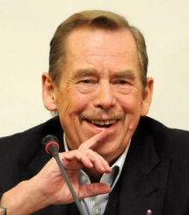
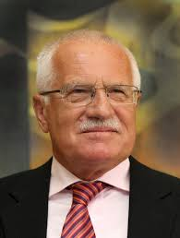
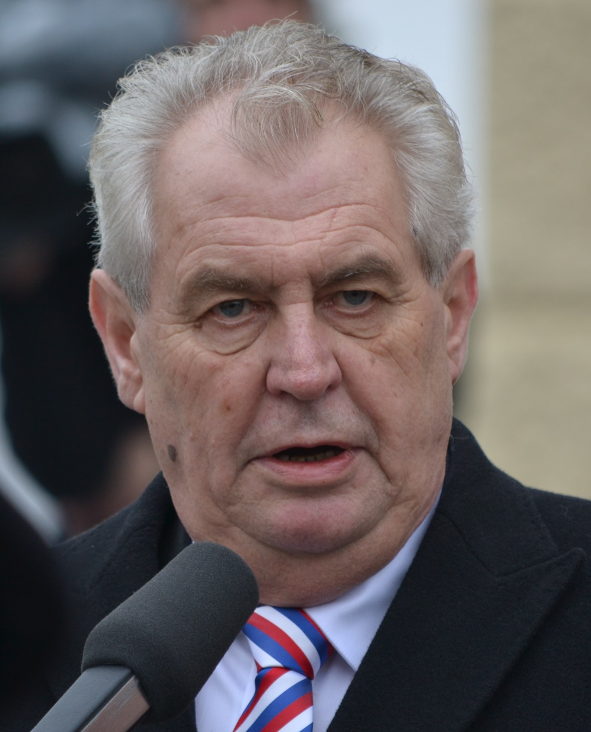

Slide 51
CR towards semi-presidentialism?
Direct election as a stronger source of legitimacy
Historical legacy
Strong persons willing to go beyond written constitution (ministerial appointments and dismissals, cabinet formation)
The case of Rusnok cabinet
Mixture of institutional setting + willingness to get power + context of the party system

Slide 52
The government
Collective body appointed by the President but responsible to the Chamber of Deputies
investiture vote X vote of confidence
Headed by the Prime Minister (Primus inter Pares)
Crucial role of political parties
Low stability (694 days on average – in 2017), often minority cabinets: reasons (anti-system parties, electoral system, personal animosities, intra-party cohesion)

Slide 53
Judiciary
Four levels of the system of courts (counties, regions, 2 Upper Courts and the Supreme Court)
Supreme Administrative Court
Constitutional Court
Protection of constitutional rights
Can repeal laws
15 judges proposed by the President and approved by the Senate (10 years, 1 renewable term)

Slide 54
Conclusion
The Czech Republic as a parliamentary democracy
Assembly parliamentarism (Sartori)
Asymmetrical bicameralism
Real functioning strongly influenced by the party system (weak governments – more in lectures on executive and party politics)
Concurrent locus of power in the Prague Castle
Discussions over reforms (the Senate, number of MPs, electoral system…)
Strong position of the Constitutional Court

Slide 55
Class discussion
Given the nature of the regime and the institutional setting, the discussion should aim at the roots of the weak points of the regime, its consequences and possible corrections (avoiding the electoral reform which is the topic of the next class).
Should the powers of the head of the state be limited? Would you abolish the upper chamber of the parliament? Shoud be there more direct democracy? What are the different discourses on Czech political institutions?

