Slide 1
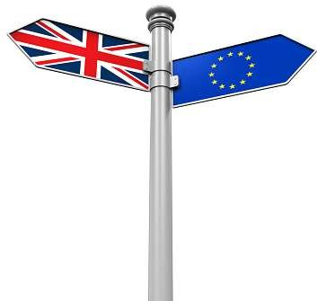

Road to the Leave vote & Renegotiations
Dr Monika Brusenbauch Meislová
Brexit: Politics, Policies and Processes

Slide 2
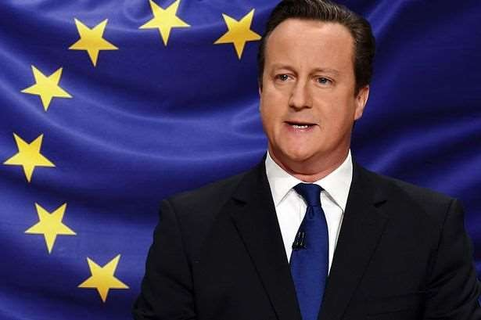
Commitment to a Referendum
David Cameron: more substantial imprint upon the British relationship with the EU than any previous British Prime Minister since the UK joined the European Community in 1973.
Leader of the CP since 2005.
Prime minister since 2010.
“Britain needs to be in the EU – it is not in Britain’s interest to leave the EU” (2011).

Slide 3
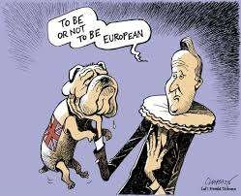

Slide 4
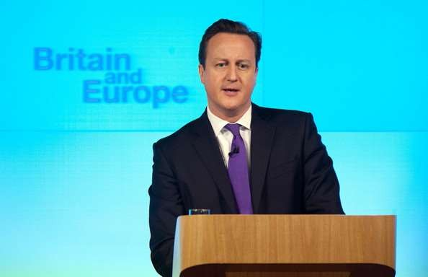
Commitment to a Referendum
Bloomberg Speech (23 January 2013)
DC discusses the future of the European Union and declares commitment to renegotiate a better settlement for the UK’s membership in the EU and hold an in/out EU referendum, should the Conservative Party win the 2015 general election.
Three Rs’: reform, renegotiation, referendum
It is time to settle this European question

Slide 5
Commitment to a Referendum
Other parts of the Bloomberg speech
  Connections between UK and Europe
  Tensions that have long been present (+ identification of some of the causes)
  Lack of public support
DC prone to taking political gambles

Slide 6
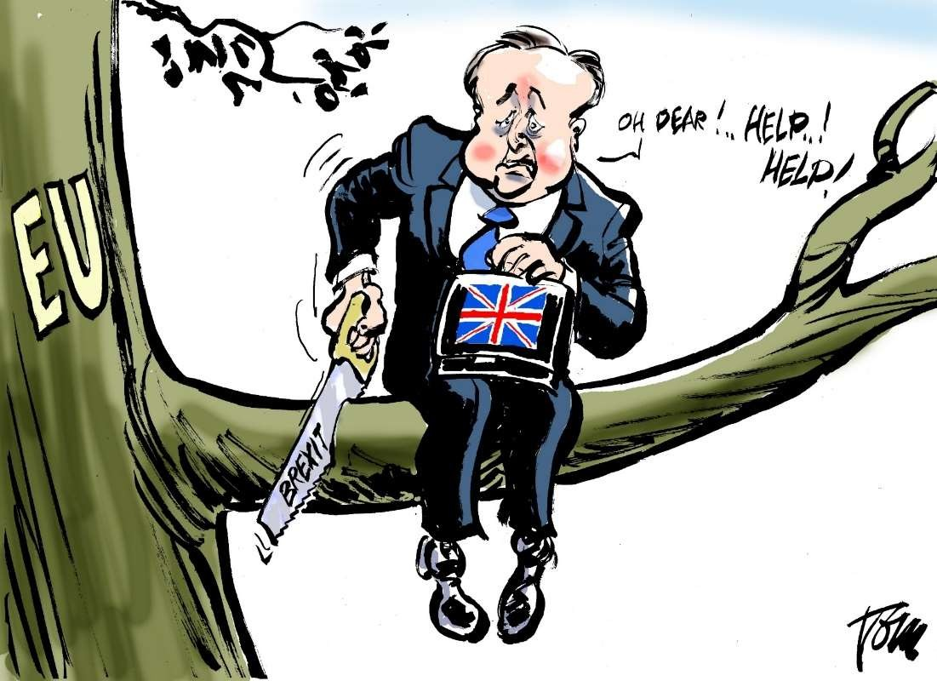
Commitment to a Referendum
Referenda in UK politics
  UK-wide referenda still rare.
  No direct provision for REFs under UK‘s uncodified constitution → govt has a large say over their timing, question, subject etc.

Slide 7
Commitment to a Referendum
Reasons behind the referendum commitment
Tensions within the Conservative Party
→ REF as a tool to hold the party together
Issue of Europe = long a source of tension within CP
A series of concessions to placate the Eurosceptics.
  Decision (2005) to take Conservative MEPs out of the group of the European People’s Party → DC did so in 2009
  Commitment to holding a referendum on Lisbon Treaty (impossible to deliver on)

Slide 8
Commitment to a Referendum
Referendum Lock (2011)
Any future amendments to the EU Treaties transferring additional “significant” powers to the European level be subject to a national referendum.
Review of the Balance of Competences (2012): an audit of what the EU does and how it affects the UK.
The 32-volume Review completed in autumn 2014
was to form the basis for the Government’s proposed reform of the UK’s relationship with the EU.

Slide 9
Commitment to a Referendum
Changing UK political landscape
  Reality of the coalition government (2010-2015)
Steady rise of UKIP
  UKIP widely identified as a populist right-wing single-issue party.
  Voters disenchanted with mainstream politics.
  An uphill battle to get noticed.
  May 2014: a record 26% of the vote in European elections (the UK's biggest party in the European Parliament)
  Party‘s message: combination of Euroscepticism, anti-immigration policies and populism.
Campaign for Britain’s departure from the EU = party’s raison d’être.
Role of media
Role of public opinion
Changing EU (especially in a sense of developments within Eurozone)

Slide 10
Renegotiations
Timeline
14 April 2015: Launch of the Conservative Party Manifesto for the 2015 General Election (Pledge: “Real change in our relationship with the European Union” and commits to “hold an in-out referendum on our membership of the EU before the end of 2017”.
May 7, 2015: Conservatives win a general election
10 November 2015
  David Cameron delivers a speech on Europe to Chatham House, setting out the case for EU reform and reaffirming his commitment to an EU referendum before the end of 2017.
  In a letter to Donald Tusk the Prime Minister sets out the four areas where he is seeking reform as part of negotiations on the UK’s membership of the EU

Slide 11
Renegotiations
̶ December 2015: The European Union Referendum Act receives Royal Assent (provides for the holding of a referendum in the UK and Gibraltar on whether the UK should remain a member of the EU).
2 February 2016: Donald Tusk writes to Members of the European Council on his proposal for a new settlement for the UK within the EU. The European Council publishes its Draft Decision concerning a ‘New Settlement for the United Kingdom within the European Union’.
3 February 2016: The Prime Minister gives a statement to the House of Commons on the progress made regarding the UK-EU renegotiation.
18-19 February 2016: European Council meeting.
22 February 2016: The Prime Minister announces the EU referendum date – 23 June 2016 – after securing a deal on Britain's membership of the EU.

Slide 12
Renegotiations
Difficult renegotiations
A three-level game (party, country, EU)
Problematic timing (reduced his leverage + meaningful reform of the EU dropped off the agenda)
Asked Tory parliamentarians not to declare support for remain or leave until after he had completed his negotiations
January 5, 2016: Ministers free to campaign on either side

Slide 13
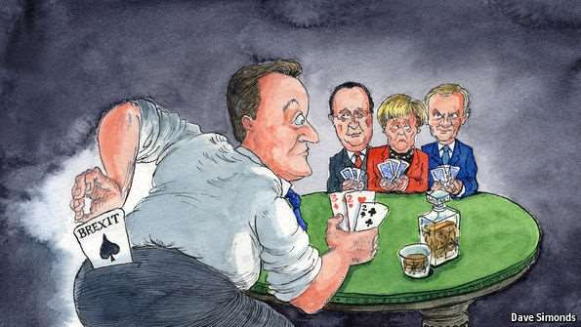

Slide 14
Renegotiations
Four clusters or ‘baskets’ or demands:
  economic governance
  competitiveness
  sovereignty
  Immigration
→ outcome offered little to placate those concerned about sovereignty, immigration or benefits payments.
Deal reached in February 2016 (“special status” within the EU)
  Immediately dismissed by hardline Eurosceptics as weak and not going far enough
  The press was very strong in its dismissal of the deal.

Slide 15
Research Briefings
https://commonslibrary.parliament.uk/category/brexit/
Brexitcasts
https://www.bbc.co.uk/programmes/p05299nl/episodes/player

Slide 16
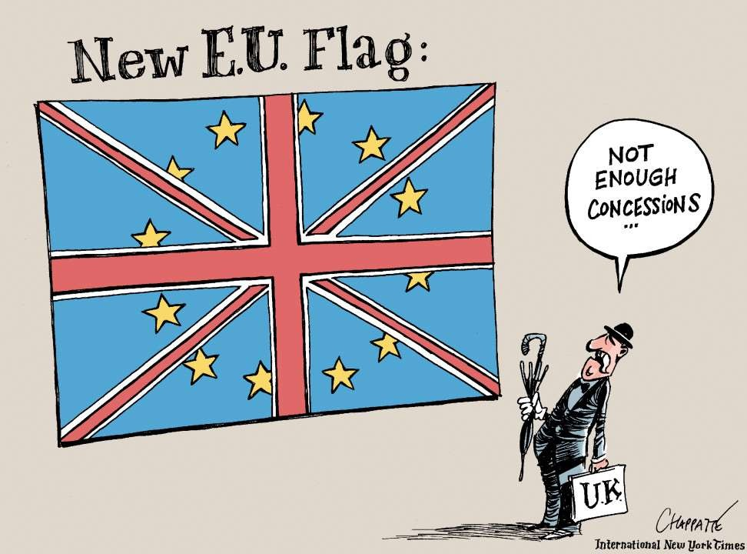

Slide 17
Thank you very much for your attention
(brusenbauch.meislova@email.cz)

