Slide 1
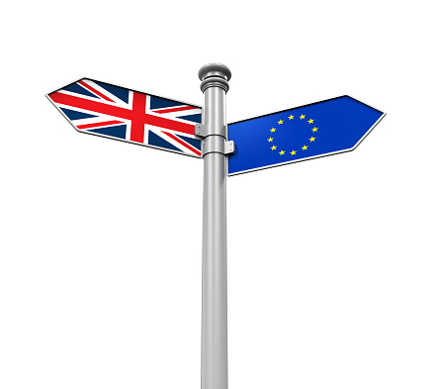

Situation after the Referendum and and the Brexit Challenge
Dr Monika Brusenbauch Meislová
EVS465: Brexit: Politics, Policies and Processes
7 April 2020

Slide 2
Brexit challenge: basic timeline
June 24, 2016: The referendum result is announced, David Cameron resigns as British prime minister, the pound plunges to a three-decade low. European Commission President Jean-Claude Juncker, European Council President Donald Tusk, European Parliament President Martin Schulz and Dutch Prime Minister Mark Rutte (representing the EU presidency), issue a joint statement on the outcome: “We regret this decision but respect it."
June 28, 2016: David Cameron’s last European Council summit.
June 30, 2016: Home Secretary Theresa May formally declares her candidacy for the Conservative Party leadership “to unite the party and country.”

Slide 3
Brexit challenge: basic timeline
July 13, 2016: May becomes prime minister (the UK will “forge a bold new positive role for ourselves in the world.”)
  Boris Johnson as foreign secretary, David Davis as Brexit secretary, Liam Fox as international trade secretary and Philip Hammond as chancellor of the exchequer.
July 27, 2016: Frenchman Michel Barnier nominated by the European Commission to lead the EU’s Brexit negotiations.
December 7, 2016: The House of Commons votes 461 to 89 in favor of May’s plan to trigger Brexit by the end of March 2017 (David Davis: it will be “the most important and complex negotiations in modern times.”)
December 15, 2016: EU leaders meet in Brussels without the UK at an informal summit and adopt guidelines for negotiating procedures during the talks.

Slide 4
Brexit challenge: basic timeline
24 January, 2017: Supreme Court rules in favour of campaigner Gina Miller, that the Government must obtain the approval of Parliament before starting the Brexit process.
29 March, 2017: UK delivers formal notice of its intention to leave the bloc under Article 50 of the EU’s Lisbon Treaty, to European Council President Donald Tusk.
18 April, 2017: May calls a snap General Election.
9 June, 2017: Election results show a hung Parliament (Labour gains and the Tories lose their majority)
13 June, 2017: May secures a deal with the DUP to support her in Parliament

Slide 5
Brexit challenge: basic timeline
19 June, 2017: Then-Brexit Secretary David Davis and Michel Barnier meet to begin formal Brexit negotiations
22 September, 2017: May gives landmark Brexit speech in Florence, where she outlined the UK’s proposals to the EU
8 December, 2017: Joint report published outlining early details of the Withdrawal Agreemen
19 March, 2018: Details of the Transitional Period agreed in principle
6 July, 20198: May hosts Cabinet at her country retreat Chequers to launch her Brexit plan (named the Chequers deal) → several ministerial resignations

Slide 6
Brexit challenge: basic timeline
25 September, 2018: Labour conference votes to consider option of a second Brexit vote
14 November, 2018: Government publishes 585-page Draft Withdrawal Agreement and Political Declaration
11 December, 2018: ECJ rules that UK can unilaterally revoke Article 50, and thus reverse Brexit
10 December, 2018: May delays a planned Meaningful Vote on the Brexit deal
12 December, 2018: May survives a vote of no confidence from within her own party

Slide 7
Brexit challenge: basic timeline
15 January, 2019: Theresa May loses Meaningful Vote (432 MPs voted against it while 202 voted for it - a majority of 230, making it the biggest government defeat since 1924).
16 January, 2019: Theresa May wins second no confidence vote
7 February, 2019: EU rejects changes To Withdrawal Agreement
18 February, 2019: MPs split from Labour Party to form "The Independent Group“
12 March, 2019: MPs reject Theresa May's Withdrawal Agreement for the second time

Slide 8
Brexit challenge: basic timeline
18 March, 2019: Speaker John Bercow tells Theresa May Meaningful Vote 3 must be different
21 March, 2019: EU accepts Brexit delay to April 12 unless Theresa May‘s deal passes by MPs
29 March, 2019: MPs reject Withdrawal Agreement in 'Meaningful Vote 2.5‘
10 April, 2019: Emergency EU summit (flexstation, flexible delay until 31 October)

Slide 9
Brexit challenge: basic timeline
23 May, 2019: The UK holds elections to the European Parliament (Brexit Party led by Nigel Farage being the largest party winning 29 seats, anti-Brexit Liberal Democrats led by Vince Cable coming second with 16 seats)
24 May, 2019 : Theresa May announces that she will resign as Conservative Party leader, effective 7 June,
24 July, 2019: Boris Johnson accepts the Queen's invitation to form a government and becomes Prime Minister of the United Kingdom, the third since the referendum.
28 August, 2019 : Boris Johnson announces his intention to prorogue Parliament in September
24 September, 2019: The Supreme Court of rules unanimously that Boris Johnson's decision to advise the Queen to prorogue parliament was unlawful
25 September, 2019: Parliament is recalled.
….BJ unable to get it through the parliament

Slide 10
Brexit challenge: basic timeline
28 October, 2019: European Council agrees to extend the Brexit deadline until 31 January 2020—the third extension
29 October, 2019: Government introduces the Early Parliamentary General Election Act 2019:
12 December, 2019: General election held in which the Conservative Party gain an 80-seat majority in parliament.
20 December, 2020: The Withdrawal Agreement passed its second reading in the House of Commons in a 358–234 vote.
22 January, 2020: the Withdrawal Agreement Bill proposed by Prime Minister Boris Johnson passed the UK parliament
23 January, 2020: the European Union (Withdrawal Agreement) Act 2020 received royal assent.
31 January, 2020: At 11 p.m. GMT the United Kingdom withdrew from the European Union,´at the deadline set for its departure by the Article 50 extension agreed between the UK and the EU in October 2019.

Slide 11
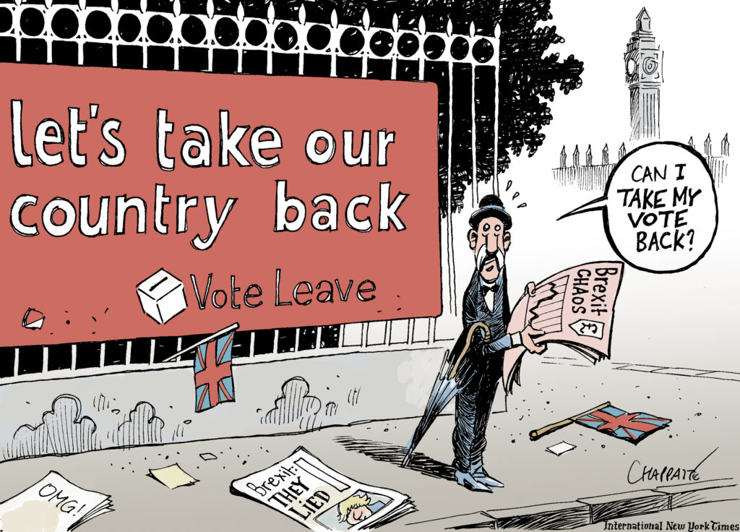

Slide 12
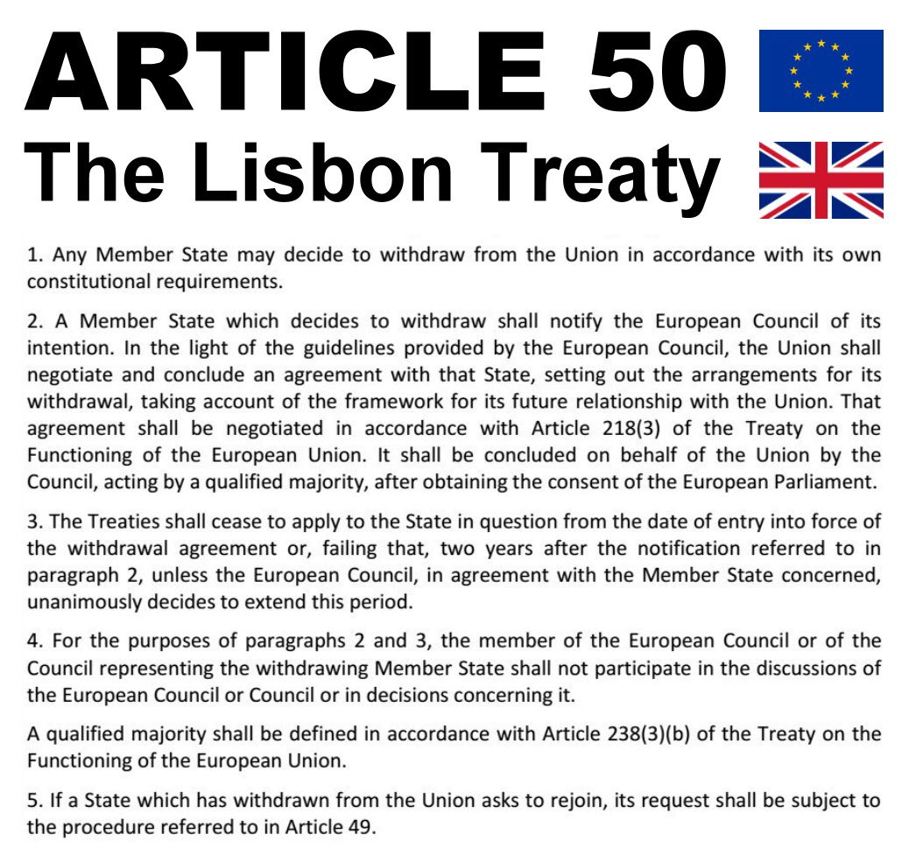
Article 50

Slide 13
Defining Brexit narrative
UK referendum triggered a series of processes in the UK (not just about handling the exit but also about defining what sort of country the UK wants to be).
British politics defined by a fight to define the Brexit narrative
Why has the process of defining Brexit narrative been so difficult?
  Theresa May struggling to find unity within her govt over what Brexit should mean.
Churchill: history is written by the victors. Is it really so in the case of Brexit?

Slide 14
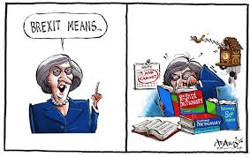
Defining Brexit narrative
‘Brexit means Brexit‘ motto sounds self-explanatory but is meaningless unless Brexit itself is defined.

Slide 15
Defining Brexit narrative
TM’s Brexit narrative defined in “big speeches on Brexit“ (Lancaster; Florence etc.)
  Three most important aims:
    Ending immigration from elsewhere in the EU
    Ending the jurisdiction of the CJEU
    Opting for free trade agreements with European markets
Her Brexit narratives challenged from many sides.

Slide 16
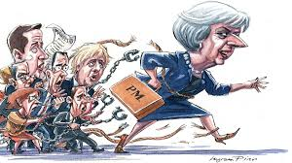

Slide 17
Defining Brexit narrative
Global Britain narrative

Slide 18
HM Government and Brexit
Brexit = for the government, it is an unprecedented peacetime challenge in terms of political unity, administration and delivery
Unity/collective responsibility
TM’s premiership struggled bc of Conservative divisions over Europe (something many of her predecessors faced)
In appointing her first cabinet she tried to bring in some balance into this by appointing leading pro-Leave campaigners
TM‘s leadership overshadowed by doubts from the very beginning
  She won the leadership race without a vote.
Her leadership has been a sore point for many – not least bc of the centralisation of decision making in Downing Street 10 around her two closest advisors: Nick Timothy and Fiona Hill.

Slide 19
HM Government and Brexit
Her decision to call snap elections (in part on the advice of some of her advisors) caught many in her cabinet by surprise.
  Her weak campaining skills and dire campaign – left her even more vulnerable post-election.

Slide 20
HM Government and Brexit
The administrative challenge
Brexit = the biggest set of administrative, legal, negotiating and constitutional task since 1945
Organising British govt for Brexit = a formidable task: i.a. because new departments had to be established:
  Department for Exiting the EU (DexEU)
  Department for International Trade
  Some departments busier than others
Enormous stretch of UK-EU links

Slide 21
HM Government and Brexit
The search for strategy
The inability of British decision makers to know what they want and whether they can get it.
No clear ends and confused ways (no surprise the UK has struggled to prepare)
TM triggered Article 50 on 29 March 2017: by choosing this time she made time an ally of the EU
Quick realization that the UK lacked the ways and means to secure a ‘quick victory‘.
Repeated failures to analyse and understand the position of the rest of the EU

Slide 22
Thank you for your attention!

