Slide 1
Energy Law: EU Energy Law (1)
Masaryk University
Spring 2020

Slide 2
Law
Oxford definition: a rule, made by a government, that is used to order the way in which a society behaves. Law and order is the condition of a society in which laws are obeyed, and social life and business go on in an organized way.
What makes LAW different from other normative systems?
Adopted by a state (legislative body)
Legally binding
Law enforcement (the process of making people obey a law or rule, or making a particular situation happen or be accepted)

Slide 3
Energy Law
Energy Law concerns the management of energy resources.
Interdisciplinary in its nature – politics, economics, geography, environmental science, engineering.
Energy plays a fundamental role in the economy of a country - employment, future economic development, personal health.
Recently, energy security, climate change and energy prices draw people’s and government’s attention.

Slide 4
Energy Law
Why do governments tend to regulate energy-related activities and the energy sector?
1) Permanent sovereignty over natural resources (UN General Assembly Resolution 1803 (XVII), 1962)
“The right of peoples and nations to permanent sovereignty over their natural wealth and resources must be exercised in the interest of their national development and of the well-being of the people of the State concerned.”

Slide 5
Energy Law
2) Human rights: Health/Environment.
World Health Organisation:
The Office of the High Commissioner for Human Rights:
A safe, clean, healthy and sustainable environment is integral to the full enjoyment of a wide range of human rights, including the rights to life, health, food, water and sanitation. Without a healthy environment, we are unable to fulfil our aspirations or even live at a level commensurate with minimum standards of human dignity.
https://www.ohchr.org/en/Issues/environment/SRenvironment/Pages/SRenvironmentIndex.aspx

Slide 6
Energy Law
Are states obliged to provide their own citizens with access to energy?
A) International Covenant on Economic, Social and Cultural Rights (Article 11)
B) Convention on the Elimination of All Forms of Discrimination against Women New York, 18 December 1979 (Article 14):
“To enjoy adequate living conditions, particularly in relation to housing, sanitation, electricity and water supply, transport and communications.”

Slide 7
Energy Law
Why do governments tend to regulate energy-related activities and the energy sector?
PRAGMATIC REASONS: Energy is the fuel that powers economic growth.
A) A matter of national security
B) Energy as a source of wealth
C) Energy as a driver of national development
D) Negative environmental impact of energy related activities
E) Energy access and affordability

Slide 8
Energy Law
INTERNATIONAL LEVEL
“International law, also called public international law or law of nations, the body of legal rules, norms, and standards that apply between sovereign states and other entities that are legally recognised as international actors.”
Objectives: peace, international coexistence, international cooperation
NATIONAL LEVEL
Constitutional law, Administrative Law, Business Law
Objective: management of energy resources, national development, energy security, functional energy market

Slide 9
INTERNATIONAL LAW dimension

Slide 10
International Law
International treaties and organizations
International treaties heavily influence energy policy adopted at the national level.
EXAMPLE: International obligations arising from the Kyoto Protocol/Paris Agreement have been translated into national legislation aimed at reducing greenhouse gas emissions, promotion of renewable energy sources.
WTO Treaties (The General Agreement on Tariffs and Trade, The General Agreement on Trade in Services)
International Investment Agreements (bilateral, multilateral).

Slide 11
International Law
Vienna Convention for the Protection of the Ozone Layer (Vienna, 22 March 1985).
Montreal Protocol on Substances that Deplete the Ozone Layer (Montreal, 16 September 1987).
United Nations Framework Convention on Climate Change (Rio, 9 May 1992).
Kyoto Protocol to the United Nations Framework Convention on Climate Change (Kyoto, 11 December 1977).
Paris Agreement (2015).
Aarhus Convention on Access to Information, Public Participation in Decision-making and Access to Justice in Environmental Matters (Aarhus, 25 June 1988).
Convention on Environmental Impact Assessment in a Transboundary Context (Espoo, 25 February 1991).

Slide 12
NATIONAL LAW dimension

Slide 13
National Law
There are different approaches towards energy regulation in the domestic realm which can – depending upon the circumstances.

Slide 14
National Law
There are 4 main elements having significant impact on national energy law.
The aim of Government Policy
Germany: With the election of Angela Merkel’s government in 2005, energy policy in Germany changed. The energy policy promoted by her party and government involved a significant emphasis on renewable energy development and the closure of nuclear energy plants—which did receive an impetus after the Fukushima accident in Japan in 2011.
The United Kingdom: The indecision of the UK coalition government elected in May 2010 has delayed new investment in the UK energy sector. It took the first few years of the government for both parties (the Conservatives and the Liberal Democrats) to agree a way forward. This indecision has reduced the interest from investors in the UK energy sector, and there has been little interest in developing new energy infrastructure.
France: Since the election of Francois Hollande of the French socialist party as president of France in May 2012, French energy policy has changed. The previous dominance of nuclear energy within the French energy policy is being reduced and a new emphasis has been placed on renewable energy development, with a planned limit on the use of nuclear energy to 50 per cent of the country’s energy mix by 2025.

Slide 15
National Law
There are 4 main elements having significant impact on national energy law.
Availability of Finance
Obtaining finance for a project has become increasingly difficult and investors are looking for a guaranteed return on their investment.
Energy projects are traditionally viewed as risky due to long construction times, long planning processes. In a time of recession, investors look for more secure projects. There have been many cases where investors have pulled out from completing major energy projects.

Slide 16
National Law
There are 4 main elements having significant impact on national energy law.
Availability of Technology
Advances in the technology for wind turbines and solar energy are having a major impact in many countries. This has resulted in many countries changing their energy law in part to capture these technological benefits from more efficient technology.
EXAMPLE: shale gas/renewables

Slide 17
National Law
There are 4 main elements having significant impact on national energy law.
Societal preferences
Different countries have different societal structures which contribute in part to different societal preferences. In many countries, this emanates from how the culture developed over time.
EXAMPLE: Ireland has a very anti-nuclear stance. The UK/France population views nuclear energy as part of the UK/France energy mix. In Denmark, there has been cross-party political support for the development of wind energy since 1970s. In the USA, certain states have a culture that has developed around their coal-mining industry.

Slide 18
NATIONAL LAW dimension

Slide 19
Constitutional Law/Human Rights
A branch of the public law of a state which treats of the organization and frame of government, the organs and powers of sovereignty, the distribution of political and governmental authorities and functions, the fundamental principles which are to regulate the relations of government and subject, and which prescribes generally the plan and method according to which the public affairs of the state are to be administered.
Charters of fundamental rights and freedoms are often considered as a part of the constitutional order.
Role of constitutional courts in protecting the fundamental human rights of individuals.

Slide 20
Constitutional Law/Human Rights
Right to property (Charter of Fundamental Rights and Freedoms)
Everyone has the right to own property. Each owner’s property right shall have the same content and enjoy the same protection.
The law shall designate the property necessary for securing the needs of the entire society, the development of the national economy, and the public welfare, which may be owned exclusively by the state, a municipality, or by designated legal persons; the law may also provide that certain items of property may be owned exclusively by citizens or legal persons with their headquarters in the Czech and Slovak Federal Republic.
Expropriation or some other mandatory limitation upon property rights is permitted in the public interest, on the basis of law, and for compensation. Taxes and fees shall be levied only on the basis of law.

Slide 21
Constitutional Law/Human Rights
All people are free and equal in their dignity and rights (Charter of Fundamental Rights and Freedoms)
Everyone is guaranteed the enjoyment of her fundamental rights and basic freedoms without regard to gender, race, colour of skin, language, faith and religion, political or other conviction, national or social origin, membership in a national or ethnic minority, property, birth, or other status.

Slide 22
Constitutional Law/Human Rights
Right to a fair trial (Charter of Fundamental Rights and Freedoms)
Everyone may assert, through the prescribed procedure, her rights before an independent and impartial court or, in specified cases, before another body.

Slide 23
Constitutional Law: Example (I.)
2007 - European Union Strategy - Energy and Climate Change Objectives for 2020
Achievement of the goals required a significant deployment of private investments.
Characteristics of energy investments:
lower operating costs,
but proportionately higher capital costs
In order to make renewable energy more attractive, EU Member States adopted various measures such as direct or indirect support lowering the costs of capital.

Slide 24
Constitutional Law: Example (II.)
Long-term unsustainability of support schemes.
The Czech Republic imposed an obligation to pay a solar levy.

Slide 25
Constitutional Law: Example (III.)
Contested provisions of Act no. 180/2005 Coll. – AMEDMENT:
PART III LEVY ON SOLAR ELECTRICITY
§ 7a Subject matter for the levy on solar electricity
The subject matter for the levy on solar electricity (the “levy”) is solar electricity produced in the period from 1 January 2011 to 31 December 2013 in a facility put into operation in the period from 1 January 2009 to 31 December 2010.
§ 7b Subjects of the levy
Payers of the levy are producers that produce solar electricity. Payers of the levy are operators of transmission systems and operators of regional distribution systems.
§ 7c Levy basis
The basis of the levy is the amount, net of value added tax, paid by the levy payer (remitter) in the form of a purchase price or green bonus to the levy payer (remitter) on solar electricity produced in the levy period.
§ 7d Exemption from the levy Solar electricity produced in an electric power plant with installed output up to 30 kW, placed on a roof construction or outer wall of a single building connected to the ground through a firm foundation listed in the real estate register is exempt from the levy.
§ 7e Levy rates
The levy rates from the levy basis are, if paid in the form of purchase price, 26%, green bonus, 28%.

Slide 26
Constitutional Law: Example (IV.)
The petitioners claimed that the statutory provisions were inconsistent:
with the constitutionally guaranteed right to own property under Art. 11 of the Charter of Fundamental Rights and Freedoms, with Art. 17 par. 1 of the EU Charter, or the right to protection from interference with peaceful enjoyment of property under Art. 1 of the Protocol to the Convention for the Protection of Human Rights and Fundamental Freedoms,
with the right to conduct business under Art. 26 of the Charter of Fundamental Rights and Freedoms and Art. 16 of the EU Charter;
with the essential requirements of a democratic, rule of law state under Art. 9 par. 1 of the Constitution, because all the contested provisions of the Act suffered from retroactive effect; and
with the constitutional principle of equality before the law under Art. 1 and 3 of the Charter of Fundamental Rights and Freedoms.
The Constitutional Court found that the contested provisions were not inconsistent with the constitutional order of the Czech Republic.

Slide 27
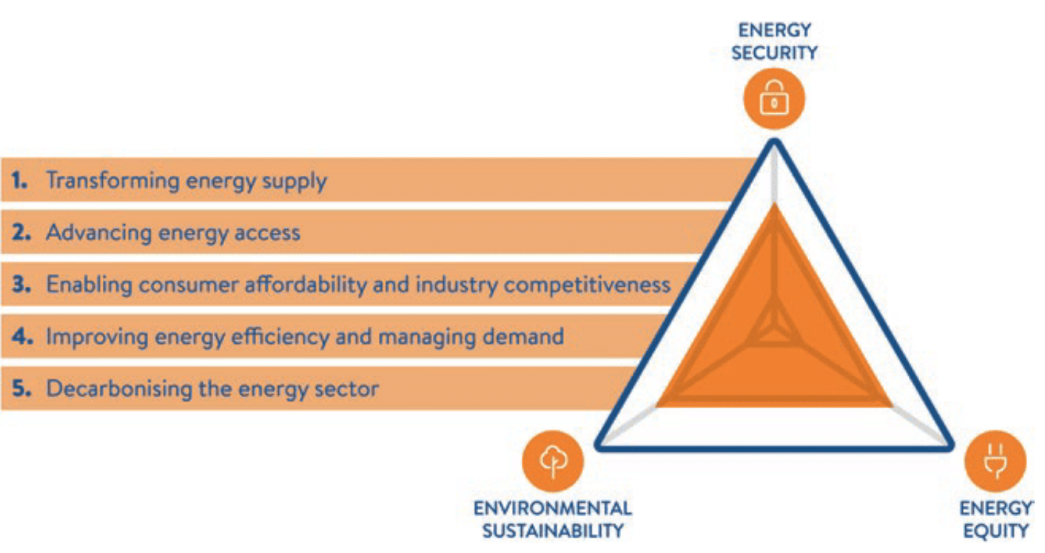
Administrative Law
The legal framework within which public administration is carried out.
Objectives: energy security, functioning energy market (affordability), environmental protection,
National regulation.
Licences.
Environmental impact assessment.
Price regulation.
Energy is highly regulated sector.
General Assembly resolution 1803 (XVII) of 14 December 1962, "Permanent sovereignty over natural resources"
1. The right of peoples and nations to permanent sovereignty over their natural wealth and resources must be exercised in the interest of their national development and of the well-being of the people of the State concerned.
2. The exploration, development and disposition of such resources, as well as the import of the foreign capital required for these purposes, should be in conformity with the rules and conditions which the peoples and nations freely consider to be necessary or desirable with regard to the authorization, restriction or prohibition of such activities.

Slide 28
Business Law/Consumer Protection/Contract Law
Contractual disputes (national courts/arbitration).
Interaction between different private actors at the national level.
Energy-related disputes most often concern energy supply, energy pricing.

Slide 29
Private International Law
Private international law is a body of rules used to resolve legal disputes between private individuals who cross international boundaries.
Example: Naftogaz v. Gazprom
Private International Law determines:
Applicable law.
Jurisdiction.

Slide 30
Private International Law (Example I.)
Naftogaz and Gazprom entered into a long-term contract for the purchase and sale of natural gas for the period 2009-2019 dated 19 January 2009 (the “Gas Sales Contract”).
The contract was governed by Swedish law, with disputes to be resolved by arbitration in accordance with the rules of the Arbitration Institute of the Stockholm Chamber of Commerce.
The main issues in dispute between the parties for consideration and determination by the arbitral tribunal were as follows:
Naftogaz claimed an adjustment of the price payable under of the Gas Sales Contract, and retroactive compensation for historic overpayments dating from 2011.
Naftogaz claimed that certain provisions of the Gas Sales Contract should be declared invalid or ineffective - specifically the volume and take-or-pay provision, the destination clause, the unilateral suspension right clause and the mandatory sales clause of the Contract.
Gazprom denied that Naftogaz was entitled to relief and counterclaimed for payment of outstanding amounts due for gas delivered and for gas accessible but not off-taken under the take-or-pay provisions, plus interest. Naftogaz rejected the counterclaim.
Tribunal found that:
Naftogaz had a right to price revision.

