Slide 1
Constitutionalism
From Legal to Populist Constitutionalism
Jiří Baroš

Slide 2

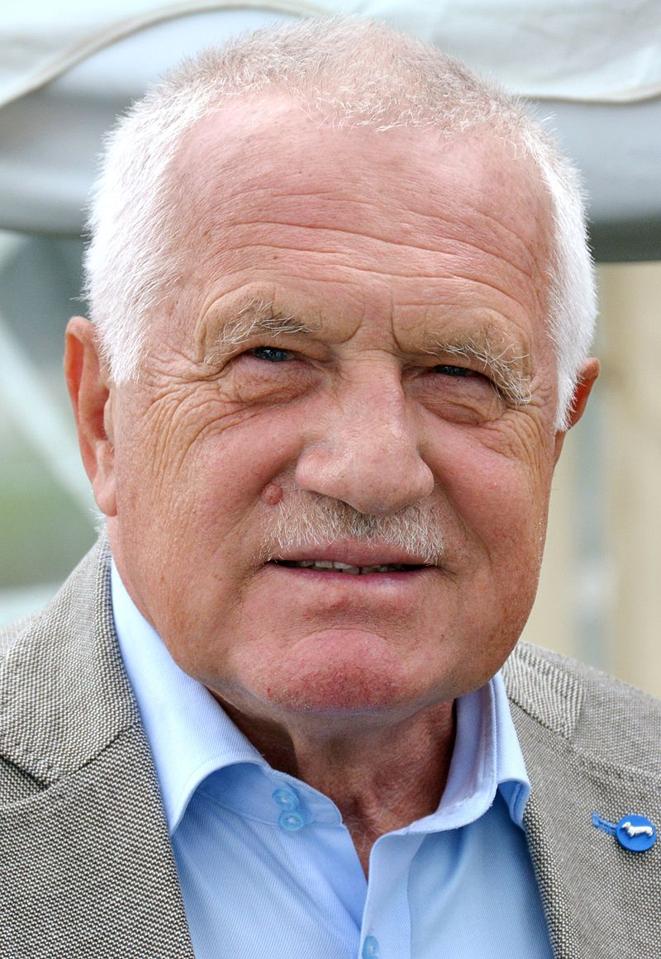
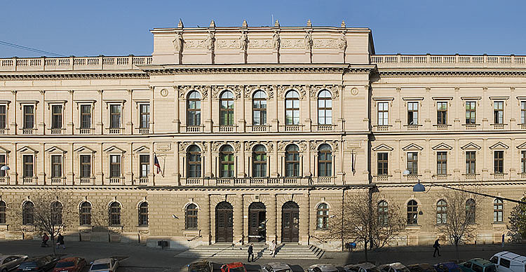
Constitutionalism

Slide 3
Constitutionalism and Democracy
What is Democracy?
What is Constitutionalism?
Harmony or Tension?

Slide 4
Constitutionalism in CE
Legal Constitutionalism and its Alternatives
Populism and Constitutionalism

Slide 5
Constitutionalism in CE
Legal Constitutionalism and its Alternatives
Populism and Constitutionalism

Slide 6
Legal Constitutionalism
What is Legal Constitutionalism?
Alternatives?
Development in CE after 1989

Slide 7
What is LC?
Negative View of Constitutions
Politics v. Rule of Law
Judicial Supremacy
Citizen Engagement?

Slide 8
Alternatives to LC?
Political C.: Constitution and Disagreement, Parliamentary Supremacy?
Democratic C.: Depoliticization X Discussion on Constitutional Essentials, Political Participation

Slide 9
CE after 1989
CC: Adhere, or Oppose Governmental Policies?
Adoption of New Constitutions?

Slide 10
CE after 1989
Czech R.: Value-Laden Constitutionalism, First and the Second Term
Hungary: Democracy by Judiciary v. Orbán´s Attack
Poland: Government´s Helper v. Kaczyński Brothers and CT
Slovakia: Mečiar´s Era, Accession to EU

Slide 11
Constitutionalism in CE
Legal Constitutionalism and its Alternatives
Populism and Constitutionalism

Slide 12
Constitutionalism in CE
Legal Constitutionalism and its Alternatives
Populism and Constitutionalism

Slide 13
Populism and Constitutionalism
Hostility or Engagement?
Populism Deconstructed
Populist Leaders Takes Stage in CE

Slide 14
Hostility or Engagement?
Democratic Backsliding and Illiberal Democracy
Negation of, Problematic Relationship with CD
X
Populist Constitution-Making

Slide 15
Populism Deconstructed (Blokker)
The Popular Will
Majoritarianism
Legal Resentment
Constitutional Instrumentalism

Slide 16
Populist Leaders Takes Stage…
Orbán (CC, Ordinary Courts, Independent Agences)
Kaczyński (CT, Ordinary Courts, NCJ)
How to Tackle Populism?

Slide 17
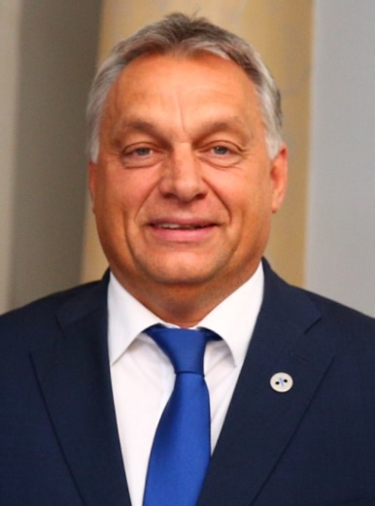
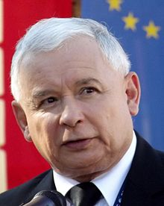
Who´s Next?

