Slide 1
Nationalism in Slovak Politics
Peter Spáč

Slide 2
Preamble of the Constitution
„We, the Slovak Nation, bearing in mind the political and cultural heritage of our predecessors, the experience gained through centuries of struggle for our national existence, and statehood…“
„…together with members of national minorities and ethnic groups living on the territory of the Slovak Republic“
Compare with the Preamble in the Czech Constitution

Slide 3
The Hungarian issue

Slide 4
The basic facts
Slovakia:
Population of 5,4 mil.
Ethnic composition: Slovaks (85,2 %), Hungarians (9,4), Roma (2), Czechs (1), Ruthenians (0,4), Ukrainians (0,2), other (1,6)
Hungarian minority:
Around 500 000 citizens
Concentrated in southern part of Slovakia but this land does not form a solid region

Slide 5
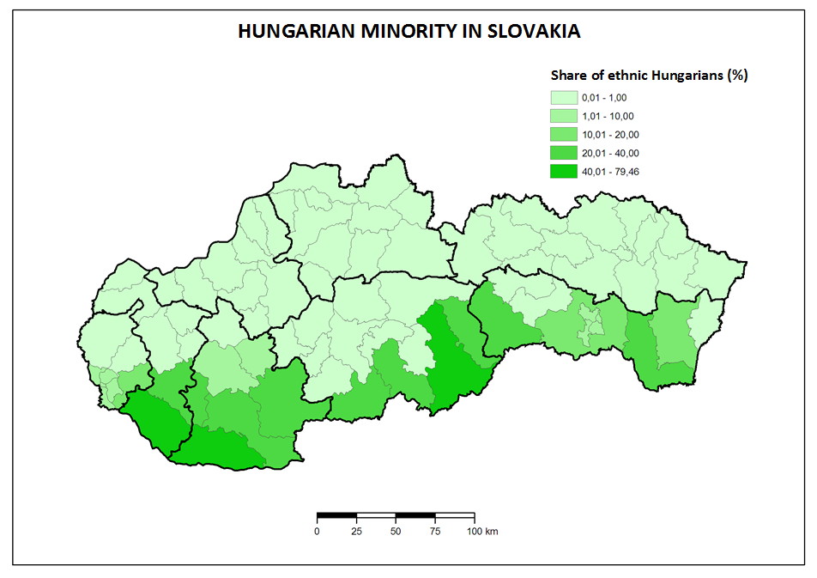

Slide 6
Hungarian parties in Slovakia
1990 – 1998:
Three independent and relevant parties
Mutual cooperation
1998 – 2009:
Integration in one subject representing the minority
2009 –
Split to 2 parties
Unsuccessful aims for cooperation yet

Slide 7
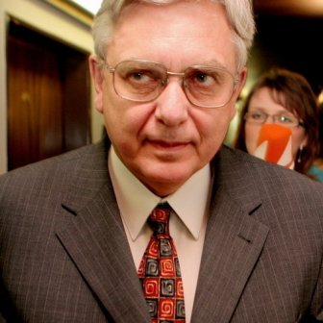
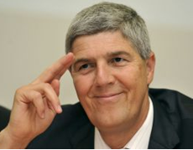
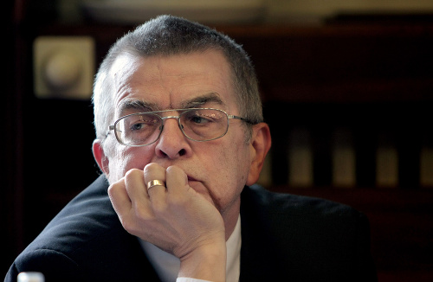
1990 – 1998
Coexistence:
„Hawks“
Miklós Duray
Hungarian Christian Democratic Movement:
„Moderates“
Béla Bugár
Hungarian Civic Party:
„Liberals“
László Nagy
Elections 1994 – together as the Hungarian Coalition (MK)

Slide 8
1998 - 2009
1998 – Mečiar’s electoral reform against coalitions → MK transforms to Party of Hungarian Coalition (SMK)
Participation on executive power in both governments led by Mikuláš Dzurinda
Internal tension after elections 2006
2009 – group led by Bugár leaves SMK

Slide 9
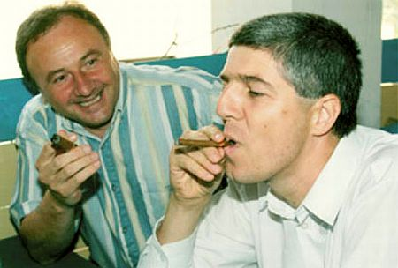
Since 2009
Existence of two parties:
SMK
The Bridge (Most-Híd)
Most-Híd took the earlier position of SMK
SMK stays out of parliament
Unsuccessful effort to cooperate
After 2020 both out of parliament

Slide 10
Influencing relations
3 models of relations:
International (Hungary – Slovakia)
Domestic (Slovakia – Hungarian minority)
National (Hungarian minority – Hungary)
Primary features:
Reflection of historical issues in present time (Treaty of Trianon, Beneš decrees)
Changing intensity of mutual tension

Slide 11
Trianon
Occasional topic for the radicals
Relevance of the topic neutralised with entry of Slovakia and Hungary to the EU
„Does anyone understand that since Trianon we do not have our home? Todays Hungary is not a real home even for those who live there, but it is only a „residual“ country“
Miklós Duray, 2006

Slide 12
Autonomy
A topic situated more in the 90s than in the present
Different understanding of the word „autonomy“ and its content by Hungarian politicians
Autonomy of culture and schools vs. territorial autonomy
Approval of Hungarian politicians not to open this topic allowed them to participate on government

Slide 13
Hungarian exterritorial laws
„“In a legal sense, in accordance with the Constitution, I want to act as the head of the government of all the citizens of this 10 million strong country, but inspirit and sentiment as the prime minister of 15 million Hungarians.”
József Antall, Hungarian Prime Minister in early 90s
„14-15 million Hungarians can do much more than 10 million”
Viktor Orbán, current Hungarian Prime Minister

Slide 14
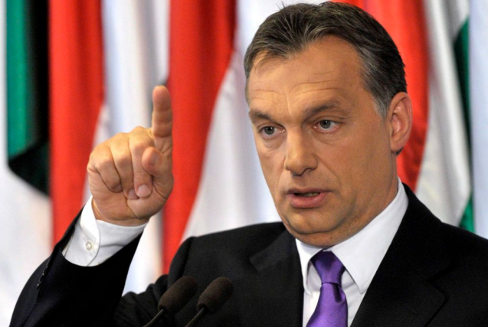
Hungarian exterritorial laws
Foreign IDs (2002):
Available for „minority“ Hungarians except from Austria
Financial advantages directly from Hungary
Some SMK officials got these IDs
Dual citizenship (2010):
Possibility to gain also a Hungarian citizenship
Slovakia adopted a counter-law leading to abandoning the Slovak citizenship
Until 2012 – about 200 thousand requests (minimum from Slovakia)
Mobilizing tool for Slovak nationalists and anti-Hungarian sentiments

Slide 15
The Hungarian issue Now from the other side

Slide 16
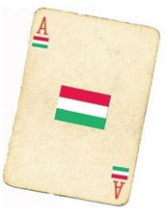
Anti-Hungarian nationalism
Playing with the so called „Hungarian card“
In use mainly in the 90s and later until 2010
Various ways of usage:
Electoral campaign
Daily politics
Reactions on Hungarian political actions
Suitable way how to overlay other negative problems

Slide 17
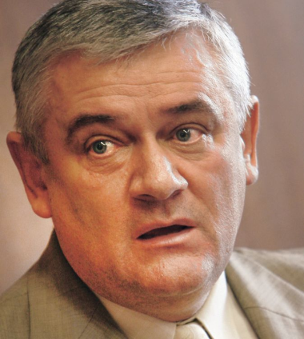
Slovak National Party
Created in 1990, claims a link with historical SNS
Radical right party:
Nationalism, xenophobia
Topics – Hungarians, Roma, homosexuals, against NATO, reserved towards EU
Main leaders until 2010:
Ján Slota
Anna Belousovová

Slide 18
Slovak National Party
Development:
Early years – searching for identity → radicalization since 1994
2001 – split, Slota creates the True SNS (PSNS)
2003 – unification after unsuccessful elections
Position in the system:
Member of governments led by Mečiar (1994-1998) and Fico (2006-2010)
Out of parliament (2012 – 2016)
Since 2016 back in government (with Most-Hid)
2020 – lost its parliamentary status

Slide 19
The peak of nationalism
Mečiar’s government in 1994 - 1998
SNS got ministries of education and defense
Topics:
Bilingual school reports
Name of towns
Names and surnames in registers
New administrative division of Slovakia
Lowering the funds for minorities’ culture

Slide 20
Electoral Campaign in 2006
SNS used very offensive anti-Hungarian campaign
A reaction following 8 years of SMK in government
„We are Slovaks. A Slovak government for Slovaks“
Program of SNS for elections 2006
Clear reaction to presence of Hungarians in government
SNS - billboards, slogans etc. with a common message:
Hungarians as an enemy
Hungarians as a threat

Slide 21
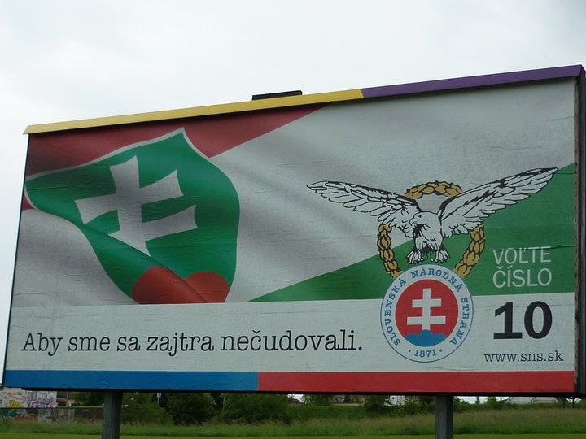
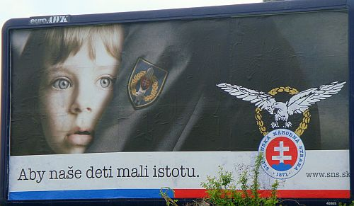
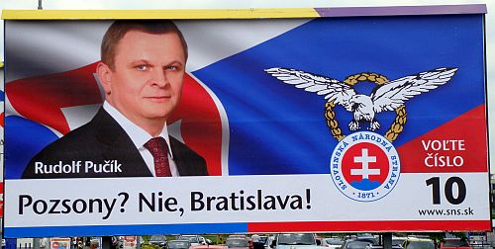
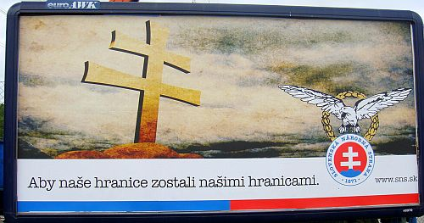

Slide 22
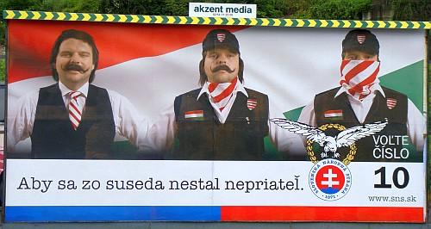
Faithless (music band) – God is a DJ:
Enemies becoming friends, when bitterness ends
SNS – Campaign 2006:
Neighbors becoming enemies

Slide 23
Ján Slota
The most visible representative of Slovak nationalism until 2010
Very offensive language towards various social groups
Verbal attacks on:
Hungary, its history, symbols and politicians
Hungarian minority
Roma
Homosexuals
Slovak politicians including prominent members of SNS
Media

Slide 24
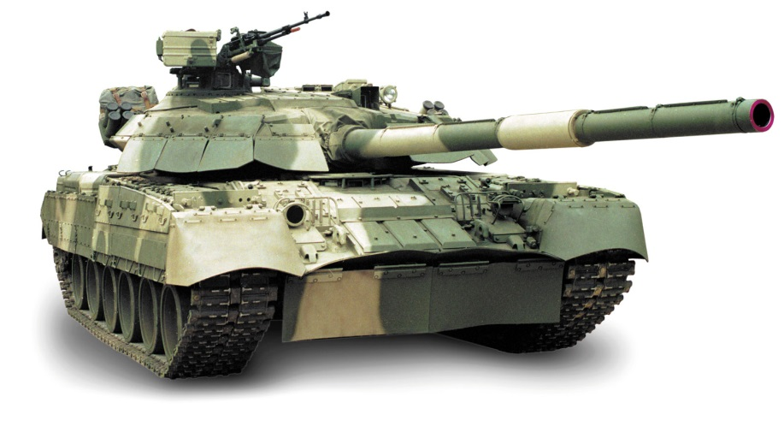
The tank attack on Budapest
Most „popular“ scandal
Occurred in 1999 on a meeting of HZDS where he was a guest speaker
Slota called for a tank attack on Budapest
„We will not leave it like this, we will go in tanks and we will flatten Budapest“

Slide 25
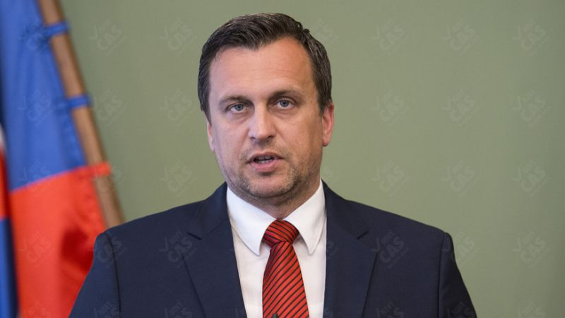
SNS after 2010
In 2012 SNS dropped out of parliament
Change of leadership:
Ján Slota excluded from the party
New leader – Andrej Danko
Change of profile:
SNS started a renewal process and claimed to differ from its past
Many representatives from the 90s however remained in the party
Decline of anti-Hungarian appeals, increase of populism and conservative values

Slide 26
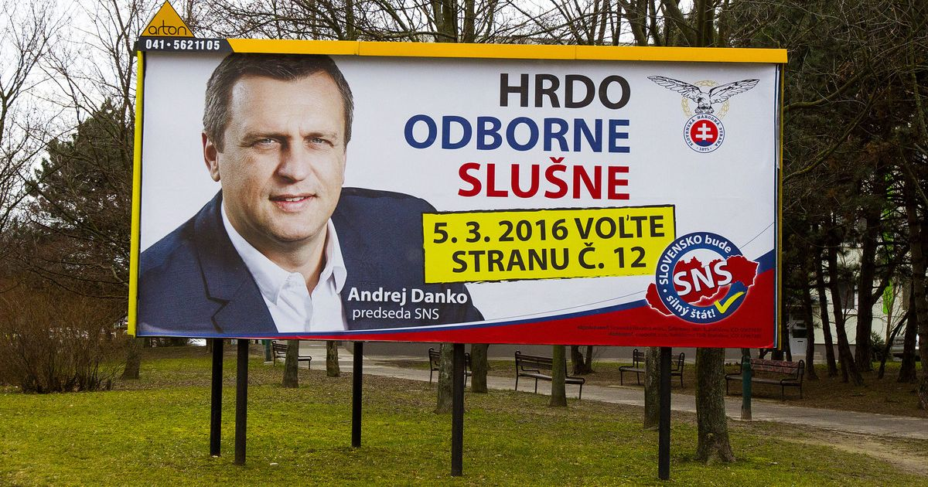
Campaign 2016

Slide 27
Temporary rebirth
Success in 2016 election:
8,6 per cent and 15 MPs
Entered government with SMER-SD and Most-Hid
A clear sign of decline of anti-Hungarian sentiments
Further increase of public support (up to 14 per cent) stopped with issues of the new leader
The military rank of captain
His doctoral thesis found to be a result of plagiarism
Became target of vast mockery in public

Slide 28
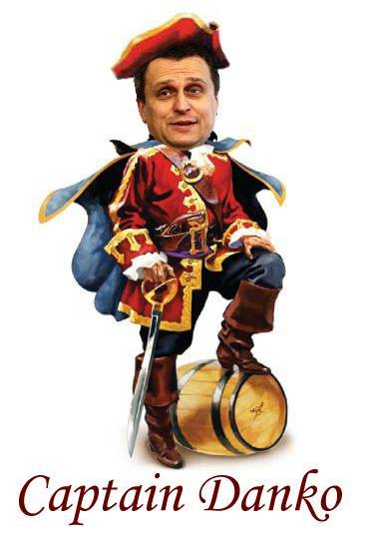
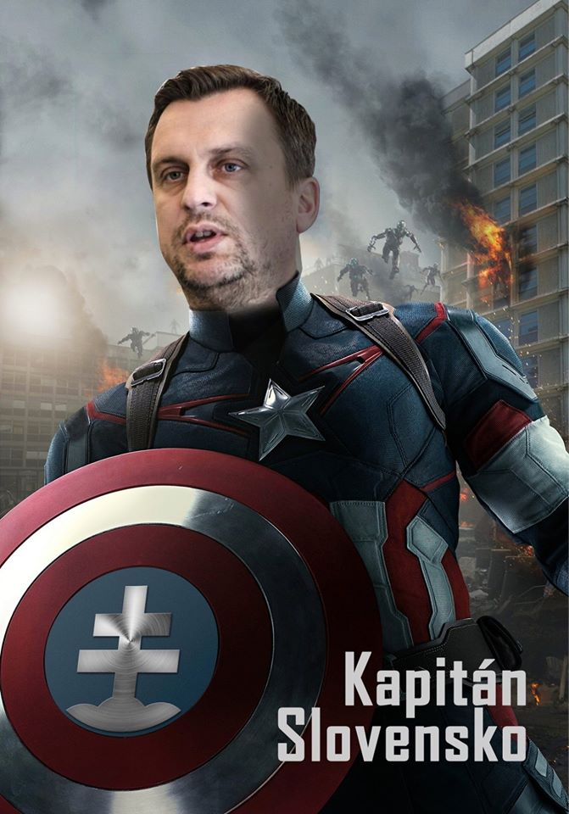
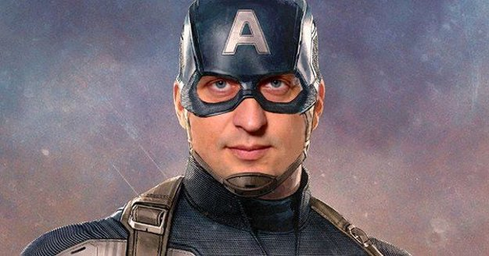

Slide 29
Temporary rebirth
Success in 2016 election:
8,6 per cent and 15 MPs
Entered government with SMER-SD and Most-Hid
A clear sign of decline of anti-Hungarian sentiments
Further increase of public support (up to 14 per cent) stopped with issues of the new leader
The military rank of captain
His doctoral thesis found to be a result of plagiarism
Became target of vast mockery in public
Continuous decline of public support resulting in 3 per cent in 2020 election

Slide 30
The Roma issue

Slide 31
Roma in Slovakia
Unclear proportion of the population
Official census:
1991 – 75 802 (1,4 %)
2001 – 89 920 (1,7 %)
2011 - 105 738 (2 %)
Real estimations around 400 000
Geographically concentrated in Central and Eastern Slovakia

Slide 32
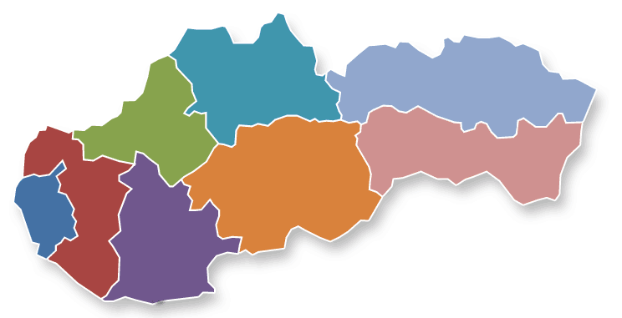
75 per cent of Roma live in Eastern Slovakia
2,14
40,76
0,54
34,5
14,68
2,88
0,73
3,77

Slide 33
Roma in Slovakia
Very bad image from the majority’s point of view
Associated features:
Lack of education
Unemployment
Living conditions and habits
Criminality

Slide 34
Public surveys – „Who would you not accept as your neighbor?“
Category | 2006 | 2008
Drug addict | 84,9 | 88,6
Roma | 72,8 | 82,4
Convicted felon | 58,8 | 71,3
Right-wing extremist | 62 | 66,8
Muslim | 49,5 | 54,7
Homosexual | 38,8 | 51,2
Immigrant | 35,2 | 41,5
Person of a different race | 28,8 | 39,5
Jew | 21,5 | 29
Disabled | 6 | 8,7

Slide 35
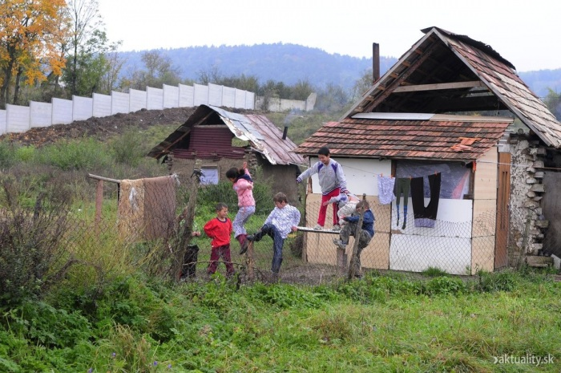
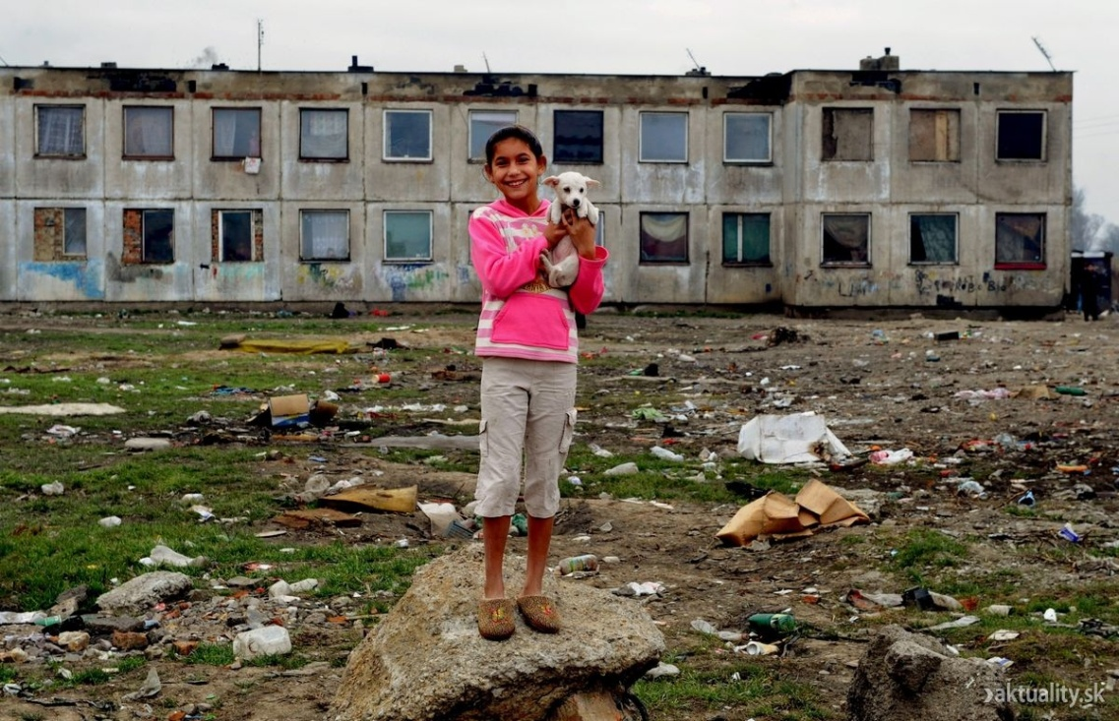
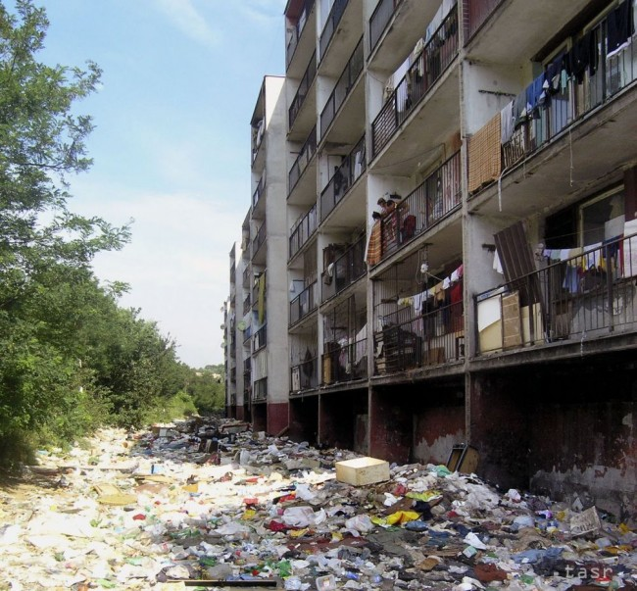
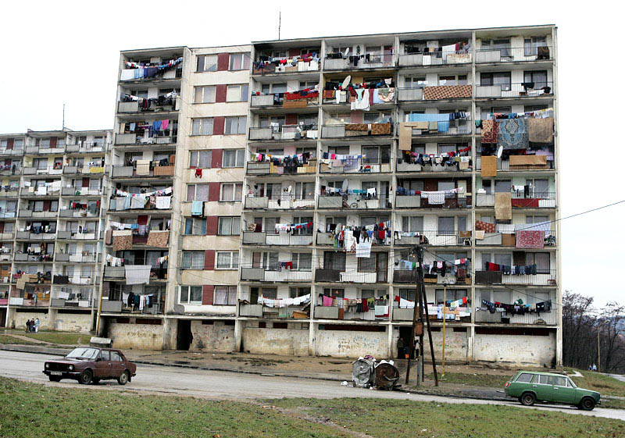

Slide 36
Roma and politics
No relevant Roma political party
Attempts to create such subjects end without any success
Roma parties receive only marginal number of votes
Lack of organizational skills and absence of unified ethnic identity
Non disciplined voters (regular attempts to buy their votes)

Slide 37
Roma as a topic for nationalists
Mostly stressed by SNS in the past
Ideas even beyond the principles of democracy or human rights
Examples:
Reservations (as Indians in North America)
„A small yard and a big whip“

Slide 38
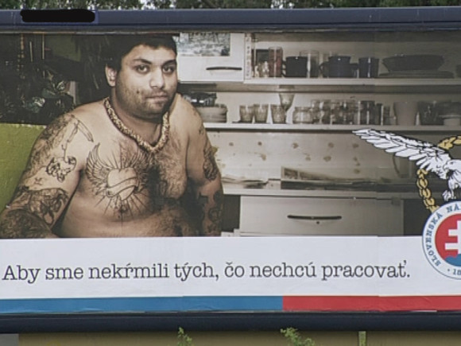
SNS campaign in 2010

Slide 39
Rise of extremism
People`s Party – Our Slovakia (LSNS)
Leader – Marian Kotleba
Emerged in 2010
Previous links with extremist Slovak Brotherhood:
Electoral failure in 2006
Dissolved in 2008

Slide 40
Ideology
Slovak Brotherhood:
Various topics
Slovak wartime state, Hungarians, Roma, NATO, homosexuals…
LSNS:
Modification of the profile
Primary focus on Roma
Other topics present, but rather secondary
Inclusion of excessive populism after 2012

Slide 41
LSNS and Roma minority
Party`s framing of the minority:
Asocial parasites
Gypsy terrorists
LSNS blames the mainstream parties for being passive and for keeping the majority unprotected
Trips to towns with Roma settlements
Kotleba`s purchase of land with an illegal settlement

Slide 42
Performance in elections
Originally only minor success in national elections:
2010 – 1,33 %
2012 – 1,58 %
Kotleba`s unsuccessful attempt to become regional governor in 2010
Regional election 2013:
Kotleba scored second in the first round
In runoff Kotleba won over SMER`s incumbent

Slide 43
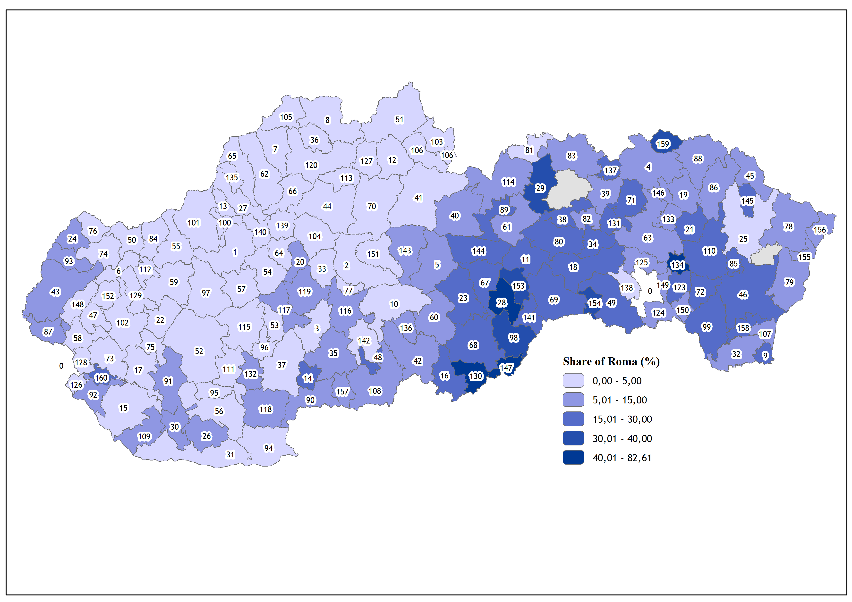

Slide 44
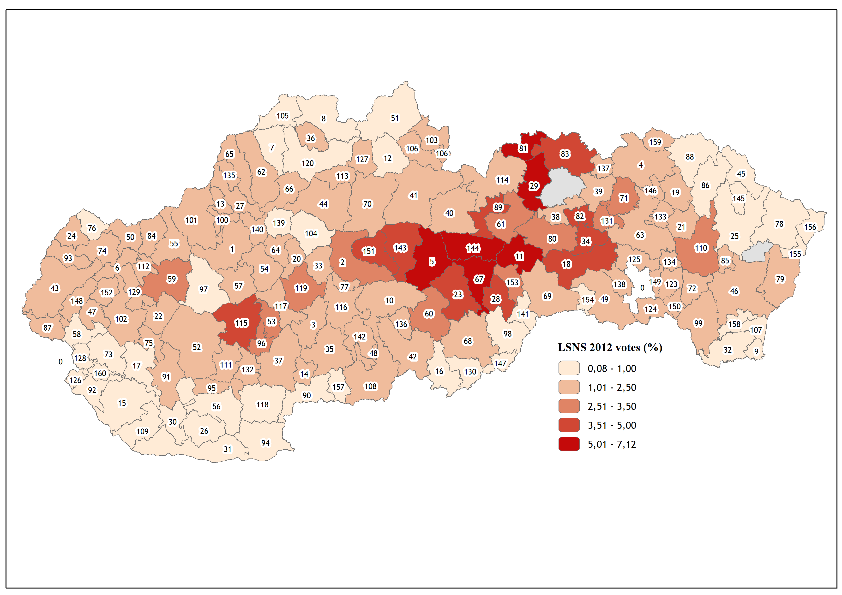

Slide 45
National elections 2012
LSNS support grows with rising share of Roma in municipalities
Maximum votes obtained in areas with 25.1 – 50 per cent Roma
Slight increase of votes in areas near Roma settlements

Slide 46
National elections 2016
LSNS gained 8 per cent (more than 200 000 votes) and entered parliament
Five times more votes than in 2012 election
The party won among young people
Rise of extremism or adoption of protest image?
Besides racial hatred, LSNS adopted new topics
Immigration, populism, anti-elitism, anti-EU, vaccine hesitancy

Slide 47
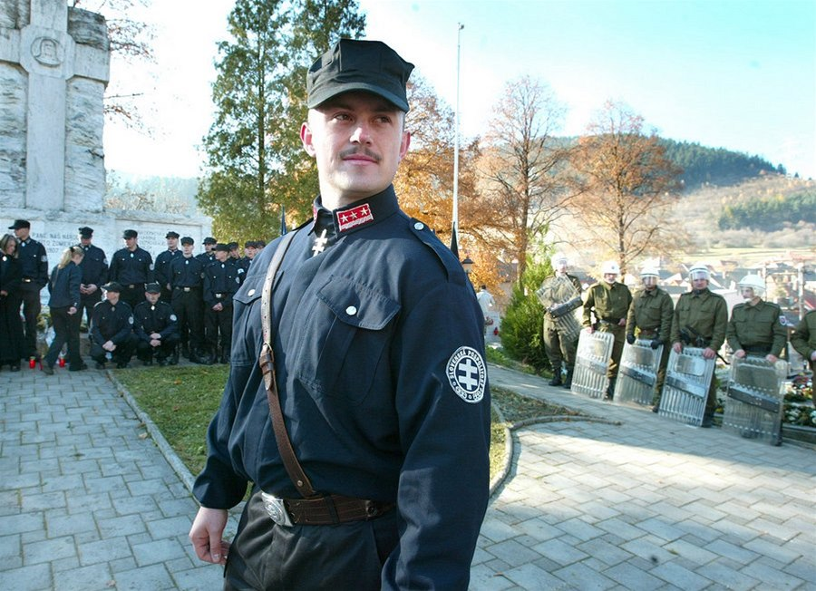
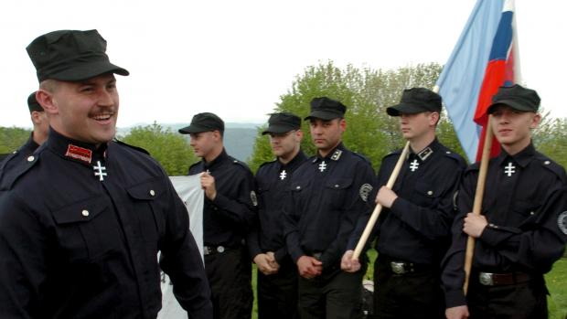
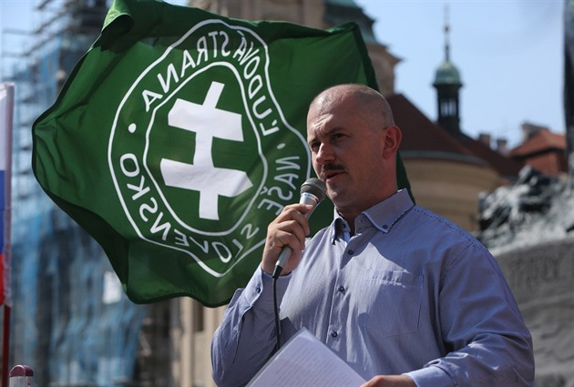
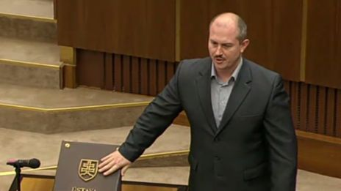
From uniforms to suits

Slide 48
After 2016
Train patrols:
LSNS started to send patrols to trains into regions with higher share of Roma
Intensified cooperation with vast network of alternative media to mobilize people
Proclaimed stress on conservative values and lives of decent people
Despite its anti-elitist stance, the government could rely on LSNS MPs when needed

Slide 49
Summary
Strong role of nationalism in Slovak politics
Increasing extremism in recent decade
Main representatives (after 1993):
SNS – until 2010
LSNS – after 2010
Far-right appeals used also by other parties (SMER-SD, We are Family) when needed

