Slide 1
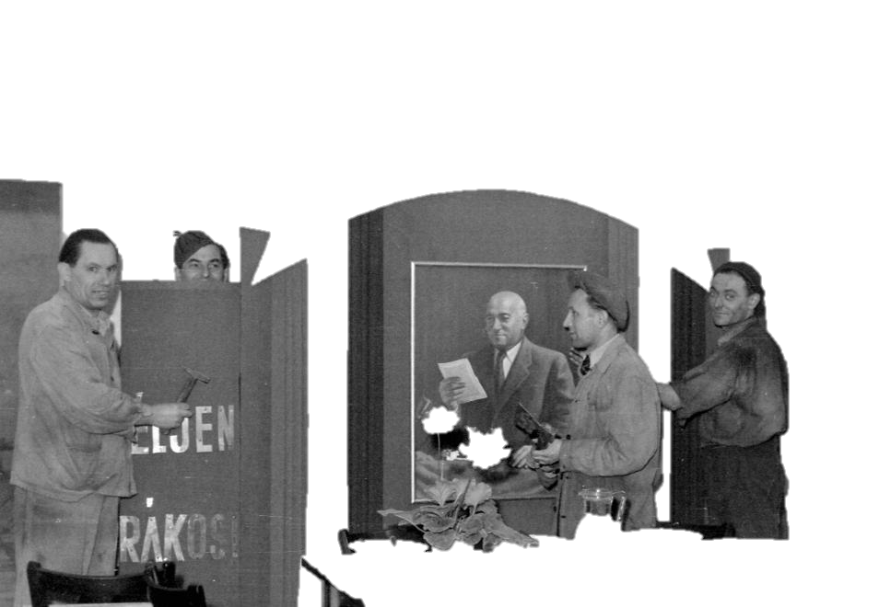
Sociology of communism From social reality to everyday life
Gábor Oláh, olah@fss.muni.cz

Slide 2
From Intellectual enlightenment to practical life in socialist society
Here I would like to take a look to the practical, everyday or mundane life of people in socialist society.
Also conceptualize the sociological approaches to the everyday life
In the previous classes you heard about intellectual enlightenment from above. Sociology of every day helps to understand the consequences of this enlightenment.
The impact of economy, architecture, urban planning, organized and collectivized agriculture, the legal system on the mundane

Slide 3
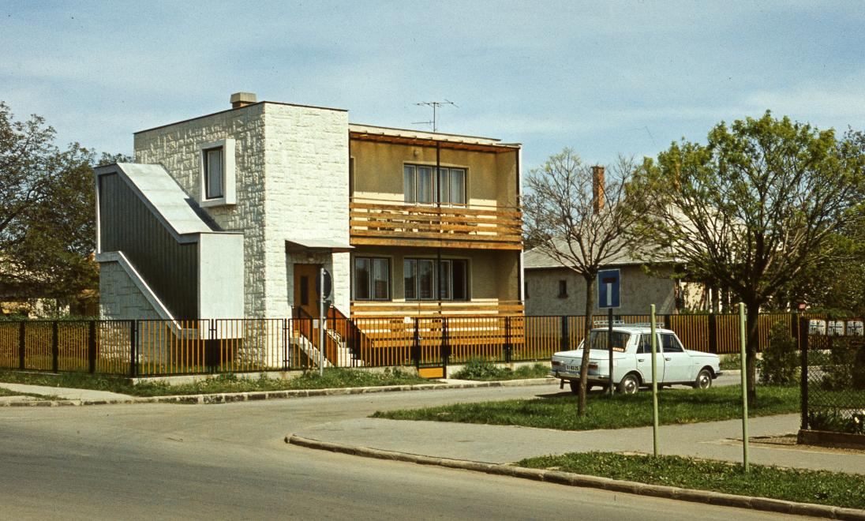

Slide 4
The role of emotion
Is needed to live the myth of socialist ideals like equality
Identification with the aesthetic and intellectual representations
Identification with the socialist values
BUILDING SOCIALISM
https://www.socialismrealised.eu/catalogue/girl-on-a-tractor/
https://www.socialismrealised.eu/catalogue/back-to-the-past/

Slide 5
Everyday in socialism
Everyday is the meeting of people with communism that turned the ideology into institutions.
Institutions are a form of social reality and a laboratory of modernity
In order to fully functioning institutional power the regime needs the myth.
The myth is a lie – myth making and performing the myth is needed for functioning

Slide 6
What is the everyday?
habits?
Traditions?
Events?
Sacred vs. Profane?
Activities of Everyone vs. Activities of Few
Incllusive vs. Exclusive
Hidden or visible?

Slide 7
Propaganda vs. caricature
Do you still have banana?
Already gone!...

Slide 8
TASK
Remember the aesthetics of propaganda from the last class
Compare with the aesthetics of caricature
Where are the ideals, the values, meanings?

Slide 9
Why focus to everyday life?
Theory vs practice and action
Structure of life
People live their lifes everyday.
It is the pragmatism that forms meanings and values
Everyday life is transforming though all the time

Slide 10
Sociology of everyday life
Rather sociologies of EL
Branch of approaches
Relatively new but also quiet old in the same time
Basically two approaches to EL:
In theory EL is taken for granted in abstract reasoning about the social
EL as the object of research

Slide 11
Elephant in the porcelain shop
Eviatar Zerubavel https://journals.sagepub.com/doi/abs/10.1177/1750481307082234
EL is the normal – but what does it mean?
It is the elephant in the porcelain shop – the thing that we do not talk about
We ignore the normal
EL was also ignored in sociology but was also present the whole time
For Rousseau EL was present in the organization of family – the natural form of social organization (in Social contract)
Division of labor

Slide 12
Durkheim
We can find references and examples in Durkheim
Division of labor
Religious life
The effects of anomy on EL
Sacred and profane

Slide 13
Marx saw the impact of capitalism in EL
Capitalist oppression
Types of alienation
Loss of self destroys family life
Aspects of EL are not natural any more
https://www.youtube.com/watch?v=JKVD-PVYPY4

Slide 14
Adorno and Horkheimer
Subjection of people when they accept ideologies
A form of deprivation
Regulation of EL through ideology
E.g. Education
https://www.socialismrealised.eu/catalogue/what-we-dont-talk-about/
https://www.socialismrealised.eu/catalogue/education-for-all/

Slide 15
Merton: Nature of social action:
Research of social action must be based on day to day experience
Giddens: Structuration theory
How social structure influences EL? Giddens shows how social structure that is a rigid structure is able to change and influence EL

Slide 16
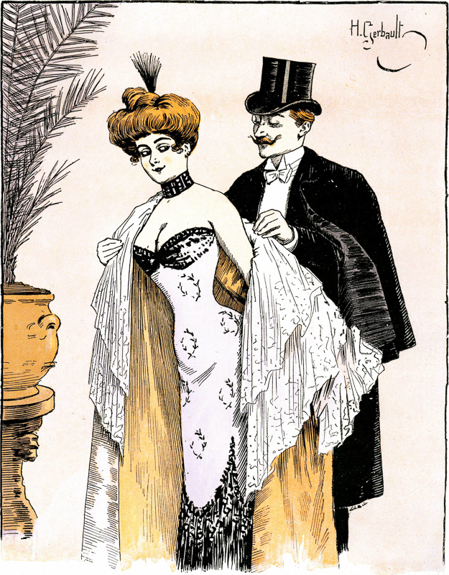
Simmel and rules of EL
Coquetry and the unwritten rules of social action
The Berlin trade
Simmel points out the dual relation btw the individual and society (product and producer)
Fashion
The usage of money

