Slide 1
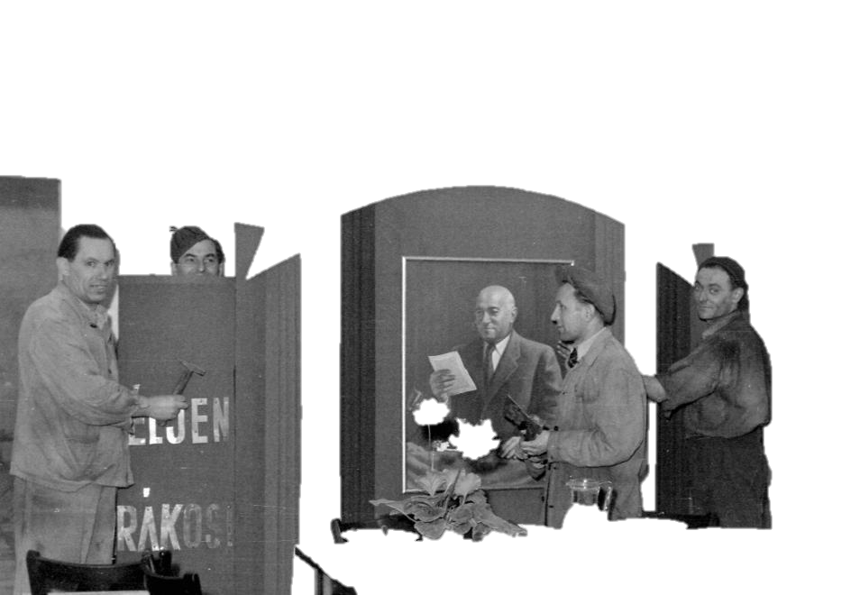
Sociology of communism
From social reality to everyday life part 2
Gábor Oláh, olah@fss.muni.cz

Slide 2
Henri Lefebvre
Marxist view on every day life and modernity andcritical view on various experiences of existence under capitalism
Everyday life as fundamental arena of social action outside the dimension of production
Pointed to the rise of beurecratic society of orgnaized consumption
Media, adverts and marketing create alienation
EL is the dimension where people can create resistance and turn alienation back

Slide 3

Lefebrve
Also points to the power of adverts
PEDRO, THE BEST PRODUCT →→
(was the only one basically…)
https://www.socialismrealised.eu/catalogue/good-ol-days/
Furthermore the language usage of beurocracy – The unquestioned rules of the institutions

Slide 4
Application of Lefebvre
The language of the institutions: Beurocracy colonizes EL and EL becomes inauthentic under the domination and terror of institutions
Controlled consumption by the offer - shortages in communism
Self regulation – in capitalist societies is voluntary, in socialist often compulsory and necessary
Terror of the ads – remember the propaganda from the earlier classes. Lefebvre was interested in the way of advertisements influence and form of life

Slide 5
Lefebvre
Lefebvre points to human creativity as elemntary character that can lead to disalienation and revolution in perception
E.g. DIY things under socialism
http://cultural-opposition.eu/games/objects-of-cultural-opposition/

Slide 6
Michel de Certeau
Focusing on the history of historiography to understand how historiography operates in the present and effects understanding of EL
History is certain type of language system – creates structural semiotic influence
History has a relation to place – it becomes reality, a construction of text
History as human activity and practice – Everyday aspect of history as living enterprise

Slide 7
Michel de Certeau
Poetics of Everyday life
The aim is not to find new cultural texts to interpret but to focus on the way people operate, how they practice EL.
Also critical to capitalism
  Life is organized and structured by economic order
  Response is human creativity
  Everyday resists to changes
  There are inventive deviations and multiple everydays

