Slide 1

The Nature of Mass Media - A Theoretical Perspective
Past, Present and Future
Henry Loeser PhD

Slide 2

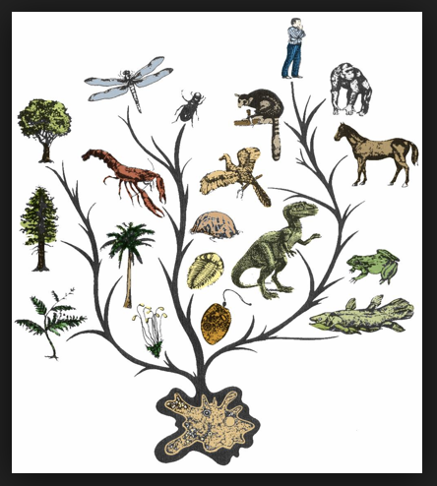
Natural Law
Structure of Nature
All living things seek utility
Nurture (Rationality)
Communication

Slide 3

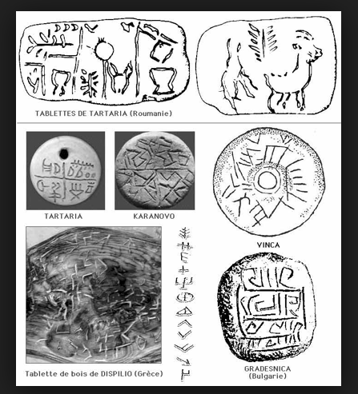
Human Evolution
Groups
Symbolic Interaction
Language
”We shape our tools, and thereafter, our tools shape us.” -Marshall McCluhan

Slide 4
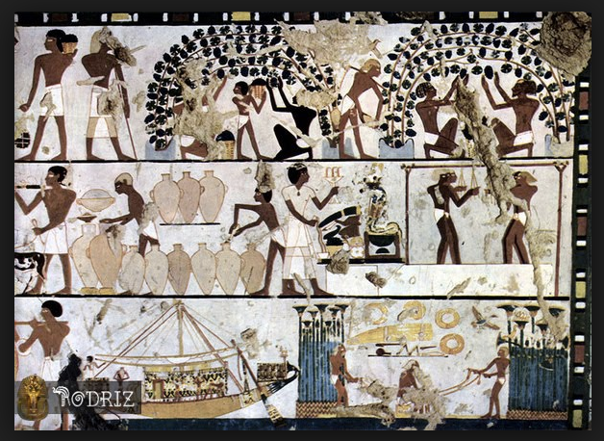
Forming Societies
Specialization
Agency vs. structure
Mass Communication

Slide 5
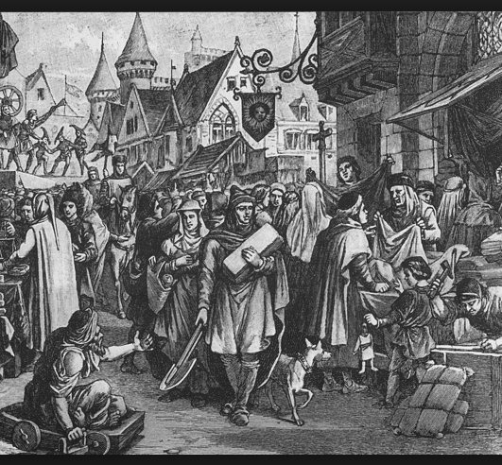
Medieval Europe
Feudalism
Dual authoritarianism of monarchy and church
Culture
Rise of merchant class media

Slide 6
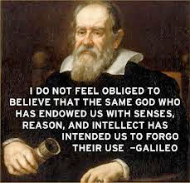
Enlightenment
Science & technology
Secularism

Slide 7
Epistemology
- knowledge
- logic /rationalism
- value
- aesthetics

Slide 8

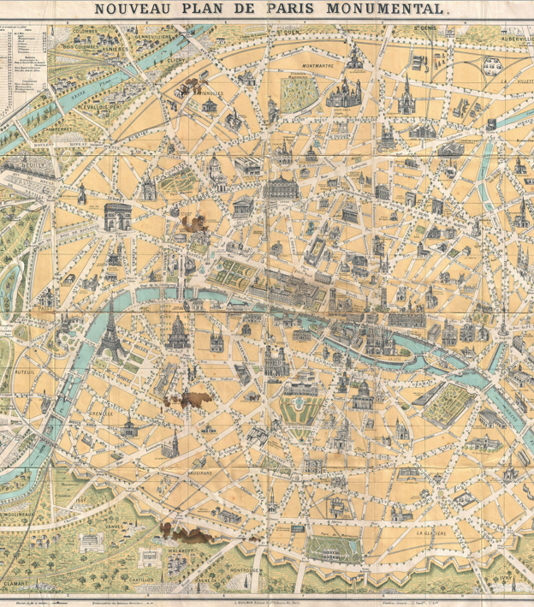
Modernity
Urbanization
Democracy
Mass Media forms

Slide 9
Social Sciences
Individual - Psychology
Groups - Sociology, Economics, Political Science
Positivist (Natural Sciences, mathematics)
Interpretivist (Symbolic interpretation / critique)

Slide 10
Sociology
Structure
- Spencer: ”each feature, custom, or practice, its effect on the functioning of a supposedly stable, cohesive system”
- Giddens: “the pre-eminence of the social world over its individual parts (i.e. its constituent actors, human subjects)”

Slide 11
Civil Society
Aristotle: “koinōnía politike” (society apart from family & government)
Hegel: “burgerliche gessellschaft” (citizens’ society)
Heller: “mosaic of identities”
Habermas: “communicative action in possibility spaces”
Bordieau, Giddens: “media reproduces culture in civil society”

Slide 12
Civil Society
a segment of society apart from commerce and government occupied by individuals and groups in public life outside the home, encompassing their cultural, ethical, political, and/or religious interests
Culture
Politics

Slide 13

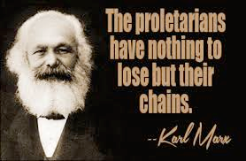
Conflict Theory
Dysfunctional society
Agency vs. Structure
Legal alternativism

Slide 14
Conflict Theory
Horkheimer & Adorno:
In the “culture industries”, the rise of 20th century large cultural industry players had created a structured, supply-driven system that “integrates its consumers from above” and was negating the opportunities for individuals and small groups of producers to comprise “a more diverse and pluralistic platform for societal understanding"
Researching the development of public policy should include not just an examination of the actors' behavior, but also an exploration of the value systems upon which the actions were based

Slide 15
Culture Industries
The Frankfurt School
Adorno & Horkheimer 1944
“culture now impresses the same stamp on everything”

Slide 16

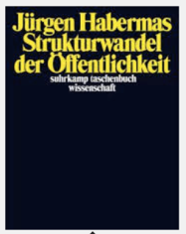
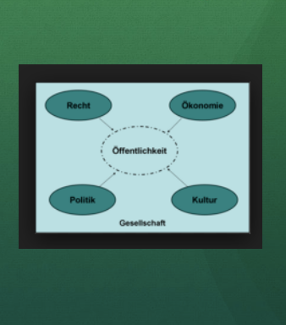
The Public Sphere

Slide 17
The Public Sphere
a participatory bourgeois public sphere of real discourse among equals that transformed into a site of spectator politics manipulated by elites who took control of the medium
the public sphere merged the private concerns of literate individuals regarding family and social integration with the larger public concerns of society
presented in spaces reserved for open discourse among citizens and delineated through argumentative discourse intended to identify and prioritize interests for the common good. Individuals could inform and influence public opinion, even if it was in opposition to the current political status quo.

Slide 18
Public Sphere
The degradation of the public sphere began in the late 19th century concurrent with the societal transition to a system marked by merging economic and political forces, the decline of the individual, and the manipulation of the culture industries

Slide 19
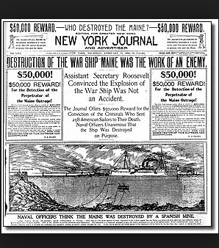
The Public Sphere
Re-Feudalization: Public Sphere transformed into “spectator politics manipulated by elites who took control of the medium”

Slide 20
The Public Sphere
Habermas: “forum for culture and politics co-opted”
Edwards: “multiple public spheres”
Fraser: “issues of class & gender”
Foucalt: “multidirectional power generation from discourse”
Herbst: “mobilize political resources”

Slide 21
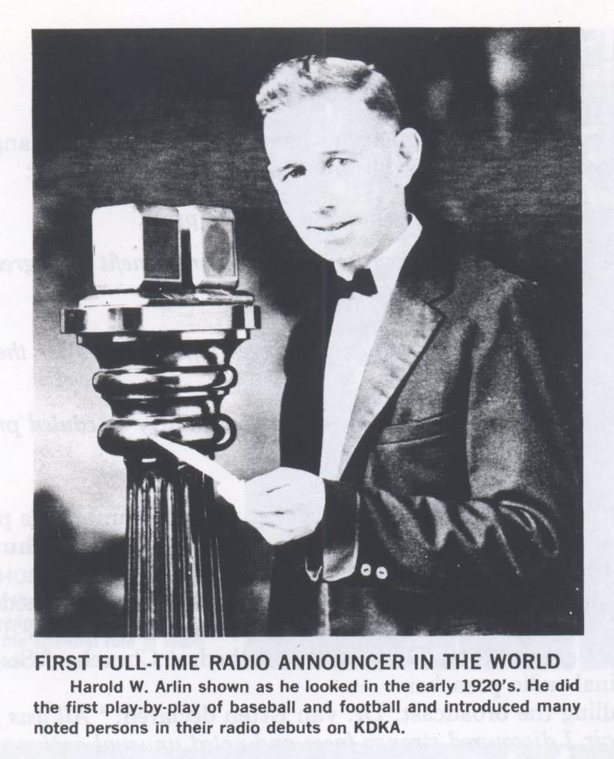
Radio

Slide 22
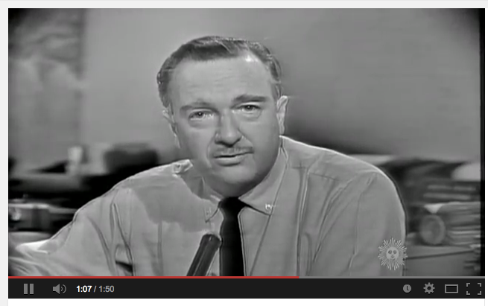
Television

Slide 23

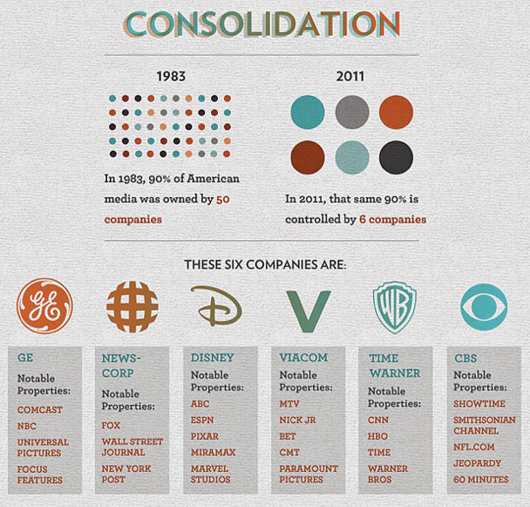
Re-Feudalization II
Re-Feudalization II:
-Policy issues
-Commercial broadcast conglomerates
-Alternatives struggle

Slide 24

IP - The Great Liberator?
One-to-many revolution
low barriers to entry
virtual democracy

Slide 25
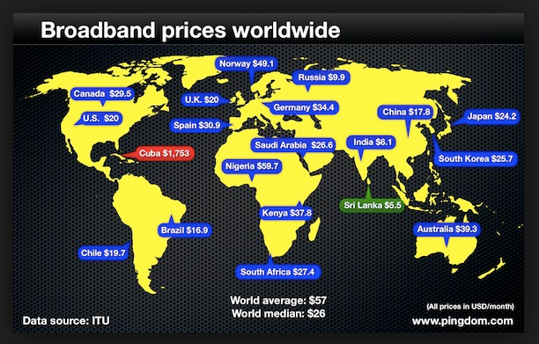
Q1 - The Pipes

Slide 26
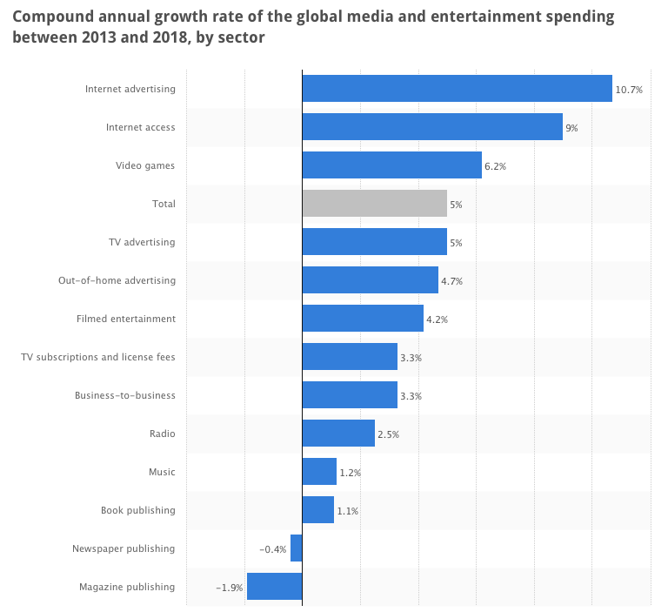
Q2 - The Revenue

Slide 27
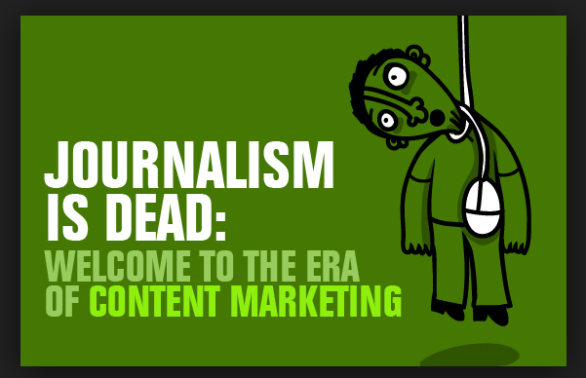
Q3 - The Content
Information
Opinion
Entertainment

Slide 28
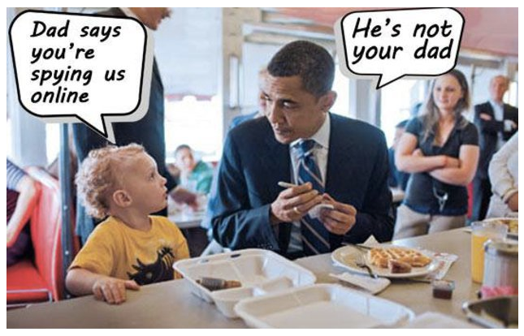
Q4 – Your Data

Slide 29
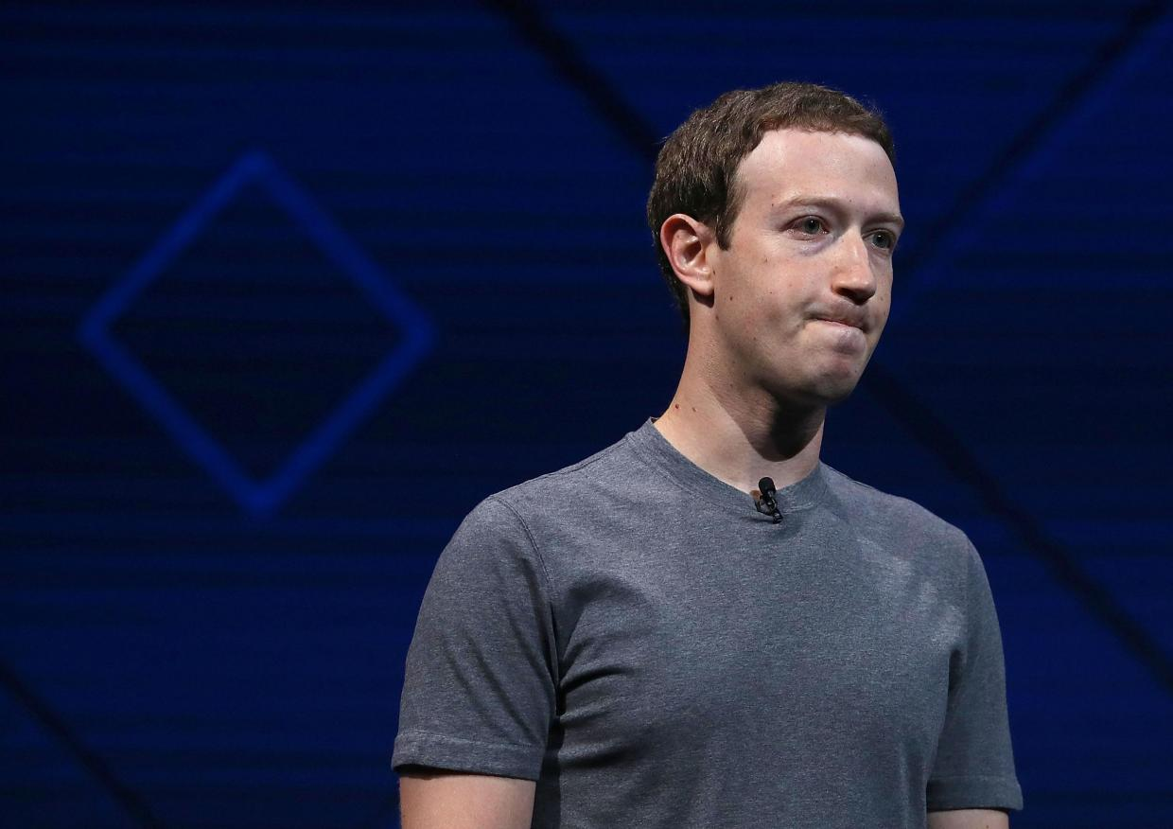
Re-Feudalization III?
Tech oligarchs
Net neutrality
Weaponization
“The Internet has become a potent tool of deception wielded by political extremists, disinformation warriors and conspiracy theorists.” -New York Times

Slide 30
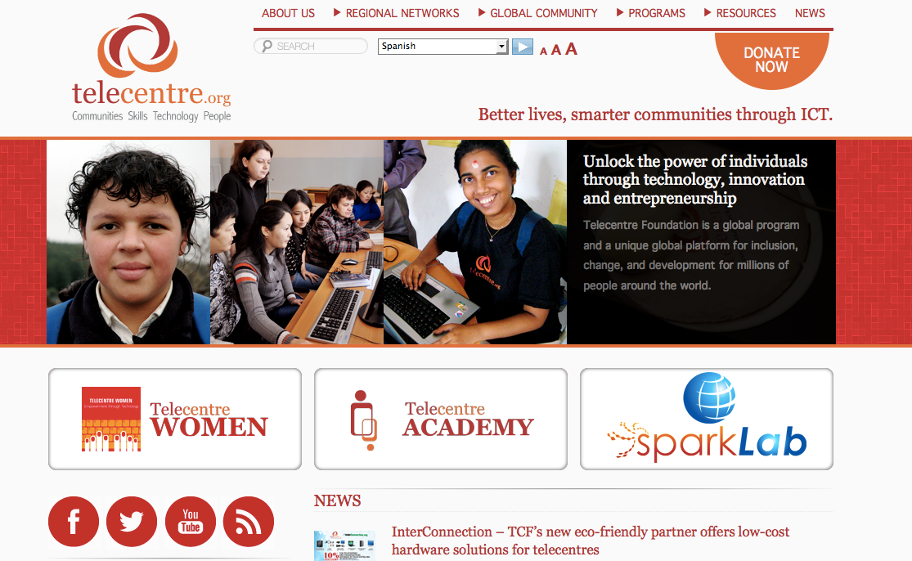
ICT4D

Slide 31

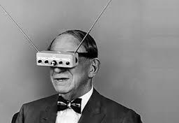
The Future
Beyond streaming
Neutrality
Creative Commons
Funding for real journalism

Slide 32
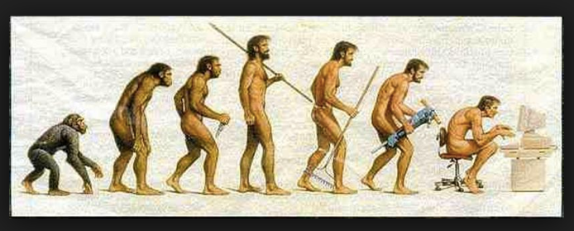
Human Evolution
Structural Functionalism?
Mass Media form?
The Public Sphere?

Slide 33
The Nature of Mass Media - A Theoretical Perspective
Past, Present and Future
Henry Loeser PhD

