Slide 1
Media & Cultural Industries
Week 3

Slide 2
Quiz Questions:
According to the reading
1) Define Horizontal and Vertical Integration
2) Define Concentration and The Long Tail
3) Explain the switch in terminology from using the “The Culture Industry” to Cultural Industries

Slide 3
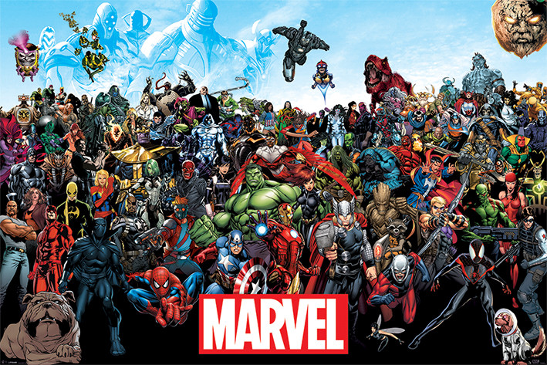
The Marvel Universe

Slide 4
Music
The Pop Star

Slide 5
From “The Culture Industry” to Cultural Industries
Adorno/Horkheimer – The Culture Industry
Commodification/Industrialization of Culture
Move towards a more complex, ambivalent and contested understanding of these industries

Slide 6
Distinctive Features of the Cultural industries
Problems:
Risky Business (cash cows; unpredictable tastes; reliance on supplemental chains of production)
Creativity/Commerce Dialectic(romantic vision vs. reality)
High Production Costs and Low Reproduction Costs (audience maximization)
Semi-Public Goods (create artificial scarcity through limits to access)
Responses
Misses are offset against hits by building repertoire (throwing mud against the wall)(The Long Tail of Niche Sales vs. Blockbusters)
Concentration, integration and co-opting publicity (Horizontal and Vertical Integration, Internationalization, Multisector integration(cross-promo))
Artificial scarcity (copyright/advertising/control of redistribution potetntial (DRM)
Formatting: Stars, genres, serials (Star System; commercial organization)
Loose control of symbol creators; tight control of distribution (Creative Management of production, distribution, and marketing)

Slide 7
Cultural Industries: Responses to The Challenge of Making a Profit from Culture
How to
explain patterns of change and continuity
Assess change and continuity
Politics and Ethics
The complex professional era of cultural production
Extent, evaluation, explain change
Neoliberalism
Information Society Discourse: Ways of Thinking about knowledge, culture and economy impacts public policy on business, communication and culture

