Slide 1
Content analysis and expert surveys
Radicalization of politics in CEE

Slide 2
Outline
How to analyze populist content?
Content analysis (various forms) – the logic, possibilities, the data
Expert surveys – advantages and disadvantages, the data
Goal: to get the basics of selected methods of analysis of political contents, introduction of some data sources

Slide 3
Based on the ideational approach to populism
Populism is “a thin-centered ideology that considers society to be ultimately separated into two homogeneous and antagonistic camps, “the pure people” versus “the corrupt elite”, and which argues that politics should be an expression of the volonté générale (general will) of the people.”
(Mudde 2004: 543).

Slide 4
Ideational approach to populism
Three core components of populism
People-centrism
Anti-elitisim
Sovereignty

Slide 5
Content analysis
Content/ textual analysis:
ideas of political actors are measured through texts that they produce (speeches, party manifestos, etc.)
Texts as „true“ representatives of what politicians say are plan to do

Slide 6
Content analysis
Types of content analysis:
Mancoded/handmade
Computerised/automatized
Note: Classical content analysis can be combined with computerised content analysis (semi-automated content analysis).
- Usually follow the deductive, concept/theory rooted approach
Notes:
There are two main types…

Slide 7
Content analysis
Classical content analysis:
a codebook is defined
coders systematically analyse text by means of a codebook (human-coded approach)
Notes:
In a classical content analysis researchers first create a codebook, in which they specify what they mean by populism, how they want to measure/ code it.
This codebook is then used by coders to analyse populism in texts of political actors – speeches of presidents, party manifestos etc.
People do the analysis – referred to as human-coded approach.

Slide 8
Content analysis
Computerised content analysis:
dictionary of populist terms defined (indicators of populism)
computer counts the proportion of words that we consider to be indicators of populism
Mostly doable in English (some tools in other languages, possibility to use Google Translate)
Notes:
In computerised content analysis researchers first create dictionary containing words/ phrases which are indicators of populism.
Computer is then given both the texts of political actors in which populism should be measured and the dictionary.
Output is the proportions of populist words in those texts.

Slide 9
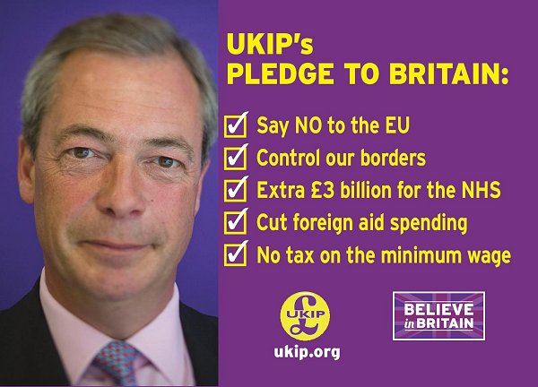

Content analysis: units of analysis
Notes:
…election manifestos, speeches…

Slide 10

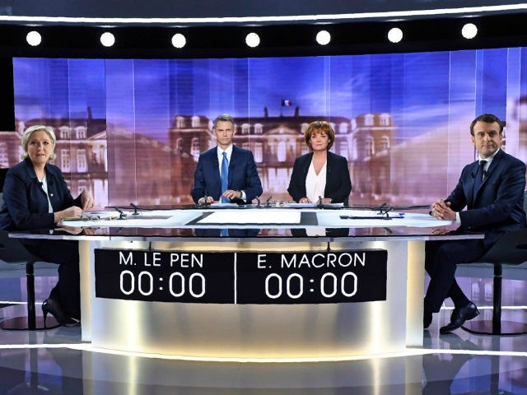
Content analysis: units of analysis
Notes:
…debates, newspaper articles, but also Tweets or Facebook posts.

Slide 11
Content analysis
units of analysis ≠ units of measurement
Notes:
Chunks of these texts are then units of our analysis.

Slide 12

Content analysis: units of measurement
Donald Trump inauguration speech transcript
1
2
3
4
Notes:
These can be paragraphs…

Slide 13
Content analysis: units of measurement
Donald Trump inauguration speech transcript
Notes:
…words…

Slide 14
Content analysis: units of measurement
Donald Trump inauguration speech transcript
1
Notes:
…entire texts (common in case of speeches).
In such case we talk about holistic grading approach in content analysis.

Slide 15
Content analysis in practise
Rooduijn , M. & Pauwels, T. 2011. “Measuring Populism: Comparing Two Methods of Content Analysis.” West European Politics 34(6), 1272–1283, online https://www.tandfonline.com/doi/abs/10.1080/01402382.2011.616665
Notes:
Lets have a look at the article on content analysis you have been asked to read before the class

Slide 16
Content analysis in practise
Rooduijn & Pauwels 2011
authors use both classical and computerised content analysis to measure and compare the degree of populism of political parties in the UK, the Netherlands, Germany and Italy
units of analysis: election manifestos
core components of populism: people-centrism, anti-elitism
Notes:
In their research,…
They measure populism in election manifestos of political parties in these countries.
And they try to identify people-centrism and anti-elitism in these party manifestos.

Slide 17
Content analysis in practise
Rooduijn & Pauwels 2011
Classical content analysis
units of measurement: paragraph
  → comparison of the degree of populism among parties based on % of populist paragraphs in their manifestos
  paragraphs in which both people-centrism and anti-elitism were present selected as populist
Notes:
In classical content analysis they look at individual paragraphs in election manifestos.
Only if both people-centrism and anti-elitism are identified in a paragraph, that paragraph is coded as populist.
Therefore, the comparison of the degree of populism….

Slide 18
Content analysis in practise
Rooduijn & Pauwels 2011
Classical content analysis: operationalisation of the core components of populism
people-centrism: “Do the authors of the manifesto refer to the people?”
  examination of every possible reference to the people (citizens, our country, society, we the people, etc.)
    list of words and combinations of words that could refer to the people: people, citizen(s), community, society, public, population, nation(al), all of us, each of us, everyone, our, we, voter(s), electorate, referenda, direct democracy, public opinion, country, specific country (depending of course on the country under analysis
  interpretation of the broader context
Notes:
By people-centrism authors mean reference to the people.
Coders provided with the list of words and combinations of words that may refer to the people, such as….
Coders also asked to take into account the context – word we may not refer to the people but to the party.

Slide 19
Content analysis in practise
Rooduijn & Pauwels 2011
Classical content analysis: operationalisation of the core components of populism
anti-elitism: “Do the authors of the manifesto criticise elites?”
  focus on criticism concerning the elite in general (critique on a specific party/ politician not coded)
  interpretation of the broader context
Notes:
By anti-elitism authors mean ciriticsm concerning the elite in general, not ciriticism of specific party or polician.
Again, coders asked to take into account the context.

Slide 20
Content analysis in practise
Rooduijn & Pauwels 2011
Computerised content analysis
units of measurement: words
  → comparison of the degree of populism among parties based on % of populist words (words considered populism)
Notes:
In computerised content analysis authors look at individual words in party manifestos.
Therefore, comparison of the degree of populism is based… in those manifestos.

Slide 21
Content analysis in practise
Rooduijn & Pauwels 2011
Computerised content analysis: operationalisation of the core components of populism
focus only on words that refer to anti-elitism
  measurement of people-centrism by means of individual words in nearly impossible (words we and our often mentioned not in reference to the people, but to the political party)
selection of words into dictionary based on both empirical and theoretical reasoning
  election manifestos of populist parties not analysed in this study used to make list of words that such parties have used to express their negativity towards elites
Notes:
Authors developed their own dictionary.
Contains only words that refer to anti-elitism.
They used party manifestos of populist parties not included in the analysis to identify those words.

Slide 22
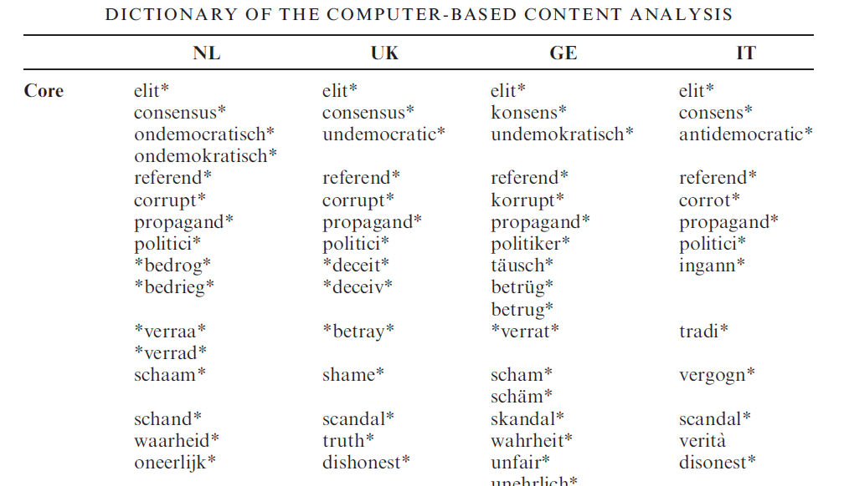
Content analysis in practise
Rooduijn & Pauwels 2011
Notes:
Here you can see what a dictionary used in a computerised content analysis can look like.
Star symbols next to each chunk.
Means that such chunk can be followed or preceded by any letters.
Why is it useful?

Slide 23
Content analysis in practise
Rooduijn & Pauwels 2011
Notes:
Example: chunk corrupt* -> not only word corrupt but also corruption, corrupted counted as indicator of populism in a text

Slide 24
Content analysis
The Manifesto Project: https://manifesto-project.wzb.eu/
content analysis of parties’ election manifestos in order to study parties’ policy preferences
for each dataset:
  codebook
  coding instructions
  list of coded documents (titles of parties’ election manifestos)
  list of political parties
Notes:
If interested in PM project – look at it at home. In the available datasets you can find informaiton about parties‘ policy preferences. Does not measure populism but you can look at policy preferences of populist political parties or compare them to other parties.

Slide 25
Jungar, Jupskas (2014)
Populist Radical Right Parties in the Nordic Region: A New and Distinct Party Family?
Comparing policy positions of PRR parties in Scandinavia
Rooted in the concepts of party families and PRR
Using CMP data (l-r and authoritarian/liberal indices)

Slide 26
Content analysis
Harvard Dataverse – Global Populism Database: https://dataverse.harvard.edu/dataset.xhtml?persistentId=doi:10.7910/DVN/LFTQEZ
measurement of the level of populist discourse in the speeches of 215 chief executives (presidents and prime ministers) from 66 countries across all continents, mostly between 2000 and 2018
holistic grading
Notes:
For this course, Global populism Database more usufl
Dataset contains data on measurement …..
Holistic grading used – entire text – speech – one unit of analysis.
Example of codebook.

Slide 27
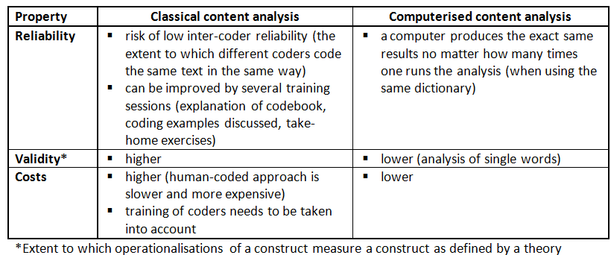
Advantages & Drawbacks of different types of content analysis

Slide 28
Expert surveys
Who are respondents in expert surveys?

Slide 29
Expert surveys
Expert surveys
respondents are experts with a high degree of specialized knowledge in their own national contexts
experts are presented with predefined questions or scales and asked to use their best judgements when answering the questions/ placing given actors on given scales
Notes:
Note: Each scale needs to be given a clear title and anchored at each end with two precise substantive definitions of the scale endpoints based on the theoretical understanding of the issue we are interested in.

Slide 30
Expert surveys in practise
Wiesehomeier, N. (2018). Expert Surveys In Hawkins, K., Carlin, R., Littvay, L. & Rovira Kaltwasser, C. (eds.) The Ideational Approach to Populism: Concept, Theory, and Analysis. London: Routledge, pp. 90–111.
Notes:
Chapter on ES

Slide 31
Expert surveys in practise
Wiesehomeier 2018
expert survey used to measure populism in Latin America (two waves: 2011/2012 and 2015)
location of parties and presidents along a 20-point scale of Political communication; 1 indicates the populist endpoint, 20 the pluralist endpoint
  pluralism acknowledges diversity in society
  pluralist actors consider different groups that constitute the social fabric of a country as legitimate, and favour the diffusion of power
Notes:
The author used ES to meaure…. Survey was conducted in two waves
In a survey, experts were asked to loacte parties along a
Unlike populism, pluralism….

Slide 32
Expert surveys in practise
Wiesehomeier 2018
Second wave (2015): Scale of Political communication
Dimension: People-centrism
  1: “Identifies with the common people and celebrates their authenticity.”
  20: “Refers more generally to citizens and their unique interests.”
Notes:
Let‘s have a look at the scales used in the 2nd wave, on whhich experrts were asked to allocate of political actors
- Two scales – one for people-centrism, other for anti-elitism
endpoints of the scale on people-centrism – populist endpoint describe as:
Pluralist endpoint described as:

Slide 33
Expert surveys in practise
Wiesehomeier 2018
Second wave (2015): Scale of Political communication
Dimension: Anti-elite: morality
1: “Demonizes and vilifies opponents.”
20: “Treats opponents with respect.”
Notes:
endpoints of the scale on anti-elitism– populist endpoint describe as:
Pluralist endpoint described as:

Slide 34
Expert surveys
Useful datasets:
2017 Chapel Hill Expert FLASH Survey (CHES)
Populism and Political Parties Expert Survey (POPPA)
Notes:
Two sources of useful datasets

Slide 35
Expert surveys
2017 CHES: https://www.chesdata.eu/1999-2014-chapel-hill-expert-survey-ches-trend-file-1
carried out in January and February 2018, asked about party positions in 2017 in14 EU member states: Czech Republic, Estonia, France, Germany, Greece, Hungary, Italy, Netherlands, Poland, Portugal, Slovakia, Spain, Sweden, UK
questions on EU placement, economic and social party positioning, policy issues - EU economic coordination, populism, and migration
data including sample questionnaire and codebook available
Notes:
First is the Chappel hill expert flash survey whcih was carried out in….
Expertes were asked about…..
Survey included questions on
Websites – you can find sample questiaonnere, codebook

Slide 36
Expert surveys
2017 CHES: items on populism
PEOPLE_VS_ELITE: “Some political parties take the position that 'the people' should have the final say on the most important issues, for example, by voting directly in referendums. At the opposite pole are political parties that believe that elected representatives should make the most important political decisions. Where do the parties fall on this dimension?”
0: “Elected office holders should make the most important decisions.”
10: “Extremely important.”

Slide 37
Expert surveys
2017 CHES: items on populism
ANTIELITE_SALIENCE: “Salience of anti-establishment and anti-elite rhetoric.”
0: “Not important at all.”
10: “Extremely important.”

Slide 38
Expert surveys
2017 CHES: items on populism
  mean scores on items used to compare how populist are the parties within a given country

Slide 39
Engler et al. (2019)
Assessing the diversity of anti-establishment and populist politics in Central and Eastern Europe
Using expert surveys to discover a) policy positions of AEPs and b) compare them with other parties

Slide 40
Expert surveys
POPPA: http://poppa-data.eu/
party positions and attitudes on key attributes related to party ideology, party attitudes toward political representation and party organisation
carried out in Spring 2018
data available in late 2019
GLOBAL PARTY SURVEY - https://dataverse.harvard.edu/dataset.xhtml?persistentId=doi:10.7910/DVN/WMGTNS
Notes:
Interesting source of data is Populism and Political Parties Expert surveys was carried out in…
Epxerts asked about

Slide 41
Conclusion
You can meaure level of populism by collecting new data or by using existing data sources
An economic way how to assess policy positions of parties or compare them accross countries or time
In same cases not necessary to know the language, althouhg the numbers needs to be explained

