Slide 1
Populist political communication
Radicalization of Politics in Central Europe
Vlastimil Havlík

Slide 2
Outline
Part I
Populism as a communication style – the approach
Features of populism as a communication style
Part II Research on populism as a communication style
1. Populism on Twitter
2. Populists prefer social media to talkshows
3. Podemos and its communication on social media
4. Gender gap and populism on Facebook

Slide 3
Populism as a communication style
Follows populism as a thin centered ideology:
“populism as an ideology that considers society to be ultimately separated into two homogeneous and antagonistic groups, ‘the pure people’ versus ‘the corrupt elite’, and which argues that politics should be an expression of the volonté générale (general will) of the people” (Mudde 2004)
BUT
Anchored in the communication studies: stress on the communication environment and communicatio per se -> populism as a matter of degree/part of communication of a political actor

Slide 4
Populism as a communication style
„Populism is reflected in the oral, written, and visual communication“ of various actors (Reinemann et al. 2016)
„it is a communication frame that appeals to and identify with the people and pretend to speak in their name“ (Jagers, Walgrave 2007)
Characteristics of a message rather than of an actor: populist messages as independent “phenomenon as such” and no longer on a particular party family or type of politician“ (De Vreese et al. 2018)
a discursive manifestation of a thin centered ideology that is not only focused on the underlying set of basic assumptions about the world but in particular on “the language that unwittingly expresses them” (De Vreese et al. 2018)
Stress on the communication tools and the style of communication

Slide 5
Populism in the changing media environment
(populist) political communication takes place in a media environment
Recent changes support the spread of populism
“populism is particularly suited to the contours of the ‘new media galaxy.’” (Kean 2013, in De Vreese 2018)
Social media as a by-pass of mainstream media (anti-populist bias – Mazzoleni 2003)
Three actors of populist political communication – political actors, the media, the public

Slide 6
Political actors
Close to the ideational approach BUT stress on the messages
Three elements of populism:
(1) reference to “the People,”
(2) a battle against the “corrupt” elite,
(3) the identification of an out-group
a specific sense of social identity is at the heart of populism.
Populist messages can define in-groups (the good people), and construct out-groups (problematic minorities, self-serving elites, scapegoats presented as threats)

Slide 7
Populist communication in Belgium
J. Jagers and S. Walgrave (2007): „Populism as political communication style: An empirical study of political parties` discourse in Belgium.“ European Journal of Political Research 46 (3), 319-345.
Context – striking electoral success of Vlaams Blok Study of supply side (strategy of the party) underdeveloped – one of the reasons for the research
Explanation of the success of the party
H: The Vlaams Blok’s external communication is characterised by an outspoken and all-pervading populism.
Need for a comparative research (in Belgium)
Lack of a measurable concept of populism – development of an operationalisable definition of populism

Slide 8
Populist communication in Belgium
Three key elements of populism: appeal to the people, anti-elitism, an exclusion strategy
Thick and thin populism
  Thin pop. – refers to the people, pretending to speak in their name, „precondition“ of thick populism (minimal definition of populism)
  Thick pop. – includes also the two other features of classical definitions of populism
Two dimensional typology (vertical and horizontal dimension)

Slide 9
Data and measurement
The aim is to examine communication style of Belgian political parties (related to the research question and the hypotheses)
Public TV broadcast– similarity and comparability of the data across political parties (each party 20 broadcast + 200 minutes per party, not electoral broadcast – to avoid affecting by political events)
Human coded content analysis
Developing of „the people index“ – proportion and intensity of thin populism in PPB, the anti-establishment index (degree of hostility towards the state, the media and politics) and the exclusivity index (proportion of positive and negative evaluations of specific groups of population)

Slide 10
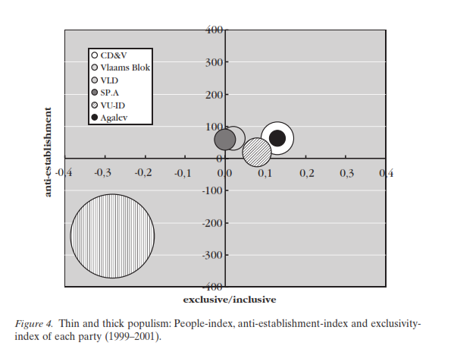
Results of the research
Vlaams Blok fundamentally differs from the other parties in terms of political communication (Jagers, Walgrave 2007)

Slide 11
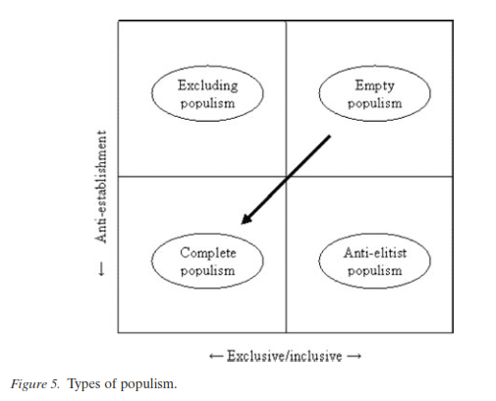
Results of the research – a typology o populism
Source: Jagers, Walgrave 2007

Slide 12
The media
Two approaches: media populism and media as a messenger (Mazzoleni)
1) media populism – media as activist actors communicating their own populist messages
2) media as messengers – carriers of someone else`s populist messages
Help populist mobilization
A tool for spreading populist messages (social media)
Media coverage of both actors and issues

Slide 13
Citizens
Communication content and its effects on political attitudes and electoral preferences (e.g. the research on framing)
as communicators expressing their beliefs and demands in reaction to the media or on the media (social media)
Some support of the relationship of populist voters and news consumption and preference of certain types of the media (mainstream/tabloid)
Messages induce/reinforce populist attitudes and support for populist parties

Slide 14
Summary of Part I
Populist political communication partly related to the ideational approach
Focus on communication rather than on actors
Populism as a matter of degree
Placed in a complex communication systems including political actors, the media, and citizens
Source: De Vreese et al. 2018

Slide 15
Part II
Research on populism as a communication style

Slide 16
Italian political leaders on Twitter
Bracciale & Martela (2017)
Both conceptual and empirical aims
RQ1. Which communication style do leaders use on Twitter, and which features characterize each style?
RQ2. Do populist and non-populist leaders adopt a populist communication style?
RQ3. What is the relationship between the adoption of a particular communication style and the presence of populist ideology?
„a political communication style model able to support ‘what is being said’ and ‘how it is being said’“ – the content (topic and function) and the form (stagecraft and register)

Slide 17
Analysis
Case selection
Tweets as a content for analysis (sampling)
Indicators of the populist style turned into dichotomous variables (similar procedure for the populist ideology)
MCA and positioning of the actors in a two dimensional space forming four communication styles:
Engaging (positive communication and political/campaing focus)
Champion of the people (negative communication and political/campaign focus)
Man on the street (negative communication and personalization focus)
Intimate style (positive communication and personalization focus)
The ideology indicators link the populist style features and the populist ideology elements

Slide 19
Conclusion
Definition and empirical validation of populist communication styles
Outline of indicators of populist political communication
Possibility to describe communication styles of political actors

Slide 20
Populists prefer social media to talkshows
Ernst et al. (2017)
systematic parallels in the use of populist key messages and the use of certain stylistic elements
Populist messages + communicative styles (not necessarily populist! See Part I of the lecture) linked to populism
a communication-centered approach and conceive of populist communication as an outcome of a strategy that uses both ideological key messages and certain stylistic elements – what is their relationship?
Detailed and clear operationalization of populism and populist communication style

Slide 23
Analysis
Set of hypotheses related to the type of the media and political actors (challengers/extreme)
Social media used more often for spreading populist content (both messages and style)
Challenger parties use populism more often
Extreme parties use populism more often
Linkage between different contents, media and actors
Nice definition of the communication styles

Slide 24
Podemos on Twitter
Casero-Ripollés et al. (2017)
What issues and functions, linked to its political agenda, does Podemos produce and circulate through Twitter?
To what extent is the populist political communication style present in Podemos’s production and circulation of political content through Twitter?
Content analysis of functions and issues to characterize and compare communication of the party and the leader
Rather descriptive conclusions – combination of populist and policy-related contents

Slide 25
Gender gap and populism
Bobba et al. (2018)
Follows the rich literature on the gender gap in voting behavior (males are usually more prone to support radical parties) and extension to the communication studies
A different perspective from the previous studies
H: Men are more likely to “like” Facebook posts by populist parties or their leaders.
H: Men are more likely to “like” Facebook posts by radical populist
parties or their leaders.
H: Men are more likely to “like” a Facebook post by political parties/
leaders containing populist elements.
H: Men are more likely to “like” a Facebook post by political parties/
leaders containing complete, excluding, and antielitist populist elements.

Slide 26
Analysis
„Likes“ on FB as DV
Italy, France, Spain (variety of actors)
Populism following Jagers and Walgrave
Male support populist parties more (but not necessarily radical ones)
Populist content matters in gender gap but only its anti-elite element regardles the type of party

Slide 27
Conclusion of Part II
Several perspectives to the study of populist communication
Focussing on the content of messages and how they are spread and perceived
Describing communication of political actors, not concentrated on actors per se
Focus on style but also on the content
Usually some kind of content analysis

