Slide 1
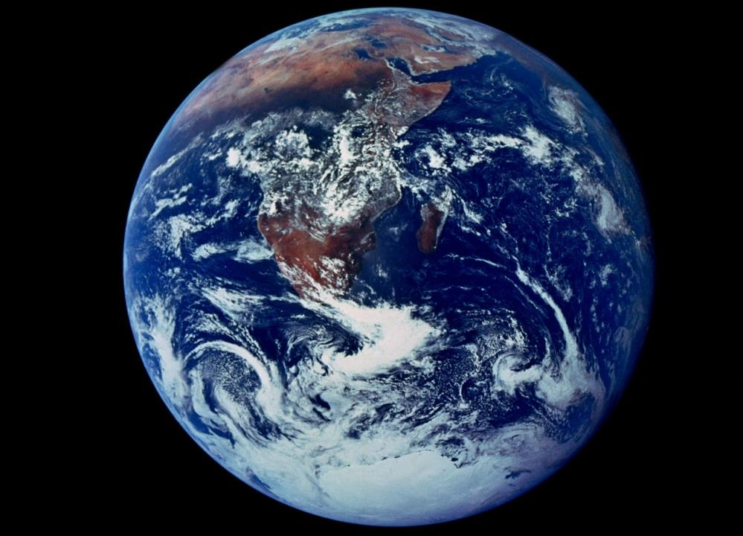

Slide 2
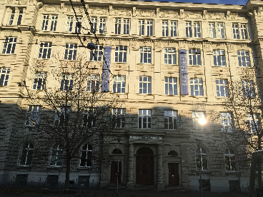
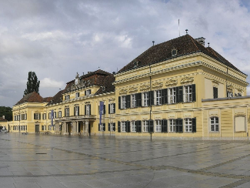
Flourishing within Limits to Growth
Brian D. Fath, Ph.D. – bfath@towson.edu
Professor, Department of Biological Sciences, Towson University, Baltimore, Maryland, USA
Senior Research Scholar, International Institute for Applied Systems Analysis, Laxenburg, Austria
Fulbright Distinguished Chair, Department of Environmental Studies, Masaryk University, Brno, Czech Republic

Slide 3
Course Goals:
1. To provide students with a basic understanding of the environment as a system including the biological, physical, and chemical foundations of ecosystem services
2. To understand how nature provides resources and constraints to socio-economic development and to students’ everyday life.
3. To learn how human activities impact and interfere with this ecological functioning
4. To explore how human activities could promote sustainable, win-win, flourishing outcomes within these limits
Course Outline: Arranged in 4- 1.5 hour blocks; specific readings (in bold) from Encyclopedia of Ecology, Fath and Jørgensen (eds). 2019. Elsevier.

Slide 4
Wednesday, May 26, 2021, 13:00 – 14:30
Lecture 1: Systems thinking: Where it comes from and where it goes
Ecological Systems Thinking: D W Orr
Human Ecology: Overview: F Steiner
Thursday, May 27, 2021, 13:00 – 14:30
Lecture 2: Natural ecosystems, ecological succession, ecosystem services
Ecosystem Services: K A Brauman and G C Daily
Flourishing within limits: Jørgensen et al. 2015 Chapter 3
Thursday, May 27, 2021, 15:00 – 16:30
Lecture 3: Limits to growth
Limits to Growth: B D Fath
Ecological Footprint: M Wackernagel and J Kitzes
Friday, May 28, 2021, 13:00 – 14:30
Lecture 4: Flourishing within limits
Flourishing within limits: Jørgensen et al. 2015 Chapter 4

Slide 5
Introductions

Slide 6
“The greatest discovery of the past century had nothing to do with nuclear physics, or computer science, or genetic engineering. Rather it was the discovery of the essential connectedness of life and environment.”
Orr 2019
“It is a century now since Darwin gave us the first glimpse of the origin of species. We know now what was unknown to all proceeding caravan of generations: that men are only fellow-voyagers with other creatures in the odyssey of evolution.
Leopold 1949
Moving toward the Ecozoic!!

Slide 7
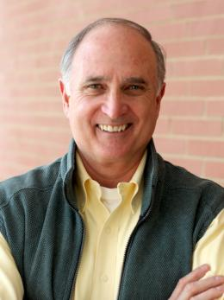
Professor David Orr
Oberlin College
Paul Sears Distinguished Professor of Environmental Studies and Politics Emeritus
Senior Advisor to the President
Systems thinker, writer, and orator.

Slide 8
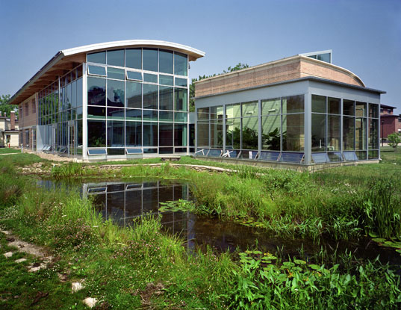
Oberlin’s Environmental Science Building:
Adam Joseph Lewis Center, was named by an AIA panel in 2010 as “the most important green building of the past 30 years,” and as “one of 30 milestone buildings of the twentieth century” by the U.S. Dept of Energy.

Slide 9
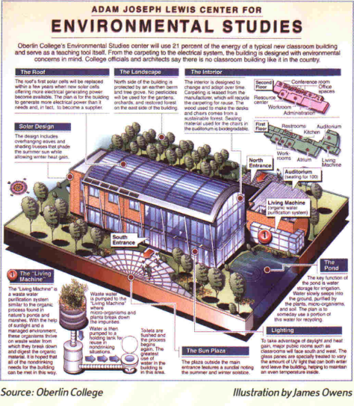
This solar-powered building showcases green building technologies and operating systems. Photovoltaic panels on the center’s roof and parking pavilion capture renewable energy from the sun and south-facing windows allow for passive solar heating. Indoors, a specially engineered wetland called the Living Machine purifies non-potable wastewater for reuse in toilets and the landscape.
Flows of energy and cycling of materials are monitored and displayed by a sophisticated system (150+ sensors) that gives real-time feedback, teaching about sustainability in the built environment.

Slide 10
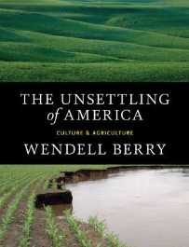
“Systems thinkers see the world as networks of interdependence” Orr, 2017, p. xv
“There is no such thing as autonomy;
there is only a distinction between responsible and irresponsible dependence” p.116 - Berry 1977

Slide 11
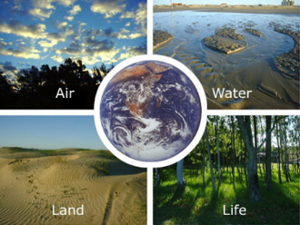
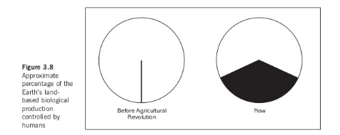
Systems thinking
“We live in a web of obligations and relationships that transcend the conventional boundaries by which we organize academic disciplines and bureaucracies” Orr, 2017, p. xv
“humans have appropriated the majority of the planet’s net primary productivity” Orr, 2017, p. xvi

Slide 12
Environmental education
should constitute a comprehensive lifelong education … it should prepare the individual for life through an understanding of the major problems of the contemporary world, and the provision of skills and attributes needed to play a productive role toward improving life and protecting the environment with due regard given to ethical values. By adopting a holistic approach, rooted in a broad interdisciplinary base, it recreates an overall perspective which acknowledges the fact that natural environment and manmade environment are profoundly interdependent….
UN-sponsored Conference at Tbilisi, Georgia, 1978
“by 2030, ensure that all learners acquire the knowledge and skills needed to promote sustainable development, including, among others, through education for sustainable development and sustainable lifestyles, human rights, gender equality, promotion of a culture of peace and non -violence, global citizenship and appreciation of cultural diversity and of culture's contribution to sustainable development.”
UN Sustainable development Goals, 2015
the idea of interrelatedness has yet to take hold of us in a deep way.
We still live in thrall to a world created by Descartes, Bacon, Galileo, and their heirs who taught us to dissect, divide, parse, and analyze by reduction but not how to put things back together or see the world as systems and patterns.
Orr, 2019

Slide 13
What educational experiences have had the most effect on you?
How can the current educational system be reformed to focus on these items?
How will education be different in the future?

Slide 14
AN ASSIGNMENT FOR THE CAMPUS
“Does four years here make your graduates better planetary citizens or does it make them, in Wendell Berry's words, ‘itinerant professional vandals’?”
Does this college contribute to the development of a sustainable regional economy or, in the name of efficiency, to the processes of destruction?

Slide 15
Examine resource flows on campus: food, energy, water, materials, and waste
Where does stuff come from? Where does it go?
“No student should graduate without understanding how to analyze resource flows and without the opportunity to participate in the creation of real solutions to real problems.”

Slide 16
Ecological literacy
Every student should graduate with basic comprehension of:
the laws of thermodynamics
the basic principles of ecology
carrying capacity
energetics
least-cost, end-use analysis
how to live well in a place
limits of technology
appropriate scale
sustainable agriculture and forestry
steady-state economics
environmental ethics
Are you learning these topics

Slide 17
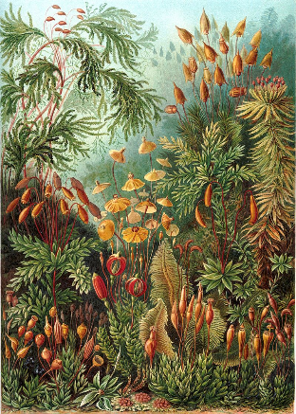
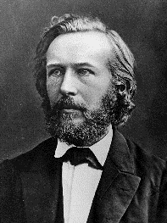
Ecology
Science of relations between living organisms and their environment (Ernst Haeckel – 1866)

Slide 18
What is Human Ecology?
Science of interrelationships between people and the environment
1920s used by urban sociologists with ecological concepts to explain urban dynamics
1960-1970s used by biologists and ecologists alarmed by human population explosion and environmental degradation. Also used by anthropologists to see impact of env on culture
1980s multidisciplinary research with natural and social scientists addressing env problems
1990s-present: sustainability science

Slide 19
Tracing the chain of effects through ecosystems and human society
anticipate the long-range environmental consequences of human actions
avoid disastrous surprises from the environment
generate ideas for dealing with environmental problems; and, in general
maintain a livable and sustainable relationship with the environment.

Slide 20
How are ways that you depend on the environment?

Slide 21
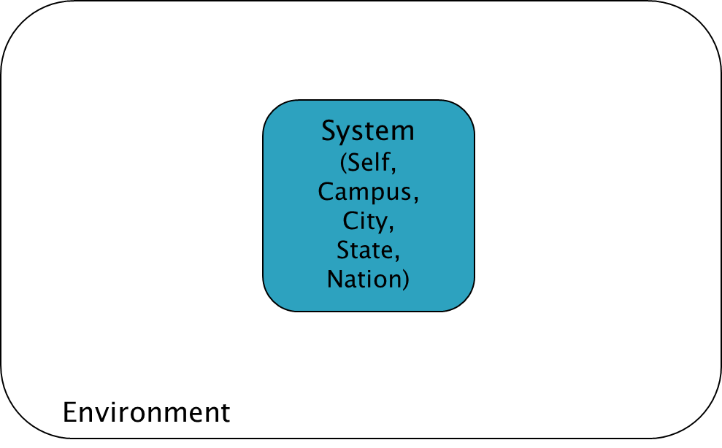
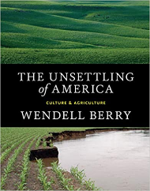
“What is Environment”
The concept of country, homeland, dwelling place becomes simplified as ‘the environment’—that is, what surrounds us. Once we see our place, our part of the world, as surrounding us, we have already made a profound division between it and ourselves.
We have given up the understanding—dropped it out of our language and so out of our thought—that we and our country create one another, depend on one another, are literally part of one another; that our land passes in and out of our bodies just as our bodies pass in and out of our land; that as we and our land are part of one another, so all who are living as neighbors here, human and plant and animal, are part of one another, and so cannot possibly flourish alone; that, therefore, our culture must be our response to our place, our culture and our place are images of each other and inseparably from each other, and so neither can be better than the other.
    Berry (1977, p. 24).

Slide 22
Systems Theory - boundaries
System
(Self,
Campus,
City,
State,
Nation)
Environment

Slide 23
Old perspective, dichotomy between system and environment
System
Environment
New perspective, system is focus of two environments
Input Environment
H
Output Environment

Slide 24
Environment
System
Input environ
H_{j}
H_{j}
H_{j}
Object
H_{i}
H_{j}
H_{j}
H_{j}
H_{j}
Output environ
Feedback
Any object/system is inseparable from its TWO ENVIRONMENTS

Slide 25
How are ways that you depend on the environment?
The environment is not “out there”, but rather in you and on you, a part of you
Homework – identify 1 mineral element that is used in the making of your smart phone, describe where it comes from and the extraction methods to get it.
What happens to it when you are done with the phone?
Post your findings on the Blackboard discussion page.

Slide 26
Systems Perspective
See how things are connected and interrelated
Where does it come from?
Where does it go?
Complex – many parts, many interactions
Adaptive – respond and change
Systems – set of parts interacting together to function as a whole

Slide 27
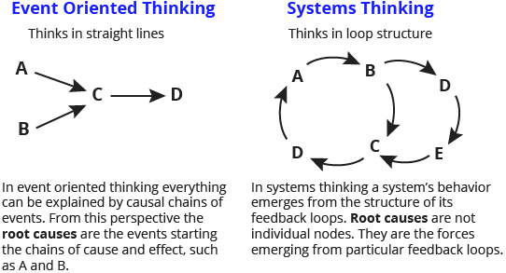
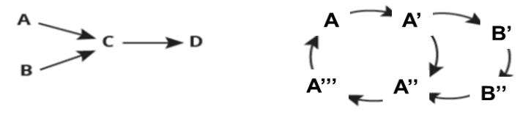
Systems Perspective
www.thwink.org/sustain/glossary/EventOrientedThinking.htm

Slide 28

Pest management example
Conventional response to crop pest is spraying pesticide designed to kill that insect. Imagine a perfect pesticide that kills all target insects and which has no side effects on air, water, or soil.
Is using this pesticide likely to make the farmer better off?
Representing the thinking used by those applying the pesticides would look like this:
Unfortunately, often crop damage gets worse in following years and the pesticide that seemed so effective does not help.

Slide 29
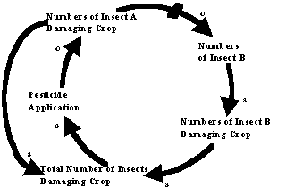
Unfortunately, often crop damage gets worse in following years and the pesticide that seemed so effective does not help.
the indirect effects cascade trough the ecosystem; the pest was controlling another insect population, either by predation or competition. The effective pesticide eliminates the control that those insects were applying on the population of the other insects. Then non-target insect populations explode and cause more damage than the insects killed by the pesticide.

Slide 30
In other words, the action intended to solve the problem actually makes it worse because unintended side effects change the system & end up exacerbating the problem.

Slide 31
Unintended consequences
Acid precipitation/rain
Ozone depletion
Eutrophication
Global climate change
Automobile dependency
…
All of today’s major environmental problems emerge from yesterday’s solutions.

Slide 32
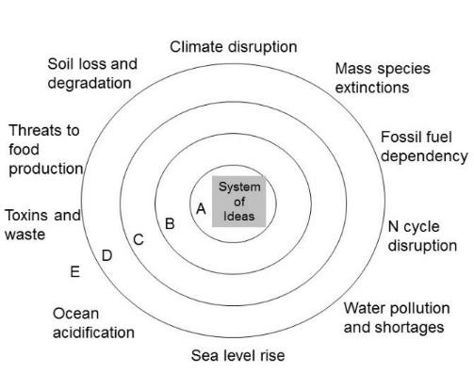
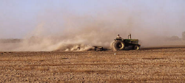
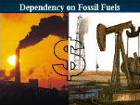
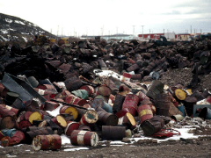
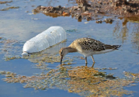
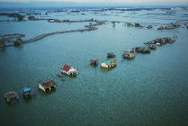
Environmental challenges are symptoms of deeper problems
Soil erosion
Toxins and waste
Automobile dependency
Water pollution
Sea level rise

Slide 33
What is life?
One of the core flawed paradigms is the separation between system and environment, or between life and its environment

Slide 34
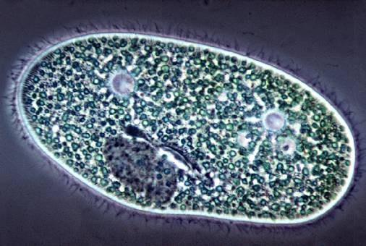
Discrete Life
A single organism that possesses all necessary aspects to be alive

Slide 35


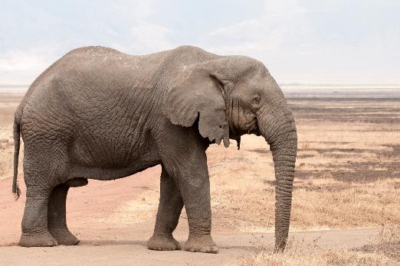
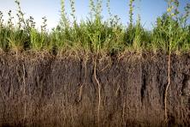
Abiotic and ecological interactions
Discrete Life
A single organism possesses all the necessary aspects to be alive

Slide 36
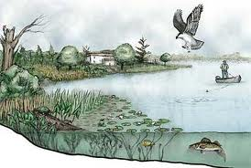
Interacting ecological community and its non-living environment is an ecosystem
Sustained Life
An ecosystem possesses all the necessary aspects to sustain life

Slide 37
Recursive nature of nature
Life and environment are best understood and modeled as unified as a single “life–environment” system.
“Discrete life” and “sustained life” are dual models that must always be used in concert in both thought and action
A hyperset equation explicitly and formally prohibits fragmentation of life from environment
life–environment =
{environment{ecosystems{organisms{environment}}}}

Slide 38
RECENT BOOK
Foundations for Sustainability is an important synthesis that points the way, along a long and rocky road, to an ultimate solution of humanity’s environmental problem. -- Edward O. Wilson, Emeritus professor, Harvard University
www.elsevier.com/books/foundations-for-sustainability/fiscus/978-0-12-811460-5

Slide 39
Human Ecology summary
Humans are part of the biosphere;
We are living organisms like other animals in many respects, but
  we have an advanced social organization, and
  the ability to extract and use energy and resources that characterizes us and our impacts on the planet.
That does not make us independent from the environment though

Slide 40
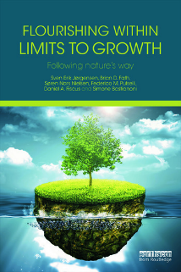
Flourishing within limits to growth
Recognize physical, planetary boundaries and capacities
Understand sustainable system design and function
Act accordingly, in all things, at all times, as part of a routine with nature

