Slide 1
External contacts
EU structures
ICMM
EU and dipl. community in Mali
Military partners
Project management partners
Media
NGOs

Slide 2
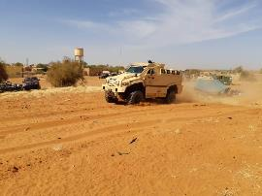
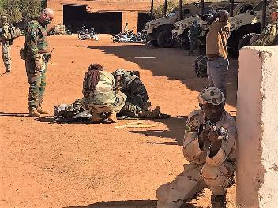
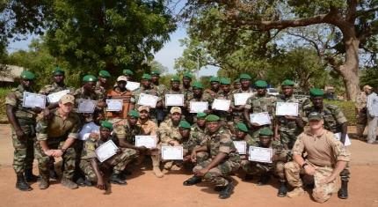
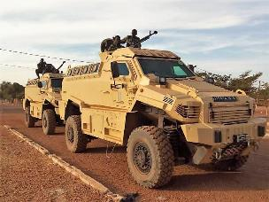
Operational task
Advice
Educate
Train
G5S JF
Non-executive mission
2 1 letadlo

Slide 3
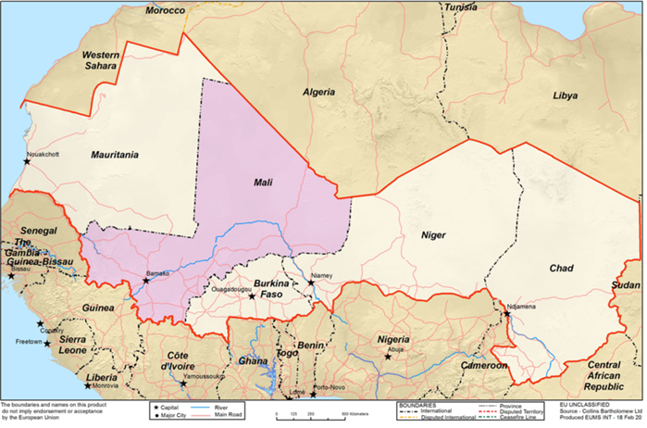
Area of Operation
1800 Km
4250 Km
Mandate 4

