Slide 1
Party System of the New Millenium
Jakub Jusko
03/29/2020

Slide 2
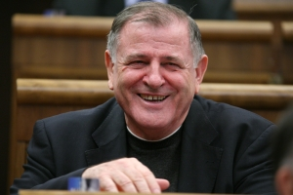
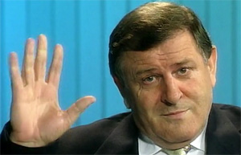
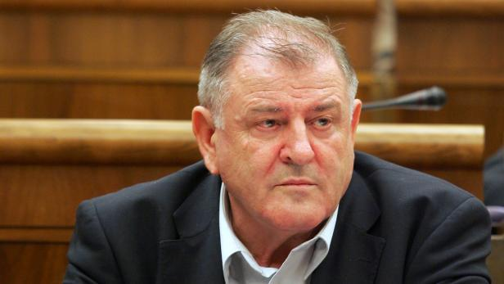
The fate of Mečiar

Slide 3
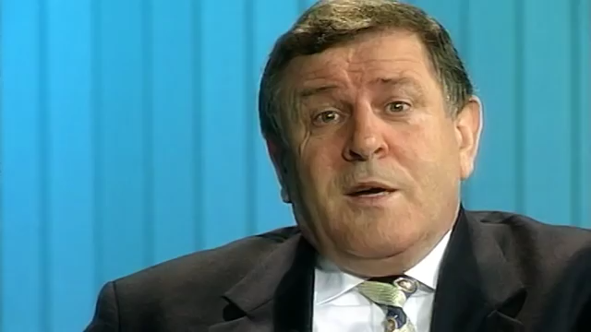

Slide 4
Party system in 1998
Huge polarization of the party system
Parties divided into two blocs:
  Governmental parties (HZDS, SNS, ZRS)
  Opposition (centre right SDK, leftist SDL, Hungarian SMK, new, leftist and populist SOP)

Slide 5
Elections 1998
Party | Votes (in %) | Seats
HZDS | 27 | 43
SDK | 26,33 | 42
SDL | 14,66 | 23
SMK | 9,12 | 15
SNS | 9,07 | 14
SOP | 8,01 | 13
ZRS | 1,3 | 0
Others | 5,81 | 0
 |  | 150

Slide 6
Governments after 1998
Years | Prime Minister | Members | Ideology
1998 – 2002 | Dzurinda I | SDK, SDL, SMK, SOP (4) | From left to right
2002 – 2006 | Dzurinda II | SDKU, SMK, KDH, ANO (4) | Right
2006 – 2010 | Fico I | SMER, SNS, HZDS (3) | From left to right
2010 – 2012 | Radičová | SDKU, SaS, Most, KDH (4) | Right
2012 – 2016 | Fico II | SMER (1) | Left
2016 - 2020 | Fico III / Pellegrini | SMER, SNS, Most (3) | From left to right

Slide 7
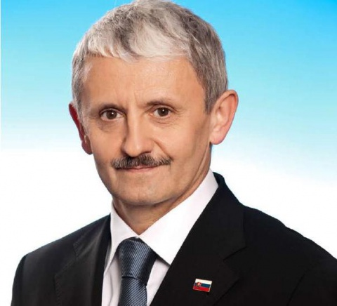
Government 1998 - 2002
Prime Minister – Mikuláš Dzurinda
High number of members – 4 vs. 10
Main task – to restore the country after Mečiar’s era:
  Return to liberal democratic regime
  Retrieval of the Slovakia’s international image
  Economic reforms, salvation of banks

Slide 8
Low stability of governmental parties
Affected all parties except the Hungarians (SMK)
Centre-right alliance SDK:
  2000 – Dzurinda establishes Slovak Democratic and Christian Union (SDKU)
  Only Christian Democrats (KDH) survived
Collapse of the left (SDL, SOP):
  Negatively affected by the unpopular economic policy
  SOP leader Schuster elected for president in 1999
  SDL leading figure Fico left his party and establishes a new one

Slide 9


Opposition
Maintained several changes
HZDS:
  Hard adaptation on oppositional role
  Non-constructive opposition work
  Stabilization after return of Mečiar to active politics
SNS:
  Post-electoral destabilization
  Division into 2 parties and interim marginalization

Slide 10


Opposition – new parties
Smer (Direction), 1999:
  Created by ex-SDL official Robert Fico
  Refused the left-right division
  Project of the third way
  Strong populism, criticism of both eras – Mečiar’s and Dzurinda’s
Alliance of the New Citizen (ANO), 2001:
  Created by media magnate Pavol Rusko
  The Slovak „Berlusconi“
  Populism, centre-right liberal values

Slide 11
Perception of Prime Ministers (2001)
 | Both positive | Mečiar + Dzurinda - | Mečiar - Dzurinda + | Both negative | Do not know (at least one)
HZDS | 5,2 | 88,1 | 0 | 2,2 | 4,5
SNS | 1 | 57,3 | 6,3 | 20,8 | 14,6
KSS | 0 | 44,9 | 6,1 | 42,9 | 6,1
SDKU | 4 | 3 | 81,2 | 3 | 8,9
SMK | 1,4 | 2,1 | 59,3 | 20,7 | 16,4
KDH | 7,4 | 5,6 | 29,6 | 29,6 | 27,8
ANO | 0 | 15,3 | 20,8 | 55,6 | 8,3
SMER | 1,9 | 24,1 | 17,5 | 42,9 | 26,5
non-voters | 1,2 | 14,7 | 13,5 | 44,1 | 13,7
undecided | 1,5 | 14,2 | 16,1 | 38,7 | 29,5

Slide 12
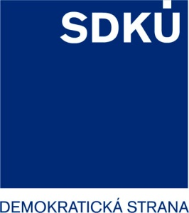
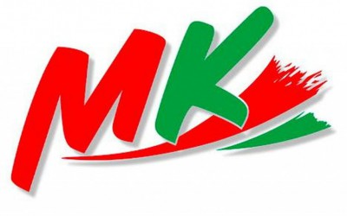

The „map“ of the party system in 2002

Slide 13
Election 2002 – the crisis of the left
Party | Votes (in %) | Seats
HZDS | 19,5 | 36
SDKU | 15,09 | 28
SMER | 13,46 | 25
SMK | 11,16 | 20
KDH | 8,25 | 15
ANO | 8,01 | 15
KSS | 6,32 | 11
SDL + SOP | 1,36 | 0
Others | 7,11 | 0
 |  | 150

Slide 14
Government 2002 - 2006
Dzurinda remained Prime Minister
No leftist parties
End of the integration process – EU, NATO (2004)
Unpopular economic reforms – taxes, healthcare, social system
Since 2003 a minority government

Slide 15
Restoration of the left (SMER)
Shift from populism to social democracy (SMER-SD)
2003-2004 – SMER absorbed smaller leftist parties
Strong criticism of governmental reforms
Huge rise of popularity

Slide 16
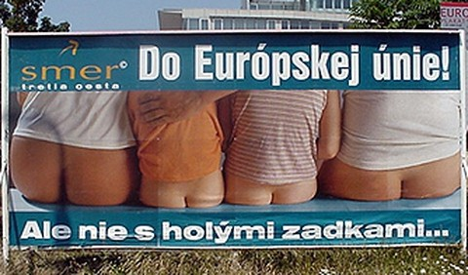
Into EU! But not with bare asses…

Slide 17
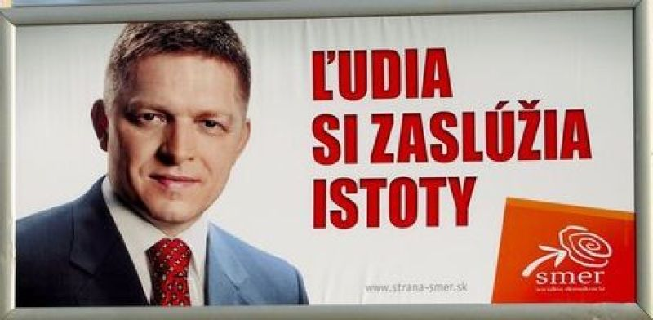
People deserve securities

Slide 19
 |  | 2002 | 2004 | 2006 | 2008 | 2010 | 2012
Gender | Men | 54.9 | 56.5 | 49.3 | 35.8 | 39.3 | 41.3
 | Women | 45.1 | 43.5 | 50.7 | 64.2 | 60.7 | 58.7
Age | 18 - 24 | 19.9 | 10 | 7.3 | 2.3 | 4.6 | 2.8
 | 25 - 34 | 25.7 | 24.3 | 20.3 | 8.4 | 8.2 | 8.8
 | 35 - 44 | 28.8 | 15 | 16.5 | 9.9 | 6.8 | 13.4
 | 45 - 59 | 19.9 | 32.1 | 32 | 32.4 | 35.1 | 30
 | 60 and more | 5.8 | 18.6 | 23.8 | 47 | 45.3 | 45
Education | Primary | 17.3 | 12.5 | 18.6 | 16.1 | 17.3 | 16.6
 | Lower secondary | 39.1 | 34 | 35.3 | 35.4 | 31.1 | 30.6
 | Higher secondary | 33.8 | 43.1 | 36.1 | 37.2 | 41.4 | 41.6
 | University | 9.8 | 10.4 | 10 | 11.2 | 10.1 | 11.2
Left-Right | Left | 31.1 | 42.9 | 46.6 | 62.5 | 64.6 | 58.4
 | Centre | 54.4 | 47.9 | 44.2 | 32.6 | 30.5 | 30.7
 | Right | 14.4 | 9.3 | 9.2 | 4.9 | 4.9 | 10.9
Income | Low | 34.5 | 31.6 | 17.8 |  | 19.9 | 35.6
 | Middle | 59.5 | 59.2 | 61.7 |  | 47.1 | 50
 | High | 5.9 | 9.2 | 20.4 |  | 33 | 14.4

Slide 20
Election 2006 – the new leader
Party | Votes (in %) | Seats
Smer | 29,14 | 50
SDKÚ | 18,35 | 31
SNS | 11,73 | 20
SMK | 11,68 | 20
HZDS | 8,79 | 15
KDH | 8,31 | 14
ANO | 1,42 | 0
Others | 12 | 0
 |  | 150

Slide 21
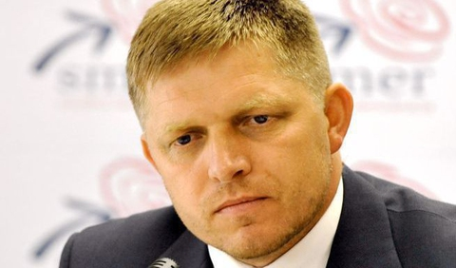
Government 2006
Prime Minister – Robert Fico
Return to ideological heterogeneity:
  Smer - social democrats
  SNS - radical right
  HZDS – vague
Analogies with Mečiar’s government 1994-98:
  Total dominance of the strongest party
  Numerous scandals, problematic style of politics
  Prime Minister as a dividing line in the party system

Slide 22
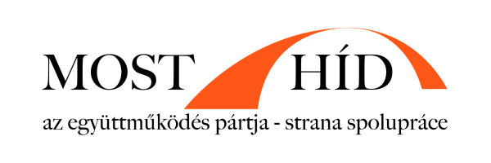

Changes in the centre-right after 2006
Most-Híd (The Bridge):
  Created by former leader of SMK Béla Bugár
  Project of Hungarian and Slovak cooperation
  Replaced the position of SMK
Freedom and Solidarity (SaS):
  Created by enterpreneur Richard Sulík
  Liberal, libertarian and postmaterialistic
Together with SDKU and KDH these parties declared not to cooperate with SMER after elections 2010 → sign of polarization

Slide 23

For future generations!

Slide 24
The „map“ of the party system in 2010

Slide 25
The „map“ of the party system in 2010

Slide 26
Election 2010 – HZDS is out
Party | Votes (in %) | Seats
Smer | 34,79 | 62
SDKÚ | 15,42 | 28
SaS | 12,14 | 22
KDH | 8,52 | 15
Most-Híd | 8,12 | 14
SNS | 5,07 | 9
HZDS | 4,32 | 0
Others | 11,62 | 0
 |  | 150

Slide 27
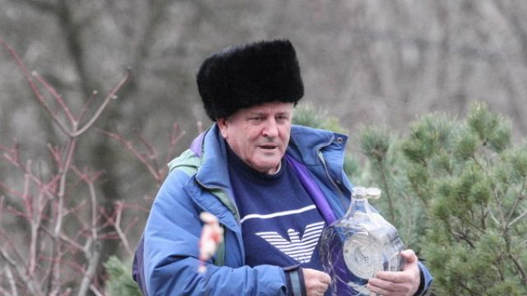

Slide 28
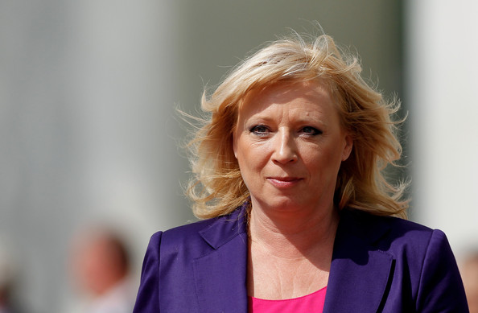
Government 2010-2012
Prime Minister – Iveta Radičová
Members – SDKU, SaS, Most-Hid, KDH
2011 – the EFSF vote:
  SaS refusal to vote for the rescue mechanism
  EFSF vote joined with the vote of confidence → end of the government
→ Collapse of the right

Slide 29
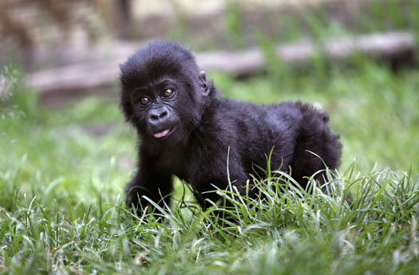

Before elections 2012
Frustration of centre-right voters
The Gorilla case:
  Revealed strong corrupt ties between politics and financial groups
  Biggest negative impact on SDKU
Ordinary People and Independent Personalities (OLaNO):
  Populist „party“, four members
  Forum for independent candidates
  Vast criticism of existing parties and corruption

Slide 30
Election 2012 – A one man show
Party | Votes (in %) | Seats
Smer | 44,41 | 83
KDH | 8,82 | 16
OLaNO | 8,55 | 16
Most-Híd | 6,89 | 13
SDKU | 6,09 | 11
SaS | 5,88 | 11
Others | 19,36 | 0
 |  | 150

Slide 31
Government 2012-16
A one party government
Prime Minister – Robert Fico
No coalition partners → full responsibility
Social democracy with far right appeals

Slide 32
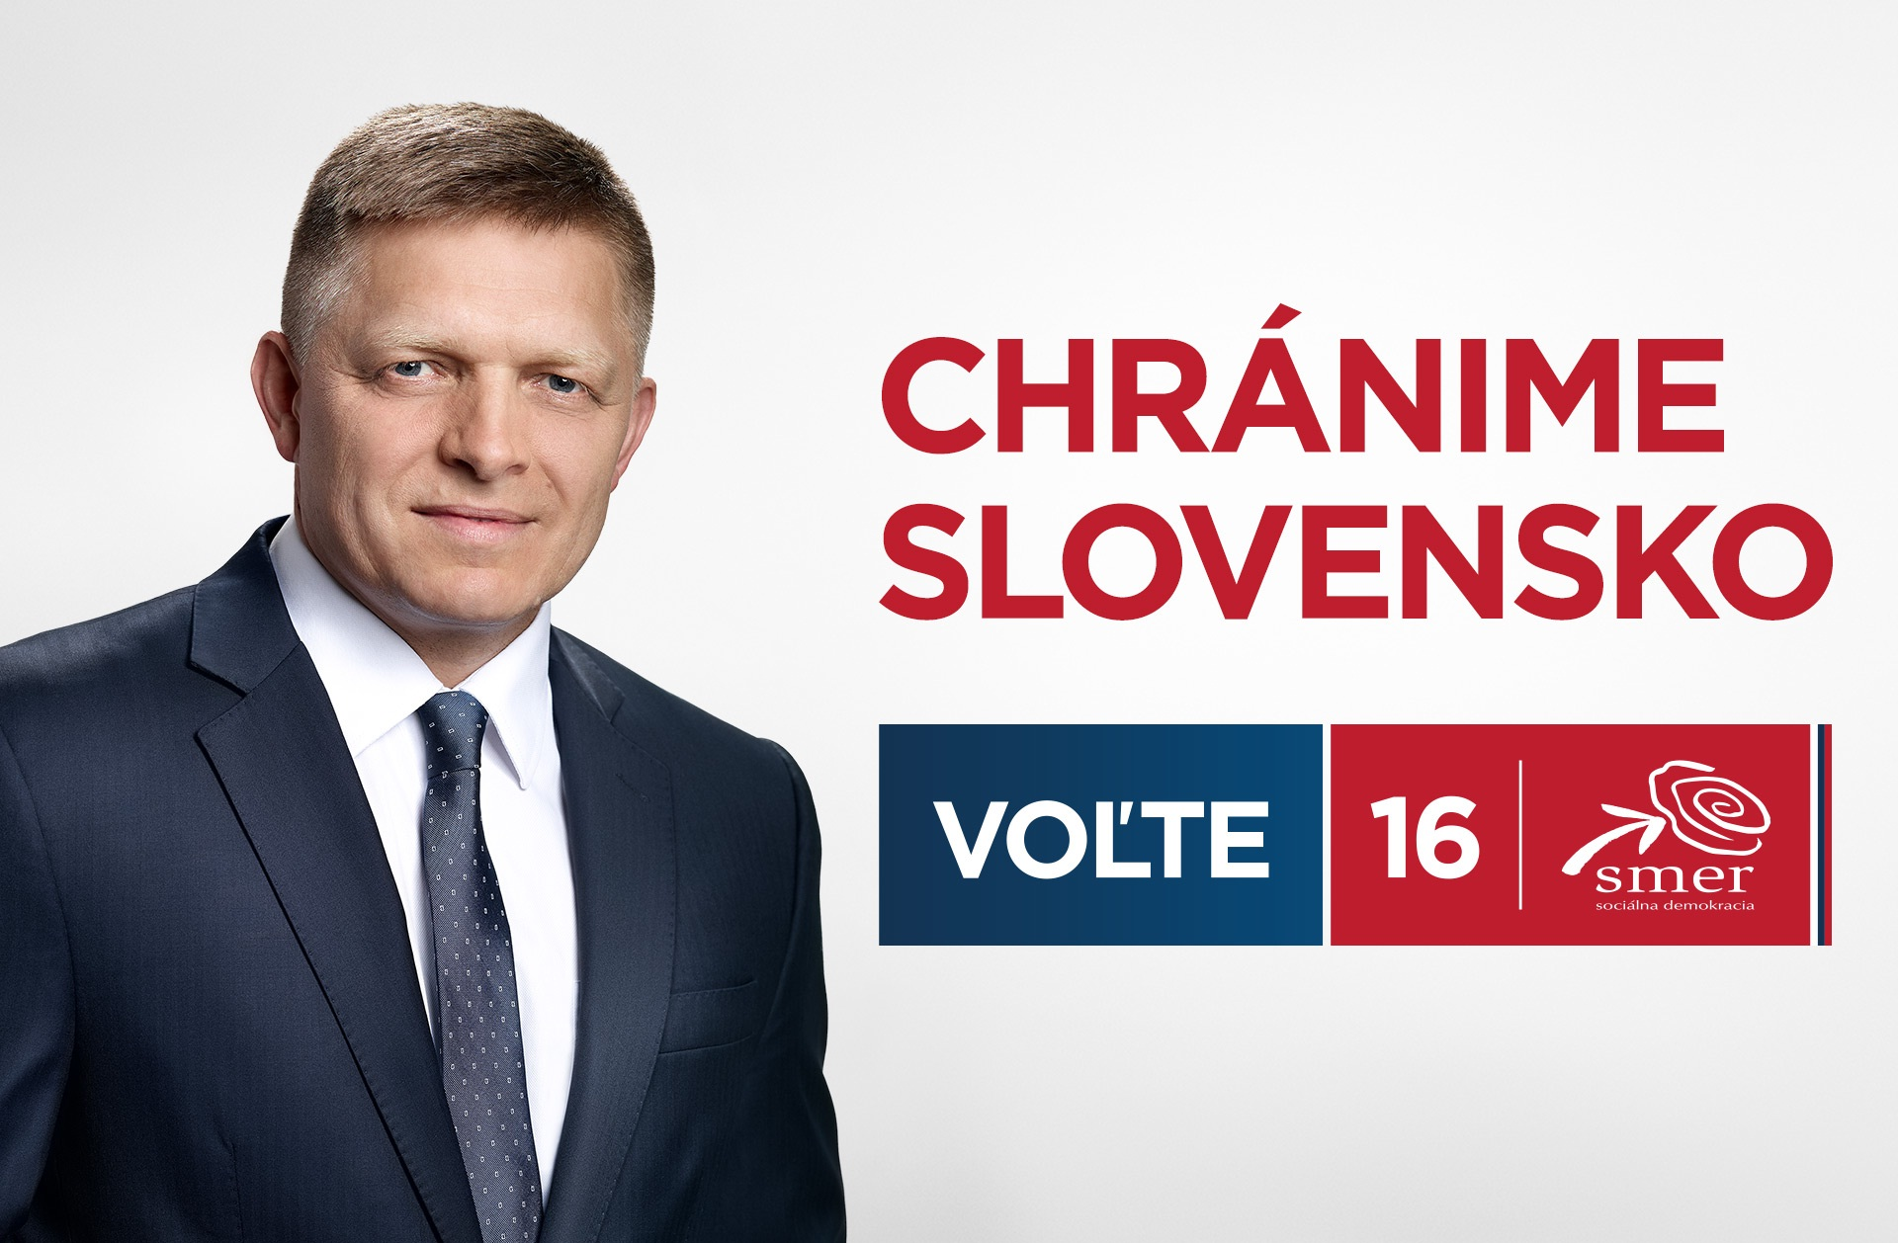

Slide 33
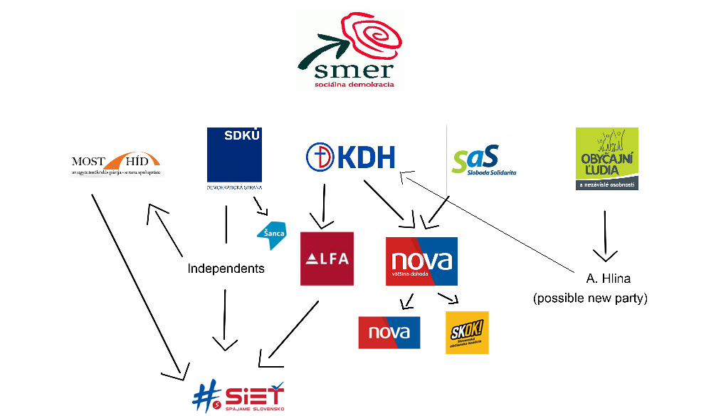
Not enough chaos? (2015)
Shift from populism to social democracy (SMER-SD)
2003-2004 – SMER absorbed smaller leftist parties
Strong criticism of governmental reforms
Huge rise of popularity

Slide 34
Election 2016 – Earthquake
Party | Votes (in %) | Votes vs. 2012 | Seats
Smer | 28,3 | - 16,1 | 49
SaS | 12,1 | + 6,2 | 21
OLaNO | 11,0 | + 2,5 | 19
SNS | 8,6 | + 4,1 | 15
LSNS | 8,0 | + 6,5 | 14
We are Family | 6,6 |  | 11
Most-Hid | 6,5 | - 0,4 | 11
#SIET | 5,6 |  | 10
 |  |  | 150

Slide 35
Election 2016
Huge decline of SMER
Disappointment for #SIET
New protest parties in parliament:
  We are Family – populist
  LSNS – extreme right
New government – SMER, nationalist SNS and Hungarian Most

Slide 36
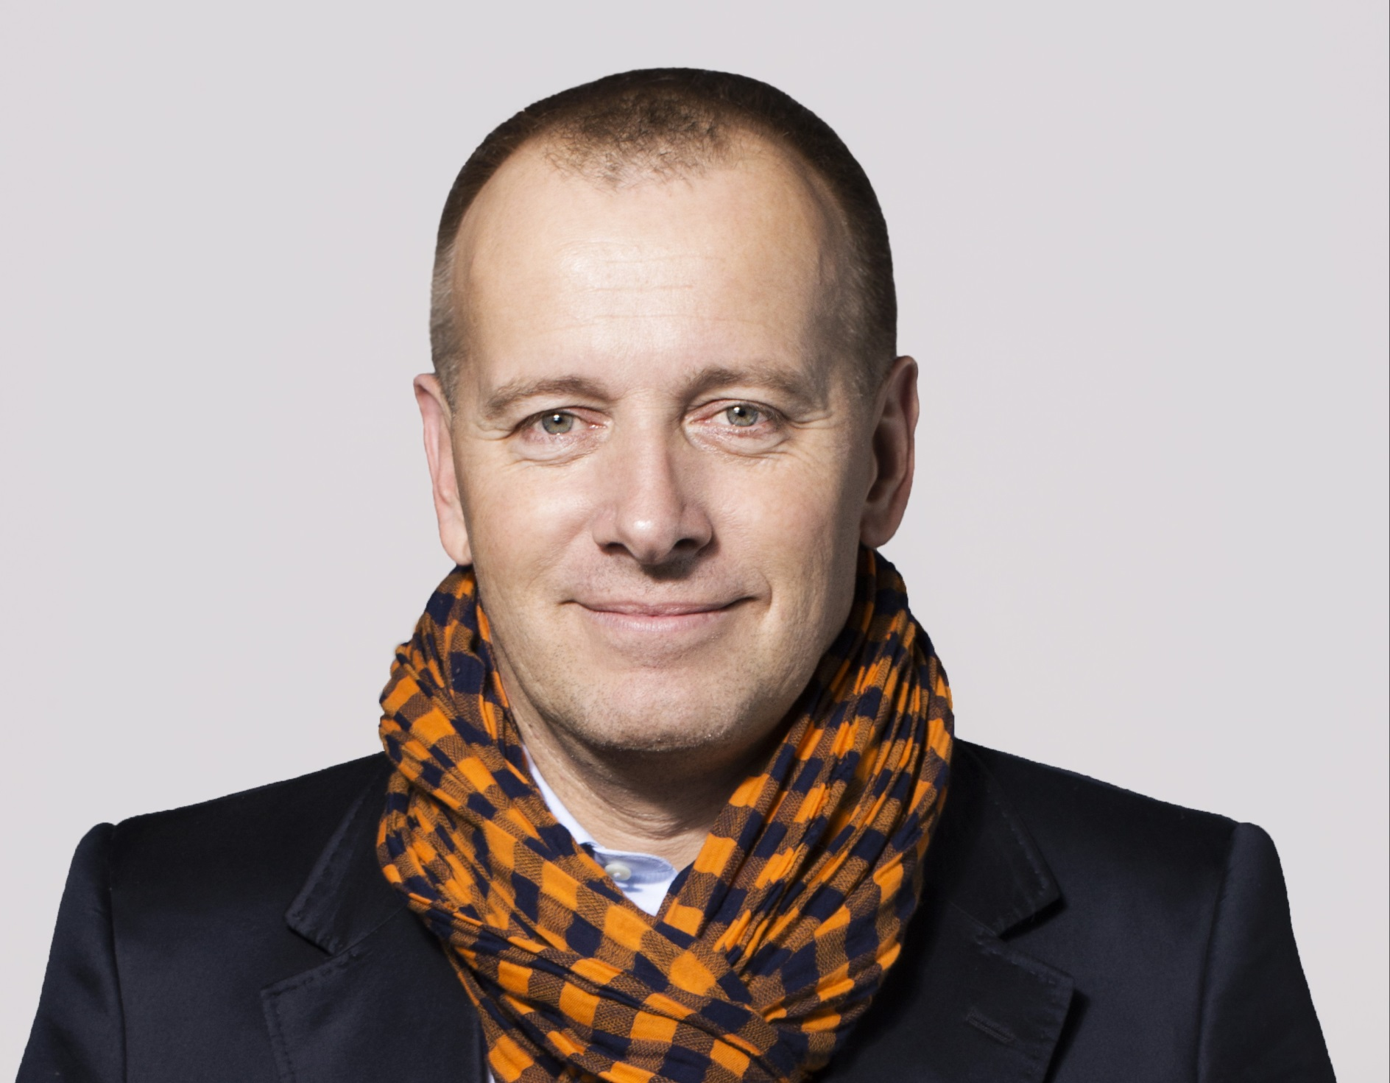

Slide 37
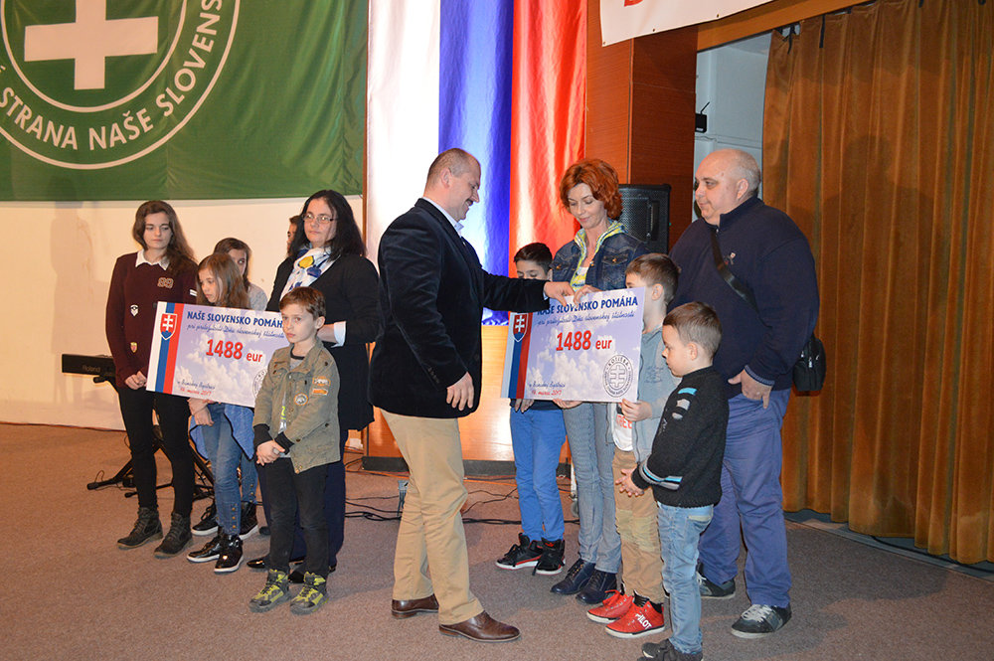

Slide 38
Governments after 1998
Years | Prime Minister | Members | Ideology
1998 – 2002 | Dzurinda I | SDK, SDL, SMK, SOP (4) | From left to right
2002 – 2006 | Dzurinda II | SDKU, SMK, KDH, ANO (4) | Right
2006 – 2010 | Fico I | SMER, SNS, HZDS (3) | From left to right
2010 – 2012 | Radičová | SDKU, SaS, Most, KDH (4) | Right
2012 – 2016 | Fico II | SMER (1) | Left
2016 - 2020 | Fico III / Pellegrini | SMER, SNS, Most (3) | From left to right

Slide 39
Governments after 1998
Years | Prime Minister | Consequences
1998 – 2002 | Dzurinda I | Collapse of the left
2002 – 2006 | Dzurinda II | Restoration of the left
2006 – 2010 | Fico I | New dividing line in party system
2010 – 2012 | Radičová | Crisis of the right
2012 – 2016 | Fico II | Political earthquake
2016 - 2020 | Fico III / Pellegrini | See lecture on 2020 election

