Slide 1
Youth and online risks
Dr. Hana Macháčková

Slide 2
Risks online
The question of online risks salient from many perspectives:
  Research, policy, prevention and intervention efforts
What types of risks you know?

Slide 3
Online risks
Important – differentiation of risk and harm
Risk – probability to encounter something negative
Harm – actual (long- and short- term) harm from the experience
What does it say about the nature of the incident?
Important – taking into account individual and social factors
  And other factors (EST)

Slide 4
Online risks – individual factors
Risk – who is prone to encounter more risks?
  Inevitably connected with higher internet use
  Personal traits – e.g., sensation seeking
Who is capable to efficiently deal with the risk - on the level of the prevention and coping?
  vulnerability, resilience and coping styles
  „new factor“ - digital skills

Slide 5
Online risks – social factors
Social environment affects the individual factors + the predictors of risks + the outcomes of the incident (harm)
Example – quality of family relationships

Slide 6
Online risks – other factors
School/community
  Social environment and its affordances
Cultural/country level
  Policies + legal system
  Intervention programs + education

Slide 7
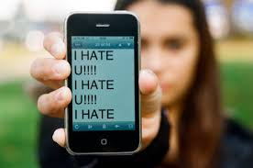
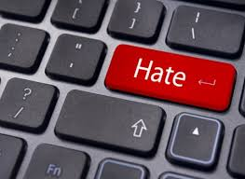

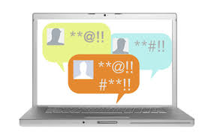
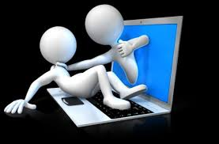
Selected risk: Aggression online
Seemingly ubiquitous
Everyday experience?
  Discussions: increased hostility, prejudices,
  intolerance, aggressivity…

Slide 8
Aggression online
In the form of direct interpersonal attacks
  E.g. discussions on SNS
In the form of shared information and materials
  On a specific websites
Often both
  E.g., comments below the articles

Slide 9
Aggression
Broad and complex term
Aggression is….“any form of behavior directed toward the goal of harming or injuring another living being who is motivated to avoid such treatment“ (Baron & Richardson, 2004, p.7)
It can take many forms:
Direct/nondirect
Verbal/physical/sexual….
Interpersonal/intergoup
Etc.
Online/offline

Slide 10
Aggression
Broad and complex term
Aggression is….“any form of behavior directed toward the goal of harming or injuring another living being who is motivated to avoid such treatment“ (Baron & Richardson, 2004, p.7)
It can take many forms:
Direct/nondirect
Verbal/physical/sexual….
Interpersonal/intergoup
Etc.
Online / offline
Need to specify type of aggression we are talking about

Slide 11
Aggression online
Various types
  Mirroring offline ones
  Cyberbullying, online harassment, cyberhate, cybercrime, cyberterrorism…

Slide 12
Aggression online
Various types
  Mirroring offline ones
  Cyberbullying, online harassment, cyberhate, cybercrime, cyberterrorism…
We will focus on cyberbullying among youth

Slide 13
Aggression online
Various types
  Mirroring offline ones?
  Cyberbullying, online harassment, cyberhate, cybercrime, cyberterrorism…
Interconnection with offline life
  Extension, augmentation, blending…
Cyberspace: Important aspect of everyday life
  „virtual“ but „real“
Cyberspace: specific social environment

Slide 14

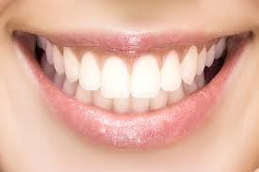
Differences from offline environment(s)
Computer-mediated communication (CMC)
  Text, visuality, hypertexts
  A/synchronic communication
  Absence of many cues
    Currently, more rich (emoticons, audio-visual cues etc.)
    „say it with gif“, memes
LOL

Slide 15
Differences from offline environment(s)
Control of self-expressions
Asynchronous communication
Visuals (graphs), hyperlinks
No others clues (gestures, posture, voice, speach)
  The lack of cues as a source of misunderstandings
  BUT, they may pose a barrier in communication offline
  Distance, anonymity, invisibility….
Storing, sharing, spreading
  Materials and information
24/7 accessibility
  countries with high internet penetration
  Digital divide

Slide 16
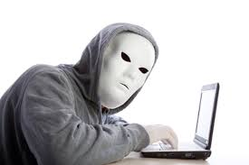
Online disinhibition effect (Suler, 2004)
Anonymity, invisibility, asynchronicity, solipstic introjection, dissociative imagination, minimization of status and authority
Toxic and benign
  hostillity x self-disclosure and support
Developed before web2.0
Anonymity???

Slide 17
Online disinhibition effect (Suler, 2004)
Anonymity, invisibility, asynchronicity, solipstic introjection, dissociative imagination, minimization of status and authority
Toxic and benign
  hostillity x self-disclosure and support
Developed before web2.0
Anonymity???
Still applicable
Social vs.
technical

Slide 18
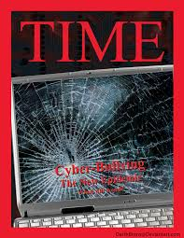
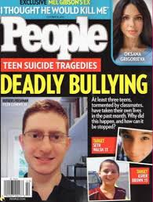
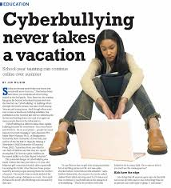
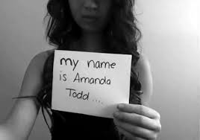
Cyberbullying and online aggression (harassment)
Cyberbullying: do you know the term?
Highly medialized
Contrast with empirical evidence

Slide 19
Cyberbullying and online aggression (harassment)
Cyberbullying: do you know the term?
Highly medialized
Contrast with empirical evidence
Kowalski et al. (2014): 10% - 40%
Also 3% - 70%

Slide 20
Cyberbullying and online aggression (harassment)
Definition of school bullying (Olweus, 1991) – criteria of
1) Intentional, causing harm
2) Repetitive
3) Power imbalance
Also many forms:
Overt/covert
Relational/Social/Physical
Physical/verbal attacks, degradation/humiliation, blackmailing, destroying things, social exclusion, ignoring…

Slide 21
Cyberbullying and online aggression (harassment)
Cyberbullying: intentional and aggressive act carried out through electronic media, which may be repetitive in nature (Nocentini et al., 2010; Tokunaga, 2010)
What are the forms here?
Verbal attacks, insults, threats, gossips…
Spreading of personal and sensitive information
  Without consent
Identity theft, mascarade
Social exclusion, ostracism
Publishing of harmful audiovisual material (changed)
Happy slapping
...

Slide 22
Cyberbullying and online aggression (harassment)
We are talking about cyberbullying if the aggressive attacks :
are conducted via internet or mobile phones
are intentionally harmful (conducted by individual or group)
  and are harmful for victim
are repeated (however….)
there is power imbalance – the victims can‘t easily defend themselves

Slide 23
Cyberbullying and online aggression (harassment)
We are talking about cyberbullying if the aggressive attacks :
are conducted via internet or mobile phones
are intentionally harmful (conducted by individual or group)
  and are harmful for victim
are repeated (however….)
there is power imbalance – the victims can‘t easily defend themselves
Harm is not always present!
Difficulties of harm assessment

Slide 24
Cyberbullying and online aggression (harassment)
We are talking about cyberbullying if the aggressive attacks :
are conducted via internet or mobile phones
are intentionally harmful (conducted by individual or group)
  and are harmful for victim
are repeated (however….)
there is power imbalance – the victims can‘t easily defend themselves
Repetition: problematic online
„once published, always online“
Important in messaging (email, phones…)

Slide 25
Cyberbullying and online aggression (harassment)
We are talking about cyberbullying if the aggressive attacks :
are conducted via internet or mobile phones
are intentionally harmful (conducted by individual or group)
  and are harmful for victim
are repeated (however….)
there is power imbalance – the victims can‘t easily defend themselves
Digital skills?
Always online
Aggressors‘ anonymity (not so common)

Slide 26
Cyberbullying and online aggression (harassment)
We are talking about cyberbullying if the aggressive attacks :
are conducted via internet or mobile phones
are intentionally harmful (conducted by individual or group)
  and are harmful for victim
are repeated (however….)
there is power imbalance – the victims can‘t easily defend themselves
If these criteria are not fullfilled:
online aggression/harassment

Slide 27
Cyberbullying and online aggression (harassment)
„New bottle, old wine“?
What is „new“?
No time/space limits – no escape
Distance – the victim does not have to be present (adding comments, likes, spreading of information….)
Wide audience - potential
Spreading and sharing – easy and fast, unlimited
No control over the content
Can be „hidden“ – out of control of adults

Slide 28
Cyberbullying and online aggression (harassment)
„New bottle, old wine“?
What is „new“?
Victims – offline often vulnerable
In cyberbullying: potential for new vulnerability
Remember „diminishing of authority“, anonymity?
More often: frequent internet users, users of webcams and IM

Slide 29
Cyberbullying and online aggression (harassment)
Cyberbullying: detrimental effect on victims
  Similar to offline bullying
  Including:
  Internalization and externalizing behaviors
  Emotional problems (depression, anxiety, suicidal thougths)
  Social problems
  Lower self-esteem
  Helplessness
  Academic problems
  Etc.

Slide 30
Cyberbullying and online aggression (harassment)
The impact depends on the severity of the attacks
- important to distinguish cyberbullying and harassment!
CB could be more harmful then offline
  Especially cases of public forms, and especially including audiovisual materials (Sticca & Perren, 2013)
Depends on the interconnection with offline bullying
- usually connected („double whammies“)
Also depends on coping with cyberbullying

Slide 31
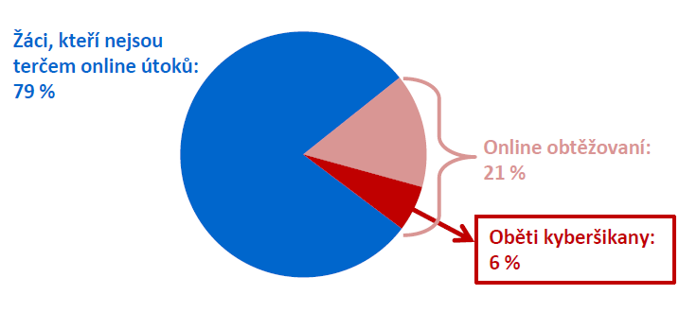
Cyberbullying and online aggression (harassment)
The impact depends on the severity of the attacks
- important to distinguish cyberbullying and harassment!
Could be more harmful then offline
  Especially cases of public forms, and especially including audiovisual materials (Sticca & Perren, 2013)
Differences in prevalences and impact
Cyberbullying: less common, but more severe
Czech project: 79% no victimization
21% harassment
http://irtis.fss.muni.cz/wp-content/uploads/2013/06/COST_CZ_report_II_CJ.pdf
6% CB victims

Slide 32
Cyberbullying and online aggression (harassment)
The impact depends on the severity of the attacks
- important to distinguish cyberbullying and harassment!
Could be more harmful then offline
  Especially cases of public forms, and especially including audiovisual materials (Sticca & Perren, 2013)
Depends on the interconnection with offline bullying
- usually connected („double whammies“)
Also depends on coping with cyberbullying

Slide 33
Cyberbullying and online aggression (harassment)
Coping with cyberbullying
Many different strategies
Emotion/problem focused
Mal/adaptive?
Similar to offline responses
new – „technological coping“
Question of effectiveneess in coping with online attacks

Slide 34
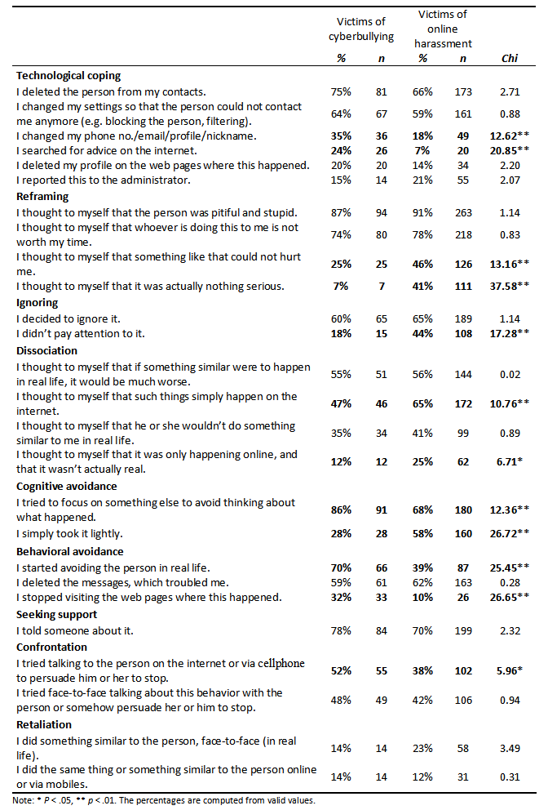
Strategies applied
CB victims more active
Cognitive strategies:
- reframing to depreciate the bully and avoided or purposefully ignored them
cognitive distancing
not much disociation
Technological coping – not so frequent
Machackova, H., Cerna, A., Sevcikova, A., Dedkova, L., & Daneback, K. (2013). Effectiveness of coping strategies for victims of cyberbullying. Cyberpsychology: Journal of Psychosocial Research on Cyberspace, 7(3), article 5. doi: 10.5817/CP2013-3-5

Slide 35
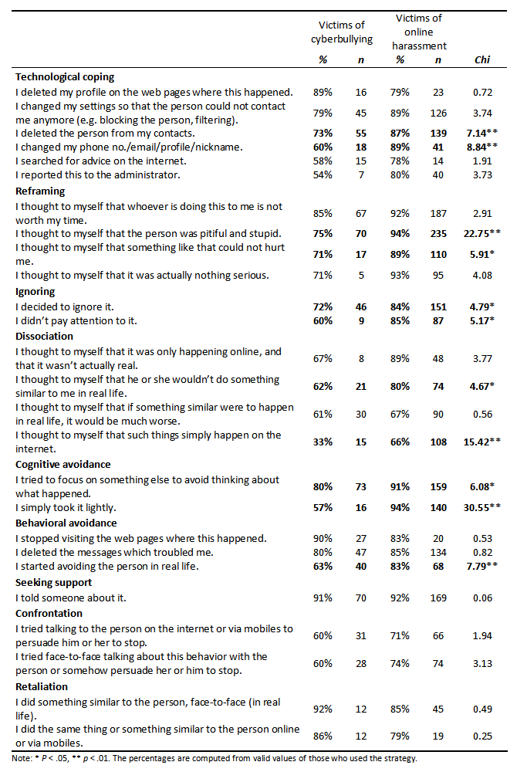
Strategies helping emotionally
- generally, less often effective among CB victims
- effective cognitive strategies
not all, exceptions: „taking it lightly“ it „happens online“

Slide 36
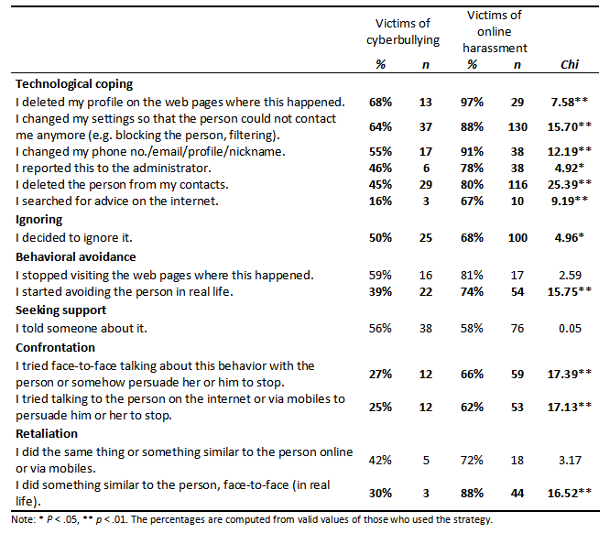
Strategies helping stop the attacks:
- technological coping
- but not all (and often not applied)
Ignoring
Confrontation or retaliation not very effective

Slide 37
Cyberbullying and online aggression (harassment)
Outcome also depends on the context
Including responses of others – the audience
Bystanders in cyberbullying
much more common than victimization
Czech project: 53%

Slide 38
Audience in aggressive events
What is your experience with online aggression?
How did/would you react?

Slide 39
Cyberbullying and online aggression (harassment)
What can they do? (online and offline)
Support the victim: emotionaly, advice provision, confrontation of aggressor…
Reinforce the bully: joining in, reposts, sharing, likes, comments…
Passivity: most common
Helpful:
decreases impact, can stop the attacks, help to cope

Slide 40
Cyberbullying and online aggression (harassment)
What can they do? (online and offline)
Support the victim: emotionaly, advice provision, confrontation of aggressor…
Reinforce the bully: joining in, reposts, sharing, likes, comments…
Passivity: most common
Increases the impact, especially when wide audience, causes of repetiveness…

Slide 41
Cyberbullying and online aggression (harassment)
What can they do? (online and offline)
Support the victim: emotionaly, advice provision, confrontation of aggressor…
Reinforce the bully: joining in, reposts, sharing, likes, comments…
Passivity: most common
Harmless? No
Increases impact, may be interpreted as silent approval by both victim and aggressor
Metadata: visits, views…

Slide 42

Cyberbullying and online aggression (harassment)
Who helps victim?
Empathy, prosocial behavior, norms, relationship with the victim…
Who reinforces bully?
Low empathy, aggressive beliefs, relationship with aggressor…
Who stays passive???
Despite common antibullying norms

Slide 43
Cyberbullying and online aggression (harassment)
What is „new“? – Context
Specific communication and environment
Distance
Lack of cues
Wide audience

Slide 44
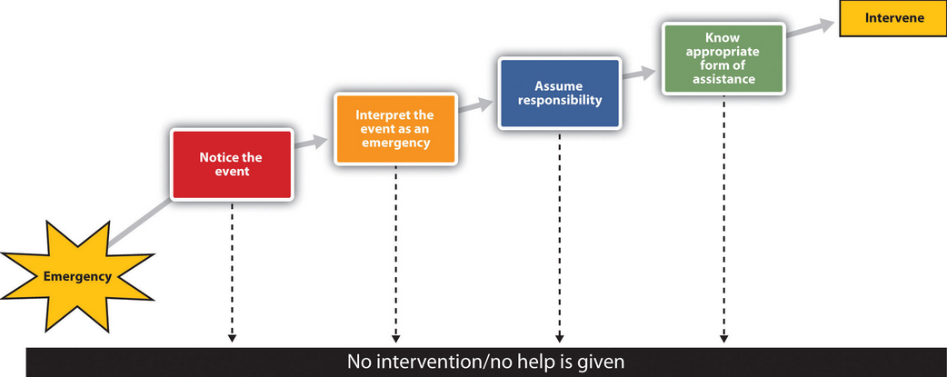
Cyberbullying and online aggression (harassment)
Latané & Darley (1970)

Slide 45
Cyberbullying and online aggression (harassment)
Attention and distractions

Slide 46
Cyberbullying and online aggression (harassment)
Complicated assessment, „just a joke“, not serious

Slide 47
Cyberbullying and online aggression (harassment)
Wide audience, who (where) is victim, ongoing event?

Slide 48
Cyberbullying and online aggression (harassment)
Assessment, self-efficacy, own victimization, aggravation of problem?

