Slide 1
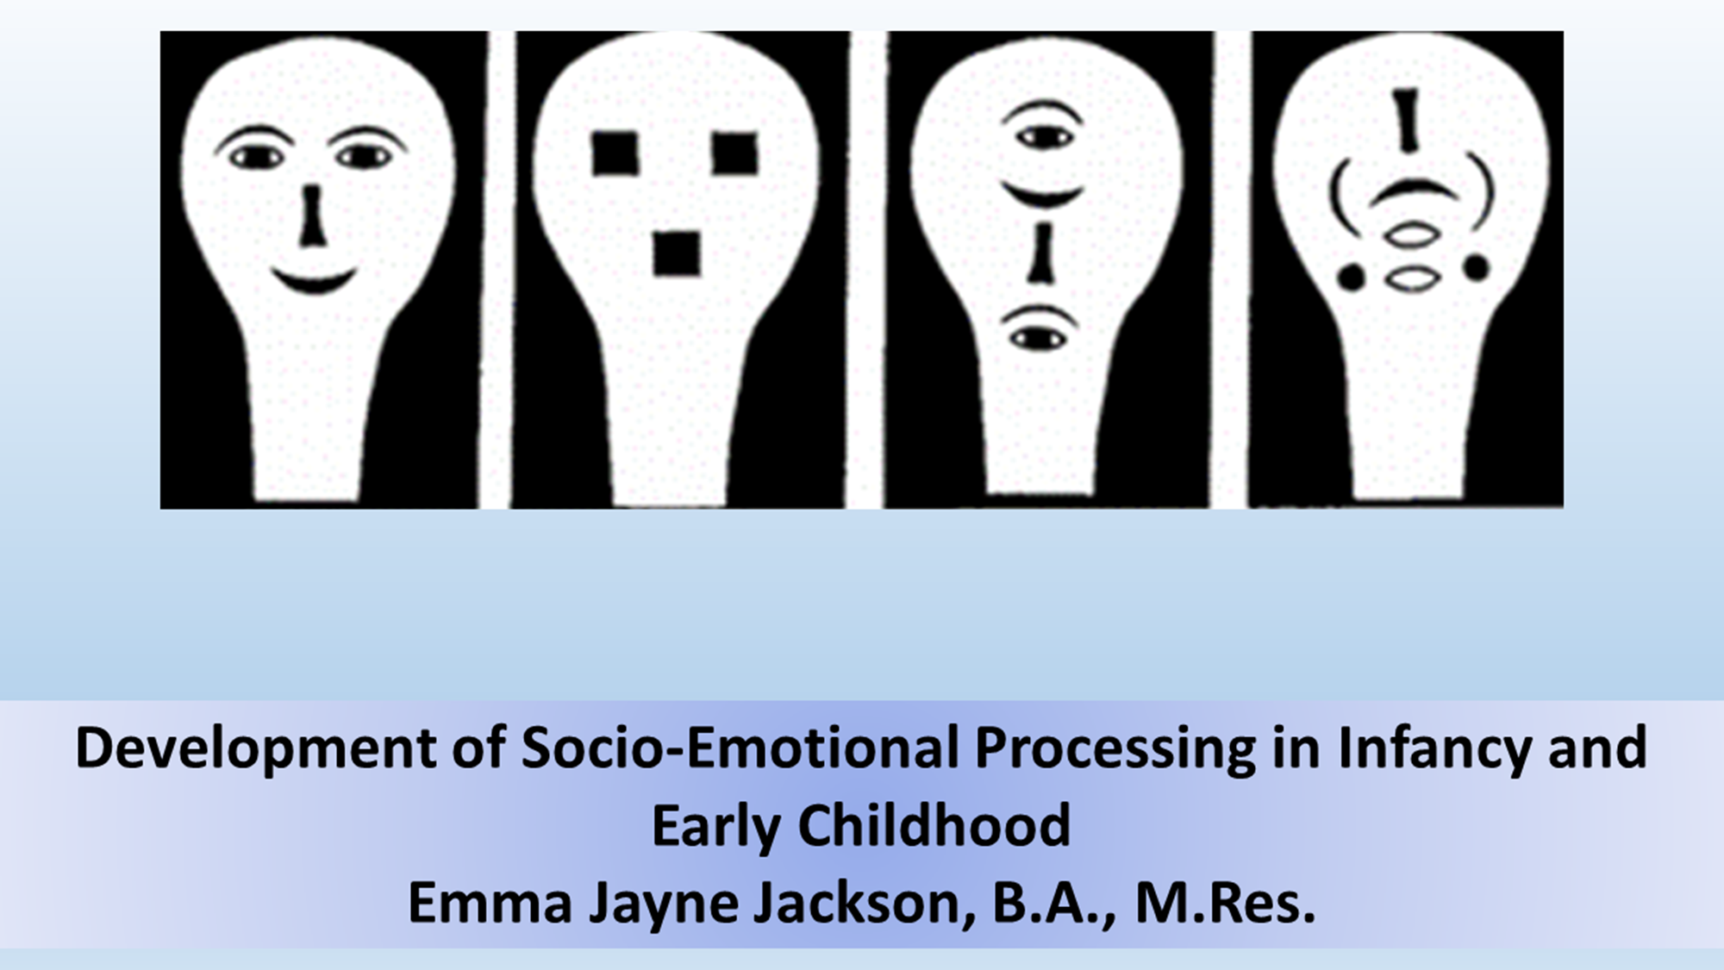

Slide 2
Workshop 1: Why and How We Study Socio-Emotional Processing Development
Aims for today:
• We will address the question of why it is useful to study socio-emotional skills, especially emotional expression processing
• We will discuss why it is important to understand the developmental trajectory of these skills.
• We will discuss methods for studying these processes (behavioural and physiological) in infants and young children.
• We will introduce the basics of EEG and how to understand the results.
• We will discuss which EEG and ERP components are relevant to the literature here.
• We will have group discussions centred around designing a study

Slide 3
Why do we Study Socio-Emotional Skills?
This might seem like a strange question, but with the resources and time poured into researching socio-emotional skills, it’s an important one!
Generally speaking, the answer can be broken down into socio-emotional processing being both “important” and “special”

Slide 4
Socio-Emotional Skills are Important
As compared to other species, our social and emotional worlds are rich, and an understanding of them is essential for normal functioning within societies and social groups.
Deficits in subdomains of these skills have been observed as central in disorders from Autism Spectrum Disorder (Lombardo et al., 2007) through to antisocial personality disorder (Marsden et al., 2019)
Deficits have also been observed in disorders that would not be traditionally be classified as social, such as schizophrenia (Derntl et al., 2009).
Difficulties in these skills can have a broad-reaching and profound impact on everyday functioning.

Slide 5
Socio-Emotional Skills are Special
The many ways in which social processing and specifically the ability to decode the emotional stimuli encountered in our environments can be impaired also highlights the diversity and complexity of skills needed.
At least on the basis of cross-species comparisons, this social cognition appears to be cognitively complex, with animals engaging in more sophisticated social processes tending to have larger neocortical ratios (Dunbar and Shultz, 2007).
Indeed, primates—and particularly humans—are distinguished from other animals through the number and kind of social bonds that are typically formed (Dunbar, 2012). Social brain hypothesis

Slide 6
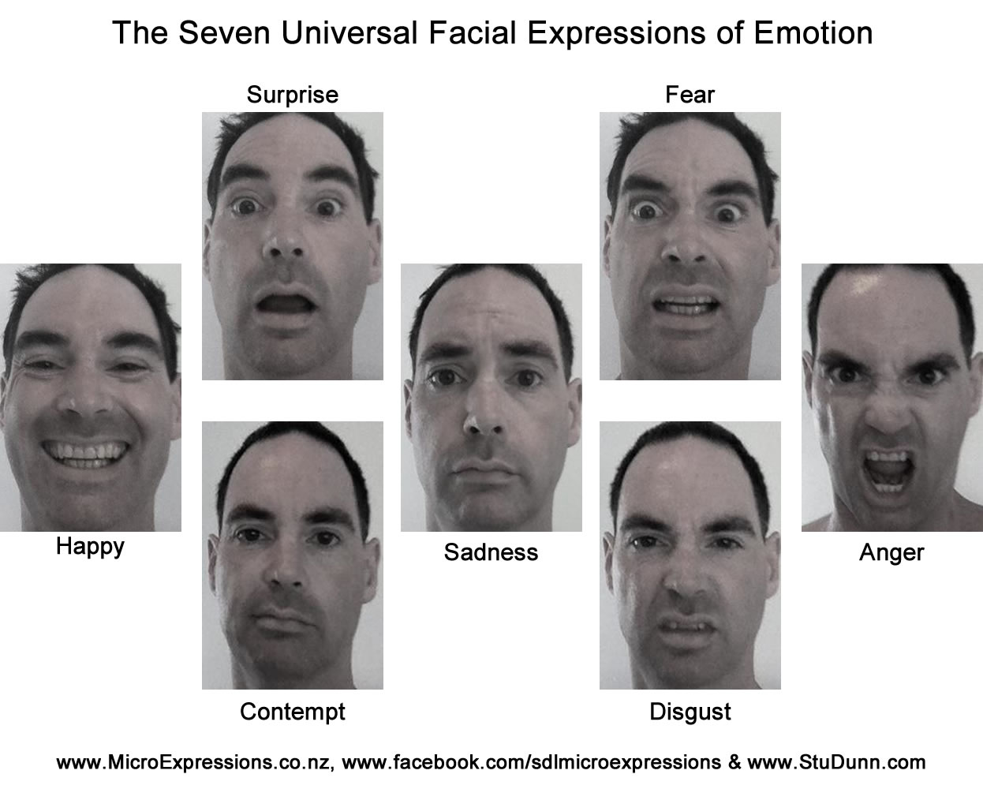
Why do we Study Emotional Expression Processing?
In typically-developing adults, emotional expressions are processed rapidly and provide a rich avenue of communication (Frith, 2009).
Humans and other great apes are distinctive in the frequency with which they are used– humans have faces adapted for communicative value (Kret et al., 2020).
Both facial and vocal emotional expressions are integral to human society, with aspects of both universal across cultures (Bryant and Barrett, 2008)
Decoding emotional expressions is usually the first stage of socio-emotional communication
Infants aren’t born with these abilities
Emotional expression processing is intertwined with more complex social behaviour (like ToM)

Slide 7
Why do we Study Development?
Again, this might seem like a very basic question– but why don’t we just examine emotional expression processing in adults– it would be easier!
The study of the emergence of these skills in infancy is especially important because the processing at this early stage in development is different in both proficiency and nature
Infant processing of faces involves differences in both the cognitive and neural networks called upon—for example, in early infancy face processing recruits subcortical areas, with a shift to cortically-based mature processing over the course of development (Johnson et al., 2015).

Slide 8
Why do we Study Development?
The cortical networks of infants undergo must undergo many years of maturation (Uhlhaas et al., 2010). E.g., while for adults this the N170 component is face-selective, in infants the equivalents are N290 and P400, which do not show the same specificity for human faces in young infants (Halit et al., 2003).
Another factor that makes infancy a unique and important period to examine is speed. Maurer et al. (1999) followed the visual acuity of infants treated for cataracts. Within as little as one hour of visual input there was improvement.
Disruption of the development of a skill earlier on in developmental time results in profound later differences: e.g. cataracts -> face processing impairment (Geldart et al., 2002).

Slide 9
What Questions are of Interest?
When do infants develop the ability to distinguish emotional expressions?
How do they process emotional expressions? When does this become adult-like?
What abilities are infants born with?
How do infants learn to distinguish emotional expressions, as well as what they mean? What drives this?

Slide 10
Okay, so now we know why we’re studying this… But how do we do it?!
I can’t talk!
I can’t press buttons!

Slide 11
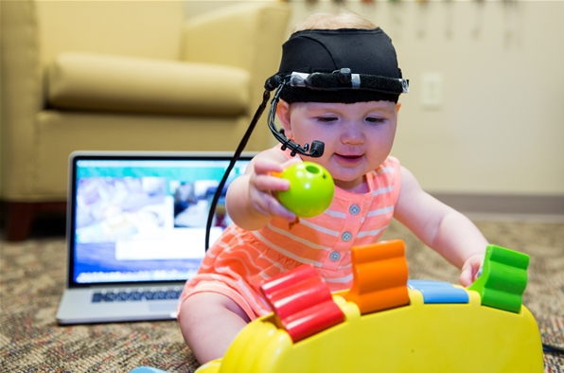
Methodology Pt. 1: Behavioural

Slide 12
Basic Principles
Infants show more emotional arousal in response to new/novel stimuli
They also show less interest in a stimulus the more they’re exposed to it (i.e. emotional arousal reduces). This is called habituation.
We can use this to examine which stimuli infants can discriminate between– for example, if we show an infant happy faces until they habituate, then we show them a surprised thing, one of two things can happen. They dishabituate, or they don’t. The former tells us they can tell the difference between happy & surprised faces.
https://www.youtube.com/watch?v=UiB2ZX1phmc

Slide 13
Mouthing Behaviour
This measure of tendency to suckle on a pacifier or protrude the tongue can be used as an approximation of emotional arousal.
This can tell us how a stimulus affects an infant, and can also tell us that they can distinguish two stimuli
For example Keen (1964) examined non-nutritive sucking in response to different sounds in neonates
This is useful when examining neonates, since they are very limited otherwise
Can be difficult to use in older infants

Slide 14
Eye-Opening Behaviour
This is the measure of the tendency of infants to open their eyes or keep their eyes open
It can be used to approximate arousal or reactivity to a stimulus. It can be used as evidence for differentiation of these stimuli.
This can be used in conjunction with methods such as habituation, as dishabituation will be associated with increased arousal.

Slide 15
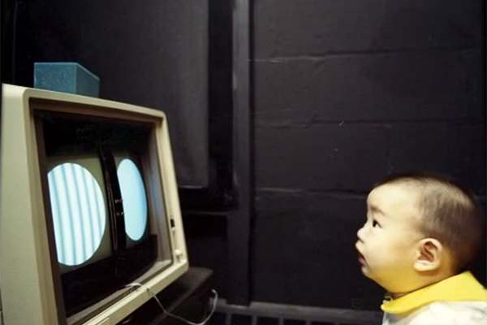
Looking Preference
This involves testing which stimulus infants orient to preferentially when they’re presented simultaneously.
This can be used as evidence that infants distinguish two stimuli– if they prefer one, that means they can tell the difference between them.
This can give us some insight into how infants process emotional expressions.
But it’s less sensitive than habituation & infants might just like the stimuli equally even if they can distinguish them.
Also, simple perceptual cues

Slide 16
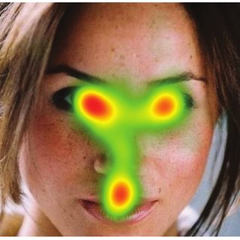
Eye Tracking Data
This involves using special equipment to measure the way in which infants scan faces
This is often used in examining cultural differences in face processing– e.g. Haensel et al., 2020 find more mouth scanning in British participants and more central face scanning, find these differences present by 10-months

Slide 17
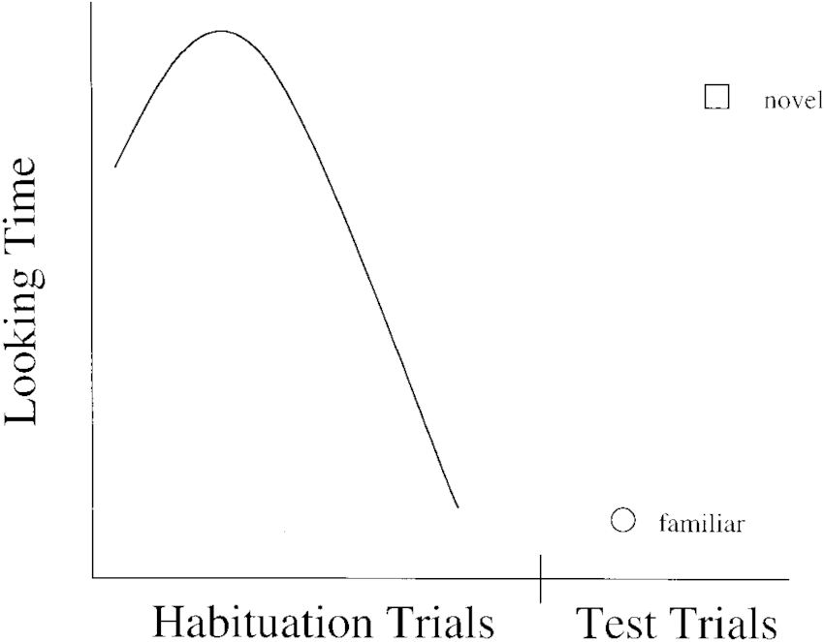
Habituation
This is when infants are presented with the same stimulus or class of stimuli until it no longer elicits the same level of responsiveness as it did at first.
For example, with visual habituation paradigms, the looking time to the stimulus will decrease with successive presentations.
Habituation can also be used with auditory stimuli, with dishabituation when one sound transitions to another measured through metrics such as eye opening and mouthing behaviour.
https://www.youtube.com/watch?v=dlilZh60qdA
Notes:
Last point especially a problem for younger infants
Can present novel stimulus alone, or alongside old stimulus (presenting alone removes need for novelty preference)

Slide 18
Habituation
This methodology can be more sensitive than simple looking preference, with discrimination between some expressions seen only when habituation is used. It can also allow for testing of categorisation
However, pre-existent stimulus preferences and experience can affect results and either novelty or familiarity preference can be observed.
We can see the former problem with an example:
Notes:
Last point especially a problem for younger infants
Can present novel stimulus alone, or alongside old stimulus (presenting alone removes need for novelty preference)

Slide 19
Pupil Diameter
This isn’t strictly behavioural, but is sometimes used alongside behavioural methods utilising looking behaviour (which is why it’s here)
It is used as a measure of emotional arousal in response to a stimulus
It’s useful because it’s very temporally sensitive, and can tell us a little more about how a stimulus is affecting the infant
However, results can be difficult to interpret directionally (larger diameters are observed for –ve and +ve emotions– see Geangu et al. 2011)

Slide 20
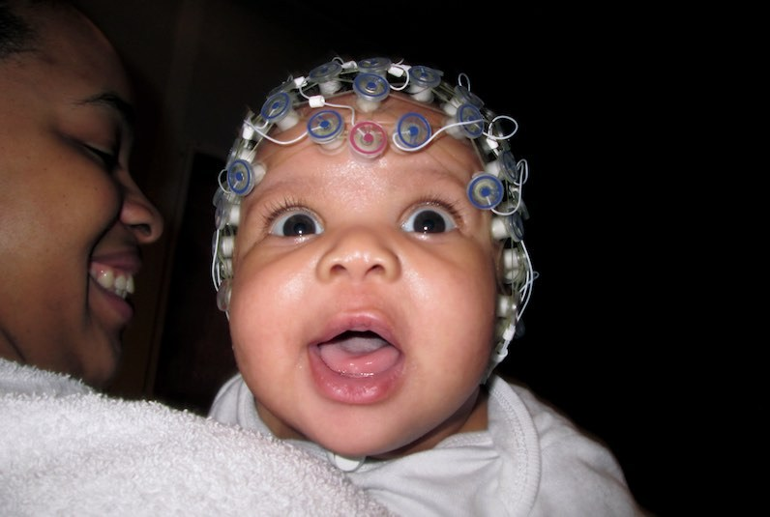
Methodology Pt. 2: Physiological

Slide 21
Non-Brain Indicators
Factors like heart-rate and cortisol levels can be used as measures of arousal
However, these can be difficult/expensive to measure and can’t tell us as much about what is causing the emotional arousal– many other things outside of the stimuli can affect these factors
Usually, factors like this are used alongside other measures or in paradigms where sympathetic arousal is of interest for other reasons (e.g. experiments looking at emotional reactivity)

Slide 22
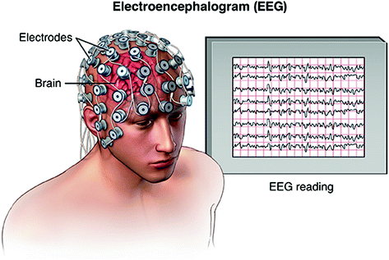
EEG– What is it?
EEG (or electroencephalogram) measures brain activity from the scalp
The reading shows us what’s going on at the top layer of the brain (in the cortex) through recording voltage fluctuations
ERPs (event related potentials) are extracted from EEG and represent the fluctuations associated with particular events, stimuli etc
EEG uses electrodes attached to caps (see below)
https://www.youtube.com/watch?v=QoDXnbGVrtE
Notes:
Video shows cap

Slide 23
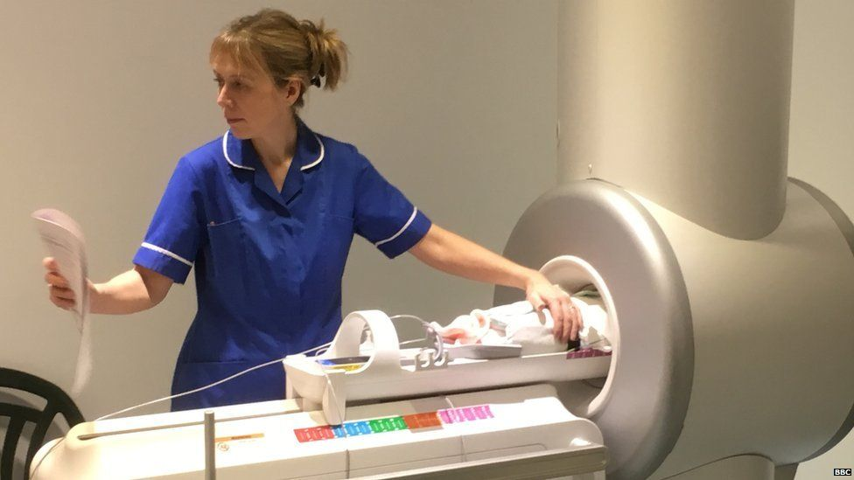
EEG– Advantages/Disadvantages
EEG has good temporal resolution, is cheap and easy(-ish) to use
However, it has poor spatial resolution and has limited ability to show is subcortical activity when compared to other methods like fMRI.
So, why do we use it for infants? Primarily for practical reasons. It is very unlikely a conscious infant would remain still and calm enough for fMRI (though some have managed it)
The vast majority of infant imaging uses EEG

Slide 24
EEG– Components Often Discussed
Nc. In children and infants, this relatively large, long-latency negative ERP component is thought to be an indicator of attention or alerting (Reynolds, 2015).
N290. This is a face-sensitive ERP component in infants and is one of the precursors to the adult N170 (Di Lorenzo et al., 2020). It is a negative component that occurs at roughly 290 milliseconds and is larger in amplitude across midline posterior electrodes.
P400. Face/non-face differentiation is observed in this component. It is a positive component that occurs at around 400 milliseconds after stimulus onset, and is greater at posterior electrodes (De Haan, Johnson and Halit, 2003). This component is also involved in facial emotion processing in infants

Slide 25
EEG– Components Often Discussed
N170. This component is a negative signal at occipito-temporal sites observed at 170 milliseconds after a stimulus is presented and is recorded both sooner and at a greater amplitude for faces as compared to objects in adults (Itier and Taylor, 2004). The amplitude of this component is implicated in emotional expression processing in adults
Frontal Asymmetry. Frontal asymmetry is the degree to which there is a difference in activity between the hemispheres of the frontal cortex, and the direction of this difference (i.e., more activity in the left hemisphere or the right hemisphere). Can be associated with temperament.
N1/N100. This negative component occurs at around 100 milliseconds after stimulus onset, is generated in part by the auditory cortex, and is generated in response to auditory stimuli (Onitsuka et al., 2013). It implicated in vocal emotion processing in infants (Crespo-Llado et al., 2018).

Slide 26
EEG– Components Often Discussed
LPC. This late positive component peaks at around 600 milliseconds after stimulus onset and is found parietally (Daltrozzo et al., 2012). It is modulated by different emotional vocal prosodies in adults (Paulmann et al., 2013). This component is also implicated in vocal emotion processing in infants (Crespo-Llado et al., 2018).
P200. This positive component peaks at around 200 milliseconds and is implicated in vocal emotion processing in infants (Crespo-Llado et al., 2018).
P1. This is a positive face-sensitive ERP component in infants, though it is not face-specific, being sensitive to differences in visual features (Di Lorenzo et al., 2020). P1 amplitude and modulation by different facial expressions in adults (Batty and Taylor, 2003).

Slide 27
Group Task Time!
We’re now going to split up into groups
Your task is to design a study using the methods discussed
Your study should address a question pertaining to how infants process emotional expressions– for example, you could design a study designed to test which emotional expressions infants prefer at birth, or a study designed to test whether newborns can tell the difference between angry and sad voices
You should have: an aim or research question; hypotheses; a target sample; stimuli; and a task
You can use behavioural or physiological measures (or both)

Slide 28
Thank you!
Next time we will focus on what research has already been done in this field

