Slide 1
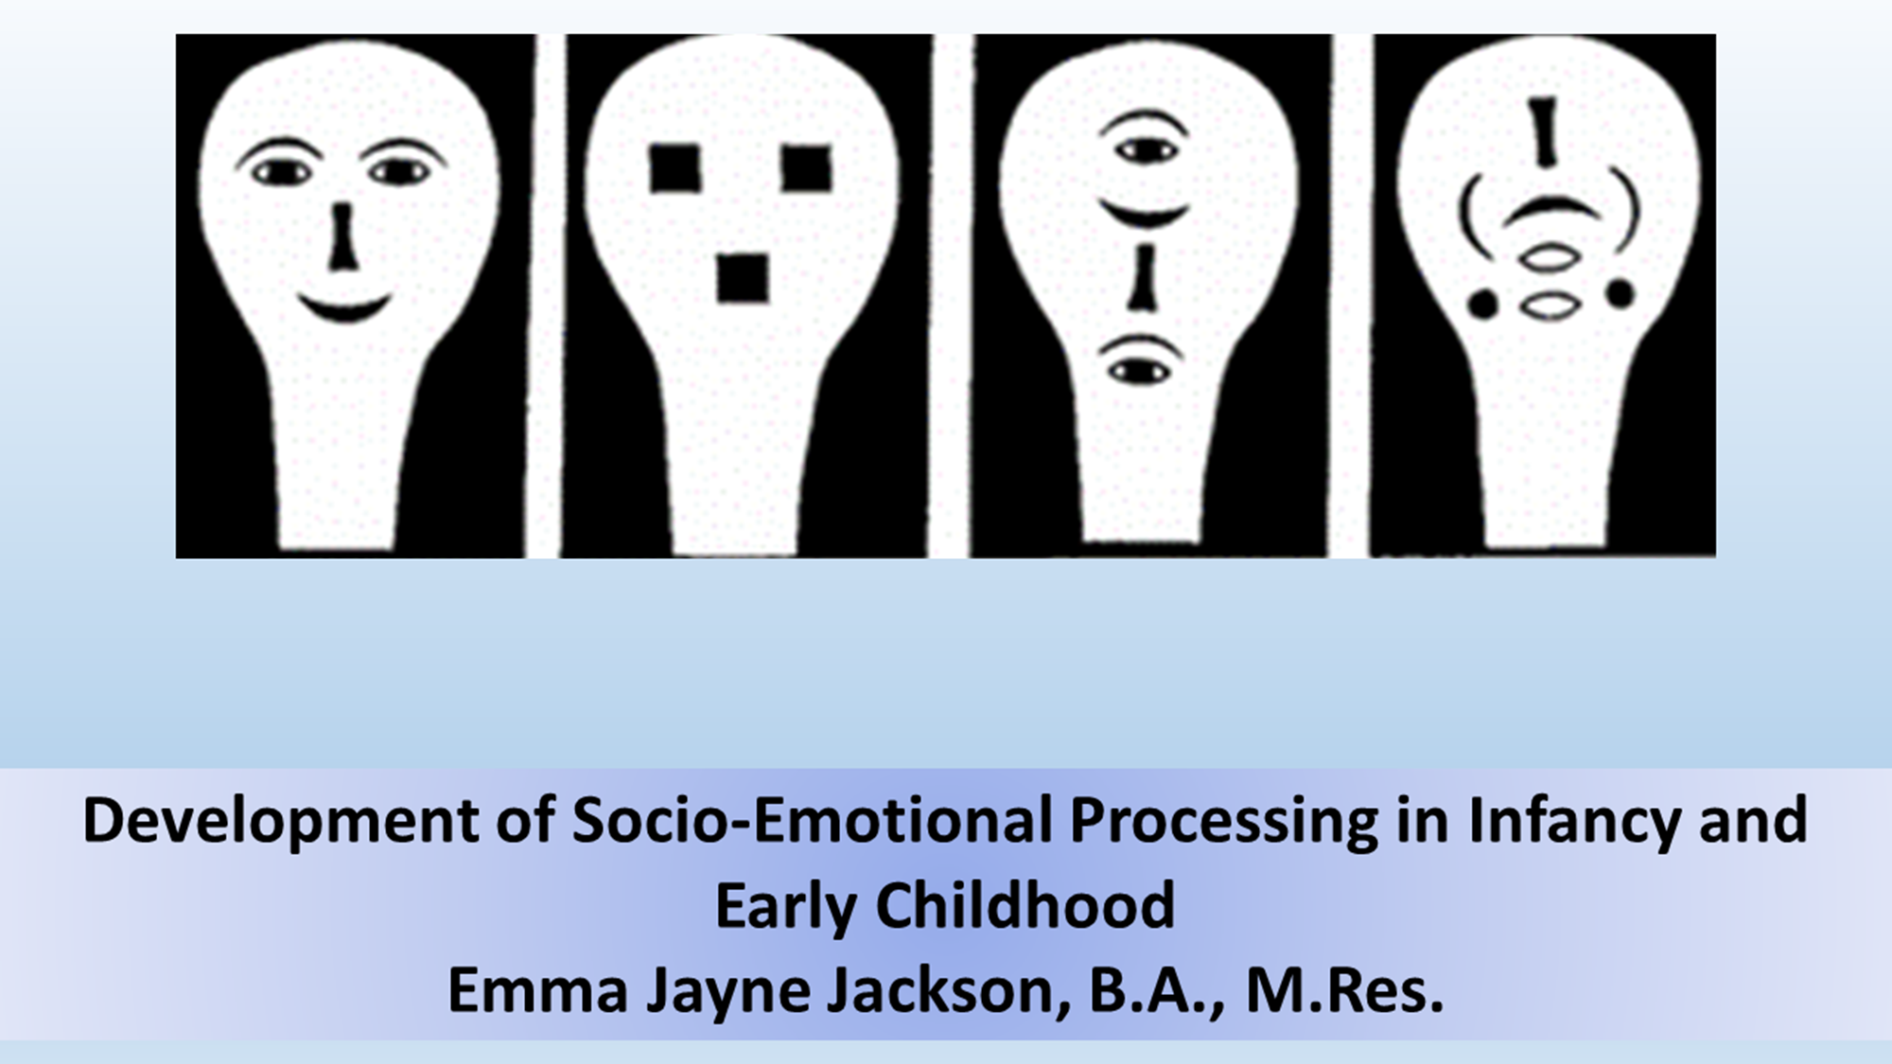

Slide 2
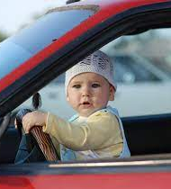
Workshop 3: Factors Driving Development and Individual Differences
Aims for today:
We will introduce different theoretical perspectives on what drives socio-emotional development (especially emotional expression processing)
We will learn about the research in support of these different perspectives
We will learn about how individual differences up to and including disorders may emerge, as well as what individual differences might lead to them
As a group we will debate the theories of development

Slide 3
Recap: Infants Cannot Differentiate and Interpret Expressions from Birth
Different methodologies can produce different results
Results are sometimes inconsistent or disproven between papers
Especially for young infants, differentiation isn’t consistent across contexts/individuals (lack of categorical understanding)
There is limited evidence at certain timepoints (e.g., around the 1- and 2-month mark)
We don’t know why some expressions are distinguished earlier than others for sure
Potential subcortical processing of expressions before cortical differentiation
Potential adaptive role for threat bias around 6-months?
Role of experience for happy/fearful expressions? We don’t know what the experience is!

Slide 4
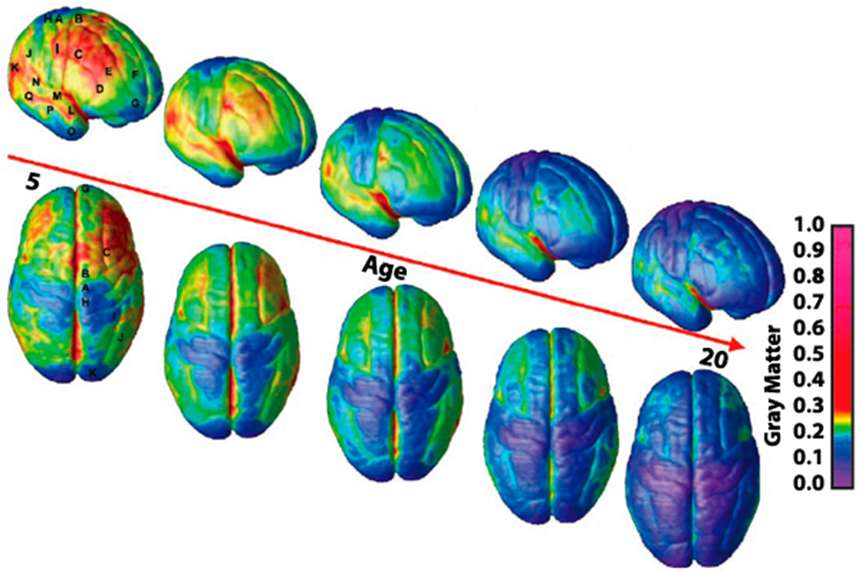
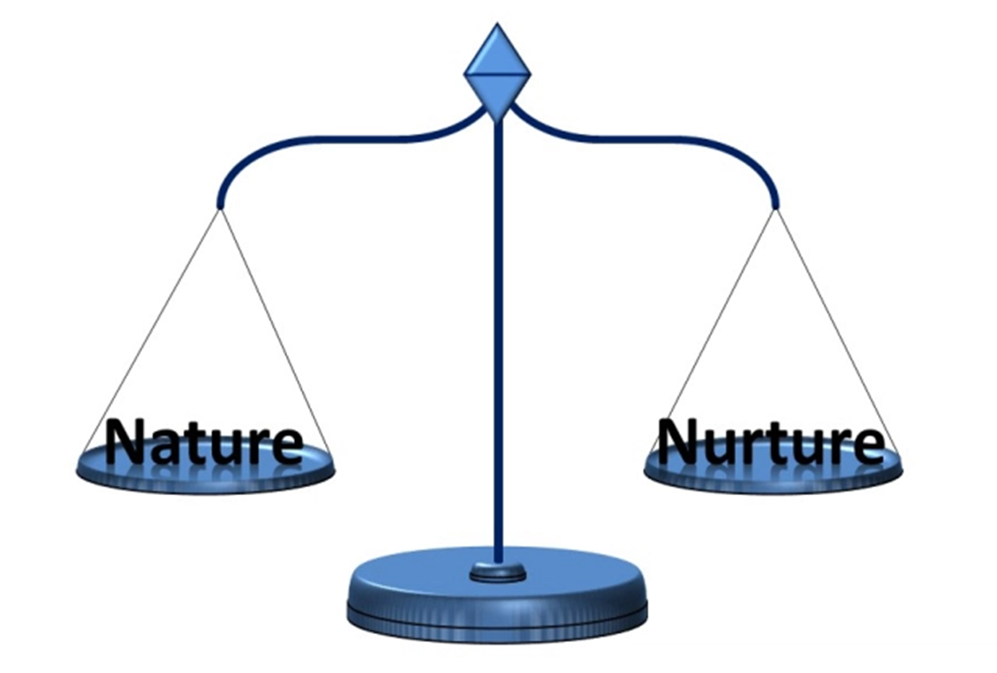
Theories of Development

Slide 5
Maturational Theories
This perspective suggests that development is a sequence of set events determined by genetics, which drive neuromaturation
Development is predicated on changes in the nervous system
This progression is linear, and skills are seen to improve with maturation
Regressive changes are not accounted for
Typically, region to skill mapping is expected
There are a series of set “milestones”
There is some allowance made for the environment to have a secondary role in potentially impairing development, but innate mechanisms are considered primary
Little allowance for or explanation of variation is included
Often “stage theories” are encompassed here

Slide 6
Environmental Theories
This perspective suggests that the environmental input infants are exposed to shapes development primarily
At the extreme end are the ‘tabula rasa’ type theorist
Infants are proposed to become more proficient at skills with age as a result of being exposed to more information
It is proposed that infants will become more proficient with classes of stimulus they are exposed to often (and vice versa)
Infants will vary in skill level dependent on the environment– this leads to a lot of proposed variation

Slide 7
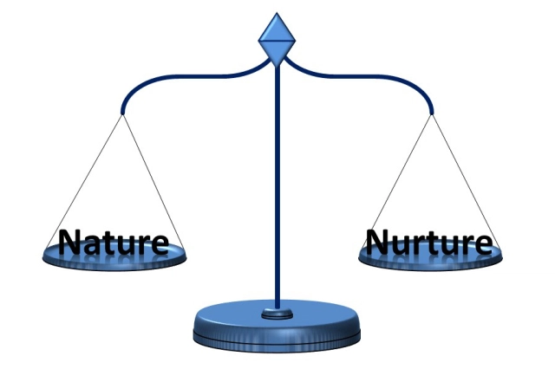
Mixed Theories
Most researchers and theories now fall somewhere in the middle, suggesting a role both for genes/maturation and the environmental input
For example, suggestions of the environment moderating the expression of genes fall into this category (such as in discussion of risk alleles and epigenetics)
So do discussions of critical/sensitive periods: the timing/nature of these periods is suggested to be biologically determined, but the input at this time shapes the output
Examples of mixed theories include interactive specialization (development is not unidirectional; there are interactions between brain and environment; no direct, simple region to function mapping)

Slide 8
What Evidence Would Support Them?
Maturational
Mixed
Environmental
Disruption to development stemming from physiological changes
Points of change in the developmental timelines corresponding to physiological changes
Individual variation associated with genes
Progressive “activation” of cortical areas and networks leading to improvement in skills
Absence of regressive changes
Disruption possible from both, especially at critical periods
Points of change corresponding to both: interconnectedness
Gene environment interactions, risk alleles
Reciprocal relationships between physiological and environmental factors
Regressive changes; networks of brain activity for skills
Disruption to development resulting from environmental input changes
Points of change in the developmental timeline corresponding to environmental input changes
Individual variation associated with environmental factors
Environmental changes precede neurophysiological changes

Slide 9
The Evidence for Maturational Theories

Slide 10
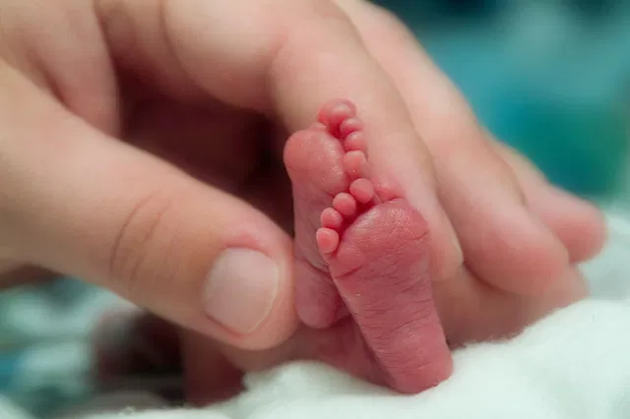
Pre-Term Infants
Pre-term infants are at a different stage to full-term infants when they are first exposed to the environment
Pre-term infants are more likely to develop socio-emotional deficits (Spittle et al., 2009)
Responses to facial emotional expressions have also been shown to differ between pre-term and full-term infants at the level of EEG (e.g., full-term infants show differential activation in response to positive faces as compared to neutral and non-faces; premature infants don’t¹)
However, can we say for sure these two groups do not differ in other ways?
Notes:
1. Carbajal-Valenzuela, C. C., Santiago-Rodríguez, E., Quirarte, G. L., & Harmony, T. (2017). Development of emotional face processing in premature and full-term infants: a quantitative EEG study. Clinical EEG and neuroscience, 48(2), 88-95.

Slide 11
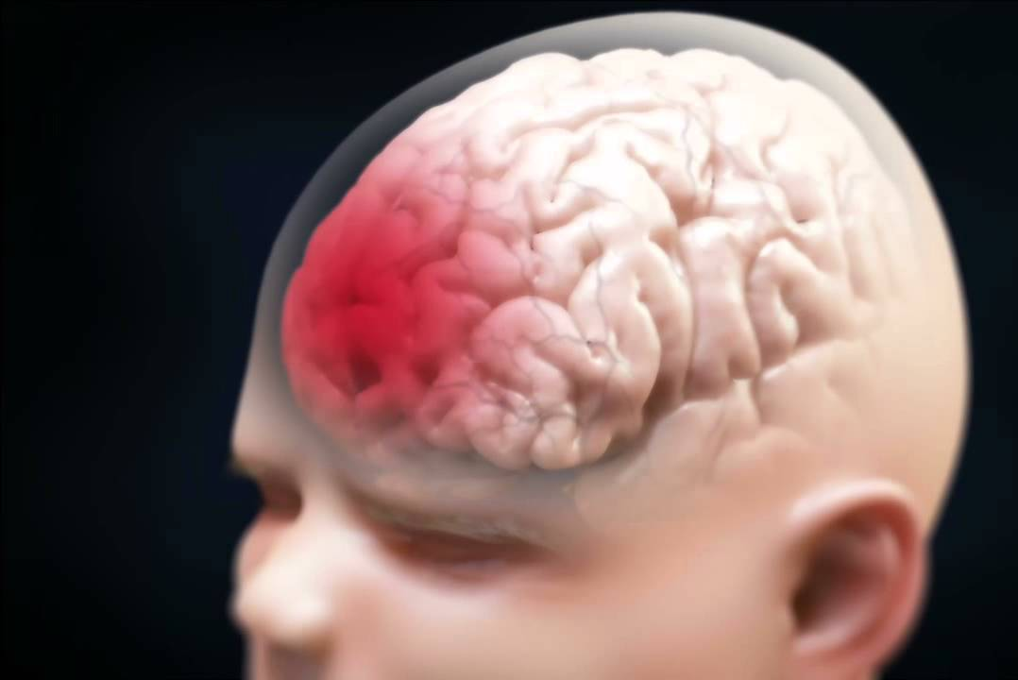
Early Brain Lesions
There is not as much evidence in this domain directly addressing emotional expression processing– but there is some on faces, and there is overlap between face processing and facial expression processing
Farah et al. (2010): report on individual who acquired bilateral occipital and occipito-temporal lesions at 1 day of age and never developed the ability to recognize faces
So, certain neural substrates are destined to underpin face processing, and neither environmental input nor neuroplasticity is enough to overcome this
But we must consider the question of necessary vs sufficient factors
Also, face emotion processing is possible without face identity processing (prosopagnosia)

Slide 12
The Evidence for Environmental Theories

Slide 13
Maternal Depression
Infants of depressed parents would likely experience significant differences in the emotional expressions they see and hear
There is evidence to suggest that processing of emotional expressions differs in these infants
E.g., Kataja et al. (2018) find infants of mothers exhibiting depressive symptoms while pregnant and postpartum show an greater bias in attention towards fearful faces
However, we have no direct measure of what differs in the environments of these infants
Also, potential explanatory genetic differences?

Slide 14
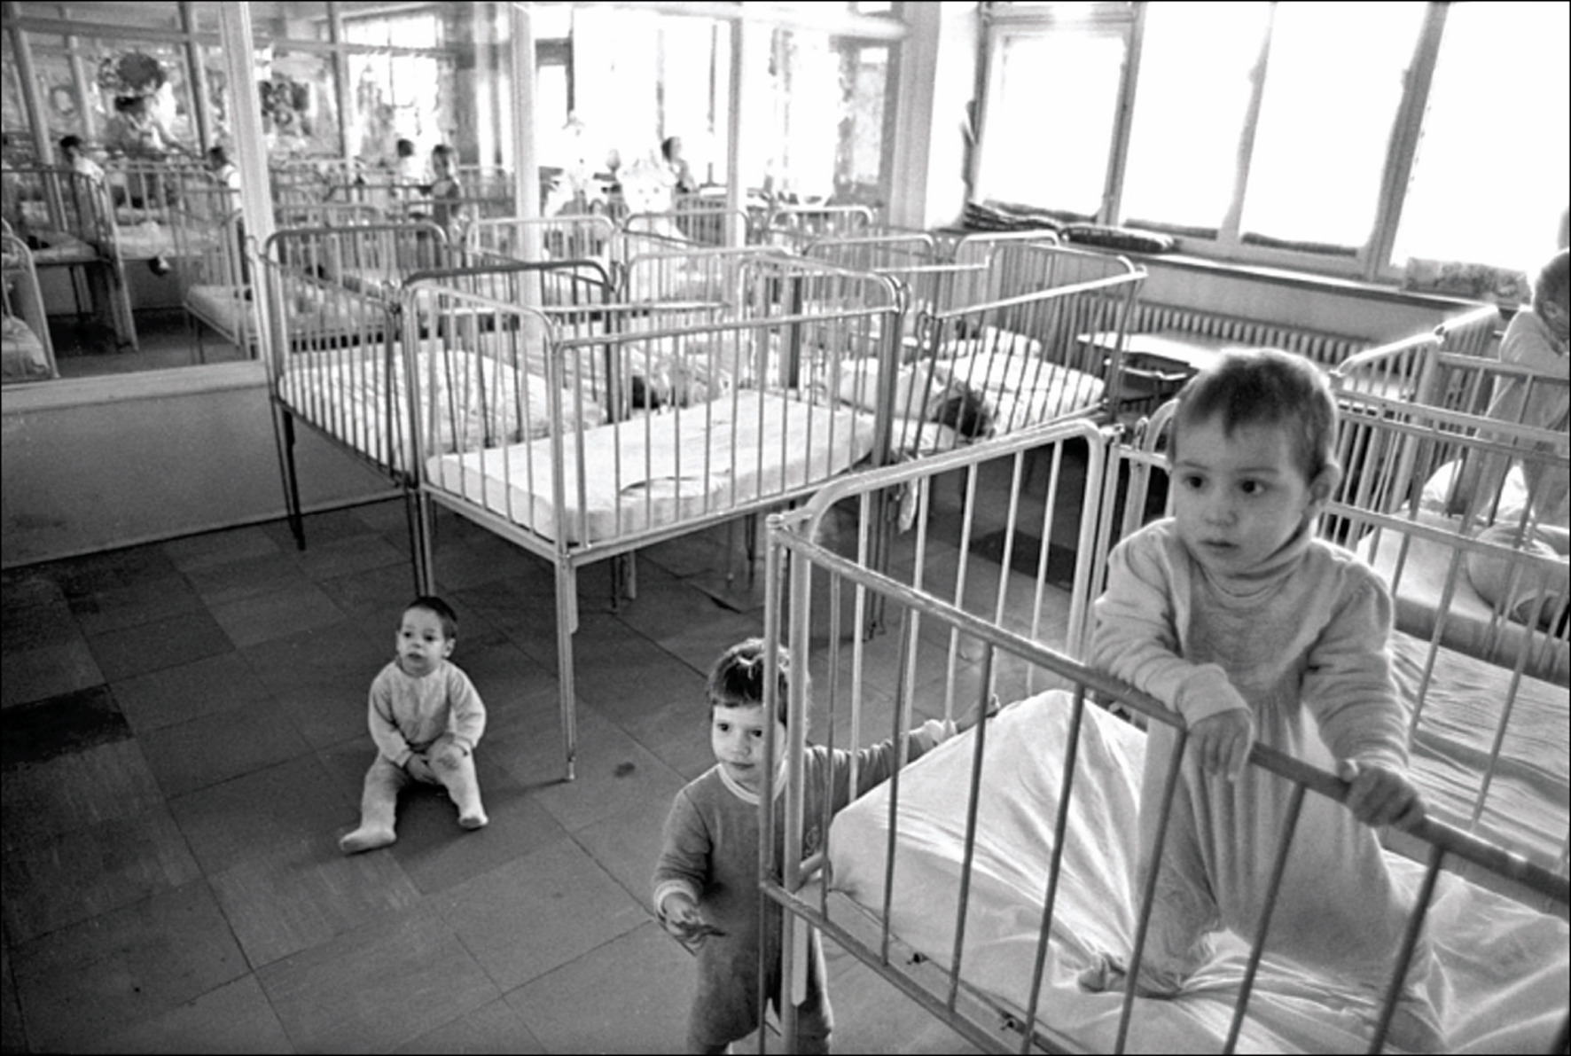
Institutionalized Children
“Institutional” orphanages such as those that were found in Romania provide(d) a highly atypical social environment, with little caregiver/infant interaction and attention
We would expect from this much less early input of emotional expressions
Sloutsky (1997) do indeed find developmental differences that extend to emotional expression processing
Institutionalized children exhibited impaired emotional expression identification associated with length of institutionalization
However, confounds: other forms of neglect, characteristics of children likely to be social orphans

Slide 15
The Evidence for Mixed Theories

Slide 16
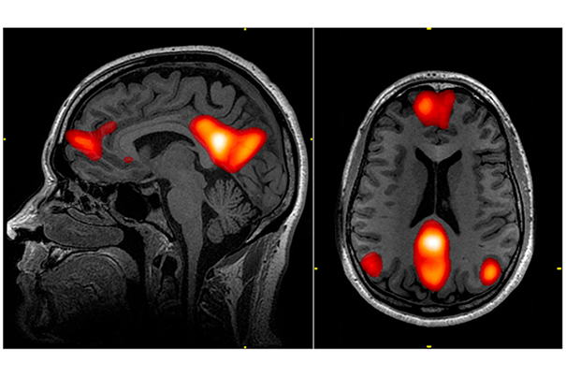
fMRI Evidence
While the maturational account would predict unidirectional, region to skill development, mixed models like interactive specialisation do not predict this
Joseph et al. (2011) examined responses to faces in children 5- to 12-years-old and adults
While they do find increased specialisation in some brain regions, they also find that this skills recruits networks, there are changes in skill to region mappings and there are regressive changes (decreases in specialisation) in the networks
Same issue with faces vs facial emotional expressions as before
Doesn’t examine infancy (which may be special/different)

Slide 17
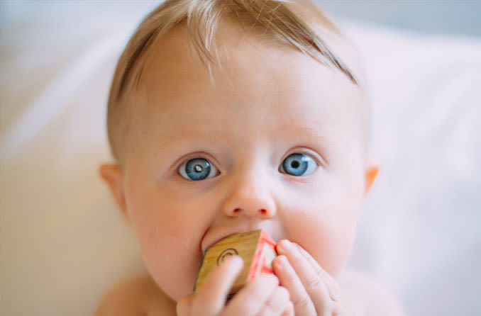
Critical Periods and Cataracts
Theories that call upon the idea of gene-environment interactions suggest that there exist critical periods: the timing and nature is innately determined, but the input at this point is very influential
One example is cataracts, which occlude vision
Infants born with bilateral congenital cataracts show later impairments in face processing, even though they are usually rectified quickly (Geldart et al., 2002)
Adults who experienced bilateral congenital cataracts demonstrate subtle qualitative differences in processing of emotional expressions in terms of the dimensions represented (especially arousal) (Gao et al., 2013)
Similar if less extensive evidence for vocal emotional prosody processing can be seen in deaf children fitted with cochlear implants (Good et al., 2017)
Notes:
Gao, X., Maurer, D., & Nishimura, M. (2013). Altered representation of facial expressions after early visual deprivation. Frontiers in Psychology, 4, 878.
Good, A., Gordon, K. A., Papsin, B. C., Nespoli, G., Hopyan, T., Peretz, I., & Russo, F. A. (2017). Benefits of music training for perception of emotional speech prosody in deaf children with cochlear implants. Ear and Hearing, 38(4), 455.

Slide 18
The Implications of These Theories

Slide 19
Implications for Our Timeline
Maturational
Mixed
Environmental
The timepoint at which emotions were differentiated would be determined by a set timeline, which potentially served an adaptive function
This is especially pertinent for the changes in processing threat-related emotional expressions at about 6m: perhaps this is a survival mechanism?
Individual differences (and disorders) would result from genetic and physiological differences
The timepoint at which emotions are differentiated would result from an interaction between innate and environmental factors
Innate factors of infants may lead them to shape their own environments (e.g., infants prone to negative emotionality will engage with emotional expressions differently, changing the input)
A combination of risk alleles and environmental differences would contribute to individual differences
The timepoint at which emotions were differentiated would be determined by the stimuli infants are exposed to
So, happy emotional expressions would be differentiated first because infants are exposed to them so often
Threat-related emotional expressions would be differentiated around time of mobility because infants seem them more often
Individual differences (and disorders) would emerge from environmental differences

Slide 20
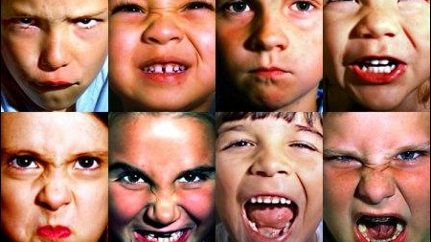
Individual Differences

Slide 21
Variation and Disorders Related to Socio-Emotional Processing
There is a range of normal variation
At certain extremes, this becomes clinical
There are no disorders defined by emotional expression processing per se, but there are several where this is implicated
We covered some of these last time– the most pertinent here are antisocial personality disorder (ASPD) and autism spectrum disorder (ASD)
This is because these differences typically originate in early childhood and infancy
So, we want to know: what individual differences in infancy are related to later differences in emotional expression processing, and how?

Slide 22
Infant Temperament
A significant early individual difference is infant temperament
Two broad dimensions are emotional reactivity and emotional regulation (Rothbart, 1986)
These dimensions can either be measured via parent questionnaire (IBQ) or observation
https://www.youtube.com/watch?v=fAmyt5gRd3k

Slide 23
Temperament and Socio-Emotional Processing (Childhood)
Populations with impaired procession of emotional expressions demonstrate differences in temperament
For example, in children aged 3- to 10-years-old, a diagnosis of ASD is associated with less effective emotional regulation (Konstantareas and Stewart, 2006)
In children, regulation dysfunction is associated with later development of disruptive behaviour disorders (Althoff et al., 2010)
Childhood temperament moderates emotional expression processing– Dennis et al. (2009) larger P1 and Nc amplitudes in response to fearful and sad faces associated with higher emotional regulation
Early childhood social functioning has been associated with earlier infant temperament
Infants who are both highly negatively emotionally later demonstrate greater social reticence (Fox and Henderson, 1999), and less reactive infants later demonstrate less empathic behaviour (Young, Fox and Zahn-Waxler, 1999)
Notes:
Konstantareas, M. M., & Stewart, K. (2006). Affect regulation and temperament in children with autism spectrum disorder. Journal of autism and developmental disorders, 36(2), 143-154.
Althoff, R. R., Verhulst, F. C., Rettew, D. C., Hudziak, J. J., & van der Ende, J. (2010). Adult outcomes of childhood dysregulation: a 14-year follow-up study. Journal of the American Academy of Child & Adolescent Psychiatry, 49(11), 1105-1116.
Chicago
Dennis et al 5- to -9-years-old– P1 is associated with processing of different emotional expressions

Slide 24
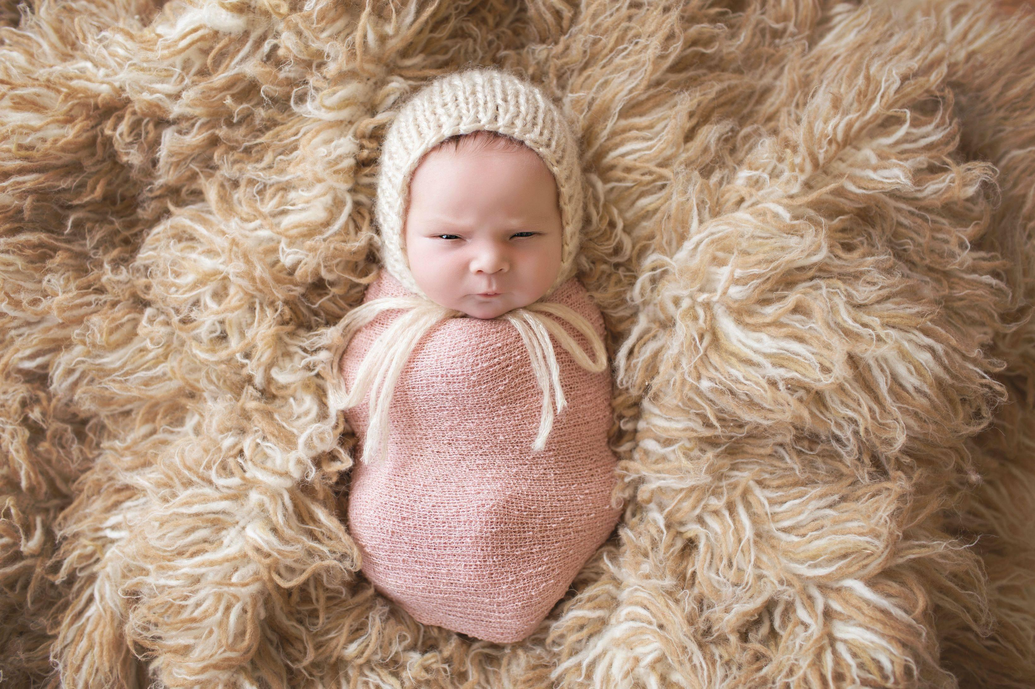
Temperament and Socio-Emotional Processing (Infancy)
Ravicz et al. (2015) found preferential activation of the left PFC in response to smiling in infants (7-months) with low negative emotionality.
Martinos et al. (2012) peak latency of Nc slower for infants (3- to 13-months) with poorer regulation regardless of expression. Better regulation associated with enhanced Nc responses to fearful faces; higher negative emotionality enhanced Nc to happy faces.
Higher negative emotionality (anger) in infancy is associated with later CU traits (Hay et al., 2014), as is lower face preference in infancy (Bedford et al., 2015
So, how do we get from simple differential attention and processing mechanism differences to varying levels of proficiency and socio-emotional skill?
We’re not sure yet, but temperamental differences may change the way infants interact with their environment
Notes:
Hay, D. F., Waters, C. S., Perra, O., Swift, N., Kairis, V., Phillips, R., ... & Van Goozen, S. (2014). Precursors to aggression are evident by 6 months of age. Developmental Science, 17(3), 471-480.
Bedford, R., Pickles, A., Sharp, H., Wright, N., & Hill, J. (2015). Reduced face preference in infancy: a developmental precursor to callous-unemotional traits?. Biological psychiatry, 78(2), 144-150.

Slide 25
Parental Variables
The parents form a significant component of the socialisation that infants are exposed to
So, as we might expect, there are many parental variables that have been associated with infant socio-emotional processing
But there is more than one pathway to this– it is not necessarily environmental in nature
Here, we will focus on maternal sensitivity

Slide 26
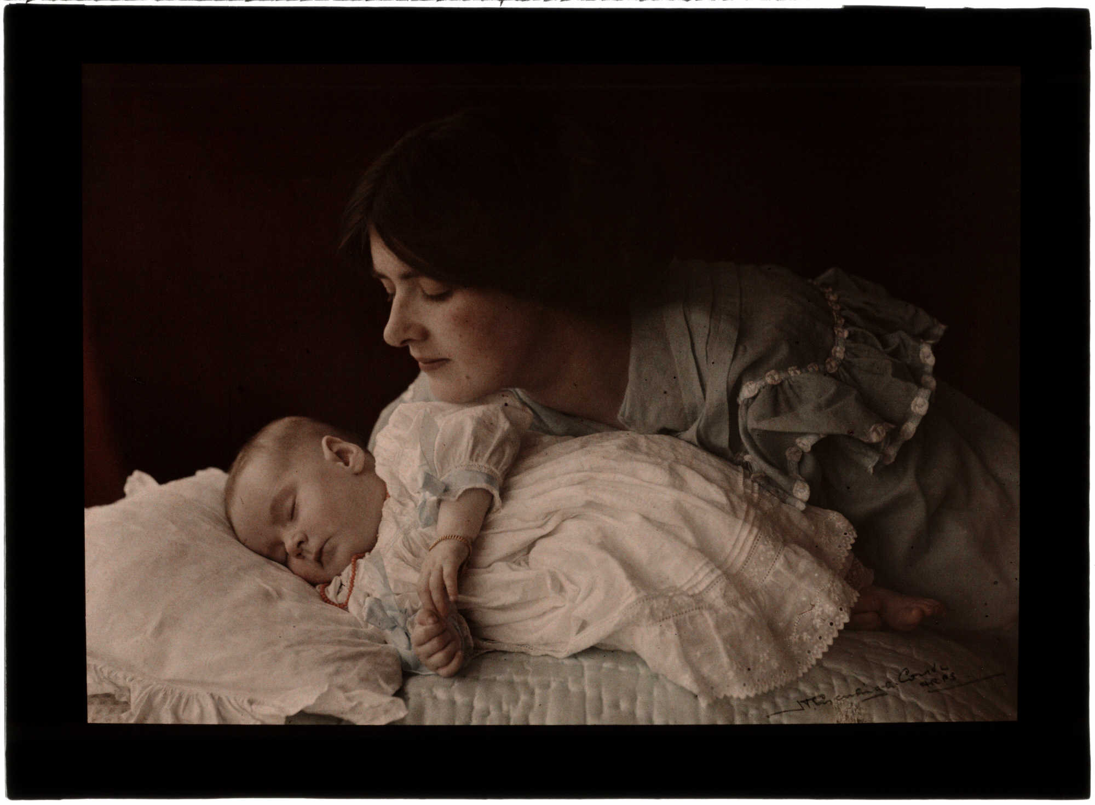
Maternal Sensitivity
Maternal sensitivity is a measure of how contingent the behaviours of the mother are on the behaviour of the child
It is dependent on an ability to interpret correctly what the behaviour of the infant is communicating
Typically, this is measured through observation of the mother and child interacting

Slide 27
Maternal Sensitivity
Maternal sensitivity of a mother is associated with the temperament of the infant (Blair et al., 2006)
It is associated with later parenting style– low sensitivity is associated with harsh parenting (Joosen et al., 2012)
Differences in maternal sensitivity are also related to the ways in which infants engage with socio-emotional stimuli
Higher maternal sensitivity is associated with increased looking preference for a familiar face (Thompson et al., 2009)
However, we do not yet know the exact nature of the relationship between maternal sensitivity, infant temperament and infant engagement with socio-emotional stimuli

Slide 28
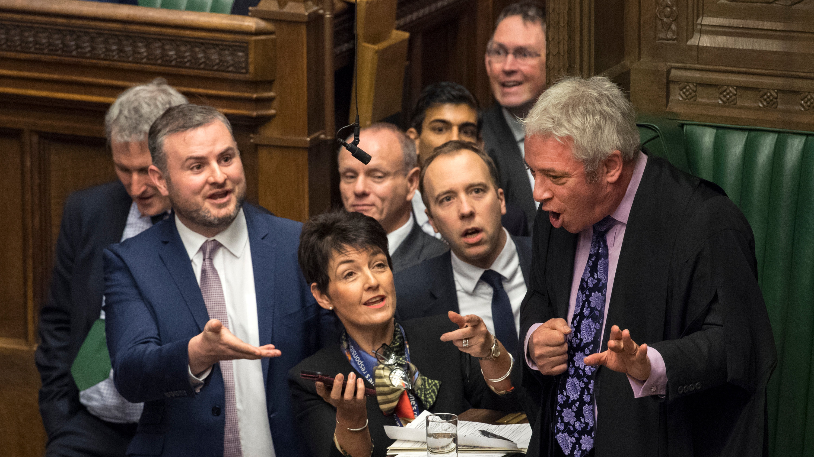
Debate: Theories of Development

Slide 29
We’ll now split into groups
Your group will be assigned an approach
Construct an argument in favour of your approach together and summarize it in the google document (https://docs.google.com/document/d/1MkfIkI3WOovePRB9FOlcmBFM49Re-ABG2j5dCEqphO4/edit?usp=sharing)
Then choose an argument from another group and construct a counterargument to it
If you have time to fill, construct a second argument
If you need to reference the slides, find them here (https://docs.google.com/presentation/d/1_6jhJ-fCNLVZF_Jl34qZE2ToZyWl3u1PtJimtHXQiOg/edit?usp=sharing)

Slide 30
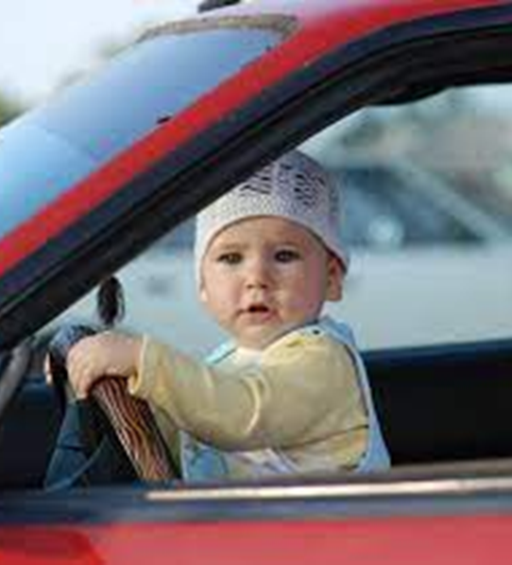
Conclusions
Knowing what drives development can help us to understand more about the developmental timeline and why changes happen as they do
There is some evidence for both the maturational and environmental accounts, but we need more direct evidence (a measure of environmental input)

