Slide 1
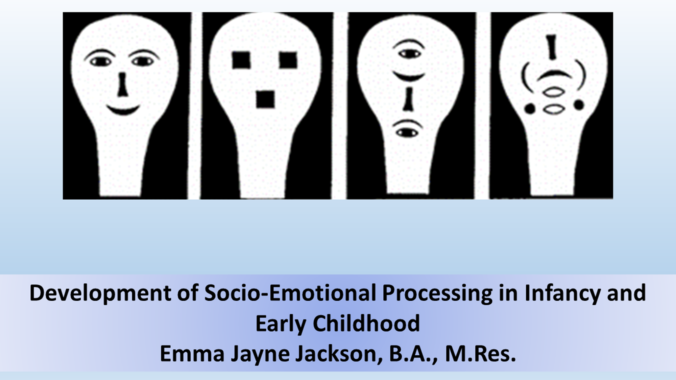

Slide 2
Workshop 4:Critically Analysing the Field and the Research for Your Essay
Aims for today:
To recap about what we have learnt
To think about what the most significant outstanding questions are in the study of socioemotional processing of emotional expressions are
To understand factors that may limit our ability to effectively address these questions
To develop the knowledge to write an effective, critical essay (like an argumentative literature review)
To be able to effectively analyse individual pieces of research
To use group discussion to think about how to approach the essay topic

Slide 3
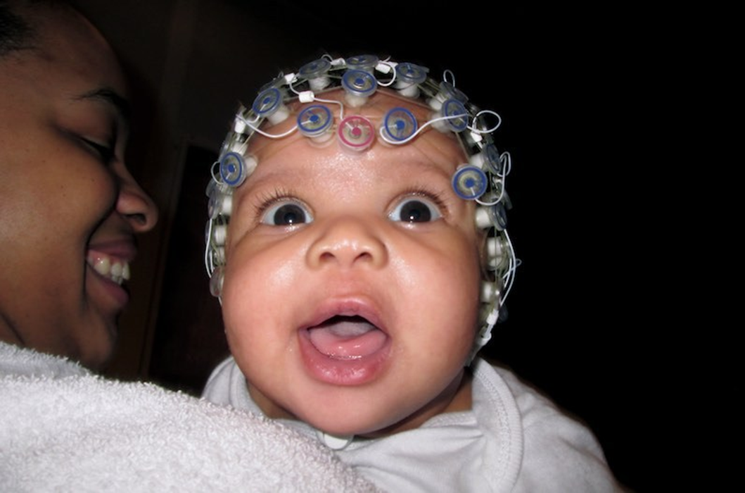
Recap: Workshop 1
Why and How We Study Socio-Emotional Processing Development

Slide 4
Why do we Study Socio-Emotional Development (Especially Emotional Expression Processing)?
They are important! Compared to other species, we are very proficient in this domain; there are disorders associated with deficits in these skills
They are special: social complexity may be what has driven the evolution of our cognitive abilities
Emotional expressions are utilised to a greater extent by humans and universal across cultures
Infant processing is not just “worse”, but qualitatively and mechanistically different (and development is
rapid)

Slide 5
What do we Want to Know (and How Can we Find Out)?
Broadly: When and how do infants learn to differentiate and understand emotional expressions? What drives this?
Methods include:
Mouthing
Eye opening
Heart rate
Cortisol
Pupil diameter
Habituation
Skin conductance
Looking preference
Eye tracking
EEG
fMRI

Slide 6
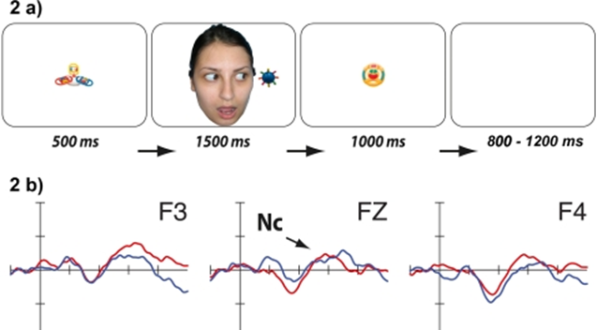
Recap: Workshop 2
What We Know About the Emergence of Face, Voice and Emotional Expression Processing

Slide 7
What Does Adult Processing Look Like?
Which is to say, what is the end result of development?
Proficient
Specialised
Experience Dependent
Largely Universal
Diverse
Broad
Categorical

Slide 8
Summary of the Developmental Timeline
Different methodologies can produce different results
Results are sometimes inconsistent or disproven between papers
Especially for young infants, differentiation isn’t consistent across contexts/individuals
There is limited evidence at certain timepoints
Some expressions are distinguished earlier than others
Potential subcortical processing of expressions before cortical differentiation
Potential adaptive role for threat bias around 6-months (fear & anger processing) and in preference for happy expressions at birth

Slide 9
Recap: Workshop 3
Factors Driving Development and Individual Differences

Slide 10
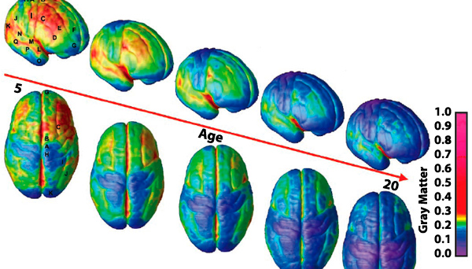
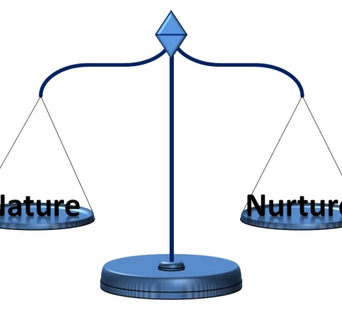
Perspectives on Development
Development is a sequence of set linear events determined by genetics, which drive neuromaturation
Biology and the environment interact (critical periods; risk alleles; epigenetics)
The environmental input infants are exposed to shapes development primarily (diversity)
Maturational
Mixed
Environmental
Pre-term infants
Early brain lesions
fMRI evidence (e.g., regressive changes)
Congenital cataracts
Maternal depression
Institutionalized children

Slide 11
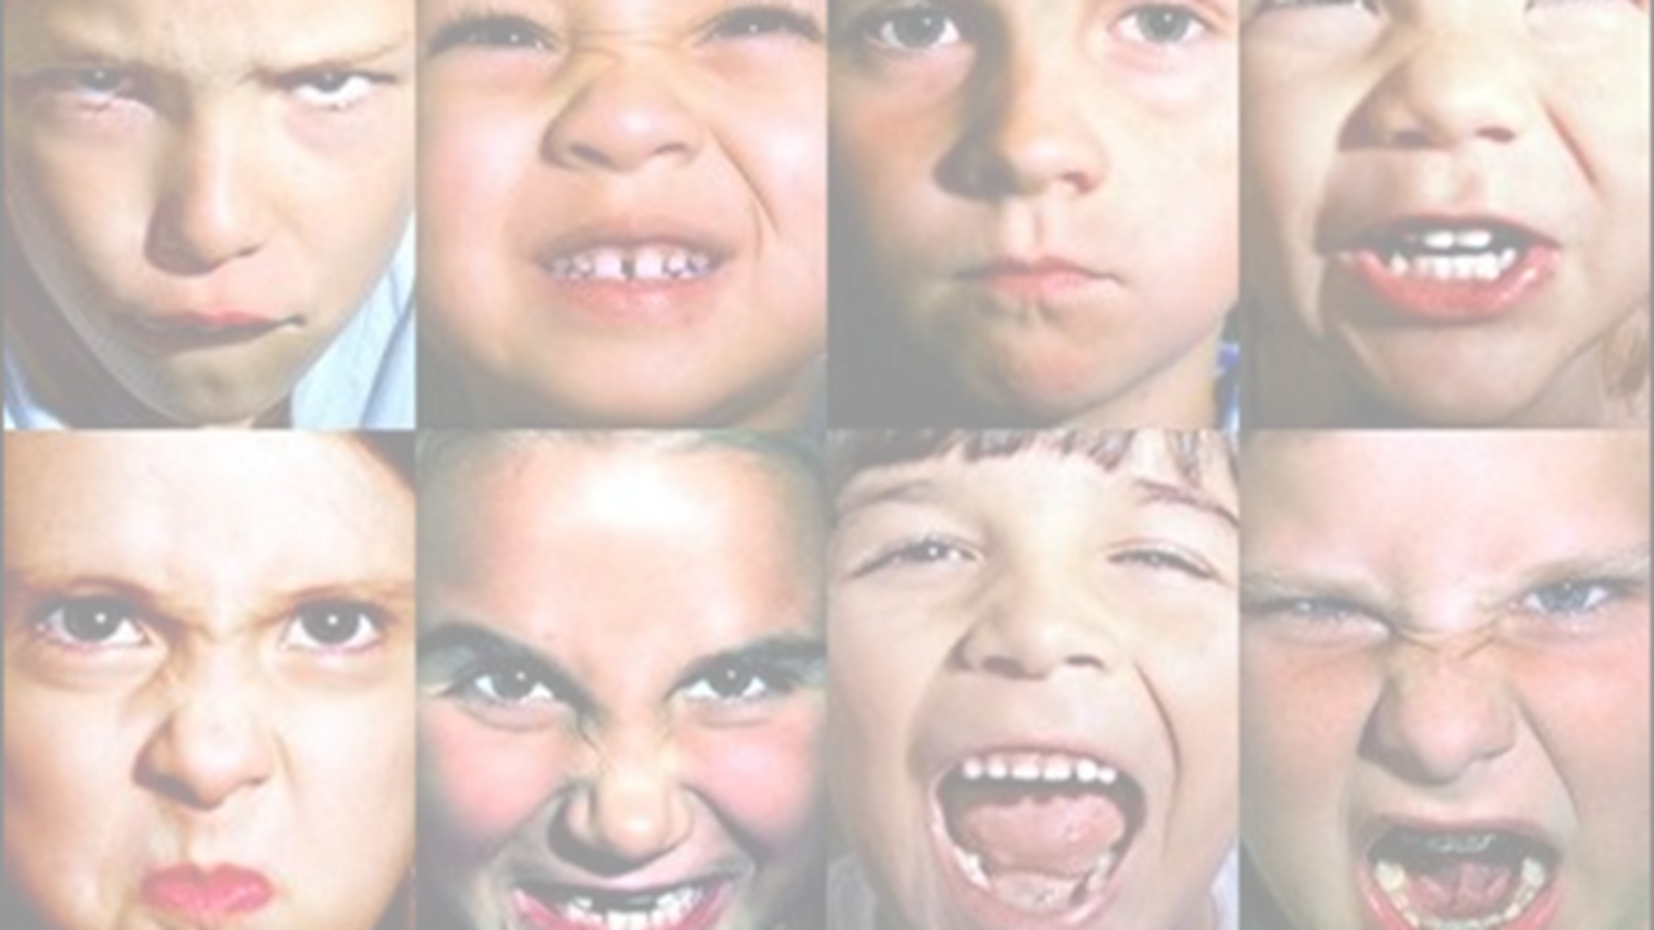
Individual Differences
Could result from genetic differences, differences in early temperament
Associated with differences in emotional expression processing & disorders
Associated with differences in infant processing of socio-emotional stimuli; but we’d expect correlation of temperaments (infant/parent)
Disorders of Social Processing
Infant Temperament
Parent Variables
ASD
ASPD
Emotional reactivity
Emotional regulation
Maternal depression
Maternal sensitivity

Slide 12
Outstanding Questions

Slide 13
Why Are Some Emotions Differentiated Before Others?
For example, happy expressions are differentiated early on. Evidence that might help to address this:
A measure of the environmental input– maybe infants see more happy expressions?
Examinations of how environmental differences change which are differentiated first (e.g., infants of depressed mothers)
Examinations of how neural differences change which are differentiated first (e.g., preterm infants)

Slide 14
Why Are Some Emotions Differentiated Before Others?
For example, happy expressions are differentiated early on. Evidence that might help to address this:
To get a good representation of the emotional expressions infants are exposed to, we would need a large, longitudinal sample, and we would need a lot of data per infant
A measure of the environmental input– maybe infants see more happy expressions?
Examinations of how environmental differences change which are differentiated first (e.g., infants of depressed mothers)
Biological differences are difficult to extract from environmental: again, we would perhaps need adoption studies, which are difficult to find samples for
Examinations of how neural differences change which are differentiated first (e.g., preterm infants)
Environmental differences are difficult to extract from biological: we would perhaps need adoption studies, which are difficult to find samples for

Slide 15
Exactly When Are Different Emotional Expressions Differentiated and Understood?
There are gaps in the facial emotional expression literature at certain age points (e.g., 1-month) and evidence is often disparate; there is much less information on vocal emotional expressions. Studies that might help to address this:
Comprehensive and longitudinal examination of the processing of all primary facial emotional expressions in the same sample over the first year
Comprehensive and longitudinal examination of the processing of all primary vocal emotional expressions in the same sample over the first year
Examination of when infants first extract communicative value from emotional expressions
There is some evidence from the visual cliff at 12m–but only joy/interest vs fear/anger

Slide 16
Exactly When Are Different Emotional Expressions Differentiated and Understood?
There are gaps in the facial emotional expression literature at certain age points (e.g., 1-month) and evidence is often disparate; there is much less information on vocal emotional expressions. Studies that might help to address this:
It would be difficult and expensive to follow a large enough sample and test them frequently and comprehensively enough without a large sample dropout; parents are difficult to recruit early in infancy
Comprehensive and longitudinal examination of the processing of all primary facial emotional expressions in the same sample over the first year
Finding vocalisations that are objectively one emotion without verbalisation can be difficult; there aren’t the same stimulus banks for non-verbal vocalisations. And again, it would be difficult and expensive to follow a large enough sample and test them frequently and comprehensively enough without a large sample dropout; parents are difficult to recruit early in infancy
Comprehensive and longitudinal examination of the processing of all primary vocal emotional expressions in the same sample over the first year
For young infants, who are not able to interact with the environment in the same way, it is hard to find a good measure of understanding
Examination of when infants first extract communicative value from emotional expressions
There is some evidence from the visual cliff at 12m–but only joy/interest vs fear/anger

Slide 17
Are Some Expressions First Differentiated Subcortically?
For example, object paired with fearful faces are differentiated on EEG before the faces themselves. Evidence that might help to address this:
fMRI scan evidence while emotional expressions are processed– this would show us subcortical activity
Use of modified EEG analysis to extract some information on subcortical activity
Comprehensive investigation into which regions of the brain different emotional expressions recruit in adults (can tell us which expressions load subcortically)

Slide 18
Are Some Expressions First Differentiated Subcortically?
For example, object paired with fearful faces are differentiated on EEG before the faces themselves. Evidence that might help to address this:
It is very difficult to keep infants still and calm enough to get a good read. Specialised infant fMRIs do exist but are rare. Temporal resolution is also poorer
fMRI scan evidence while emotional expressions are processed– this would show us subcortical activity
Use of EEG to measure subcortical activity is new, difficult and only possible when cortical activity is sparse
Use of modified EEG analysis to extract some information on subcortical activity
Comprehensive investigation into which regions of the brain different emotional expressions recruit in adults (can tell us which expressions load subcortically)
Knowing which emotions recruit subcortical regions in adults would not necessarily tell us which recruit subcortical regions in infants because processing is qualitatively different

Slide 19
What is the Significance/Source of Individual Differences?
Infant temperament and parental variables are associated with differences; so are disorders (ASPD/ASD) Evidence that might help to address this:
Longitudinal examination of how the relationship between temperament / parental variables and processing of emotional expressions emerges early in the first year
Longitudinal examination of emotional expression processing and temperament in infants at risk of social processing disorders (ASD/ASPD/CD) (e.g., perhaps highly reactive infants who avoid looking at faces are more likely to be diagnosed later)
Examination of how environmental and genetic factors are related to differences in early emotional expression processing

Slide 20
What is the Significance/Source of Individual Differences?
Infant temperament and parental variables are associated with differences; so are disorders (ASPD/ASD) Evidence that might help to address this:
The nature of the relationship between some variables may be difficult to extract (e.g., if temperament does predict the trajectory of development, it could be because one causes the other or because of a shared source). Again, this would need to be a large sample
Longitudinal examination of how the relationship between temperament / parental variables and processing of emotional expressions emerges early in the first year
There may be ethical issues or parents may be reticent to take part, especially with ASPD. This would require later assessment of the participants for disorders, which is medical. Samples would be difficult to find
Longitudinal examination of emotional expression processing and temperament in infants at risk of social processing disorders (ASD/ASPD/CD) (e.g., perhaps highly reactive infants who avoid looking at faces are more likely to be diagnosed later)
As before, the relationships between environmental and genetic factors is complicated and interconnected, so it would be difficult to extract the two
Examination of how environmental and genetic factors are related to differences in early emotional expression processing

Slide 21
How to Write Your Essay
‘Critically discuss factors influencing and constraining development of socio-emotional processing, including processing of emotional expressions’*

Slide 22
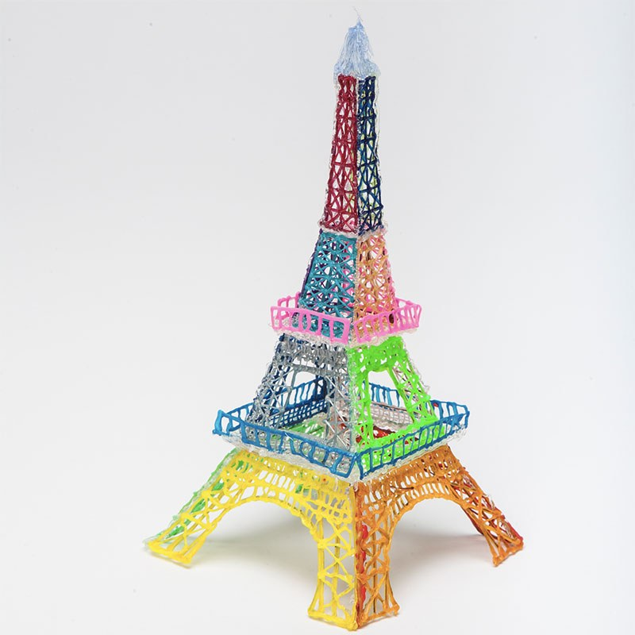
Essay Structure
This is the broad structure your essay should follow
Title
Include the essay title
Introduction
This should state the aim for your essay, and briefly introduce any key terms or concepts. The essay should be motivated– why is this topic important? You should outline the points you will be discussing in the essay, as well as any central argument that you might be making. This should be brief (one paragraph)
Main body paragraphs
There should be a paragraph per point made, and around four main body paragraphs. These should follow PEEL structure (see next slide), and the placement of paragraphs should make logical sense
Conclusion
This should be one paragraph that restates the purpose of the essay and summarizes the points you have made, as well as your final verdict on the topic. Consider broader implications of this topic briefly
References
Make sure all research cited is referenced. Please use APA format referencing and citations

Slide 23
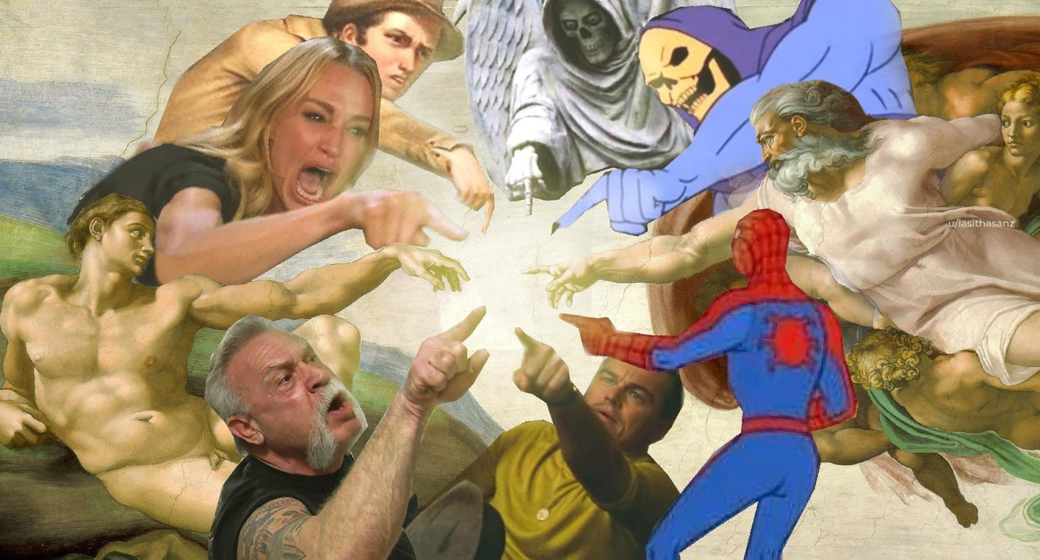
Main Body Paragraph Structure
There is a little flexibility with the order, but each of these should be covered
Point
Make one point
“Dogs are better-liked than cats in the UK”
Evidence
Include evidence from the literature with citation(s)
“26% of UK adults own a dog, whereas 24% own a cat
(Loeb, 2020)”
Explain
Explain how the evidence supports the point
“Since people tend to choose pets that they like, it would be
reasonable to take this as evidence for a preference for dogs”
Link
Include a sentence or two to outline how this is related to the question and/or the following point
“This is evidence that, at least in comparison to cats, dogs are the UK’s best-liked animal”

Slide 24
Don’t just describe the evidence– think about its strength, weaknesses and implications
This is broad, so it can include what drives development, individual differences, change with age etc.
The focus should be on infants and children
‘Critically discuss factors influencing and constraining development of socio-emotional processing, including processing of emotional expressions’
The focus should be on emotional expression processing, though you can touch on other skills

Slide 25
Critical Analysis Example
How to effectively critically analyse a study

Slide 26
Why Do We Need to Critically Analyse Research?
Because the study conclusions might be undermined by things like…
Conflicting evidence (especially from future replications)
Conflicts of interest & other unethical behaviour
Statistical methods
Methodological errors (e.g., tasks used, low sample size)
Flaws in the authors’ logic (e.g., unsubstantiated assumptions)
Factors unaccounted for

Slide 27
What Does Good Critical Analysis Look Like?
Specific
Research-based
At level of both study and field
Suggests directions for future research
Well-explained
Linked to a wider argument

Slide 28
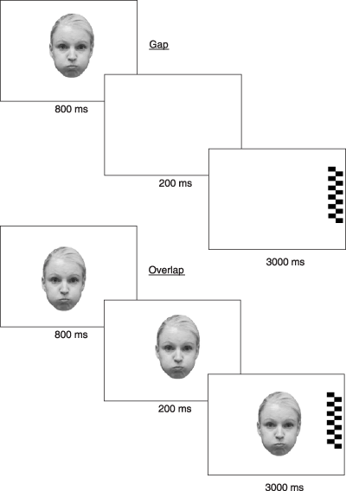
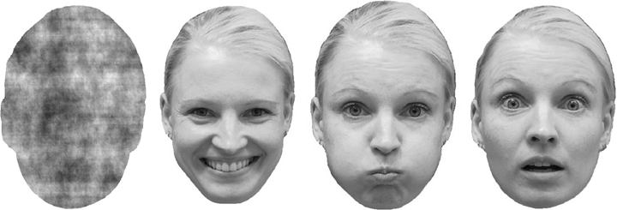
Peltola et al. (2008)
This study examined visual attention in 28 7-month-old infants
The authors wanted to investigate the hypothesis that infants allocate more visual attention to fear because fearful faces are relatively novel
They examined infant response to happy, fearful and novel facial expressions posed by two female models, as well as a scrambled face
Validity of the facial expressions was tested with ratings from 12 adults
Looking behaviour of infants to the faces individually was measured (sequential), and a gap/overlap paradigm was then used
Notes:
https://onlinelibrary.wiley.com/doi/full/10.1111/j.1467-7687.2007.00659.x

Slide 29
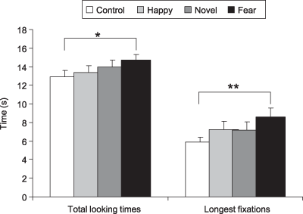
Peltola et al. (2008)
Videos of infants were coded by an independent observer
11 infants were excluded on the basis of gap/overlap data, and 1 on the basis of looking time data (primarily for excessive movement), leaving 17 infants (8 male, 9 female)
Looking time difference between fearful faces and control stimuli was significant, but the difference between fearful and happy faces or any of the other differences was not
In the gap/overlap, there were less frequent saccades to the target when the central face was fearful (so, lower frequency attention disengagement)
Novel face did not differ from control or happy in frequency of disengagement or looking behaviour
Notes:
https://onlinelibrary.wiley.com/doi/full/10.1111/j.1467-7687.2007.00659.x

Slide 30
Peltola et al. (2008)
We’ll now discuss critical analyses of this study in groups
All of the information you need is here: https://drive.google.com/drive/folders/1PoKvsRHHO7YDE3DNdZo3DXblRlivGiBw?usp=sharing
It’s not necessary to read the full paper, but it’s there if you want to refer to details
Notes:
https://onlinelibrary.wiley.com/doi/full/10.1111/j.1467-7687.2007.00659.x

Slide 31
Peltola et al. (2008) Critical Analysis Examples
Sequential presentation faces (unlike other studies)
No significant difference happy/fearful– contradicts other studies
Only two models used
Infants may be seeing fearful expressions at 7-months
Perceptual cues (eyes)
High exclusion rate leading to low sample
Notes:
https://onlinelibrary.wiley.com/doi/full/10.1111/j.1467-7687.2007.00659.x

Slide 32
Essay Discussion
‘Critically discuss factors influencing and constraining development of socio-emotional processing, including processing of emotional expressions’
The essay is due on the 25th of June. If you need an extension, please email me at ejj515@york.ac.uk ahead of the deadline. Late essays without an extension requested won’t be accepted.
The essay is a minimum of 1200 words and a maximum of 1500 words. Essays outside of this will not be accepted, so please double-check!
The essay should be in a word document format with APA references/citations—essays in other formats are difficult to mark, and so won’t be accepted
The essay is pass/fail

Slide 33
Essay Discussion
‘Critically discuss factors influencing and constraining development of socio-emotional processing, including processing of emotional expressions’
In groups, discuss points and topics that you may include in your essays
Think about which points will be the most relevant
This is a formative task, just to get you thinking about the essay ahead of time
https://drive.google.com/file/d/1IxQFVgbeVJFgzrjgifAqdCZmq3SUNxY5/view?usp=sharing

