Slide 1
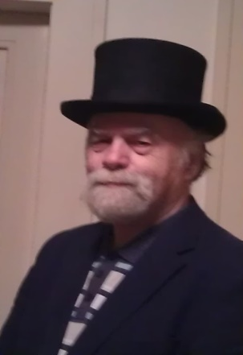
The Art of Asking Smart Questions
Lubomír Kostroň

Slide 2
Back to basics:
Hierarchy of what it is known :
data (information),
knowledge ,
understanding of priciples (wisdom)
What should be the criteria to sort out the information / knowledge? According to their origin, time, culture, the author? What are they concerned with (the name index)? Formal signs (kvantifiable x nonquantifiable)?
According to the mean of their transfer (Michael Polanyi) :
explicit (tangible knowledge) vs. implicit (tacit knowledge)
According to their usefullness, neeediness?
The basic unit for our purpose might be the professional domain, field.

Slide 3
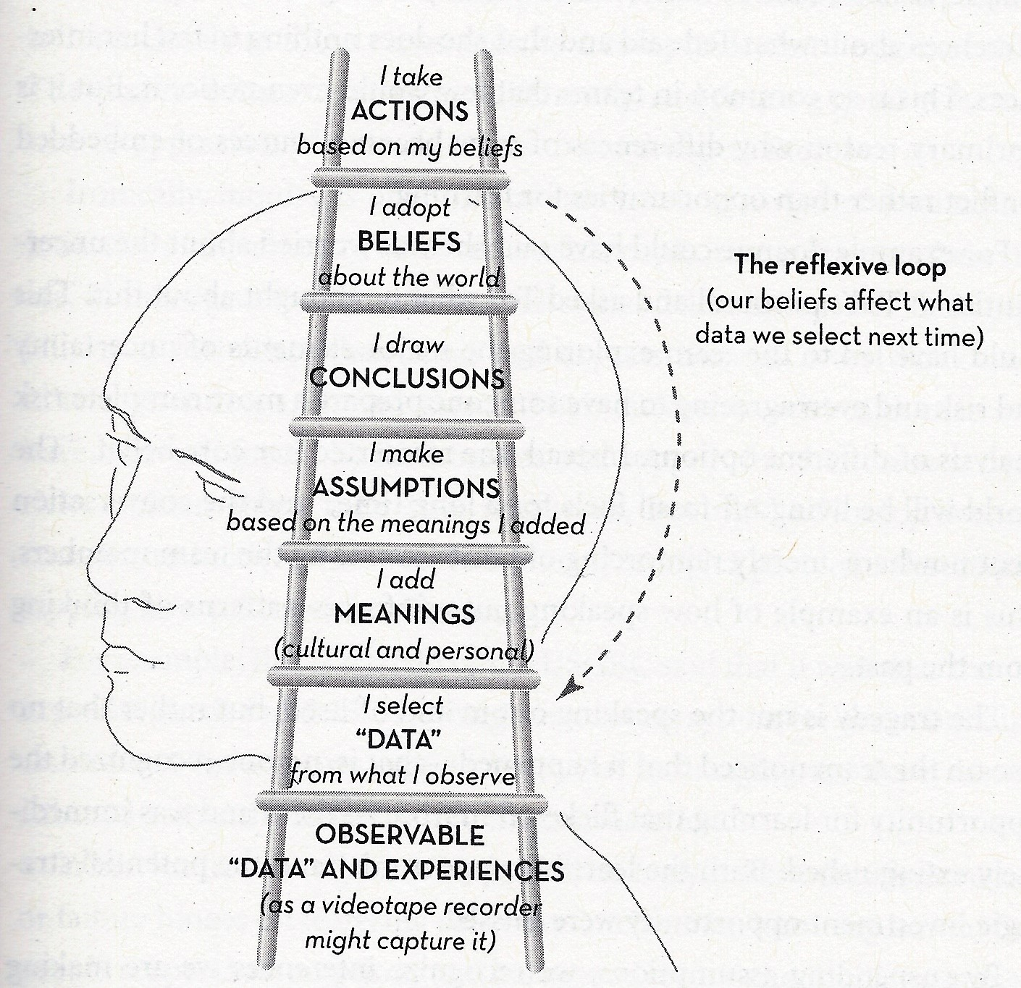
Thinking is
a process of a choice

Slide 4
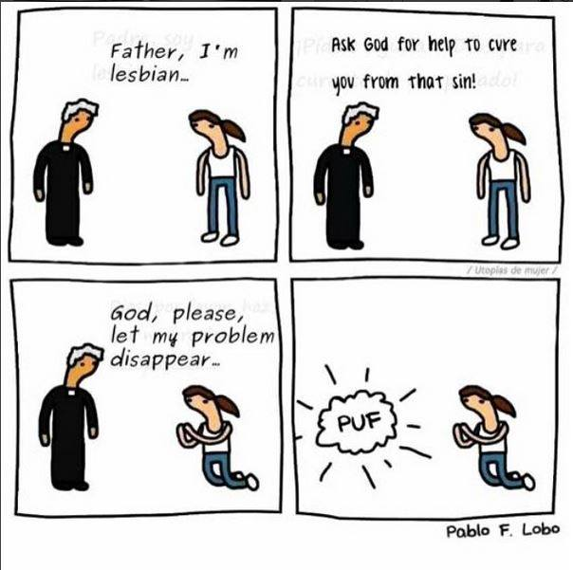
Thinking is a process of a problem conception

Slide 5
Remember, thinking (decision-making) is also a process past (tradicion, paradigm) dependent
The continuity
of past processes
rule. I can foresee,
but not to influence
Future
uncertainity
scope
The past
Evolution
trajectory
Expected and unexpected consequences.
The processes, I can influence
by decisions and actions
The predictions
time
horizon
present decision
moment
time
By Jay W.Forrester

Slide 6
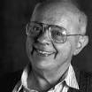
History - the changing paradigm:
All is within the powers of God….
All is deterministic, subject to eventual discovery and knowning; the nature can a will be mastered (the éthos of an industrial age)
The quality of a science and scholarship rests in the preservation, addition and extension of internally cohorent knowledge and opinions. The model is a growing and branching off tree of knowledge.
The world is a process of a change. The simple accumulation of „facts“ is not right any more….
Getting to know is and active process of a reconstruction of the perceived/truth).
„…the impulses, affecting our sensors, turn into an information if we can ascribe to it some meaning. The meaning, however, changes according the context, the situation…“
Stanislav Lem (1921 – 2006)

Slide 7
The quality of education according to its meaning
The meaning of a scholarship during the history:
a) To know and to accumulate the knowledge and skills ; to explain the world and life according the dogma, a practical use in life and a guidance to enter the life in a Paradise
The contemporary meaning :
a) + b) to master the production and the increase of productivity rules; the sustainable growth problems solution (i.e. economic, ecological, social = cultural, food, health, security needs),
The meaing of tomorrow:
a) + b) + to anticipate and to prepare for a new, even unexpected, increasingly rapid changes. The criterion of a quality today is: how are we prepared to cope with changes in the future? Basic knowledge, limits of their validity, the skills to open a new questions.
See also sir Kenneth Robinson on www.ted.com

Slide 8
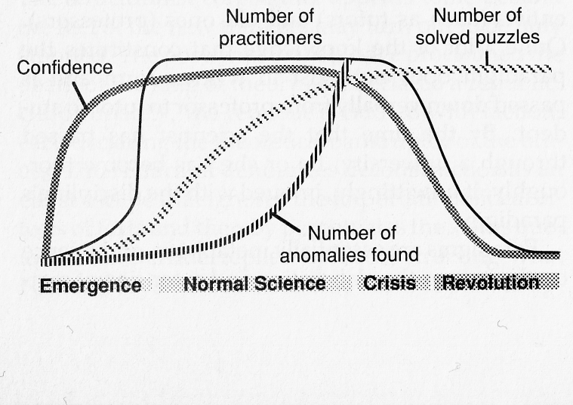

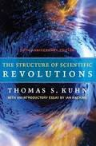
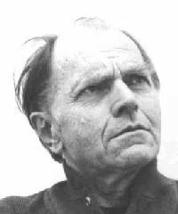
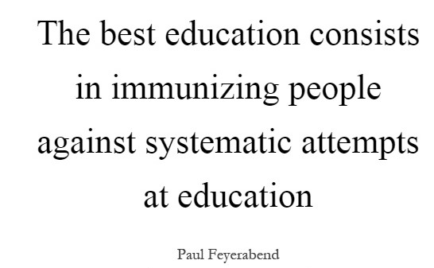
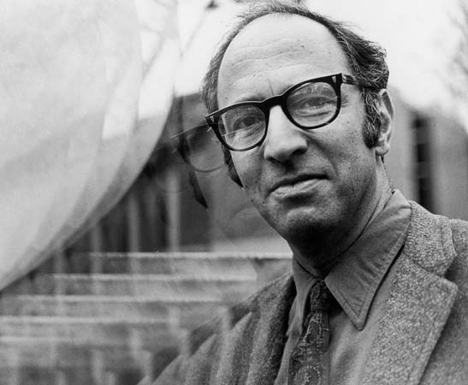
Learning new is an active process of a „truth reconstruction“ – a relativistic world
Paul K. Feyerabend
(1924 – 1994)
Paul Samuel Kuhn
(1922 – 1996)
„Anything goes“
„The answers depend
upon how you ask“

Slide 9
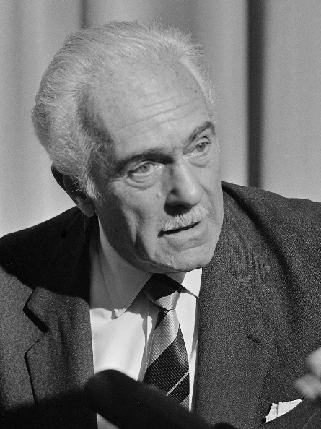
The quality of education (understanding) is changing:
We need both:
a) the explanation of the world, as well as
b) the ability to cope with the unknown future
Thus we need to predict all, what
is possisble, „to see the future in more
variants“ (see picture 34)
„although the future is unknowable,
it is possible to change it “
Aurelio Peccei,
the founding Club of Rome president
(1908 – 1984)

Slide 10
The art of asking questions:
The classic metaphor: The circle content is all we know,
the surrounding space is the unknown. As we learn, then the more we know (the circle content enlarges), the more questions arrise (the circle circumference extends).
If the amount of what we know and our
skills to ask increases, what happens with the scope of the unknown!?
Saying: the“ human IQ seems to be limited, the ignorance unlimited“

Slide 11
The „mainstream“ economics´ trajectory dictates: „grow“!
The life trajectory dictates: „grow and then decay“.
Is the ideal, ultimate goal of our specie to maximize knowledge (natural enquiery in children x life-long education)?
Is this assuption of growing and later decreasing ability to learn valid only for the individual or whole societies? Are the conditions for social learning fulfilled?

Slide 12
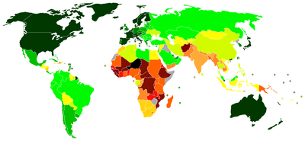
The economic trajectory dictates: „grow“!
It is said, that the transition to the use of a more sophisticated form of energy, requires to double the amount of information (knowledge) compared to the previous state.
How much is it necessary to know
to live a satisfied/happy life?
GDP gross domestic product or
HDI: human development index?
Which one is more „information“ (educational system) demanding?
Do they teach „satisfied life“ (friendship) in our schools – or families?
Is it a case of explicit (tangible) or implicit (tacit) knowledge transfer?
How to teach attitudes toward the unknown and the openess toward changes? The tolerance toward ambiguity (F scale)?

Slide 13
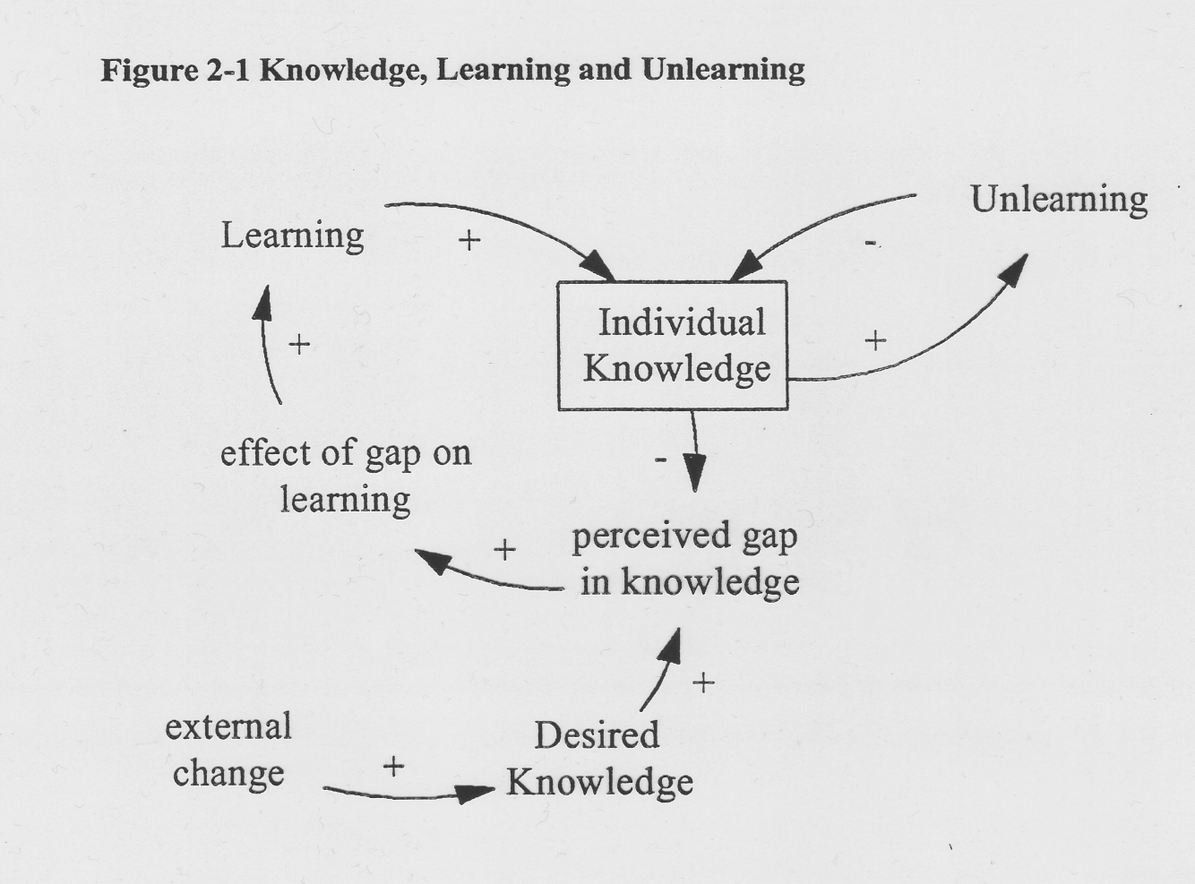
How to decide what is better to forget – to unlearn?
The difference between „to know“ and „to understand“. To understand grows from knowing the detailes, which then become unnecessary and are to be forgotten – unlearned to free the memory space (see „Aikidó“).
How to transform „change“ into the „gap“? Predicton of trends…?

Slide 14
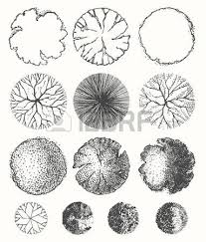

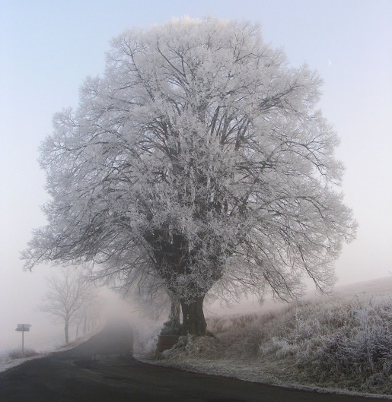
The art of asking questions
Why can we imagine things we want to do - and donn´t know how - better („puzzles“), than new, desired objects of our imagination („problems“)? Available or missing target metaphor?
How could we imagine (inquire about) objects we do not know yet so, as we could think better about how to create them – and thus the structure of known and unknown elements would emerge out of the realm of unknown?
Examples?

Slide 15
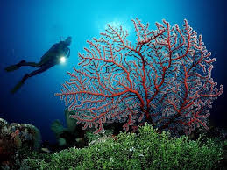
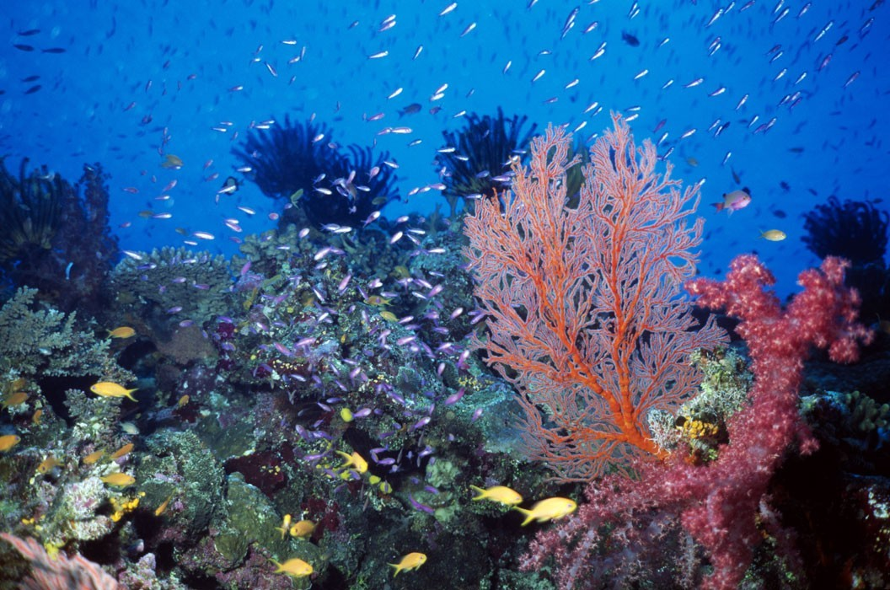
The art of asking questions
The information does not fade away, on the contrary, it spreads by sharing
(see also „the memes“ of Susan Blackmoore) and acquires a new meaning in a new
contexts.
Information/knowledge generator?
If we consider structures of the „known and new“ differently, then under which
circumstanecs could the information (knowlege) grow?
Could the AI „cultivate, grow“ knowledge as in plastic surgery they heal skin
wounds by nets of implants? (and as urban planners do in city – slums) ?

Slide 16
Considering the field: „metapsychology“
How to determine what is the subject matter of your professional field? What is an integral part of it and what already is not? By its theories - or problems, it copes with ? Any other idea?
What is most interesting topic in the given field and why? The most difficult one and why?
Which parts of the field are most controversial (consensus is missing) – is it due to their position on the border with the unkown? Their speculative nature (inaccessible to empirical research)? No professional tools available?

Slide 17
Metapsychology 2
Which are the most frequented topis in research or practice? Which are the least? What are the „blind spots“ of the field?
Could you draw a conceptual map of the field of your interest? What will you include in it?
Ho much will such a concept map change over time (short and long range)?
In what degree is its appearance result of a prevailing paradigm? How different would the map look if you change the paradigm? What concepts would you drop out, what new would you include, which relationships will change?
Name few theories explaining one problem. Say which seems to be mutually coherent (in agreement), and which are contradictory (inner inconsistency, conflict).

Slide 18
Metapsychology 3
How to define utility (usefulness)? Can you estimate the „utility/longevity“ of some kind of knowledge (for instance of a concept, of a theory)? Limits of their validity?
Can you use an economical concept of „aded value“? Given an effort which you need to develop in order to pass an exam, which course seems to be most usefull for you as a practicing psychologist later on?
Which professional activities seem to be well structured, as to be accessible to algorhytmization – meaning succeptible to diagnostic IT systems, „robotics“?

Slide 19
The exploration of the unknown, material objects
Durbin Gail, Morris Susan, Wilkinson Sue: Learning from Objects: A Teacher's Guide (Education on Site)
A workshop dedicated to the development of:
reasoning,
interpretation (various opinions about value, time and purpose of origin of things….),
sorting out concepts,
- wording questions,
- to see patterns, functions and their mutual relations,
- to make judgments developed on fragments

Slide 20
continue
Also some skills:
The placement of an object into a proper context, distiguishing among various contexts,
Hypotheses formulaton, comparison, judgment, assessment, prediction of individual traits consequences in respect to the whole / context, also in respect to possible generalizations,
Discovering the structure and function relations, the substance and principle used,
Searching for an adequite social, historical, economic and spiritual contexts (paradigm) at the time of the object´s origin .

Slide 21
continue
Examples of questions:
- What is the object´s value (symbolic, emotional, other…),
- Does it express any values or attitudes of its users toward the world?
- Are there present any time, usage, survival, changes, continuity, development traces?
- Consider the aesthetic quality, novelty - originality or is just a „recycled“ older concept used; is it specifc - typical, uncertain, multipurpose or one purpose tool to be used for analysis or synthesis ?
- Is it all or just a part of some larger whole? Does it belong (in)to something? Is it ment to be mobile or stabile?
- What did it served to?
- What material(s) were used for its production?
- I it raw (unfinished) material or is it worn out by its use?
- Is it hand made or machine produced?
- ….
- Tell a story „how does it feel if you would become this object?“

Slide 22
An analogy: generating questions about abstract concepts
(take pychology as a whole or just your narrow field of your professional interest):
1) What is the name of your professional field (domain)?
2) What is its basic topic, subject matter, what is it dedicated to? What problems does it solve?
3) Into what decade would you place its origin?
4) Did it develop from a broader, older domain, field?
5) State 5 – 10 basic concepts (theories) used in your field.
6) Can you draw a concept map which constitute the field (basic concepts and their mutual relations)?
7) Is the map internally consistent? How can you prove it (empirical research)?

Slide 23
Generating questions about your field 2
8) What are any other fields of related knowledge? Can you also loceta them somewhere on the map?
9) Is it a field, which prospers thanks to an interdisciplinary co-operation?
10) Is it a filed mostly descriptive, defining and structuring the subject matter of its interest – or a prescriptive or predictive one?
11) What is the nature of the main research methods (approaches) used in the field? Are they used by other sicences? Does it use experiments?
12) Which of its theories have an origin in solving practical problems?

Slide 24
Generating questions about your field 3
13) Does it have its own research methodology (methods) or just adopted them from other sciences?
14) Does the body of a theory grow by an accumulation of knowledge gained – examples?
15) Is the research methodology mostly of a qualitative or a quantitative nature?
16) Does it use both approaches – to what purposes? Any use of an „Action research“?
17) Would you include your area of interest among natural or social sciences?
18) Depending upon the topic, is it rather the basic or applied research?
19) Considering the social needs, what is main contribution, meaning and significance of psychology?

Slide 25
Generating questions about your field 4
20) Considering the future social needs, which discovery (innovation) in psychology would bring a greatest social benefit ?
21) In which area the development of the field stagnates; what might be the cause of it?
22) During the course of history, did psychology experience any conceptual crises, revolutionary change and shifts? What was the problem, who were the„big names“?
23) Does your field grow from a „real word“ or is rather of a speculative nature ( does it use more the corespondency vs. coherency theory of truth)?
24) They say, that the development is not a linear, continuous one. How did your field develop, can you imagine its next qualitative leap?

Slide 26
Generating questions about your field 5
25) What are the main principles („wisdom“) of your field? Which of them may change so, as to cause convergency of a particular key important „psychological domain“ with some other science? How will psychology – as a science – change in the next few decades?
26) Into the solution of what problem will you invest your energy, talents and time – to make a real contribution ?!
27) ….?

Slide 27
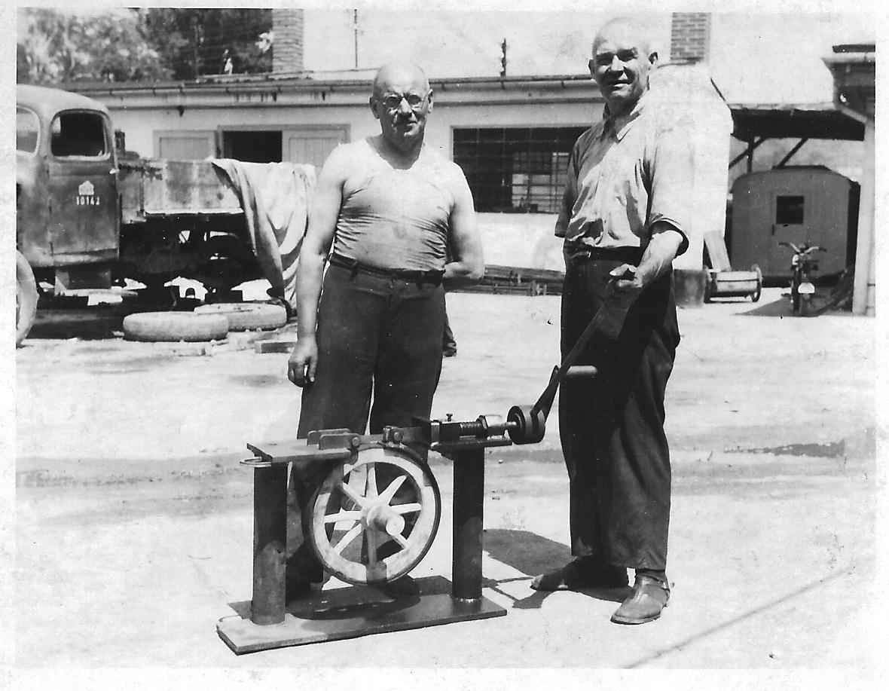
Good timing: the sad case of a discovery, which came too late
My own grandfather,
blacksmith František
Čáp, posing proudly
by his new discovery.
This device puts a metal
hoop on wooden wheels
under normal
temperature,
without heating the
metal red hot.
Průmstav,
Výstaviště, Brno 1946

Slide 28
Additional „Remarks on creativity“
Robert P. Crawford
The basic creative process is :
a special kind of adaption. The choice of one item´s feature (trait) and its use on other item;
an item (a process, a thought), which we take one feature (quality) from; a second item (a problem, process, thought) becomes richer, changed by the use of a feature (quality) of the first item added;
a third item arises (a problem solved, a new prosess, a thought), enriched and changed by the application of the said feature (quality).

Slide 29
Remarks on creativity 2
How to recognize and to choose the essential, substantial features (traits):
In the social context they are usually the financial profit, a success, a laber reduction, well-off being, taking things easy, an aesthetic experience, adopting a prevailing way of thinking (a paradigm),
It is essential to recognize the substantial, fundamental features early at the beginning – before dealing with detailes – they influence later direction of reasoning,

Slide 30
Remarks on creativity 3
A list of obvious features (qualities) improves the ability to discover other ones, more hidden (equivalents to operations with abstract concepts might be those, which we do with material objects: enlarge it, reduce it, lower or increase its prize, extend (shorten) it, reduce the weight, decorate it (or vice versa), make it safer, turn it into a mobile item, change the round shape into other one, put it upside-down or inside-out, change material or colour used, increase user friendliness),

Slide 31
Remarks on creativity 4
d) Perceive differences sensitively. The ability to „look into the future“ evolves from observation. Features, characteristics of objects should be considered from the point of view of the future, of the past and not only the presence.
e) New evolves everywhere, the creative process is endless in time, as well as in space, possibilities have no boundaries.
f) The acceptance of a new idea depends upon the possibility of its application and use to solve a pressing problem.

Slide 32
Remarks on creativity 5
While seeking a solution to a problem (for instance a technical malfunction), retreat from the level of an actual technical solution used and elevate your considerations to a more general level of a physical principle used. Use a different one.
Accordingly, in the social systems, a conflict resolution may be more obvious, when you consider the importance of basic values involved.
In a hopeless situations refer to Murphy´s laws.

Slide 33






Remarks on creativity (group procedures) 6
Edward de Bono „Six Thinking Hats“
What do I want to achieve? One direction thinking only.
Facts, points of departure, no tendencies, no directions
Alternative ideas, thoughts, asociations,
pointing to all directions
Emotions, interests, preferences, ideas pointing outise from the core
Critical points, identification od weak points, what will brake down and why is it all wrong
Management, the bird and more distant view, broader contexts; summaries, recapitulation – overall overview

Slide 34
Remarks on creativity (group procedures) 7
The future scenario plannning
A weekend brainstorming session. Key steps:
- What is the key question to be answered (may be agreed upon in advance)?
Which forces drive the development forward?
What are the most important risks and uncertainties?
Out of the dominant tendencies, choose two axes, creating four quadrants (possible „worlds“).
Define the natures of those four worlds and also an image of four types of organizations, prospering in them.
Compose four types of business strategies (later even personnel strategy), adequate to these worlds. Choose the desirable ones and work the in detail.
Later, repeat the procedure periodically and compare your choices with the reality. Adjust the navigation.

Slide 35
Conclussion: a) in long run, what would you prefer – to learn or to remain courious? b) rewrite the textbook ! c) thanks for your thinking.

Slide 36
Literature
Bono Edward de (1985) „Six Thinking Hats“, Key Porter Books
Boorstin Daniel J. (1983), „The Discoverers. A History of Man´s Seach to Know His World and Himself“, Random House
Crawford Robert P.,(1964), „Direct Creativity“, University of Nebrasca, Fraser Publishing Comp., Vermont
Duncan R., Weston-Smith M. (ed.) (1977) „The Encyclopaedia of Ignorance – everything you ever wanted to know about the unknown“, Pocket Books, N.Y.
Durbin Gail, Morris Susan, Wilkinson Sue: „A Teacher´s Guide to Learning from Objects“, English Heritage
Stenudd Stefan, (2008) Aikido: The Peaceful Martial Art. BookSurge.
Turner W.B., (1986) „Nothing and Non-Existence:
The Transcendence of Science“, Philosophical Library, N.Y.

