Slide 1
BEHAVIOURAL ADDICTIONS

Slide 2
Behaviours that:
Have a potential to produce short-term reward
Individuals tend to engage these behaviours repetitively and with diminished control
Persistent pattern of engagement in these behaviours leads to problems and conflicts over time
Behaviours that have similar symptoms as substance addictions (in Griffiths’ model salience, euphoria, tolerance, conflicts, relapse & reinstatement. Questionable presence of withdrawal symptoms).

Slide 3
Similarities with substance addiction
Both have similar course: they start as ego-syntonic and slowly develop into ego-dystonic (love-hate relationship with the subject of addiction). Ego-syntonic = in harmony with ego (its values, goals, needs) ego-syntonic = opposite to one’s needs, values, self. Ego-syntonic nature of these behaviours is the reason why we do not label them as obsessive-compulsive disorders.
High mutual cooccurrence – gamblers often show pathological use of alcohol, nicotine, or even amphetamines. Pathological gamblers have several times higher chance of being diagnosed as addicts to some substance. Cooccurrence of behavioural addiction and substance addiction predicts increased severity of each
Similar personality profiles – males of younger age are more susceptible. Increased impulsivity, sensation-seeking, ADHD and decreased harm avoidance (internet based addictions are exception – harm avoidance is increased). Increased comorbidity with depressive symptoms

Slide 4
Similarities with substance addiction
Similar cognitive deficits - e.g. cues related to addiction are processed faster. Cue-association found in the same brain areas
Alteration in functioning of mesolimbic dopamine pathways reported – both substance and behavioural addictions are primarily disorder of motivation and learning
Parkinson patients treated by dopamine agonists found (is some cases) to develop behavioural addictions
Reward deficiency syndrome (gene-based decreased number of dopamine D2 receptors) found also in gamblers
Behavioural component is very strong also in substance addictions
Similar responsiveness to treatment - in most cases, even substance use treatment targets the behavioural/cognitive/psychological component of addiction. No medication for behavioural addictions yet, but promising results in use of opioid antagonists used for alcohol and opioid addictions.

Slide 5
But it may just not exist because
We know too little. 1) evidence comes mostly from gambling studies- are there any other behavioural addictions at all? 2) no animal studies 3) only few and rather short longitudinal studies 4) low number of family and genetic studies
Normativity issue – is behavioural addiction just a new label for bad behaviour? Aren’t we over-pathologizing certain behaviours? Aren’t we spreading unnecessary panic?
Problems with tolerance and especially withdrawal symptoms – behavioural and substance addiction may be less similar than we think. However, all research in this field was done through optics of substance addictions and thus may be biased from the beginning

Slide 6
diagnostics
Gambling included in DSM-IV and ICD10 under umbrella of Impulse Control Disorders = disorders characterized by failure in temptation (e.g. kleptomania, pyromania,…). Other potential behavioural addictions could be diagnosed as “impulse control disorder unspecified/other”
DSM-5 (2013) included gambling as addiction. Internet gaming disorder included only as experimental diagnosis
ICD11 (2018) included 1) gambling disorder 2) gaming disorder 3) compulsive sexual behaviour disorder (gambling and gaming under umbrella of addictions)
Other potential behavioural addictions include: eating disorders (overeating, bulimia and anorexia nervosa), excessive exercise, excessive use of social networking sites (that includes excessive use of smartphones), love, shopping,…

Slide 7
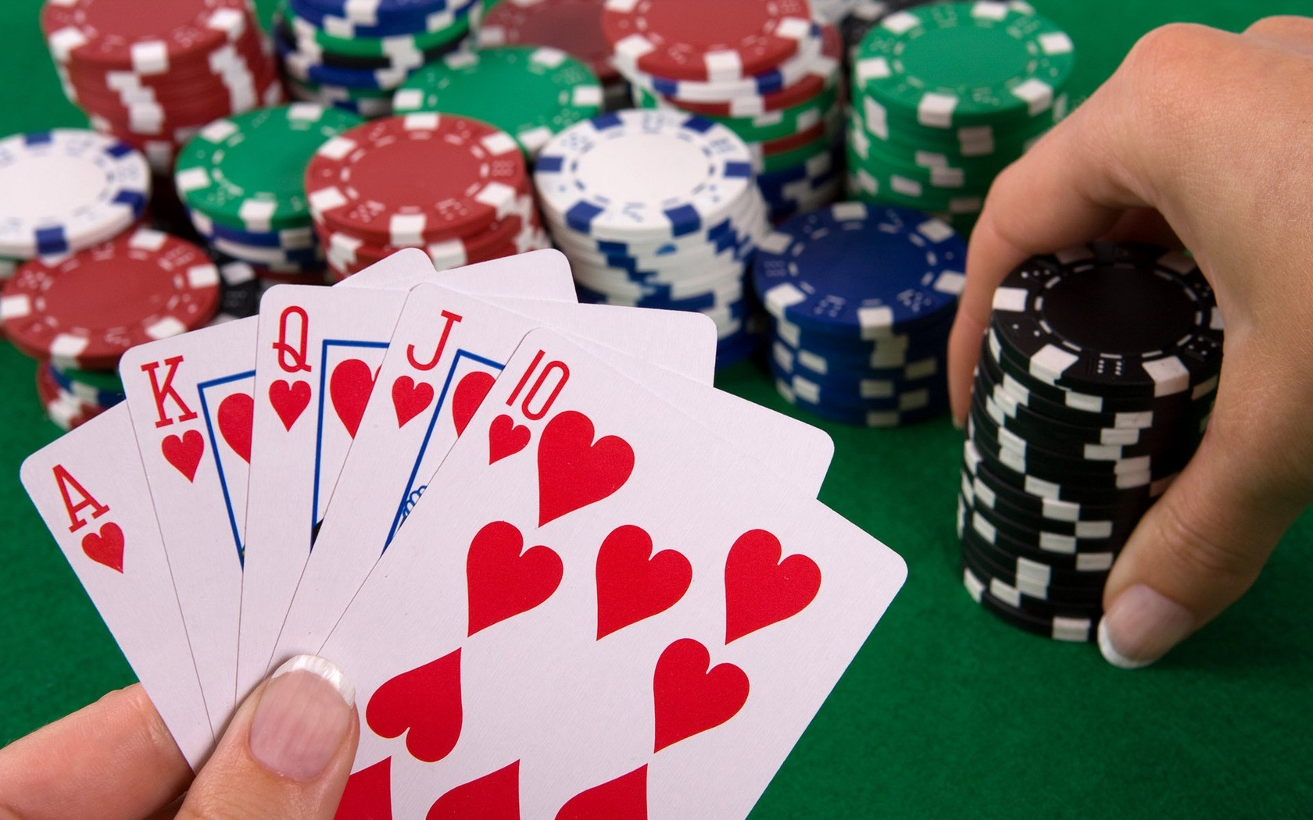
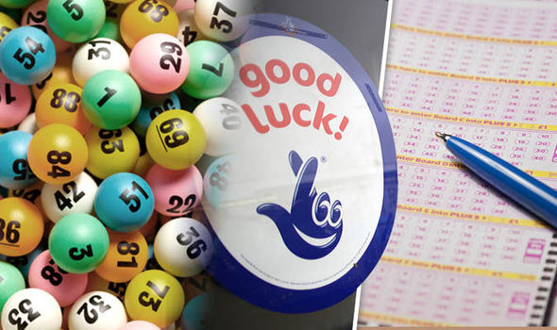
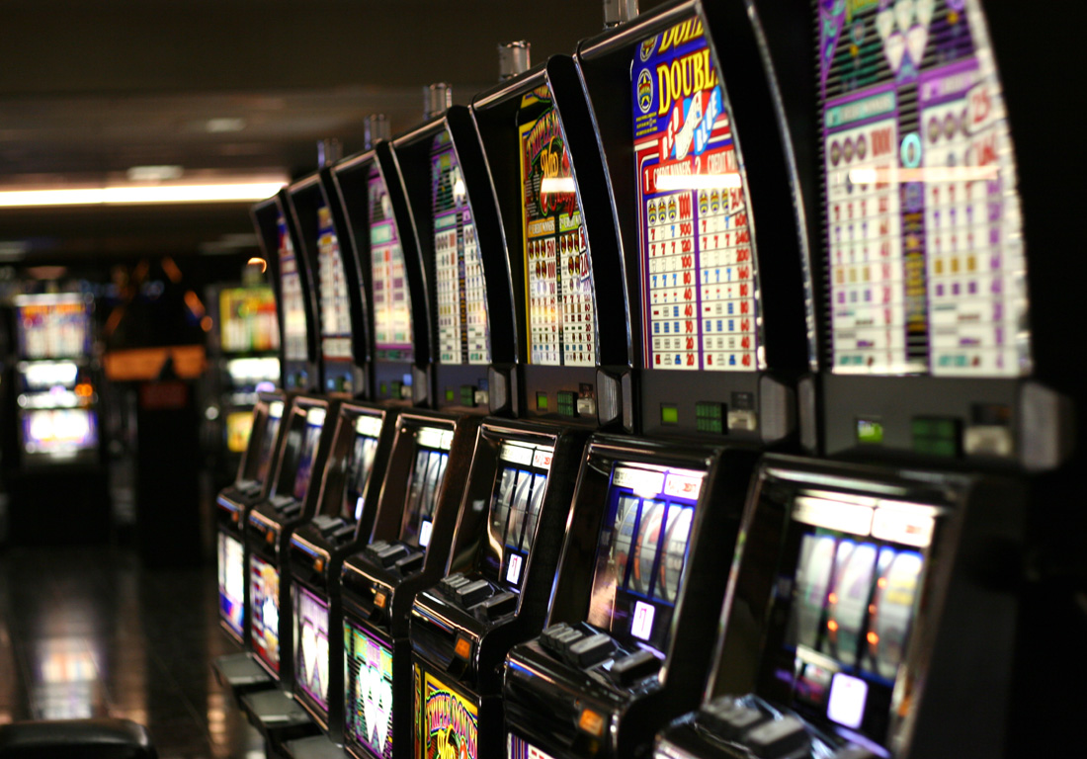
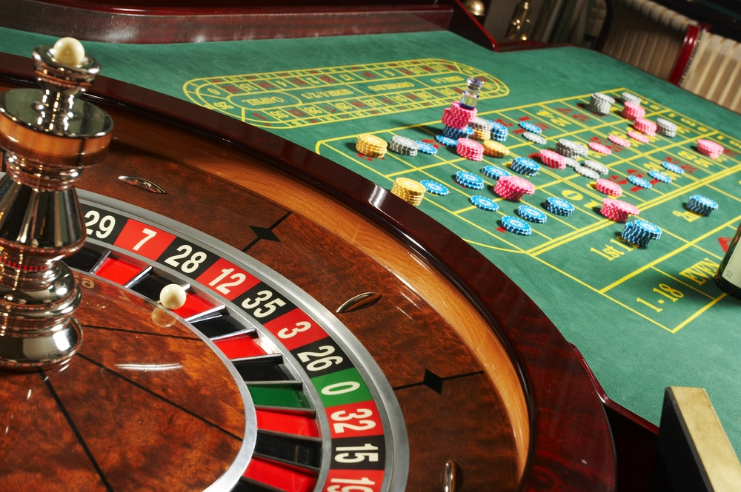
GAMBLING

Slide 8
gambling
Popular entertainment from the beginning of mankind
“a game o chance”
Games differ in speed (tempo); size of bet, prize structure; frequency of win/reward; role of skill
Games of pure chance: lottery, slot-machines
Games of skill: sport betting, poker

Slide 9
Pathological gambling in ICD 11
Gambling disorder is characterized by a pattern of persistent or recurrent gambling behaviour, which may be online (i.e., over the internet) or offline, manifested by:
1) impaired control over gambling (e.g., onset, frequency, intensity, duration, termination, context)
2) increasing priority given to gambling to the extent that gambling takes precedence over other life interests and daily activities
3) continuation or escalation of gambling despite the occurrence of negative consequences. The behaviour pattern is of sufficient severity to result in significant impairment in personal, family, social, educational, occupational or other important areas of functioning.
The pattern of gambling behaviour may be continuous or episodic and recurrent. The gambling behaviour and other features are normally evident over a period of at least 12 months in order for a diagnosis to be assigned, although the required duration may be shortened if all diagnostic requirements are met and symptoms are severe.
Exclusion criteria: bipolar disorder

Slide 11
pathological gambling prevalence
Prevalence varies in European countries between 0.5-2% (more in Finland 3%)
Prevalence is several times higher in adolescents – up to 12%
Huge differences between countries even of similar cultural background suggest strong influence of legal status of gambling (availability)

Slide 12
Risk factors – social & demographic
Age – usually starts and peaks in older adolescents. Exposure in this age correlates with severity in adulthood
Gender – males gamble more often and face more sever pathology. Males prefer skill games (betting, poker), females prefer slot machines (for dissociation).
Social economical status – lower SES correlates with gambling
Accessibility – close proximity to gambling places highly increases likelihood of the behaviour
Marital status – singles are more at risk
Family background – living in one parent family or social modelling – positive attitudes towards gambling in family or peer group
Experience – winning large sum at the beginning of gambling carrier predicts more persistent and stronger pattern of behaviour

Slide 13
Risk factors – psychological & psychiatric
Depressiveness – 50% of gamblers have lifetime mood disorder. Gambling usually precedes depression
Anxiety – up to 40% of gamblers have lifetime anxiety disorder or obsessive-compulsive disorder
Substance use – majority use alcohol, up to 40% use other (illegal) drugs. Substance abuse increases risk of remission, overal pathology, suicidality
Early childhood trauma – emotional up to 60%; physical 40%; sexual 20%. Presence of trauma correlates with severity of pathology. Abuse was significantly more common condition for women.
Sensation seeking – under-aroused, prone to boredom, hypomanic

Slide 14
Risk factors – irrational cognition
Illusion of control – superstition tendency, believe in skill is often magnified (too high self-confidence). https://www.youtube.com/watch?v=I0xOoyMeSF8 3:27-7:20
Recall bias - wins are overestimated in their strength and frequency while losses are underestimated and forgotten
Gamblers fallacy – believe that even totally random events are influenced by past events. If something happens more frequently now, it is going to happen less frequently in future
Near miss phenomenon - a failure that is felt to be close to win and thus raising hope for future success. Gives wrong information and produces excitement. Produces illusion of control even in pure games of chance. It would be foolish to stop when I am so close… https://www.youtube.com/watch?v=uAZu0coArhI
https://www.youtube.com/watch?v=6NZuyfpQTms

Slide 15
Negative effects
Crime – majority of pathological gamblers have some experience with theft, fraud, robbery, assault & blackmail
Bankruptcy and other financial issues
Deterioration of family situation
Suicide – some suicidal intention in almost half of pathological gamblers
Very high comorbidity with substance use – especially alcohol, nicotine, amphetamines – increase all health risks typical for those substances

Slide 16
Pathway – antisocial impulsivist
Predominantly males
Highest severity of pathology
Common personality disorders, substance abuse, suicidality, criminality, low frustration tolerance, higher impulsivity and attention deficits
Under-stimulated – tendency to experience boredom

Slide 17
Pathway – emotionally vulnerable
Higher rates of emotional difficulties, anxieties, depressiveness
Gambling to cope with negative emotions, escape from life troubles (overstimulated)
Lower rates of criminal activity compared to antisocial impulsivits
More typical for female gamblers
Telescopic effect -women start later in life but pathology develops in shorter time.
However women tend to seek treatment more quickly than men

Slide 18
Pathway – behaviourally conditioned
Irrational believes, poor decision making
Lower psychological, psychiatric conditions compared to other groups
Lower severity of pathology – so called sub-pathological population population
Probably the largest group

Slide 19
Gambling online
casinos (roulette, slot machines)
poker
sport betting & live betting
lotteries, bingo
skilful gaming (mahjong, chess, knowledge games)
Even regular computer games include more and more gambling features

Slide 20
Gambling online
Even when legal and thus accessible – increase in prevalence of gambling is rather small
However increase in adolescents who are not allowed to gamble otherwise –online gambling may serve as a gateway for regular gambling or may develop to pathology itself
Attractive for males, younger, with above average income BUT pathological online gamblers have rather below average income

Slide 21
Gambling online
Pathological offline and online gambling are not necessarily related
For some online gambling is only a momentary activity when (preferred) offline gambling is not accessible
Both offline and online venues attract different personalities
Lower related risks – lower exposure to substance use and criminal environment

Slide 22
Gambling online
Online gambling is potentially riskier because
Accessible anytime anywhere
Lower social control when on computer – what one does may not be transparent for long time.
Anonymity on the internet
Significantly lower age of most online gamblers
Online casinos use strategies like training rooms, play for free etc. – online gambler may be pre-conditioned even before regular gambling starts
Electronic money not as real as real money
Higher illusion of skills involved

Slide 23
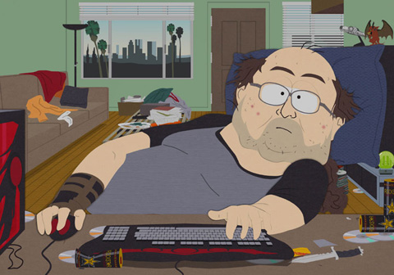
GAMING ADDICTION

Slide 24
GAMING DISORDER – does it really exist?
Computer games is one of the fastest growing entertainment industry (nowadays earning more than all world film industry)
From “nerd-only” genre it evolved to attract more diverse social groups
For the vast majority of gamers it is just a free-time activity without any harm – even phenomenon like induced aggressiveness was not proofed
Computer games suffer from moral panic - similar to situation in film cinemas in 30s, comic books in 50s, TV in 60s – situation is judged by people who grew up without computer games and thus they tend to misinterpret it

Slide 25
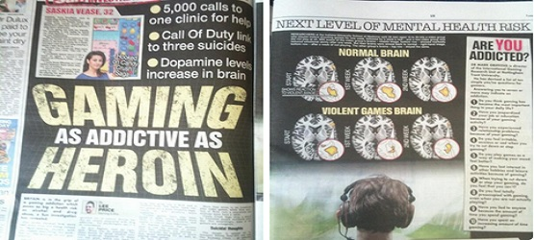
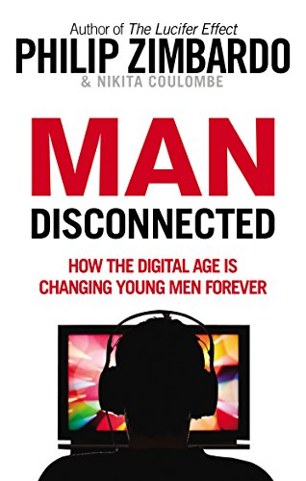
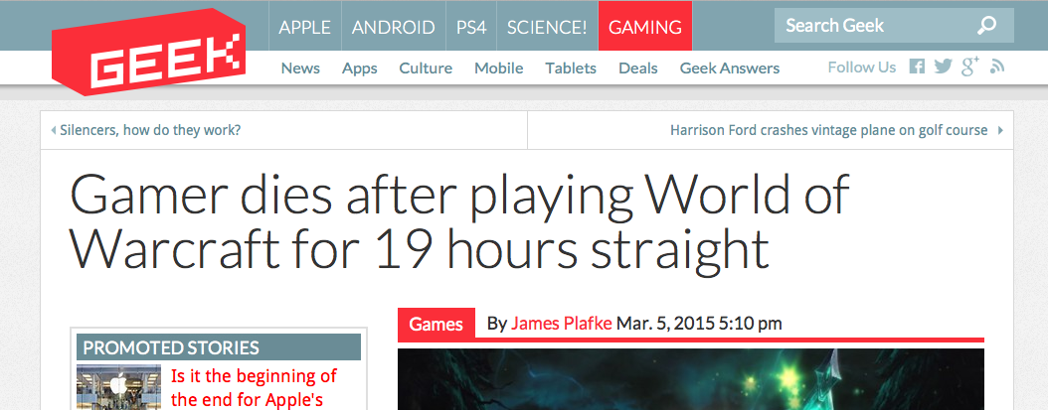

Slide 26
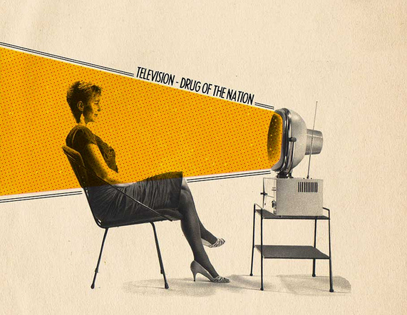
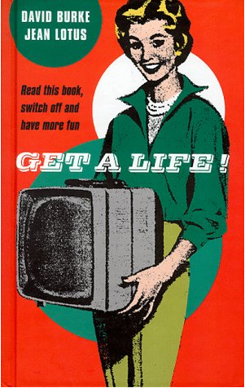
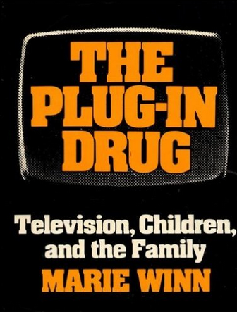
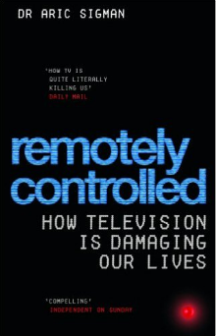
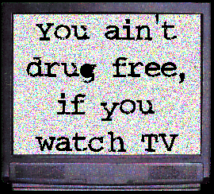
Notes:
Nadměrná konzumace televize
- hloupnutí, pasivita, lenost, obezita, vyšší kriminalita a ochota k násilí, těhotenství nezletilých...
Frankfurtská škola – televize odvádí pozornost od podstatných věcí
Boom kritiky televize v USA 70-90. léta, v ČR 90. léta a později
Williams (1975): flow jako sekvence nebo sada sekvencí obsahů

Slide 27
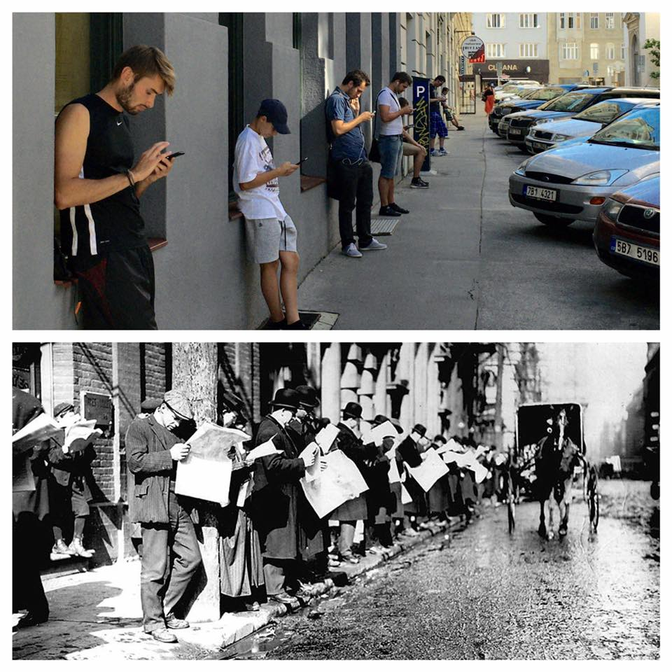
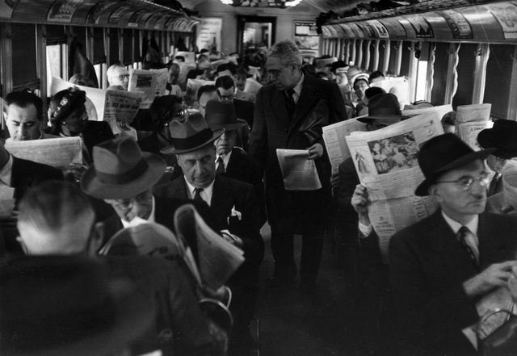

Slide 28
GAMING DISORDER
Intensity of gaming is much higher than any media usage before – online games are played about 20 hours per week, those with higher addictive potential about 35 hours per week on average
The most successful games are still those targeting “standard nerds” –90% of gamers are younger men (teenagers and young adults)
But we still know too little – only few neurological studies (however they support addiction model – intensive gamers have changes in reward pathway and prefrontal cortex similar to cocaine users) and too short longitudinal studies (we have no idea whether gaming disorder persists longer than 2 years)
Even if the addiction model will not proof, intensive gaming is not healthy due to time devotion, unhealthy physical and social lifestyle: problems in school/work, lack of sleep, problems in social interactions, health problems (repetitive strain injuries,…)

Slide 29
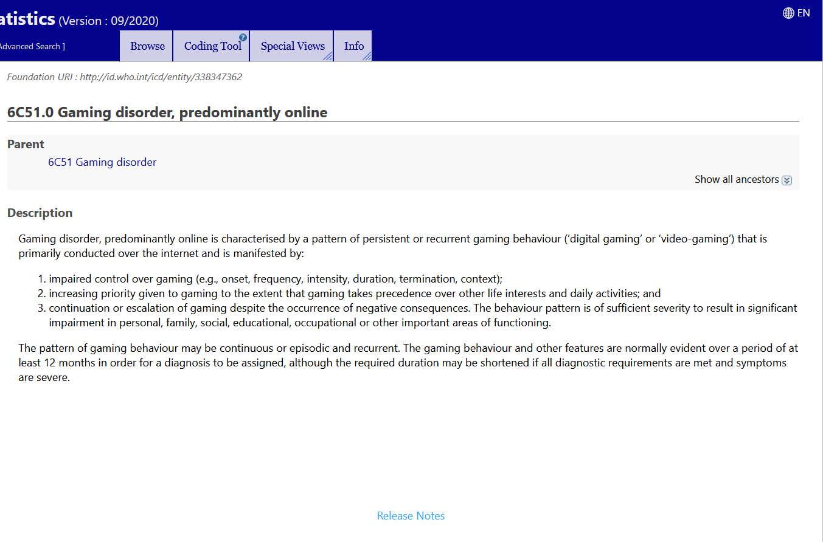
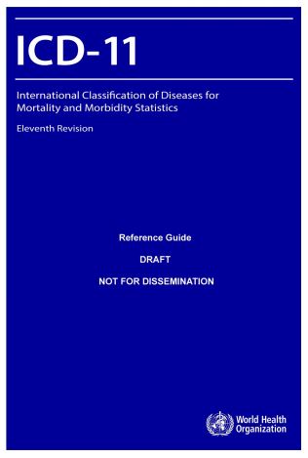

Slide 30
What games are suspects and why?
MMO – Massively Multiplayer Online (e.g. World of Warcraft, Even Online) & MOBA – Multiplayer Online Battle Arena (e.g. League of Legends, World of Tanks)
Other game genres like Simulation games or First-Person Shooter games do not seem to be the problem. Offline games (traditional computer and video games) are not problem at all
Important features (structural characteristics increasing addictive potential):
Social dimension – recognition, easy communication
Advancement & permanent rewarding
Permanent feedback – feelings of control
Persistent world – exist even when the person is offline, no-end and blurred time structure
Inclusion of reward mechanisms known from gambling (e.g. near miss, random reward boxes)

Slide 31
Risk factors of addiction
Males of younger age
Feelings of loneliness
Low self-esteem and low self-efficacy
Social anxiety and generally lower social competence
Need for control, low flexibility
Self-control difficulties and hyperactivity (e.g. ADHD) in younger age
Higher alexithymia (decreased ability to reflect emotions) and mild autism-like personality
Depressiveness

Slide 32
ADDICTION VS ENGAGEMENT
Engagement – intensive game play that is not pathological
I feel happy at the thought of playing
I often experience a buzz of excitement while playing
Addiction – intensive game play that could be labelled as pathological. General addiction criteria used in most addiction-like behaviours - conflicts, relapse, loss of control, escapism
I sometimes neglect important things because of an interest in…
I have made unsuccessful attempts to reduce the time I spend playing
I have used game play as a mean to escape from…

Slide 33
Those under influence play more intensively: stimulant-type pharmaceuticals (+9.8 hr/week), Ecstasy/MDMA (+9.6), sedatives (+6.9), amphetamines (+6.2), caffeine (+3.8) Game-related motives were mentioned by 1/3 of respondents: avoiding sleep (25.8%), increased concentration (15.6%), enhanced enjoyment (13.8%), tension management (7.3%), increased courage (4.1%), avoiding hunger, (2.7%), and insomnia management (2.0%). Higher scores in addiction: sedatives (including alcohol), tobacco, tranquilizers (eliminating anxiety and fear)
Higher scores in engagement: stimulants, caffeine, ecstasy

Slide 34
Impulsivity – inability to delay gratification, tendency to ignore negative consequences, less behavioural control. Important factor in most (all) addictions
Frequency of gaming: addiction β=.29, engagement β=.24
Impulsivity: addiction β=.25, explained 7% of variance; engagement β=.07, explained 1% of variance
Plays a role especially in combination with age – adolescents have naturally higher impulsivity (peaks at 17 and then gradually decreases with age)
Impulsivity stays behind relapses to problematic patterns

Slide 35
Alexithymia and gaming
Alexithymia – impaired emotional awareness, decreased sociability and empathy, concrete logic-like thinking (decreased imagination)
Affective dysregulation often leads to high risk of other psychiatric conditions – somatization, anxiety, depression, often found in substance abuse and gambling
Alexithymia explained 30% of variance of addiction while only 2% of variance of engagement
addiction: diff. in describing emotions β =.270; externally oriented thinking β =.199
engagement : externally oriented thinking β =-.162
Need for external rewards. Avoiding coping style

Slide 36
For public and uninformed professionals both addiction and engagement may look similarly – danger of overpathologization
Addiction and engagement are qualitatively distinct concepts – both predicted and associated with different psychological factors
Addiction is associated with those psychological concepts that have been shown to be associated with other addictions and other pathological behaviours
Substances are making their way to media use
Negative consequences are not necessarily caused or related to addiction

