Slide 1
ENVIRONMENTAL BASIS OF ADDICTION
ADDICTION

Slide 2
Addiction as rational choice
Taken from economy theory – addictive behaviours are consumer behaviour
Cost-benefit analysis: we do things because they bring some benefits that out-weight negatives
Weighting benefits (e.g., pleasure, relax, decreased tension, boosting energy) and costs (e.g., money loss, legal consequences, health consequences, deterioration of social ties).
Example 1: why are some substances more common than others? – their costs are not that high (e.g., they are legal; easily accessible; health effects only slowly accumulates over time).
Example 2: In stressful and bad times (personal or societal crisis), benefits of drugs are getting higher (e.g., they help to forget, create social ties)
Assumptions are rather vague. Detailed analysis (e.g. using mathematic formulas) usually wrong. E.g., theory predicts older people to be more involved in addictions, but it is the opposite

Slide 3
Why do we engage in addictive behaviours?
Improve social interaction
Improved physical & sexual appearance
Improved cognitive performance
Improved sexual performance
Improved self-esteem and feelings of self-worth
Coping with stress
Pleasure-seeking
Sensation & novelty seeking
Overcoming boredom
Reduce psychiatric symptoms
Gaining position withing social structures
And others…

Slide 4
Diffusion and epidemic model of addiction
Diffusion follows rules of imitation – inferiors imitate the superiors (trickle-down effect). E.g. lower class adopts behaviour of higher class; role-models show trends
Epidemic follows rules of other (natural) epidemics. Spread of addiction through social proximity - via families, neighbourhoods, friendships, schools, workplaces, prisons
Urban hierarchy – usually goes from large cities to smaller towns and to countryside via the most frequent used means of transportation

Slide 5
Societal risk factors
Families – genetics, parental neglect & abuse, impaired attachment styles, modelling behaviors, parental approval
Intimate relationships – can be both the risk and protective factor
Gender – addiction associated with a traditional gender role in men (men consume much more substances and are involved in addictive behaviors – often culturally understand as manly behavior) but also with non-traditional gender roles in women.
Environmental factors are stronger in women while genetic factors are stronger in men. Women have much lower chance of becoming addicted, their addiction tends to develop later in life (often after 30 while in teenagerhood in men) but has faster progression and is more frequently associated with affective dysregulation – telescoping effect
Being a parent can be a protective factor (but often it isn’t, especially in men) - it is contextual with other factors

Slide 6
Societal risk factors
Peer influence is very powerful, especially in adolescence (but also later in life)
The reason is to gain better position within group hierarchy, to socialize, to be more confident in establishing romantic relationships, to decrease anxiety in general
In later life stages, the peer influence is more associated with mere availability of the substance (attitudes, norms)
Normative substance use – each group has some unwritten rules what is considered as normal. Addicted people often think that the norm is higher that it actually is
Normative feedback (peer disapproval) can be used for prevention and interventions

Slide 7
Societal risk factors
Ethnicity – addictions and addictive behaviours are much more common in ethic minorities
Reasons: cultural background, genetic susceptibility, more frequent poverty, discrimination, stress
Critical sociology – addictive behaviours are more severely sanctioned when it is in minorities, youngsters, poor, lower socio-economical status – those that have less power within the society
Majority (or the group in charge) has power to label what is legal and what is illicit, what should be punished, what should be treated or even what should be researched
Availability of the substance is necessary condition for addiction however many negative effects come only because the drug has limited available. Should be substances that are now considered as illicit available (under certain conditions)?

Slide 8
Social developmental model
Originated in criminology
Explains the origins and development of delinquent behavior during childhood and adolescence
children adopt beliefs and behavioral patterns within 4 social units - family, community (neighborhood), school, peer groups. If the social unit has prosocial attitudes, then the child adopts a prosocial orientation; if the social unit is antisocial, then the child often manifests problem behavior
Positive socialization is achieved when youths have the opportunity (within each unit) to be involved in conforming activities, when they develop skills necessary to be successfully involved, and when those with whom they interact consistently reward desired behaviors.
These conditions should increase attachment to others, commitment to conforming behavior, and belief in the conventional order. These social bonds to conventional society prevent delinquent behavior.

Slide 9
Social developmental model
Individual risk and protective factors (e.g. cognitive and emotional regulatory abilities) out-weights the social factors
Risk factors out-weights the protective factors
Peer influence brings the biggest risks, especially in early initiation. The strongest protective factor comes from combination of well-functioning family and good individual predisposition
Family and community are relatively more important in childhood and early adolescence; school and peers are relatively more important in mid- and late adolescence

Slide 10
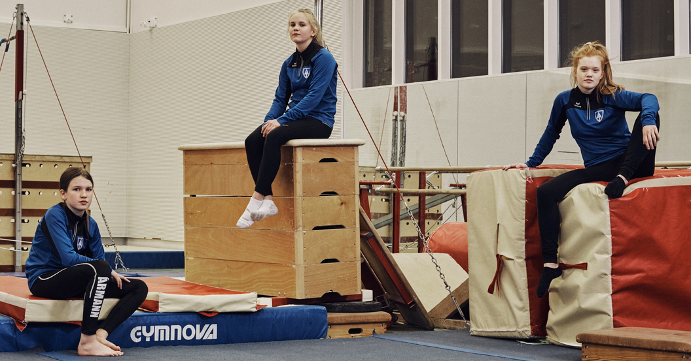
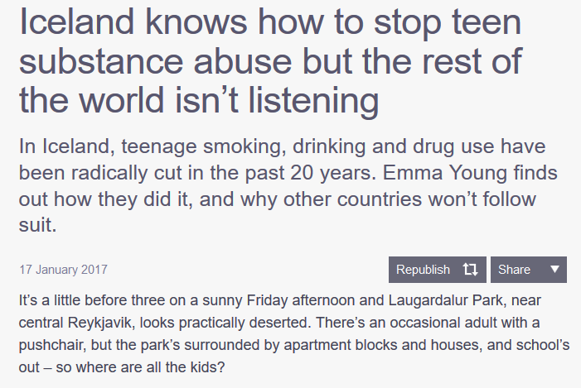
https://mosaicscience.com/story/iceland-prevent-teen-substance-abuse

Slide 11
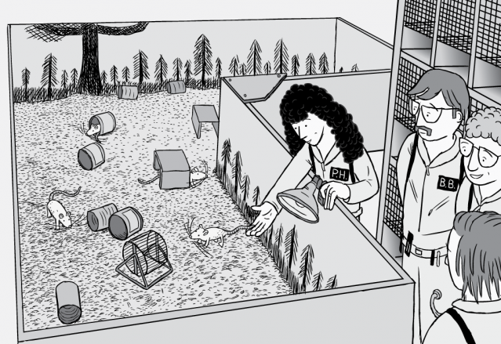
https://www.dailymotion.com/video/x73gvzf

