Slide 1
HISTORICAL UNDERSTANDING OF ADDICTION

Slide 2
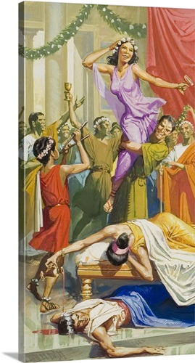
Episodic intoxication in traditional societies
Substance use known throughout time and cultures
Limited access – psychoactive substances are rather rare and expensive
Heavy societal control for who, when and where can have access to. E.g.:
heavy drinking during festivals and important social situations
altered states of mind during religious rituals
use for medical purposes (e.g. pain relief)

Slide 4
Epidemic spread of drugs
16th century
New discoveries and globalisation of trade
Cheap and slave labour
Advancement in agricultural technology
Intensification of substances – more potent, cheaper, easily transportable, available worldwide
1) introduction of tobacco in Europe and Asia, 2) export of cheap alcohol to Europe, 3) export of opium to far east Asia and Europe
First attempts to solve the problem: taxation and market limitation

Slide 5
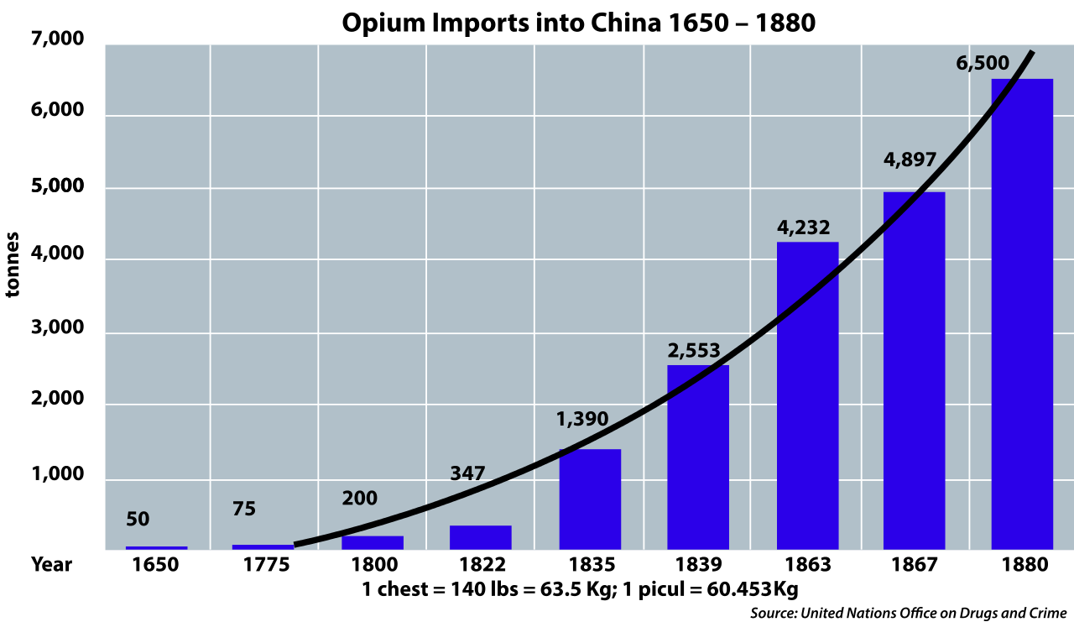

Slide 6
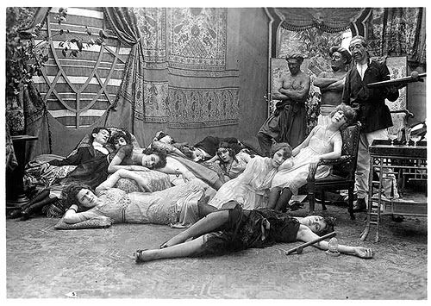

Slide 7
Addiction as immoral/criminal conduct
The first model of addiction (appeared in 16th century) and still living today
Substance use is not seen as a disease but as a personal moral failure, sinful and criminal act
Excessive substance use is considered as a behaviour of choice and not as loss of control and thus subject of legal action and punishment
Understanding still preferred right-wing political ideology. E.g. war on drugs
It is simple, clear and straightforward
BUT it is oversimplification and in contradiction to current knowledge (e.g. genetic predisposition). And leading to even bigger problems - escalation of violence, organized crime networks, prisons overload

Slide 9
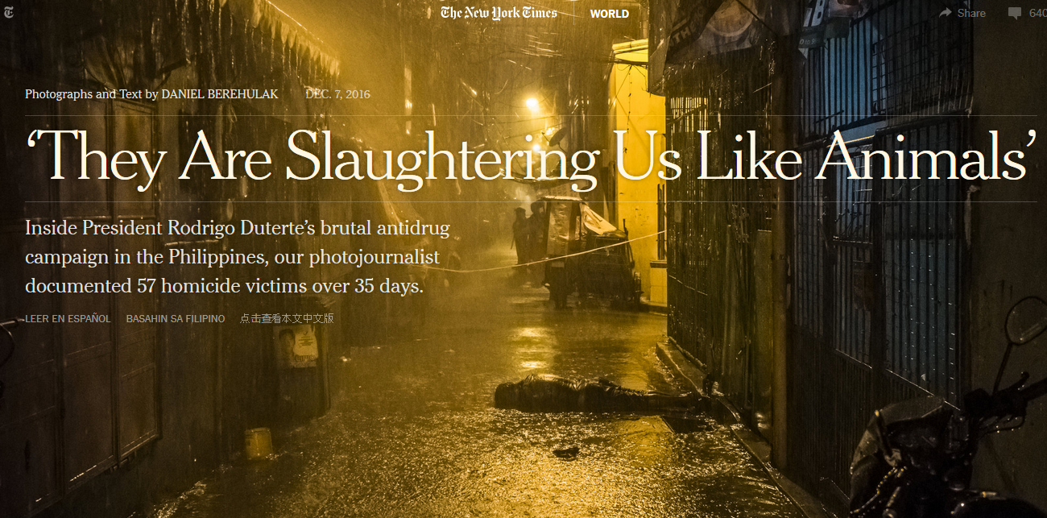
http://www.nytimes.com/interactive/2016/12/07/world/asia/rodrigo-duterte-philippines-drugs-killings.html?_r=0

Slide 12
Addiction as immoral conduct
Believe in just world (just world hypothesis)
Consequences are result of one's actions (you reap what you sow)
Often used as blaming of the victims of crimes, poverty etc. (raped woman was too seductive; poor people are too lazy,…)
Connected to believe in destiny and higher order - often found in right-wing and religious ideology
Guilt reduction, discomfort reduction (discomfort caused by empathy with victims), anxiety reduction (anxiety caused by uncertainty and unpredictable world)
The poor homosexuals — they have declared war upon nature, and now nature is exacting an awful retribution (Pat Buchanan, 1983) – summary of why not doing anything with spreading HIV epidemic in US during Reagan‘s administration

Slide 13
Temperance model of addiction
In the most primitive form – preternatural model – the substances are demonic and can take possession over human mind (demon alcohol)
Addict does not have ability to control him/herself
Addiction is a form of involuntary mental condition
It is the substance to be blamed
It is reasonable to abstain from the use completely
Sympathize with addicts but rejects mild users

Slide 14
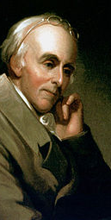
Temperance model of addiction
Benjamin Rush (1745-1813)
Founding fathers of the United States
Founding father of American Psychiatric Association
Alcohol use is behind poverty, health issues, violence, crime, family disruptions
Addiction is also a disease – addicts should be treated
Taste not, handle not, and touch not!

Slide 15
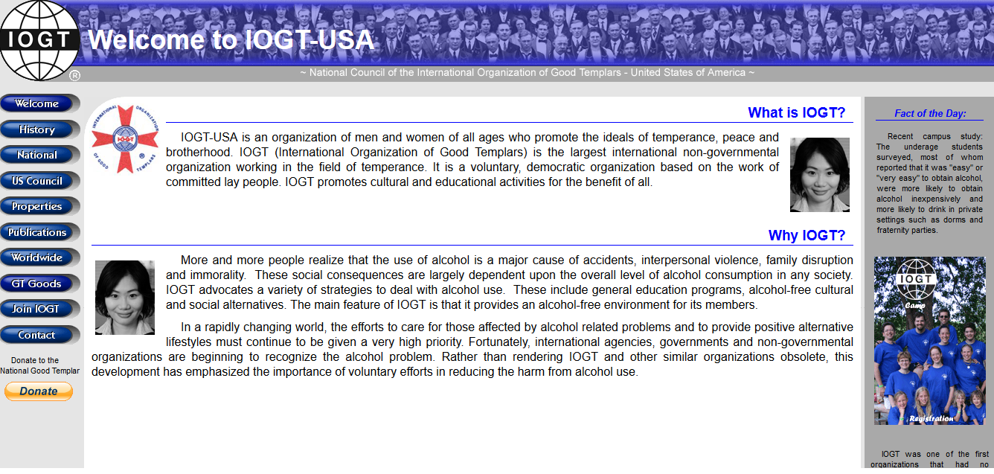
International Organization of Good Templars

Slide 16
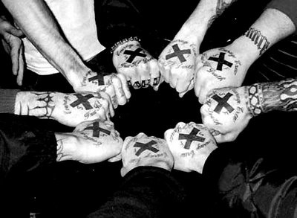
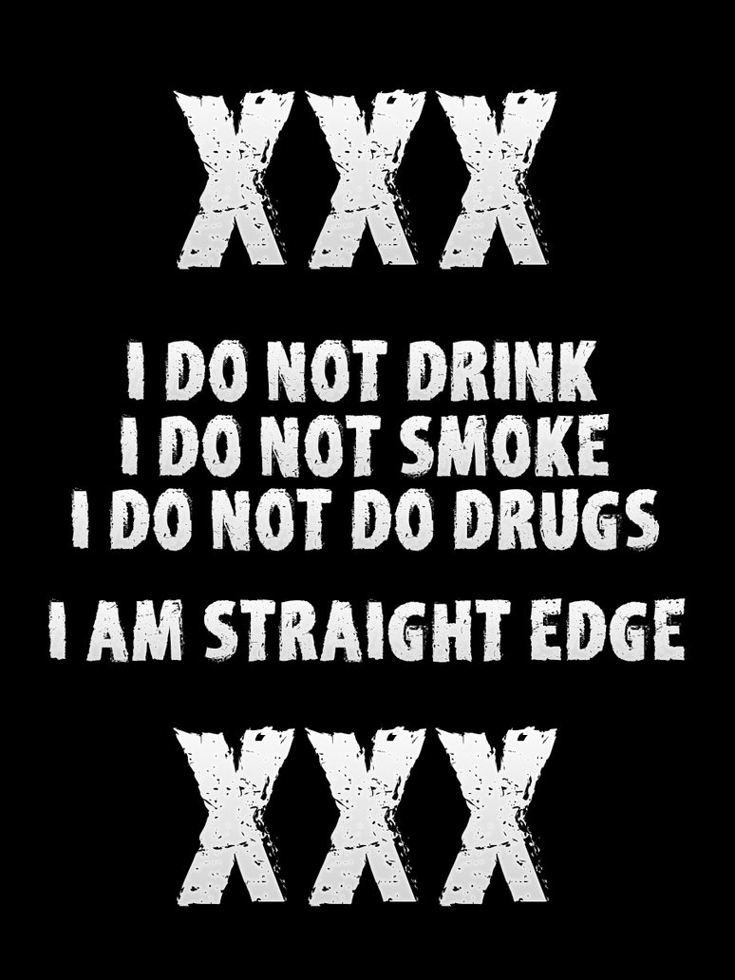
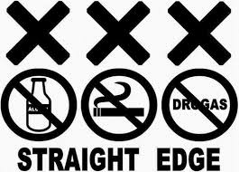

Slide 17
Illness & personality disorder models of addiction
Evolved in 1800s in USA – asylums in rural areas that supported people with food and shelter. No access to the substance
People in such treatment where in miserable conditions and had to accept themselves as ill. Often moral semi-religious treatment
Addict has a personality disorder – excessive substance user often shows array of antisocial and maladaptive behaviours.
The person is untreatable and unrepairable
Rise of self-help communities

Slide 18
12 step program – Alcoholics Anonymous
1939 - Alcoholics Anonymous: The Story of How More Than One Hundred Men Have Recovered from Alcoholism
self-help group
admitting that one cannot control one's alcoholism, addiction or compulsion;
recognizing a higher power that can give strength;
examining past errors with the help of a sponsor (experienced member);
learning to live a new life with a new code of behavior;
helping others who suffer from the same alcoholism, addictions or compulsions.
newcomers to becoming aware of their lack of ability to control their behaviour (steps 1 through 3 )
to expand self-examination and incorporate the outcomes of self-reflection into actions (steps 4 through 9 )
focus on maintaining positive changes in behaviour and the recovery process. The recovery process includes attending meetings, listening to other members at different recovery stages and working with a sponsor, who is an experienced member who is encouraged to complete all of the steps (steps 10 through 12 )

Slide 19
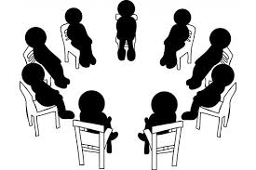

Slide 20
