Slide 1
COCAINE, AMPHETAMINES, KETAMINE,
OPIOIDS
ADDICTION

Slide 2
COCAINE
stimulant drug extracted from coca plants (growing in Ands)
Usually powder (of very bitter taste) that is snorted or pills that are eaten. Less commonly administered via injection. Cocaine is not smoked.
Crack cocaine – smoked substance made of cocaine and other chemicals (e.g. baking soda) that forms wax like block
After cannabis the most frequently used illicit drug
In brain, cocaine blocks reuptake of dopamine, noradrenaline, serotonin and even helps their release. Dopamine causes feelings of pleasure, noradrenaline increases physical energy (increased blood pressure, body temperature, heart rate,…), serotonin causes higher confidence

Slide 3
effect
If eaten (chew coca leaves, drink as tea), effect comes slowly and is less potent (most of cocaine is degraded by stomach acid)
If snorted (most common), effect comes in couple of minutes, plateaus in 20 minutes and comes down in 60 minutes. Party drug – often taken several times during night or as multidose
If smoked (crack cocaine) the effect comes in a dozen of seconds. Effect is short (2-3 minutes) but powerful
Injection, although the fastest, it is less common
Smoked and injected is not only faster, but also stronger and more addictive (general rule – the faster the effect comes, the more addictive)

Slide 4
effect
Positive and desired
Euphoria, mood lift
Physical and mental boost
Increased sexual stimulation
Appetite suppression
Neutral
Increased blood pressure, heat rate and body temperature, significant weight loss over time
Negative and undesired
Dry mouth, sensation of throat closing
Insomnia
Rapid mood swings and emotional instability
Anxiety, panic, paranoia
Sensation of insect crawling (and consequent skin damage from scratching)
Strong psychological need to take more
Destroyed nose mucosa in long term use of powder; burn lips and destroyed lungs in crack cocaine

Slide 5
effect - overdose
Heart arrhythmia, heart attack (and consequent death)
Overheating (and consequent death)
Acute psychosis- anxiety, paranoia, fear
Extreme aggression
Rhabdomyolysis – muscle fibre degradation and consequent kidney failure (and consequent death)
Overdose often happen when cocaine is taken together with other stimulants and alcohol (creates cocaethylene that lasts longer in body plus synergic effect)
If one is overdosed – keep cooling the body, sedatives like diazepam may help too

Slide 6
addiction
Highly addictive
There is no physical dependency and physical withdrawal
Psychological withdrawal does exist (excessive appetite, anxiety, excessive sleepiness, tiredness. Worst withdrawal so called “crash” – suicidal tendencies
Tolerance is built quickly, but is levelled also rather quickly
Treatment can be almost only psychological (therapy)
About 5% of European population ever tried cocaine, about 1% used cocaine in the last year (2% in population under 35) and between 0.3-0.6% are risk users.
Males prefer cocaine much more (about 3 times more likely to try compared to females)
Rather expensive and thus more used in rich places like London or party cities like Barcelona
Usage is currently on the raise (after decade of lower use)
Rich risk group reports powder cocaine usage with alcohol and cannabis, poorer risk group reports usage of crack cocaine (often injected) with use of heroin

Slide 7
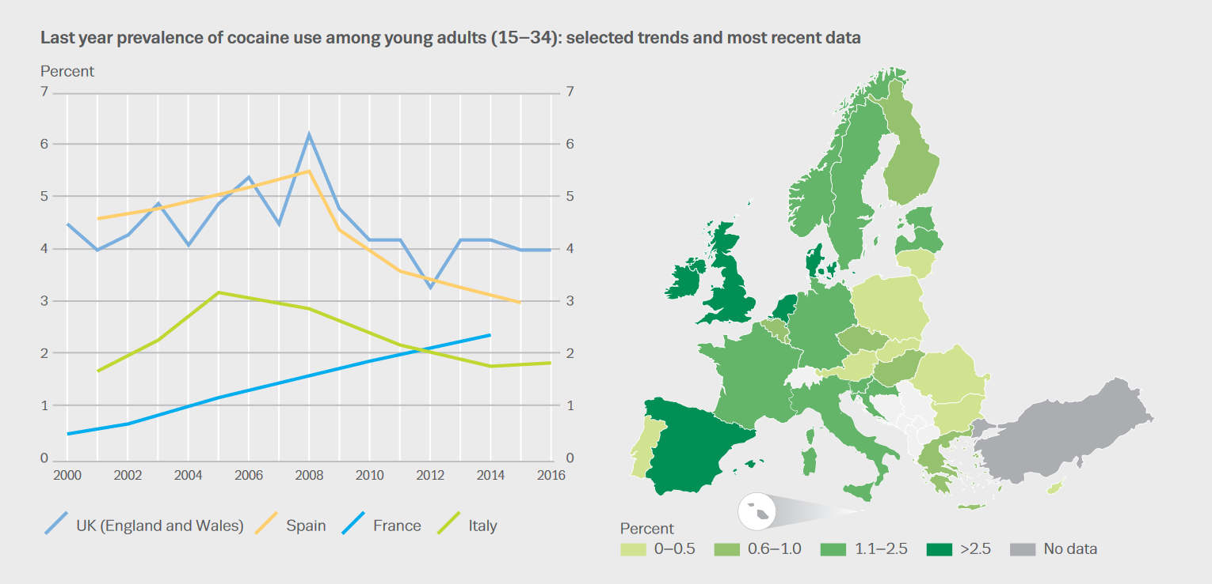

Slide 8
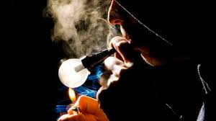
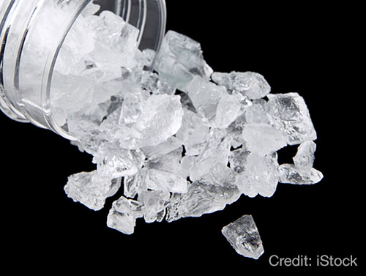
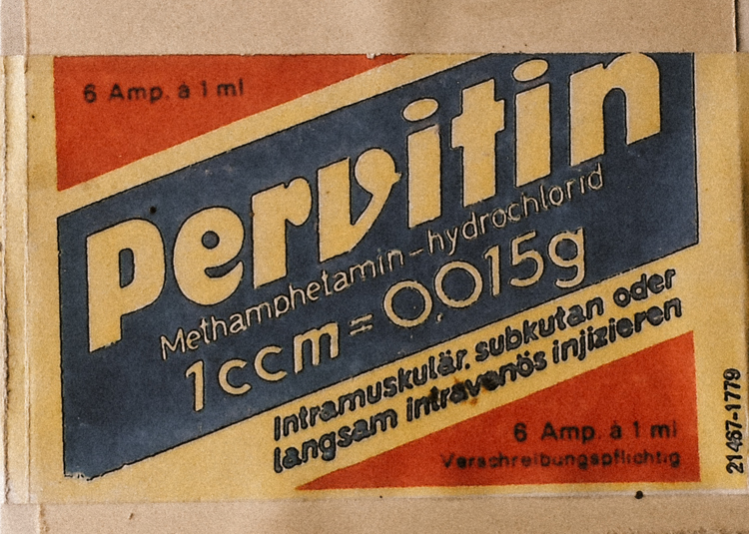
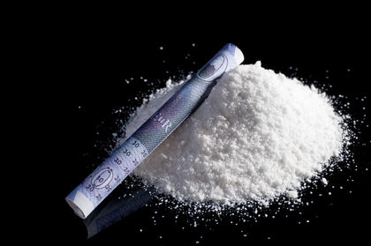
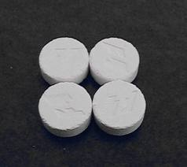
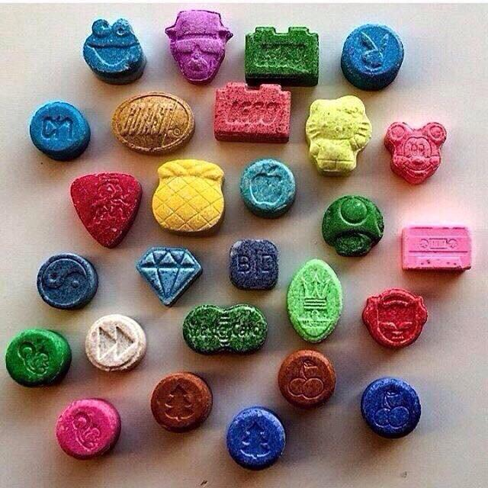
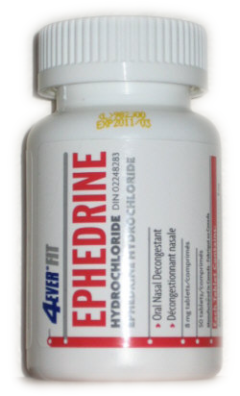
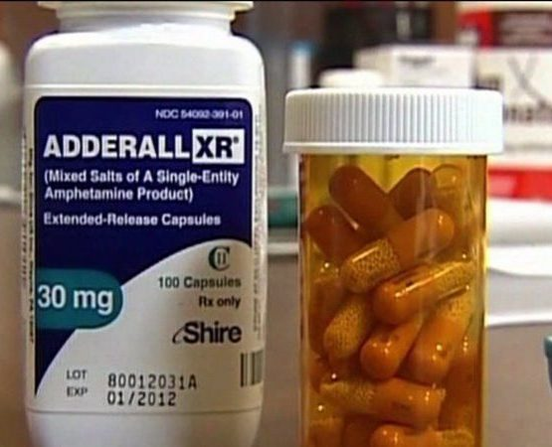
AMPHETAMINES
Meth – crystal, ice, pervitin. Usually injeckted, smoked (vaporized) and inhaled. Only pure material can grow crystals
Speed – street name for various amphetamines and methamphetamines. Usually in form of tablets or powder
MDMA – ecstasy. Usually in form of tablets
Various prescription drugs (e.g. Ephedrine, Adderall)

Slide 9
METHAMPHETAMINE
First synthesized 1887 and used as prescript drug since 1930s, largely used during ww2
Stimulant that is often used for treatment (ADHD, narcolepsy, obesity, depression) e.g. Adderall
Mimic the sympathetic system (“psycho-motor stimulant” - similar to cocaine, but even more powerful) – huge presynaptic release of dopamine and noradrenaline. Methamphetamine has the highest potential for dopamine release of all drugs (up to 20 times higher that the highest possible via natural way).

Slide 10
effects
Positive
increased alertness and motivation
increased sociability / talkativeness
positive mood shift, sense of well-being and euphoria
increased sex drive
reduced appetite

Slide 11
effects
Negative
Dry mouth, headaches
Increased heartrate, blood pressure, sweating, temperature
Increased body movements, convulsion
Impaired speech
Insomnia (person can stay awake for days)
Anxiety, fear, panic – psychotic episodes
Overdose – convulsion and coma. Extremely influenced by tolerance – poisoning and death can happen after administration between 2-500mg

Slide 12
long-term effects
Methamphetamine psychosis (lasts for weeks after last usage)
Aggression and violent behaviour
Crime
Sexual transmitted diseases
Hepatitis B &C
Malnutrition
Skin problems
Sleep deprivation
Bizarre manners
Dental problems
Cognitive deterioration – permanent brain

Slide 13
addiction
Both physical and psychological withdrawal exist – confusion, extreme hunger, depression, anxiety, fatigue
High tolerance
Dependency develops slowly and within years – amphetamines (especially meth – smoked and injected) are usually not the drugs of first choice. Develops in about 20% people who used
Males are much more vulnerable
Social environment plays very strong influence – challenge for treatment (as e.g. peer pressure to stop is needed). Sedatives, antidepressants and antipsychotic are sometimes used to help from withdrawal
Widely popular in West and North Europe. Meth is popular in USA (drug of bike gangs), Central Europe, Australia and Asia

Slide 14
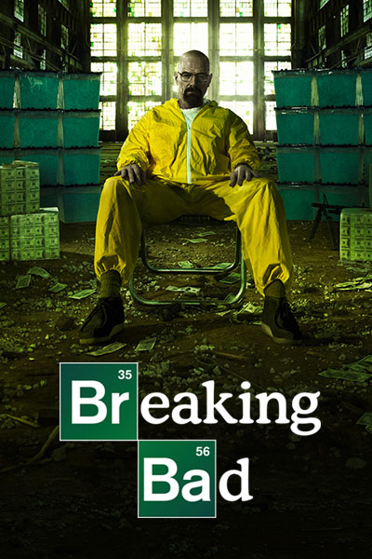
https://www.youtube.com/watch?v=PB5bsFzl98Q
https://www.youtube.com/watch?v=CVp9rKF3hag

Slide 15
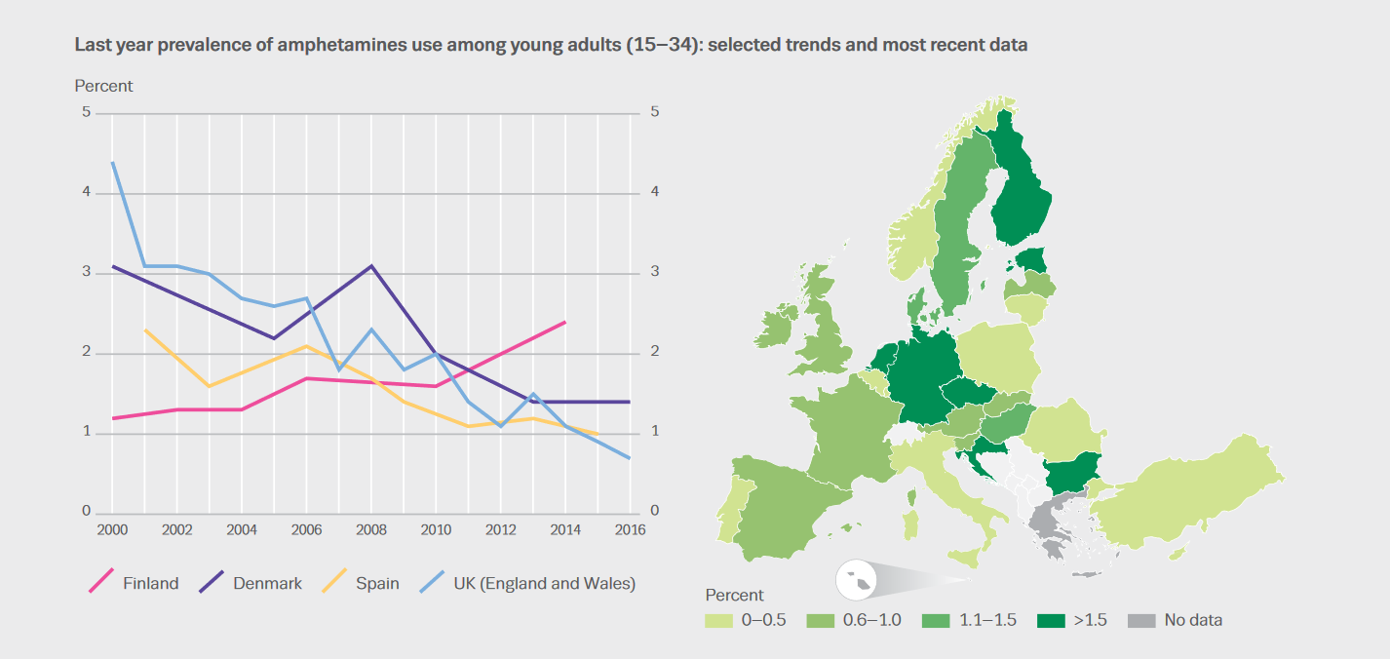

Slide 16
MDMA
“psychedelic amphetamine”
Party drug, however, heavily unreliable on street market content wise - can consist basically of anything from ephedrine, caffeine, methamphetamine to fertilizer
Effect starts after 20 minutes and lasts 3-5 hours
Apart from general amphetamine effects, positive special effects include:
Ego softening
Feelings of love and empathy
Spiritual feelings and inner peace
Appreciation of sensation (music,…)
Negative special effects include
Inappropriate social bonding
Erectile and orgasm dysfunction
Confusion and memory loss
Sadness on coming down effect
Hangover may last up to a week! – inability to focus, depression (even up to 2 weeks)

Slide 17
mdma
Taking mdma during parties can be associated with various health risks:
Overheating
Excessive drinking and loss of salt
Overreaction to impurities
Overreaction with combination with other stimulants
Dangerous combination with Viagra (penis injuries, heart attacks – mdma users often need more than one Viagra pill)
Animal studies showed permanent brain damage - not confirmed for humans yet but it prevent to use in psychotherapy (promising therapy results in PTSD patience)
Addiction:
For most users mdma lose its magic after 10-25 pills
It is probably not addictive as it dominantly works through serotonin

Slide 18
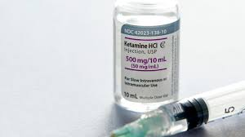
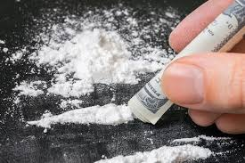
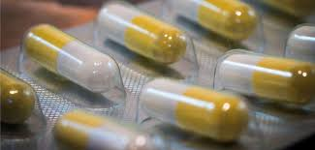
KETAMINE
dissociative anesthetic with analgesic and amnestic properties
Used for medical (especially emergency, surgery, pain management) and veterinary purposes since 60s. Sometimes used as unofficial antidepressant and anti-asthma. As a drug used since 80s.
Used as a pill, liquid, powder, solution in injections
Effects are very similar to other hallucinogens
Extra psychological effect – tantra-like sexual feeling; passivity; lethargy
Extra physiological effect – relaxes muscles (especially of rectum)

Slide 19
Addiction and risks
Ketamine can be addictive – confirmed also from animal studies
Overdose has been reported (ketamine does not have know overdose reversal agent)
Withdrawal symptoms include anxiety attacks, palpitations, shaking
Most risk comes from the setting – danger of accidents, injuries
Spreading of transmitted diseases
Risk of rape and use in sexual slavery
Ketamine is usually found at the same places as MDMA

Slide 20
OPIATES
Group of chemicals derived from poppy
Includes opium, morphine, methadone, heroin
Morphine - natural opioid used for treatment of pain e.g. in palliative treatment
Heroin – semi-natural derivate of morphine (often in form of white to dark brown powder that is either smoked, snorted or taken intravenously)
Body has natural opioid receptors (in CNS, spinal cord, GI tract) and produces own opioids like endorphin (endogenous morphine). The are active on inhibitory neurons – when bid to receptors there inhibitory neurotransmitters are blocked. As a result they block pain or cause more dopamine in the system. Exogenous opioids cause massive release of dopamine in reward pathway that has euphoric and calming effect

Slide 21
Heroin effects
Intravenous injection can produce strong effects in 3-5 seconds; smoking produces milder effects in 5-15 seconds. Intramuscular and subcutaneous injection produce a more gradual onset in 5-10 minutes. Insufflate heroin produces effects within 2-10 minutes, similar to suppository distribution (anus or vaginal insertion). Oral use can take 60-90 minutes to produce effects.
Intravenous injection, smoked, or insufflate - euphoria followed by a sedation lasting for 2-4 hours. Intramuscular and subcutaneous injection lack the wave of intense euphoria, and cause only feelings of sedation
Overdose causes death by lack of oxygen (person has very shallow breath and gradually stops breathing). Typical sign are pinpoint pupils. Naloxone (opioid antagonist) is used as immediate treatment – it binds to opioid receptors with higher priority

Slide 22
health risks
Connected to injection way of distribution: hepatitis C, HIV, superficial veins deterioration, emboli
Financial issues
Drug purity issues
Overdose risks
Heroin is popular in south and west Europe (Turkey, Greece, Spain, France, UK)
Usage of heroin is not growing, but its purity in – increasing number of overdose and deaths

Slide 23
addiction
Rapid tolerance and physical dependency - high addictive potential
Withdrawal symptoms are very unpleasant but not life threatening – vomiting, sweating, hallucination, anxiety, oversensitive genitals (e.g. permanent painful erection in males), body shaking and shivering
Tolerance is rapidly fluctuating – even a short break may lead to overdose. Overdose may be also caused by break in daily habits and by higher purity of substance or when in combination with other sedatives.
Treatment is usually combination of psychotherapy and help of substitute treatment (methadone – opioid agonist that binds to receptors but does not produce euphoria)

Slide 24
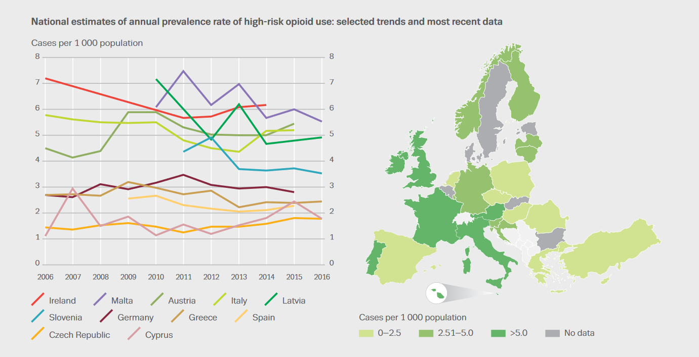

Slide 25
Current opioid overdose crisis (USA)
In 2017, 47000 Americans died on opioid overdose
Increase from 2016 is 30% overall, 70% in Midwest area, 50% in large cities
25% of patients prescribed opioids for chronic pain misuse them
Between 8 and 12 % develop an opioid use disorder
An estimated 4 to 6 % who misuse prescription opioids transition to heroin
About 80 % of people who use heroin first misused prescription opioids
Cause of the problem: massive increase in prescription of opioid painkillers since 90s – believe that every pain should be avoided/treated, believe that prescript opioids are not addictive
Solution? Change our attitude towards pain, other pain management strategies (e.g. psychological), more accessible anti-overdose drugs (e.g. Naloxone in form of spray in emergency and police cars).

Slide 26

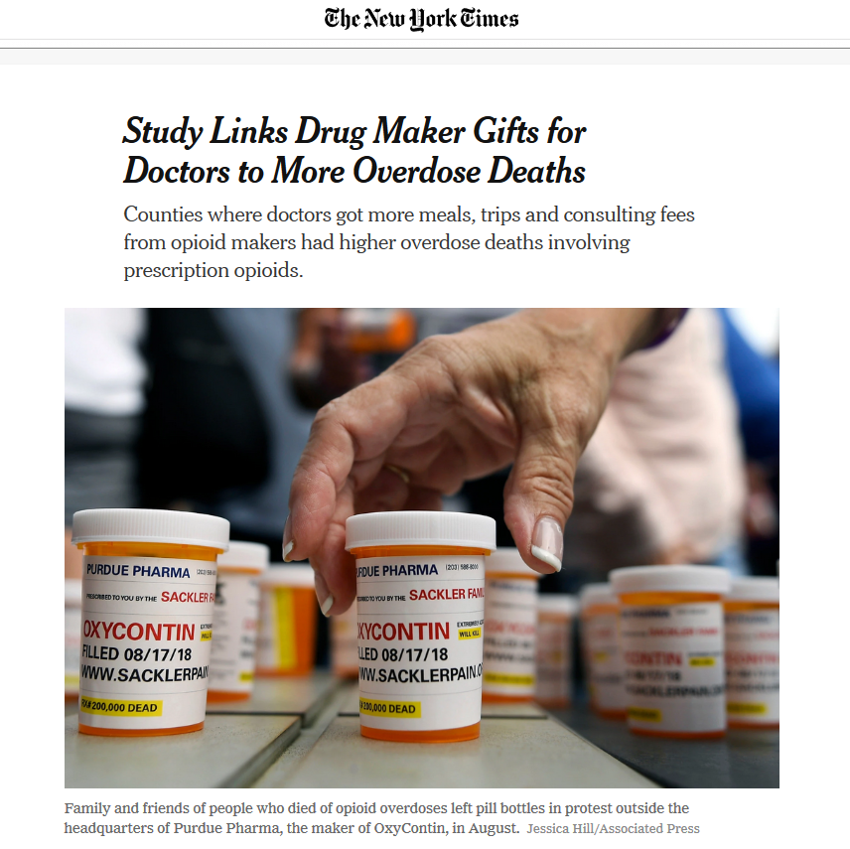
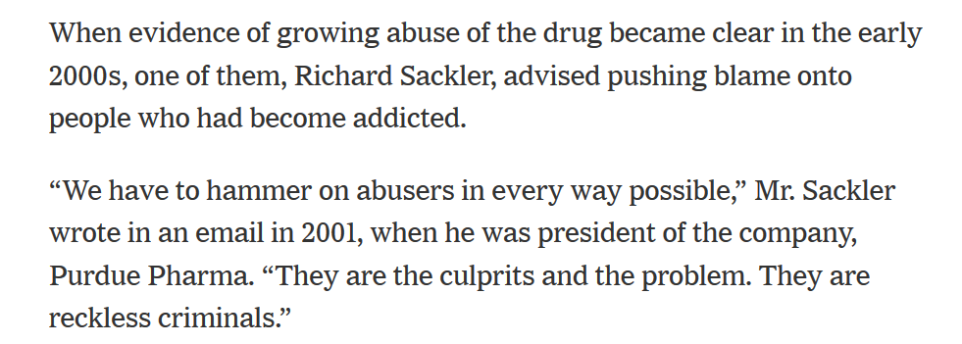

Slide 27
Heroin attempt to quit and relaps effect
https://www.youtube.com/watch?v=pm4fsi6OvFI
https://www.youtube.com/watch?v=7RoMaS1pzOE
Heroin overdose
https://www.youtube.com/watch?v=v6uBkJSbQO0
Heroin withdrawal
https://www.youtube.com/watch?v=KYAmt9WRoNo

