Slide 1
PSYCHOLOGICAL BASIS OF ADDICTION
ADDICTION

Slide 2
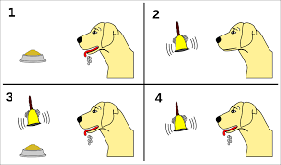
ADDICTION AS LEARNED BEHAVIOUR
Classical conditioning
I. Pavlov & J.B. Watson
Learning is a result of pairing of a unconditioned stimulus with a neutral stimulus. After repetition of such paring, original reaction to unconditioned stimulus becomes conditioned to the originally neutral stimulus.

Slide 3
Addiction and classical conditioning
Drug effects are strongly influenced by the context in which the drug is administered. The context usually refers to the physical environment in which the drug is given.
Drug effect is paired with environmental stimuli – cues and they may trigger craving – overwhelming desire for the substance/behaviour
Classical conditioning is behind key factors of addiction – craving, withdrawal symptoms, relapse
Conditioned drug tolerance: tolerance and sensitization to the behavioural effects of drugs are expressed in the environment in which the drug is chronically administered but not in an environment not previously associated with the drug.

Slide 4
Cue reactivity – learned response that involves psychological and physiological reactions to drug related cues
Cues are the most important factors of relapse
Withdrawal model – cue reactivity should resemble withdrawal-like states (i.e. should produce opposite to the drug effect)
Incentive model – cue reactivity should be similar to positive motivational state (i.e. should produce somewhat similar to the drug effect)
We usually see mix of these two reactions, however, in alcohol/cocaine/tobacco/behavioral addictions incentive reaction is stronger while in heroin withdrawal reaction is stronger

Slide 5
Prevention and treatment should focus on blockade of cues (e.g. via cue exposure) – associations then become gradually weaker and weaker – it is a long process with uncertain results. It takes long time to build the cues and even longer to destroy them

Slide 6

ADDICTION AS LEARNED BEHAVIOUR
Classical conditioning
B.F. Skinner
Experience of reinforcement or punishment increases or decreases likelihood of certain behaviour

Slide 7
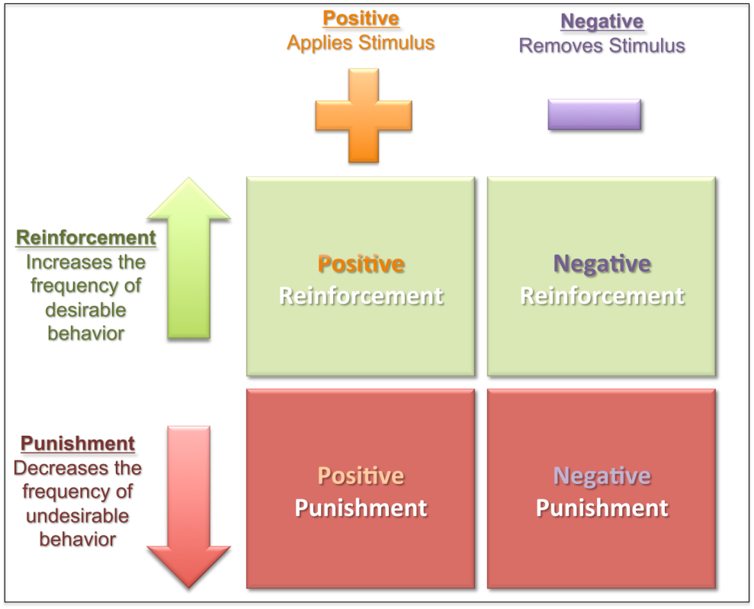

Slide 8
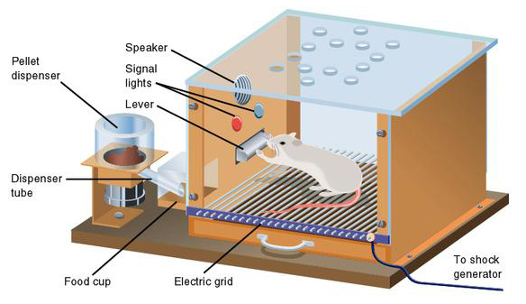
https://www.youtube.com/watch?v=I_ctJqjlrHA

Slide 9
Positive reinforcement: drugs and certain behaviours (sex, gambling) are strongly pleasurable and serve as positive reinforcer
Negative reinforcement: decreased level of drug in body unbalances physiological system - withdrawal symptoms
Occasional reinforcement – somewhat randomized reward produces much stronger reinforcement - activity to get the reward increases and is more resilient to change. Secondary reinforcement – cues learned via classical conditioning may be experienced as reinforcers themselves

Slide 10
Drugs and certain behaviours are powerfully rewarding themselves, but addiction arises through experience and repetition
Involved processes are automated
Pre-conscious cue processing - addiction related cues are mentally prioritized without knowing
Frequently conflict between not conscious/learned motivation and conscious attitude
Various people vary in their proneness to reward and punishment (e.g., Cloninger‘s typology of alcoholism)

Slide 11
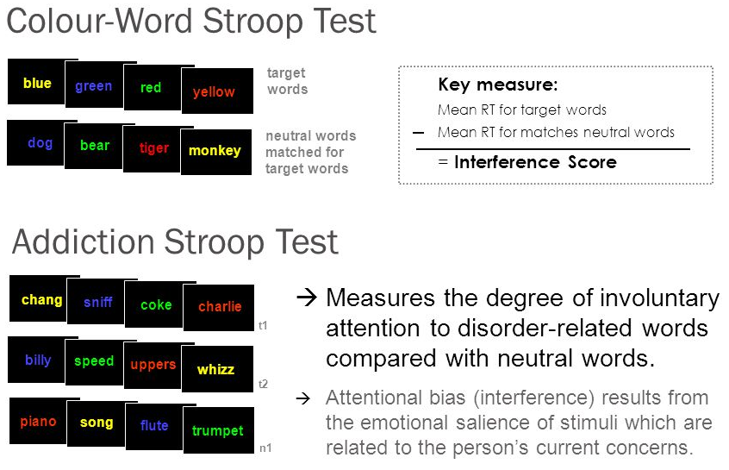

Slide 12
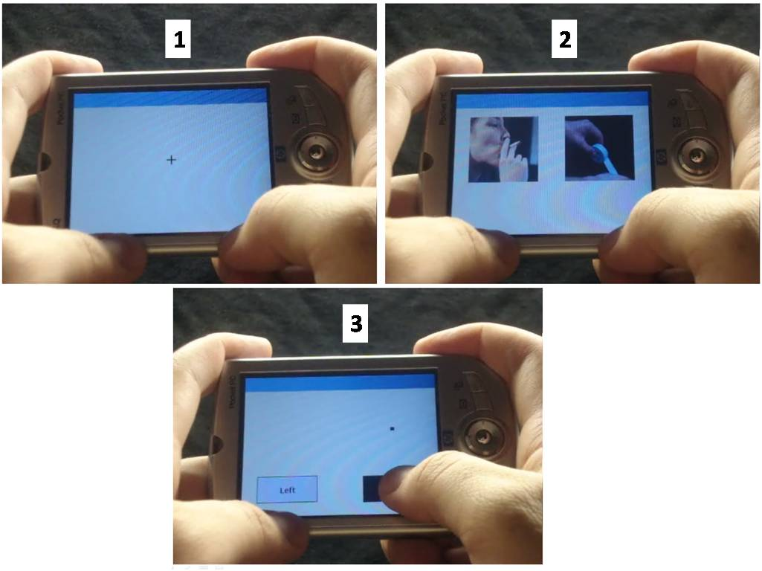
Visual probe task

Slide 13
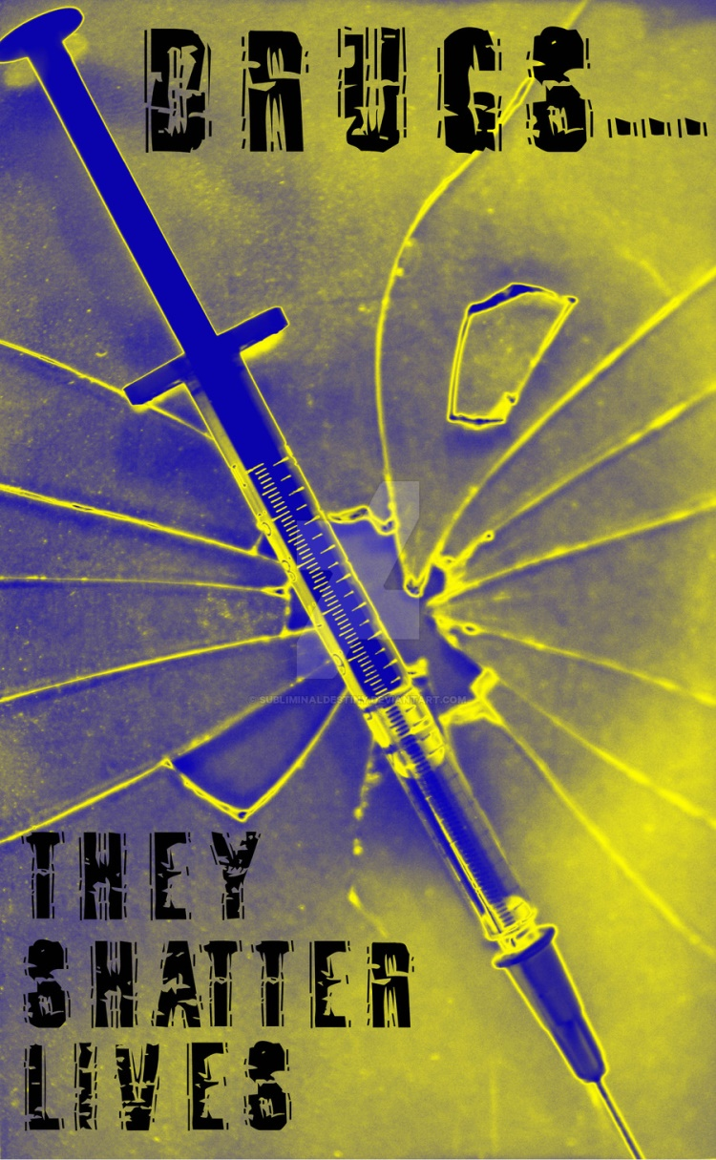




Slide 14
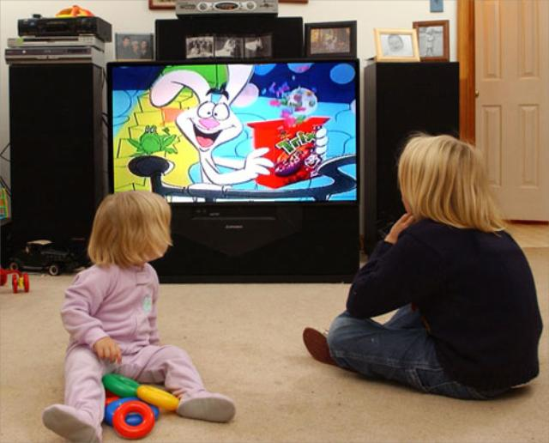
ADDICTION AS LEARNED BEHAVIOUR
Social learning theory
Albert Bandura
Learning in social environment through observing and listening to others
Addiction is learned through imitation of and identification with role-models
Social identity – whom I follow, what is the group I belong to, what is the group I would like to be part of

Slide 15


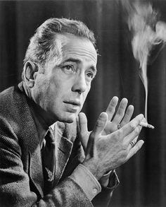


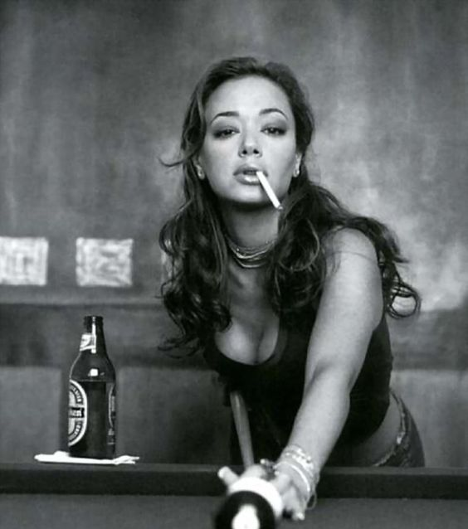

Slide 16
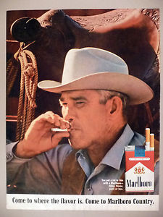

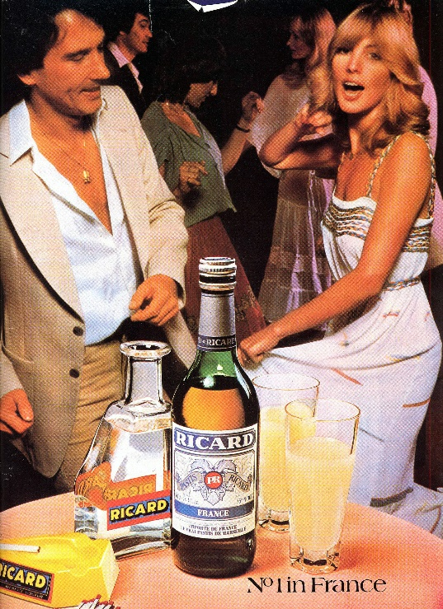

https://www.youtube.com/watch?v=EJT0NMYHeGw

Slide 17

SELF-EFFICACY
Albert Bandura
Individual believe in own ability to perform certain behaviour
High self-efficacy – set higher goals, invest more effort and energy. More resistant to stress and negative experience and able to try various coping strategies.
Low-self efficacy – lower effort, cease treatment more quickly. Lower stress resistance, often use substances as the first coping strategy
Learned hopelessness – opposite to self-efficacy. When the person repeatedly experience aversive stimuli. Sometimes a product of repeated abuse, trauma. Can lead to enduring negative mood states, addictive behaviours, cycles of poverty

Slide 18

SELF-MEDIACATION MODEL OF ADDICTION
Taking drugs or involvement in problematic behaviour is a coping strategy with negative and unpleasant mood states and/or negative life experiences
People with some mood disorder or problematic affect regulation are more prone to develop addiction - e.g. higher depressiveness, higher anxiety, personality disorders like antisocial or borderline
People with experience of child abuse, trauma or childhood neglect are much more prone to develop addiction

Slide 19
Psychodynamic psychology – emphasizes feelings and emotions as forces that shape our behaviour, focus on early child experience
S. Freud – psychoanalysis - use of drugs with oral administration (alcohol, tobacco,…) are a form of regression to the first year of life (oral stage – when pleasure is experienced through mouth). Oral stage is about gaining trust in others. Addicts usually have underdeveloped trust and show unhealthy relationship profiles: avoidance and/or overdependency.

Slide 20
M. Klein – object relation theory
Birth and first months are extremely stressful for the child. Chaos, anger, fear are the dominant emotions – they must be cultivated in contact with parenting figure. Parenting figure is internalised as a mental object – parent (mother) within
Good object relation = good affect regulation (positive mood, ability to cope with unpleasant, more resilient), poor object relation = poor affect regulation.
Relationship with this internalized object affects social relationships throughout our lives - what develops in early childhood stays for lifetime

Slide 21
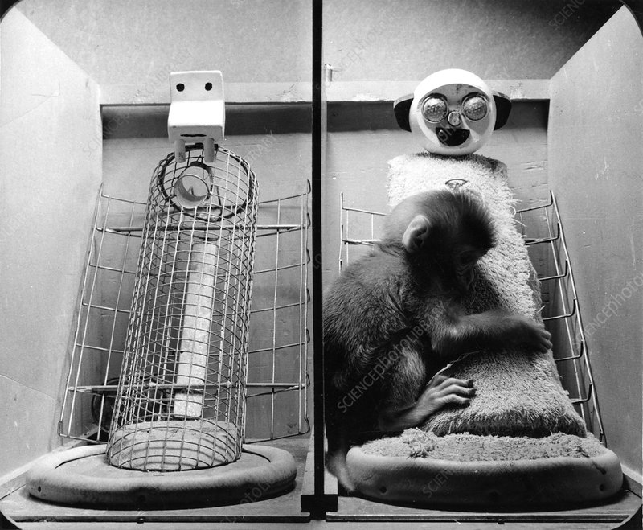
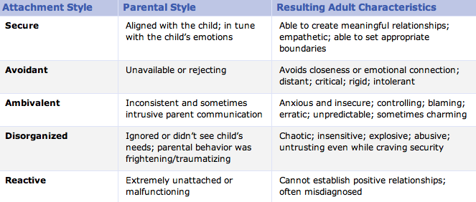
H. Harlow, J. Bowlby, M. Ainsworth – attachment theory
https://www.youtube.com/watch?v=OrNBEhzjg8I
Children internalize cognitive and affective representation of self and others based on their early attachment experiences.
Attachment to the parenting figure (significant other) is created especially in the first 6 months.
Attachment attitudes are persistent and lead our relationship to others and our affective regulation during our lives

Slide 22
Insecure attachment/poor object relation are strongly related to lifetime depressiveness, affective disorders, low self-esteem, lower social support. It creates fertile ground for substance use and other behavioural addictions
Self-medication model does not explain all cases of addiction – many addicts do not have affective difficulties, insecure attachment, child trauma or neglect
Self medication model does not explain HOW addiction is created BUT it explains why some people are more prone to it
Insecure attachment and poor object relation do create similar condition as reward deficiency syndrome

Slide 23
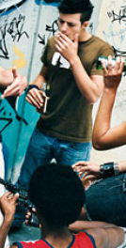
DEVELOPMENTAL MODEL OF ADDICTION
Two main risk periods – early childhood (attachment) and adolescence
E. Erikson – psychosocial stages of development – adolescence is about identity crisis, time of storm and stress, and increasing power of peer groups. Substance use may develop as a mean to gain status in peer groups, it may become part of personal and social identity
Addiction may be understood as an externalized pathological behaviour. Externalized behaviour includes conduct problems (verbal and physical aggression, lying, risk taking, vandalism), ADHD, various addictions
Any externalized behaviour may be replaced by another externalized behaviour
Externalized behaviour may occur in childhood as a reflection of internalized disorders (anxiety, trauma, neglecting parental approach)
Adolescent brain is somewhat similar to addicted brain (due to developmental disbalance between reward centres – already fully developed - and self control centres – still maturing

