Slide 1
neomaterialismy, problém agency a více-než-lidského sociálního jednání

Slide 2
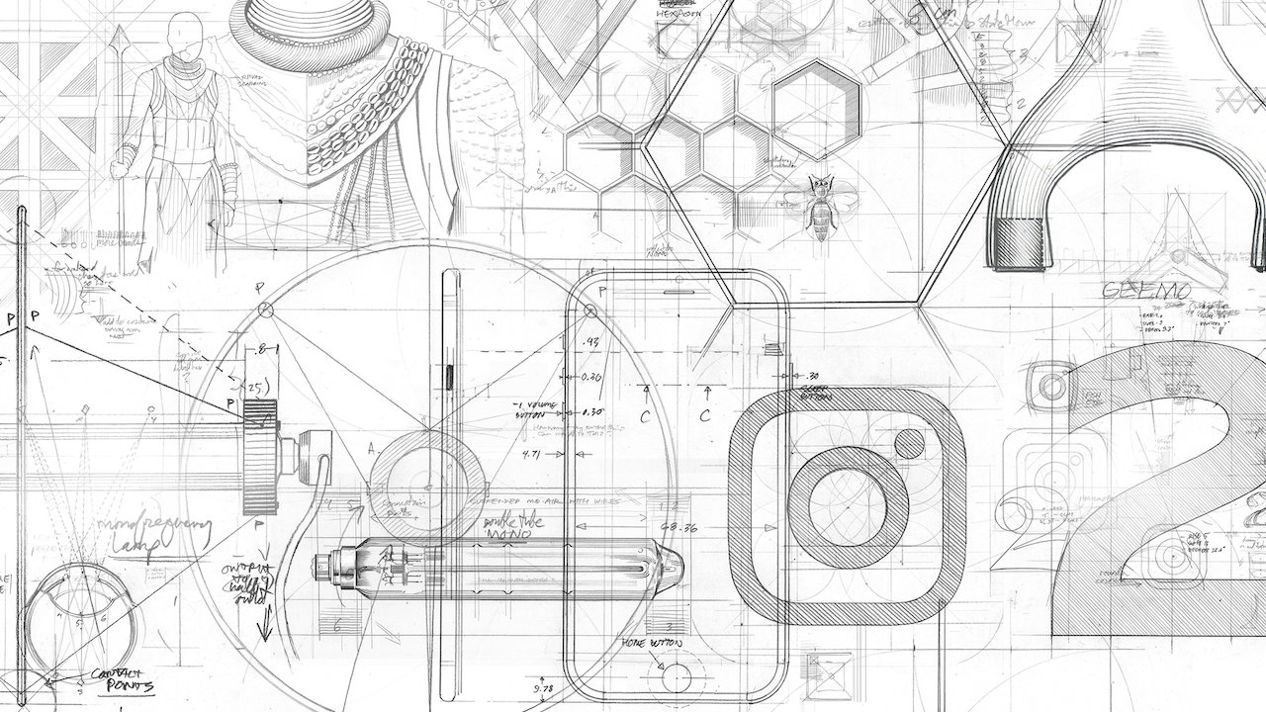
sociální život věcí, antropologie věcí (Appadurai)
Alfred Gell, Marcel Mauss (Esej o daru), Simmel, Marx, Kopytoff
ANT, OON, vibrant matter (Jane Bennet), agential realism (Karen Barad)
věci, sítě a jednání
kritika/reflexe neomaterialismu (Lemke)

Slide 3
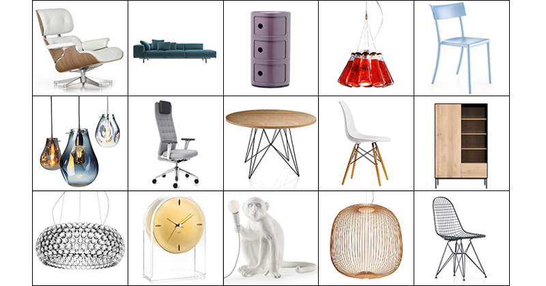
klasická materialita/ materiální kultura
hmota
hodnota
ekonomie jako sociální forma je směnou hodnot „exchange is not a by-product of the mutual valuation of objects, but its source“(Appadurai cituje Simmela)
věci
tělo
hodnota
umístění v ekonomii
symbolické struktury ekonomie

Slide 4
neomaterialismus
https://mitpress.mit.edu/books/neomaterialism
matter is energy and energy is information
waves, roentgen, radio animals …
síť a relacionismus
problém agency

Slide 5
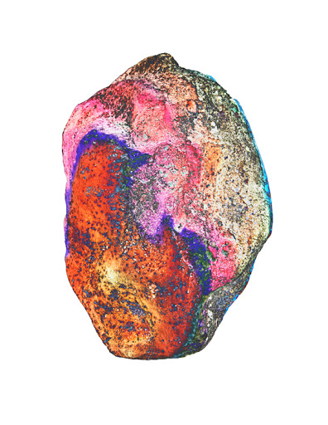
https://criticalposthumanism.net/new-materialisms/
Karen Barad, Rosi Braidotti, Elizabeth Grosz, Jane Bennett (2010) New Materialisms: Ontology, Agency, and Politics, Duke University Press.
Tsing, Anna Lowenhaupt (2015) The Mushroom at the End of the World: On the Possibility of Life in Capitalist Ruins. Princeton: Princeton University Press.
https://anthropoceneprimer.org/index.php/new-materialism-posthumanism-and-object-oriented-ontology/
http://lab.cccb.org/en/quantum-agencies/

Slide 6
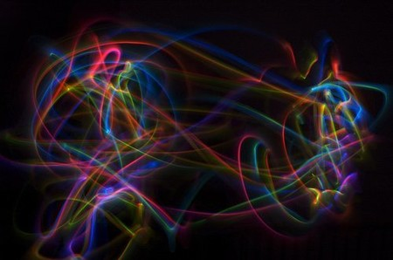
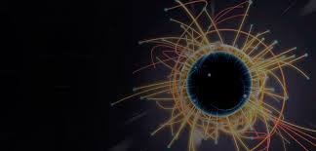
kvantová mechanika

Slide 7
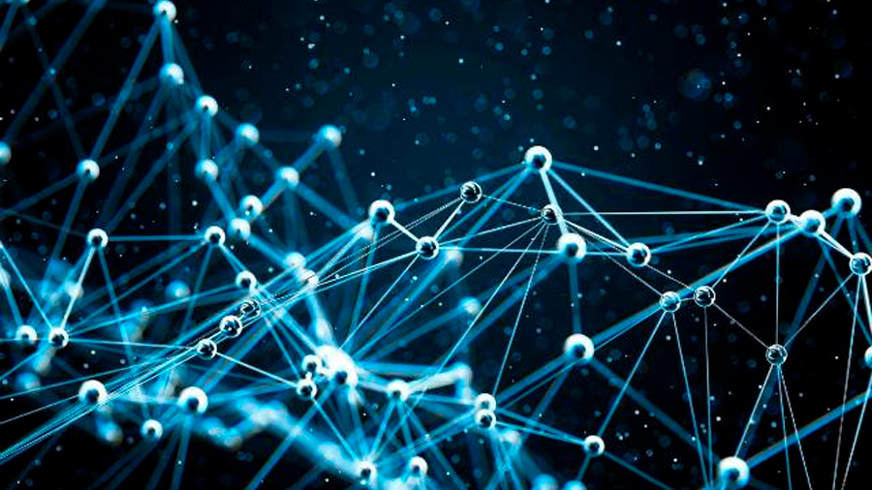

Slide 8
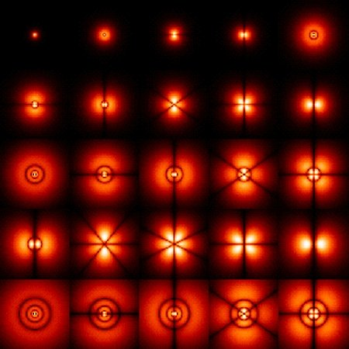
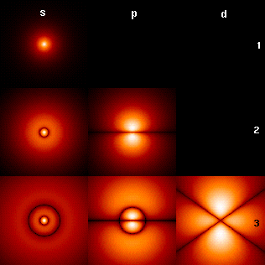
kvantová mechanika

Slide 9
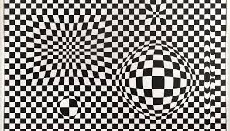
ANT_actor network theory
Actor-Network Theory (zkráceně ANT)
Bruno Latour, Michael Callon, John Law
nezahrnuje pouze lidi, ale také objekty, věci, organizace, procesy.
actors, actants (aktéři, činitelé, agenti, elementi, herci)
překlad, heterogenní síť, symetrie
materiálně-sémiotická metoda

Slide 10
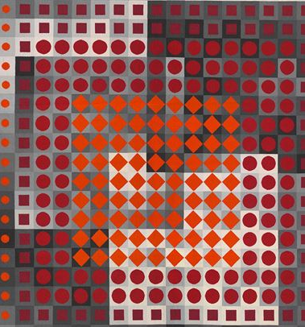
LAW, John; HASSARD, John (1999). Actor Network Theory and After. [s.l.]: Oxford and Keele: Blackwell and the Sociological Review
LATOUR, Bruno (2008) Reassembling the Social: An Introduction to Actor-Network-Theory. New York: Oxford University Press
Shapiro, S. (1997). Caught in a web: The implications of ecology for radical symmetry in STS. Social Epistemology, 11(1), 97-110. doi:10.1080/02691729708578832

Slide 11
Esposito R (2015) Persons and Things: From the Body´s Point of View. Polity Press.
Rick Dolphijn and Iris van der Tuin, “Interview with Karen Barad”, in New Materialism: Interviews & Cartographies, ed. By Rick Dolphijn and Iris van der Tuin (Ann Arbor: Open Humanities Press, 2012), pp. 48-70 (p. 48).
Material Feminisms, ed. by Stacy Alaimo and Susan Hekman (Bloomington and Indianapolis: Indiana University Press, 2008), pp. 1-19.
Rosi Braidotti, The Posthuman (Cambridge: Polity Press, 2013).
Karen Barad, Meeting the Universe Halfway: Quantum Physics and the Entanglement of Matter and Meaning (Durham and London: Duke University Press, 2007).
Jason W. Moore, Capitalism in the Web of Life: Ecology and the Accumulation of Capital (New York: Verso, 2015).
Jane Bennett, Vibrant Matter: A Political Ecology of Things (Durham and London: Duke University Press, 2010).
WHAT IS NEW MATERIALISM? https://www.tandfonline.com/doi/abs/10.1080/0969725X.2019.1684704?journalCode=cang20
New Materialism: Interviews & Cartographies_ https://quod.lib.umich.edu/o/ohp/11515701.0001.001/1:5.2/--new-materialism-interviews-cartographies?rgn=div2;view=fulltext
NEW MATERIALISM: AN ONTOLOGY FOR THE ANTHROPOCENE_ Melinda H. Benson, Natural Resources Journal, Vol. 59, No. 2 (Summer 2019), pp. 251-280
https://anthropoceneprimer.org/index.php/new-materialism-posthumanism-and-object-oriented-ontology/
Lorimer (2016) Gut Buddies: Multispecies Studies and the Microbiome. In Environmental Humanities, 8(1):57-76. https://doi.org/10.1215/22011919-3527722, text here: https://read.dukeupress.edu/environmental-humanities/article/8/1/57/61693/Gut-BuddiesMultispecies-Studies-and-the-Microbiome

Slide 12
„We walk on anarchy of vibrations“
Gaston Bachelard
„... that all particles are made of the same substance: energy“
Werner Heisenberg
“Time and space are shaped by matter”
Albert Einstein

Slide 13
kvantová biologie

Slide 14
kvantová biologie

Slide 15
agential realism_ Karen Barad
is a posthumanist performative ethics that uses the insights of quantum theory to reconceptualize our understandings of subjectivity, agency, causality, and—ultimately—the being of the universe itself.
role kvantové fyziky (superpozice, pozornost, multičetné reality, otázka: co je to hmota (= informace a energie)
problém její teorie/kritika – kdo je to „my“, nezohledňuje politiku, moc, hierarchie

Slide 16
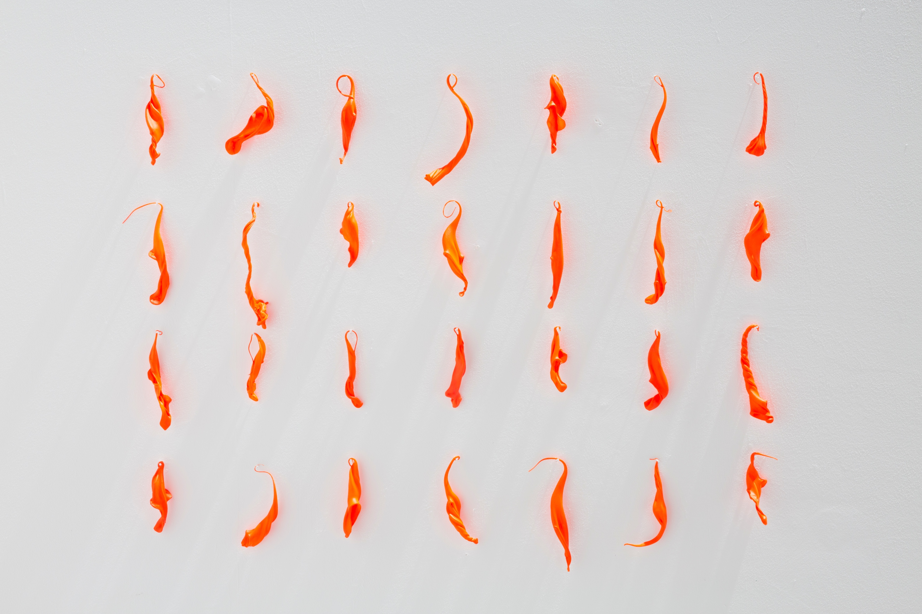
Vibrant Matter_ A Political Ecology of Things Jane Bennett
https://www.werktank.org/projects/28/els-viaene-vibrant-matter
https://helenpailing.com/portfolio/vibrant-matter/

Slide 18
Esposito_ persons and things Esposito, Roberto. 2012. Third Person: Politics of Life and Philosophy of the Impersonal, Zakiya Hanafi (tr.), Polity. Esposito, Roberto. 2015. Persons and Things. From the Body´s Point of View. Polity.
Foucault (Slova a věci)
vlastnit nebo být vlastněn_ osoby vs věci (římské právo a definice právní osoby)
být lidským – být osobou – být věcí
“No other principle is so deeply rooted in our perception and in our moral conscience as the conviction that we are not things – because things are the opposite of persons” Esposito, Persons and Things
“A thing is a non-person and a person is a non-thing” (According to this reading, this conceptual framing in Western history since Roman Antiquity has allowed a hierarchal distinction not only between humans and nonhumans but also within the human species and within every single individual. It made it possible to deny rights to nonhuman animals, and also to distinguish various levels of personhood down to the status of animality: the line of subordination and exclusion goes from slaves in Roman antiquity to the denomination of Jews as “anti-persons” in Nazi Germany“ TL)
“Not only it is impossible to classify the body as a person or a thing, the perpetually new challenges that the human body poses to the law show that it is in urgent need of a new formulation.” Esposito, Persons and Things

Slide 19
_person : from Anglo-Norman parsone, persoun et al. (Old French persone (“human being”), French personne), and its source Latin persōna (“mask used by actor; role, part, character”), perhaps a loanword; compare Etruscan (φersu, “mask”). Displaced native wight (from Old English wiht (“person, human being”). Doublet of par son. Cognate with Proto-Germanic *fur, *fura, *furi (“before”), Proto-Indo-European *per-, *pero- (“forward, beyond, around”), and Proto-Indo-European *suHnús (“son”), from Proto-Indo-European *sewH- (“to bear; give birth”).
(human) being, mask & role, beyond-to give birth, cognate-son (kinship echoes) … and … legal person (legal personification and reification)
Strathern, M. 1999. Property Substance and Effect: Anthropological Essays on Persons and Things. London: Athlone Press.
„Personhood beyond the individual … how people emerge from an ongoing field of social relations involving humans, animals, things and places?” (Fowler 2004:3)
“… the category of person appears to be the only one that can unite human beings and citizens, body and soul, law and life.” (Esposito 2012:4)

Slide 20
“With the advent of biotechnology patents, biomedical interventions, transgenic crops, and new environmental sensitivities, the distinction between persons and things has become a focus of general social anxiety. In each of these technological areas, persons become indistinguishable from things: gene sequences are at once part of the genetic programme of the person and chemical templates from which drugs are manufactured; embryos are related to their parents by means of the commodifying forms of contract and property, and yet they are also persons; depending on the uses to which they are put, the cells of embryos produced by in vitro fertilisation might be seen as having either the ‘natural’ developmental potential of the human person or the technical ‘pluripotentiality’ that makes them such a valuable resource for research into gene therapies. In each of these cases, the categorisation of an entity as a person or a thing is dependent upon a contingent distinction rather than an embedded division”
(Pottage 2010: 4-5)

Slide 21
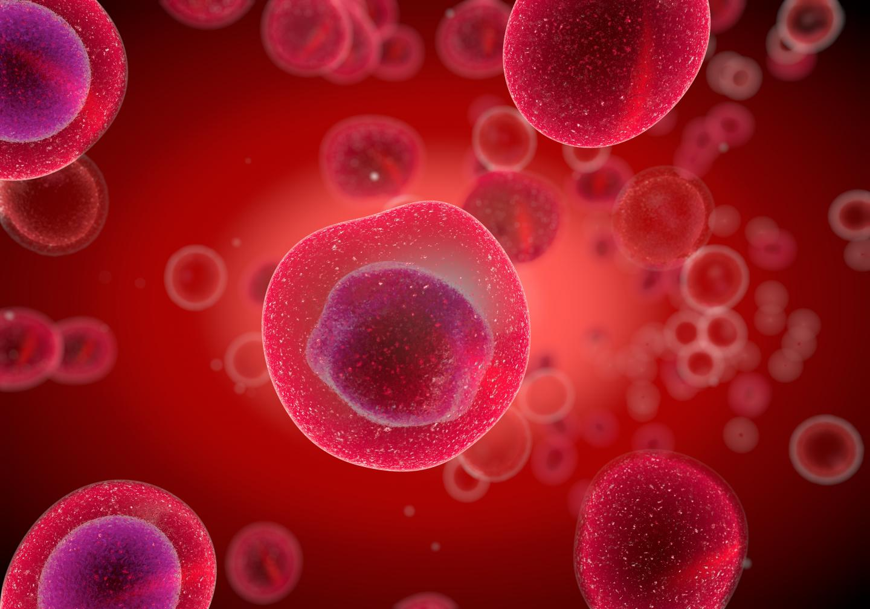
bio-objects involved life-like entities liminality
embryo-like entities
lifelike entities
immortal cell lines
genetic tools/genes as tools
edited germ lines
bio-informatic life models
human entities with embryo-like features (SHEEFs)
embryo like bodies
living things
pre-embryo
soubuní
věc
materiál

Slide 22
místo governmentality k enovironmentalitě
Environmentality („first, the rise of a form of resilient biopolitics and a neocybernetic regime of control, and secondly the emergence of a new set of practices linked to “probiotic ecologies” and vital systems security.“ TL)
„Current neoliberal forms of government do not target directly the individual or collective body but rather focus on the social, ecological and technological conditions of life as a privileged field of intervention.“ (TL)
„ The environment is no longer conceived of as a natural surrounding but becomes itself a technological project.“ (TL)

Slide 23
ken rinaldo_ projects
https://www.kenrinaldo.com/projects/
3-story robots_ https://www.kenrinaldo.com/portfolio/3-story-robots/
The Parlaiment of Robots_ https://www.kenrinaldo.com/portfolio/c-borg/
Mirror Masks_ https://www.kenrinaldo.com/portfolio/mirror-masks-columbus-2014/
Electroasis_ https://www.kenrinaldo.com/portfolio/electroasis/
Autopoiesis_ https://www.kenrinaldo.com/portfolio/autopoiesis/

Slide 24
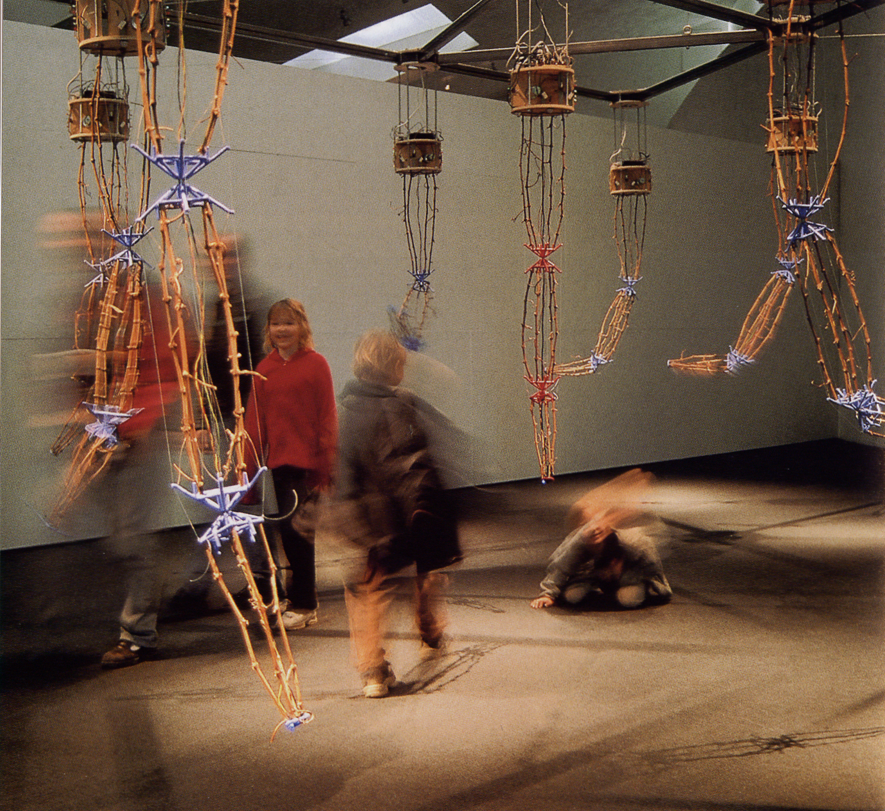
ken rinaldo autopoiesis
https://www.youtube.com/watch?v=S0Ts-LD2bc4

Slide 25
„koronavirus ovlivňuje, zavírá školy, plní nemocnice“ koronavirus jedná (more than human agency)
„Coronavirus is beginning to bite“ (Expats in Germany)
https://www.vexels.com/vectors/preview/193496/coronavirus-illustrated-background-design
„Here’s what coronavirus does to the body“ (https://www.nationalgeographic.com/science/2020/02/here-is-what-coronavirus-does-to-the-body/)
Co všechno koronavirus způsobuje, zapřičiňuje, problematizuje, ovlivňuje, nese, umožňuje, ničí, tvoří …

Slide 26
věci materialita koronaviru ekologie koronaviru
roušky
ochranné pomůcky
ventilátory
léky
data
databáze
virus
Ne už jednotlivé oddělené věci/nehybné a pasivní objekty, ale sítě, procesy, vlny, ekologie, ekosystémy,

