Slide 1
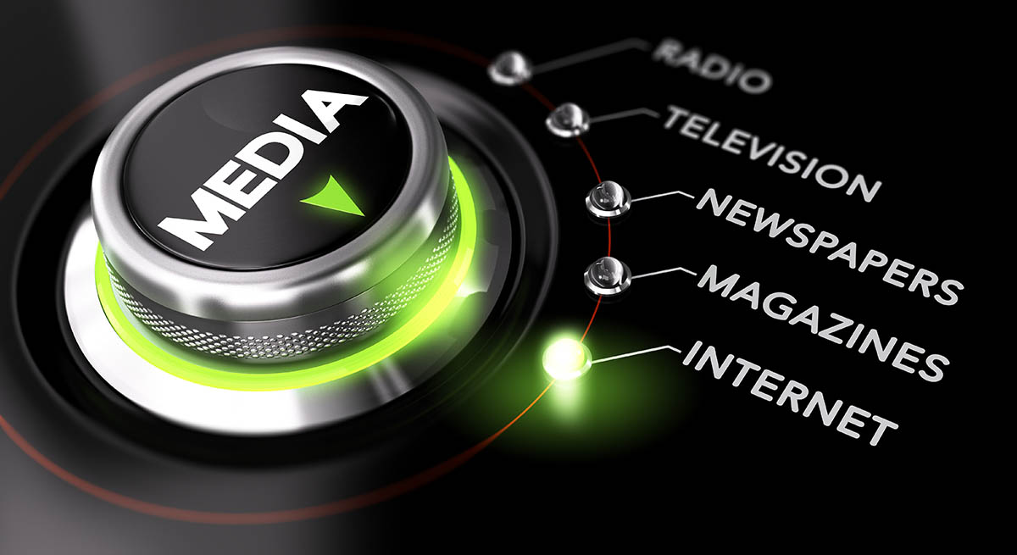
Media Representation and the question of identity

Slide 2
Media and representation
Media:
mass media, new media,…
Representation:
politics or law
representation as portrayal
representation of something in external reality
Standing in place for something
Mirroring the “real world”
X representation creating the meaning (e.g. S. Hall – politics of representation)
Reality has no meaning without being represented.
Action becomes real through representation.
Representation happens in a symbolic system.

Slide 3
Representation
Representation happens in a symbolic system - mostly language
meanings are created in the process of signifying, it does not come from its own “essence”
some meanings are privileged in certain societies
e.g. labelling theory = labelling deviant behavior, how do we know it is deviant?
labelling does not reflect reality but the opinions of society
labelling is driven by power – who signifies, who has the right? (S. Hall, M. Foucault etc.)
the easiest way to label – stereotypes and types
reducing people to a “typical” traits, social characteristics that are understood as essential (given by nature) = we know what is normal and what is not!

Slide 4
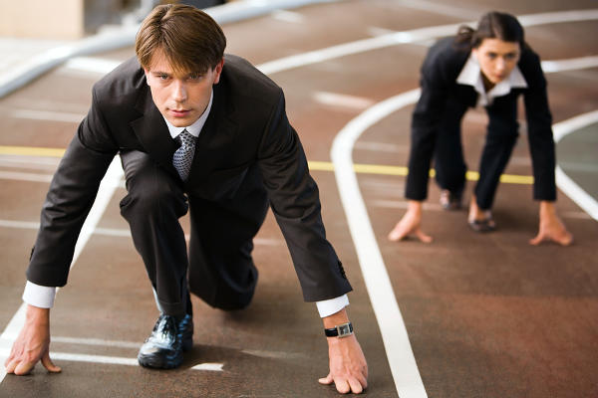
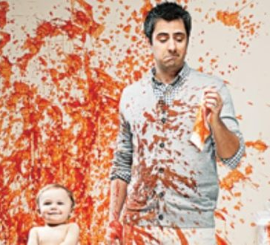
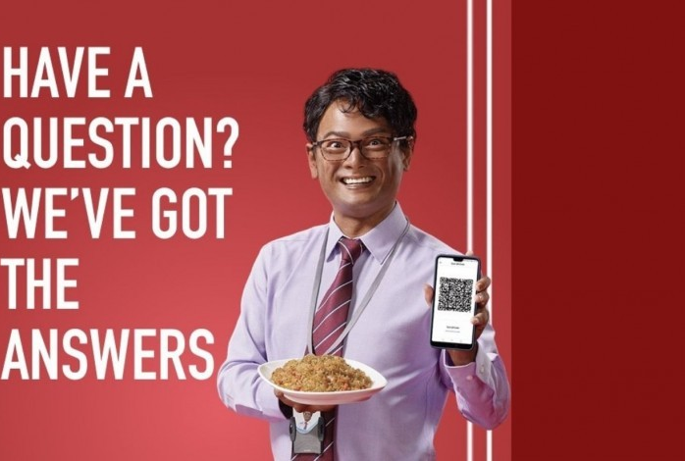
Stereotypes?

Slide 5
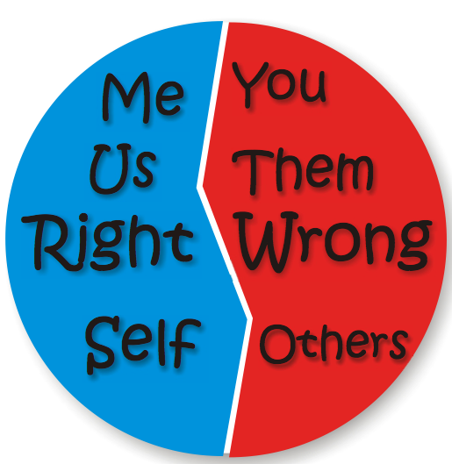
Us vs. them
there is no us without them (even though both categories are constructs)
historically many dichotomies: orient vs. occident, etc.
Who is them/the other?
Simone de Beavoir The second sex (We are not born woman, we become one)
Teun van Dijk – ideological square

Slide 6
Why do we talk about representation in media?
we perceive the world with the help of media (symbols, stories, visuals…)
media mirror or create the notion of others and us
media bring us information we do not know firsthand (how does a penguin looks, etc.)
(mainstream) media support (and uphold) the status quo of its region:
democracy and capitalism
heteronormativity
gender binarity, “right” race, age, social status, health etc.

Slide 7
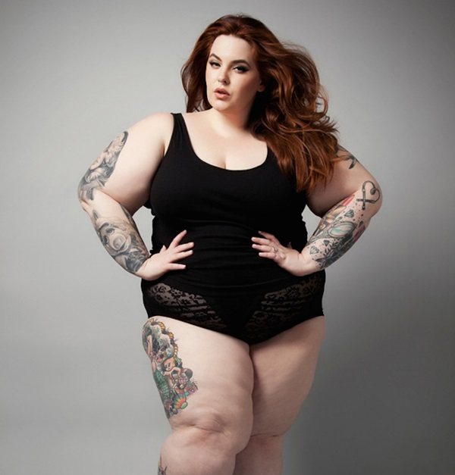
Media construction of reality
media help us to understand the world, it contributes to our imagination of how does world looks like
= we know what is right, normal, common, ordinary…
exemplary videos in IS: (Haiti needs our help X Norway needs our help)

Slide 8
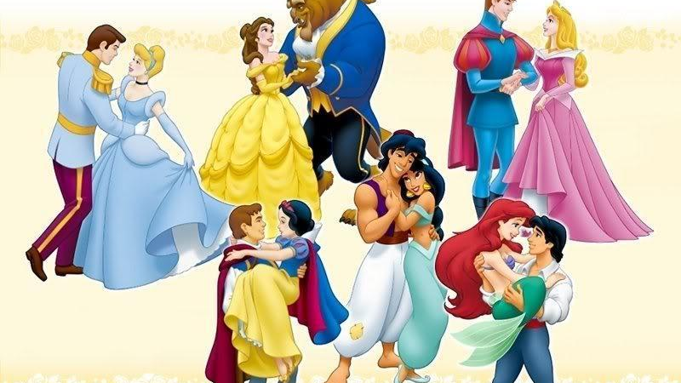
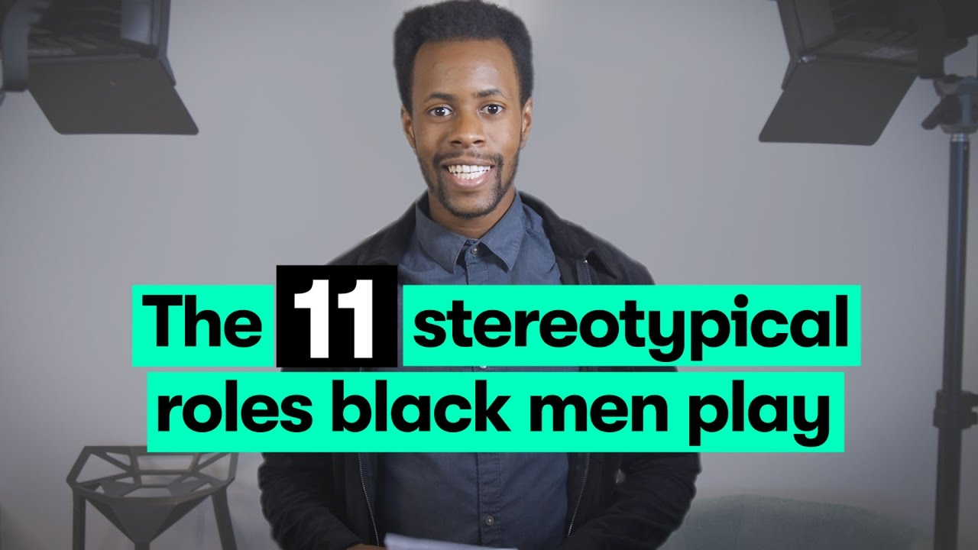
Narratological construction of reality
we understand the world with the help of stories
not only news but also literature, movies, TV series, comics etc. help us comprehend the world around us (in both positive and negative ways)

Slide 9
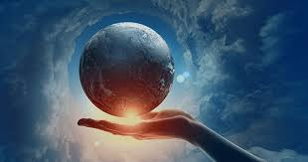
Constructivism
constructivism vs. essentialism (reductionism)
Bin is a bin because it has an essence of a bin OR is it a bin because we agreed as a society that it is a bin?
social construction of reality (Berger, Luckmann 1999)
socially constructed reality by ordinary people without them ever knowing
the reality seems to be objective, we understand the types and stereotypes, institutions etc.
we take the world as it is and that’s what “keeps it spinning” (we reiterate and confirm it everyday)
crucial role of language!

Slide 10
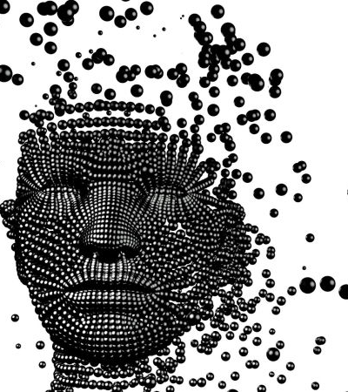
Identity
self-understanding (sociological and psychological term)
social roles played in society (E. Goffman)
social construct created during enculturation
discursive and performative character – it is a practice (repeated practice) that creates what it names
See Judith Butler (1993), Stuart Hall (1996) and others

Slide 11
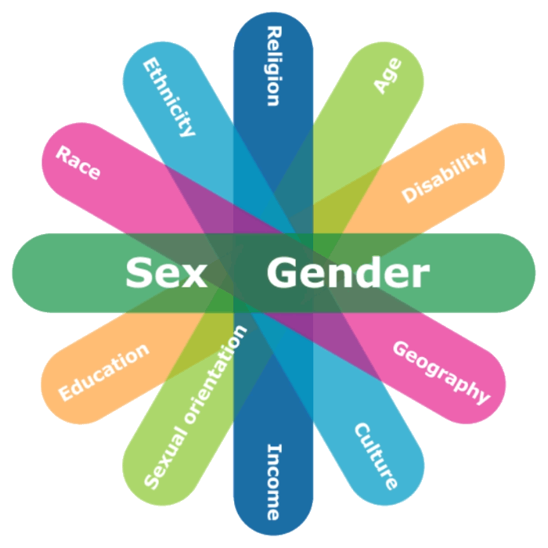
Intersectionality
there are many layers of identity that can be a source of discrimination for a person, and they are entangled
some people are thus target of bigger discrimination than others (Crenshaw 1991, Shields 2018)
intersectionality – interlaced web of socially determined subordinations
black handicapped lesbian vs. white female athlete

Slide 12
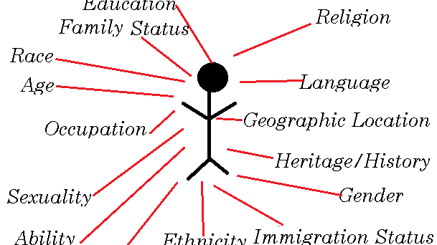
Your turn:
What are your most privileged and most discriminative identities?

Slide 13
Your turn: Media representation and its consequences Let's discuss!

