Slide 1
Media representation of age

Slide 2
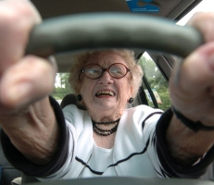
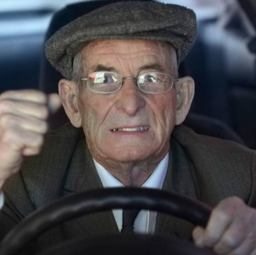
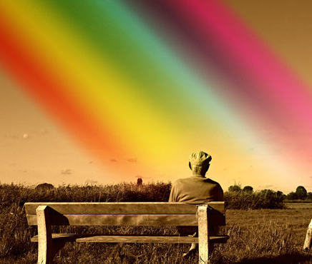
Age – old age / young age
age – in demographic statistics – age reached by the person
preproductive age, productive age, postproductive age
topics connected to the age:
ageism – discrimination based on the age of the person
violence against seniors
classical myths and stereotypes?
what about age and (homo)sexuality?

Slide 3
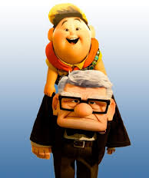
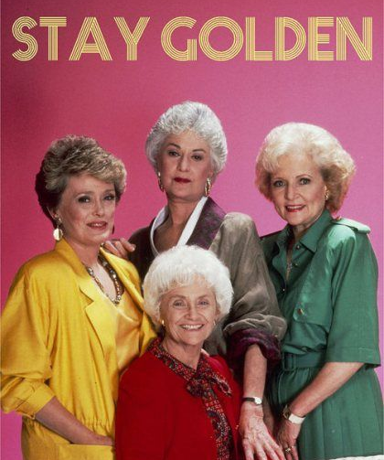
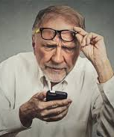
Older citizens in “factual” and “speculative” media
activism (#kafesbabi, #pivosdědou, the Jesus’ grandchildren, the pandemic support, students and seniors living together…)
stereotypical representation
inclusive and positive representation

Slide 4
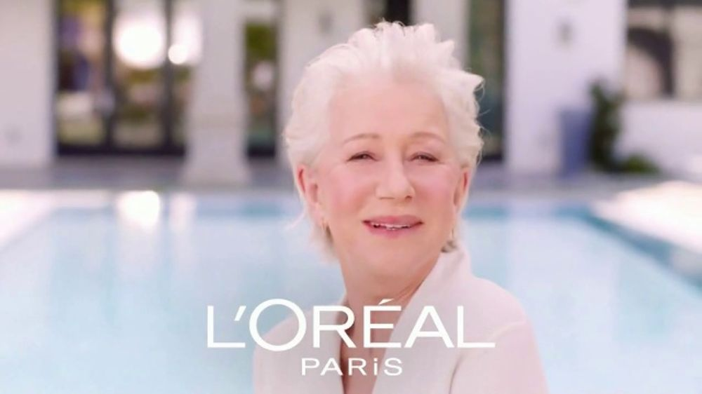
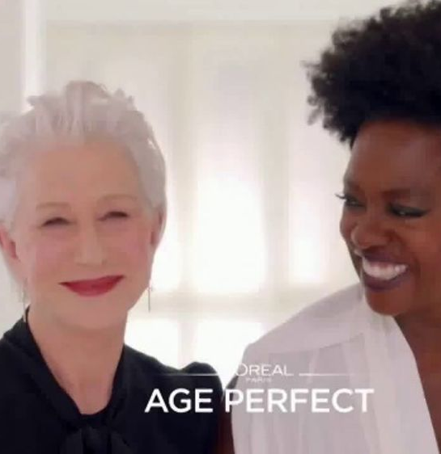
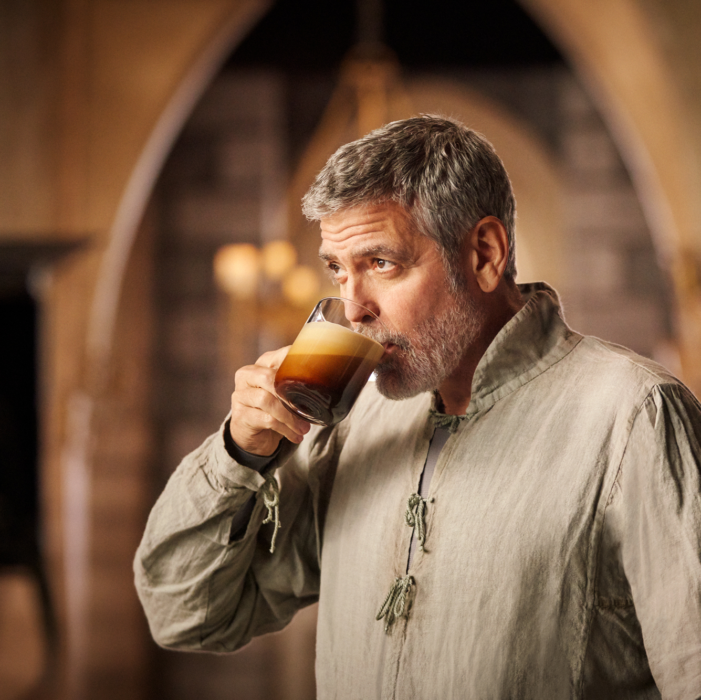
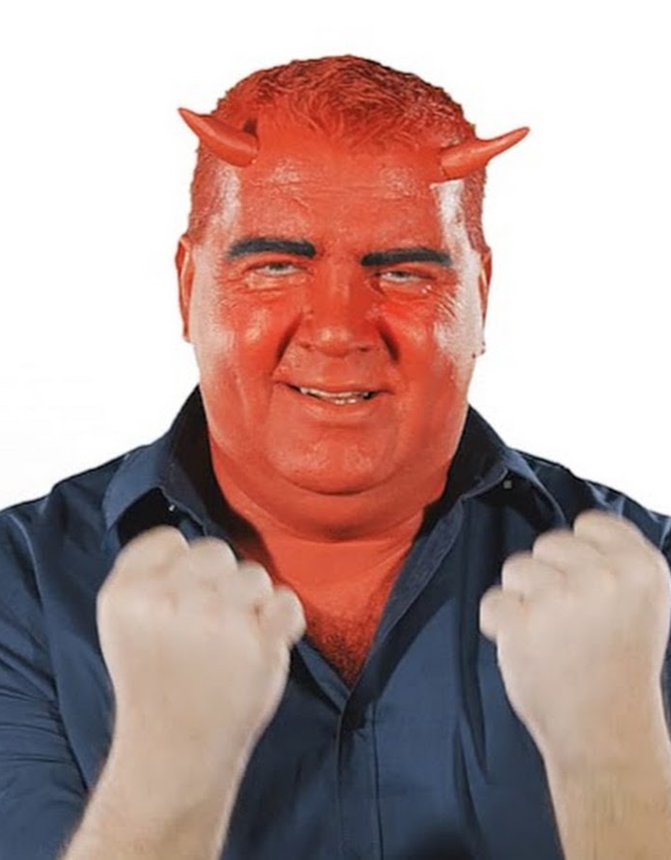
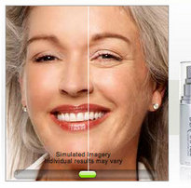
Age and advertisement

Slide 5
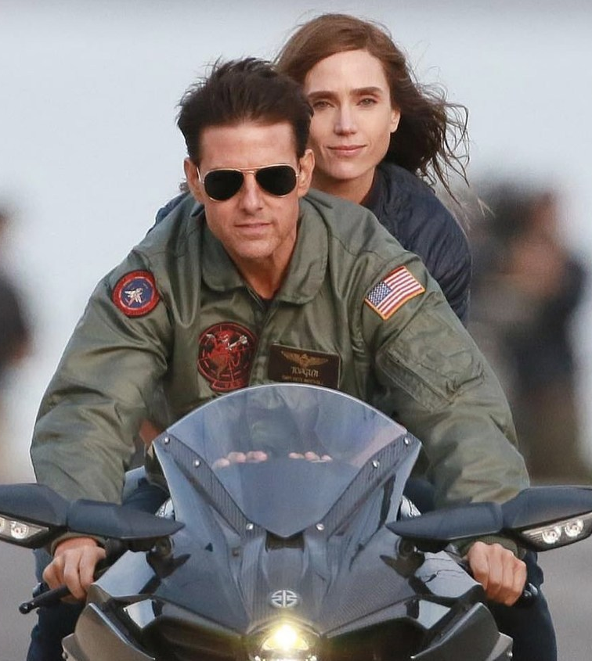
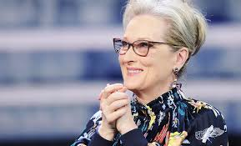
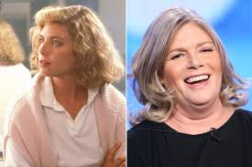
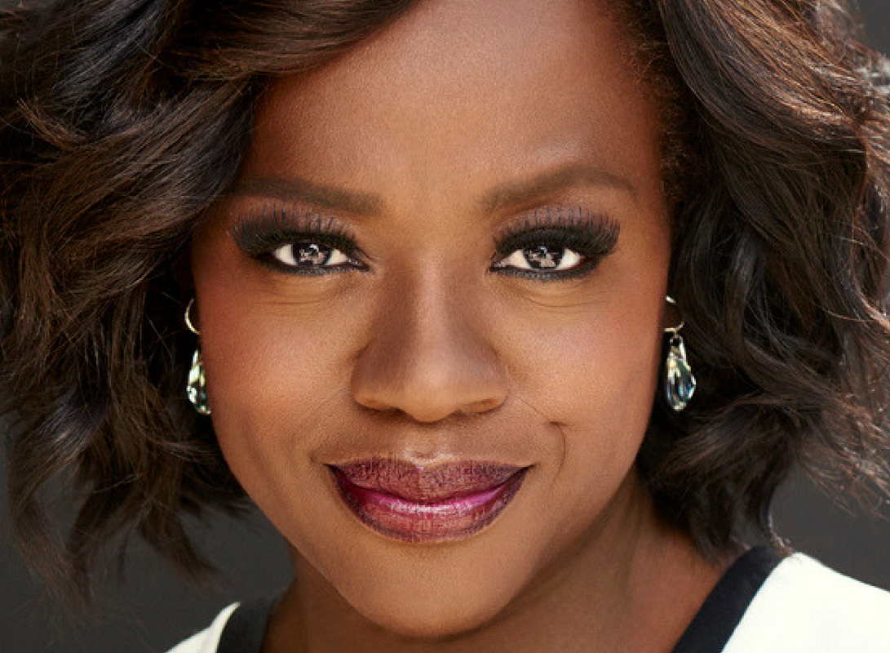
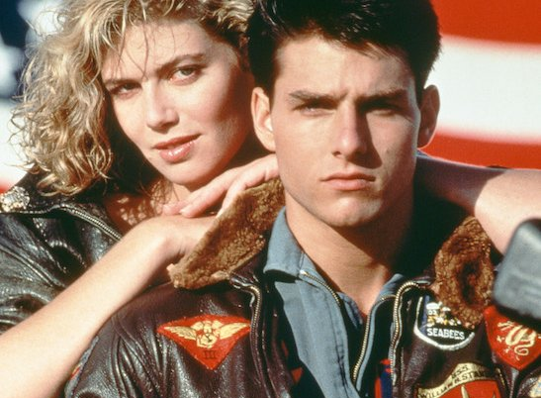
“Golden Hollywood”
quite radical beauty standards (we can observe a change)
only a few actresses “can get old” (Glen Close, Meryl Streep, Viola Davis, Julia Roberts…)
typical depiction of older men and younger woman
E.g. Top Gun (1986 vs. 2020)
mainstream media vs. satire
SNL – see video in IS

Slide 6
The Rawness of Scandi Noir or British TV

Slide 7
Let’s discuss the reading now!

