Slide 1
LANGUAGE AND IDENTITY
Robert helán
faculty of social studies

Slide 2
introduction
1. What is identity?
2. How we present our identities to the world
3. Types of identities
4. Identity formation
5. How language and identity intersect

Slide 3
1. What is identity?
What we choose to portray to the world outside of ourselves.
Aspects of identity:
age
gender
social class
profession
level of education
religion
geographical location
values and beliefs

Slide 4
1A. What is identity?
We can choose to portray different identities depending on the group we are with = “identity switching”
The whole sum of characteristics given by place, gender, age, race, history, nationality, sexual orientation, religious beliefs, religious orientation, ethnicity and, above all, the blanks between all these, allowing people to be part of one and another culture at the same time, all depending on context or sometimes even on free choice. (meyer)
Identity is fluid depending on the situation

Slide 5
2. How we present our identities to the world
The way we dress (clothes, hair, accessories, tattoos, piercings)
How we behave
The music we listen to
The movies we watch
The sports we play or watch
The books we read
Our hobbies
Our houses and cars

Slide 6
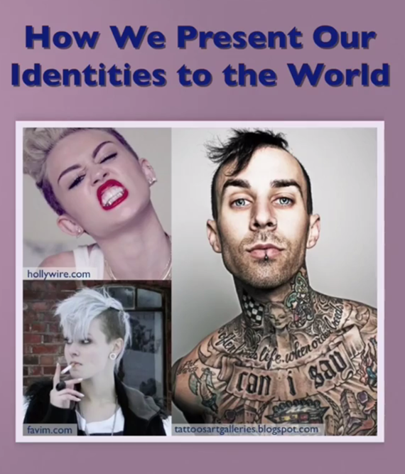

Slide 7
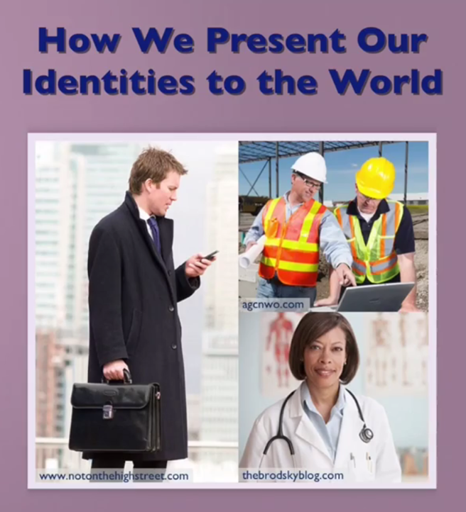

Slide 8
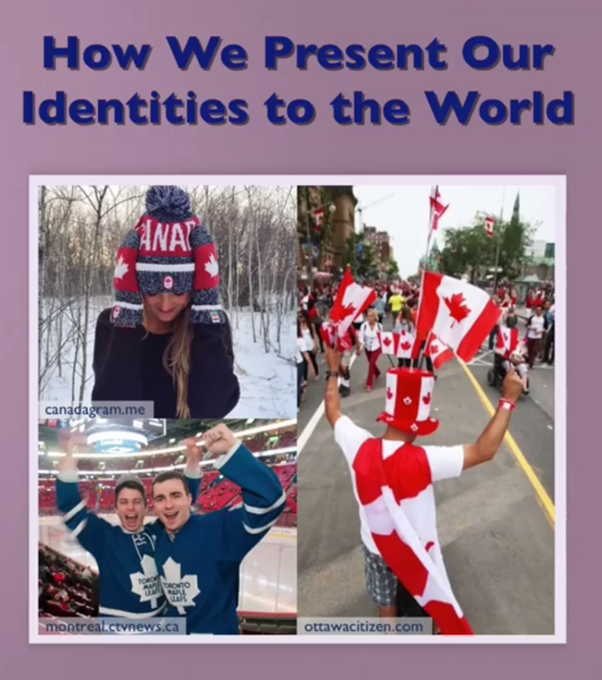

Slide 9
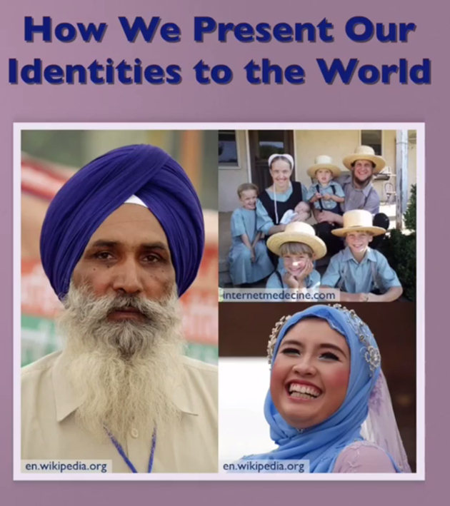

Slide 10
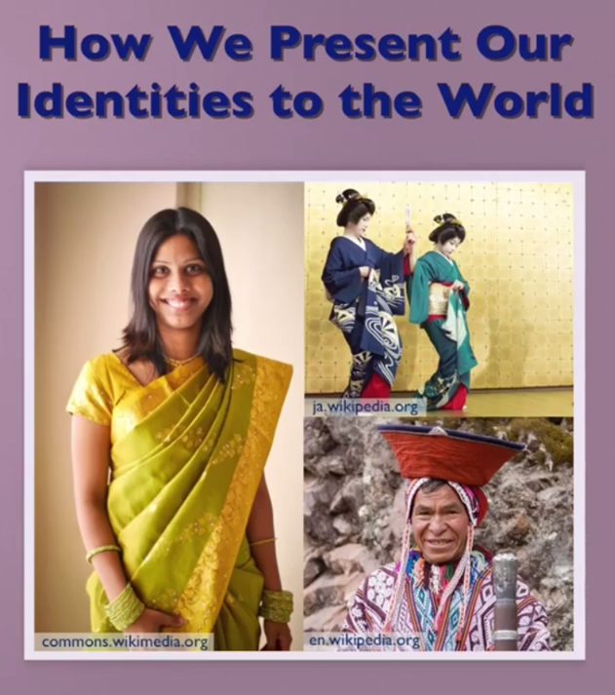

Slide 11
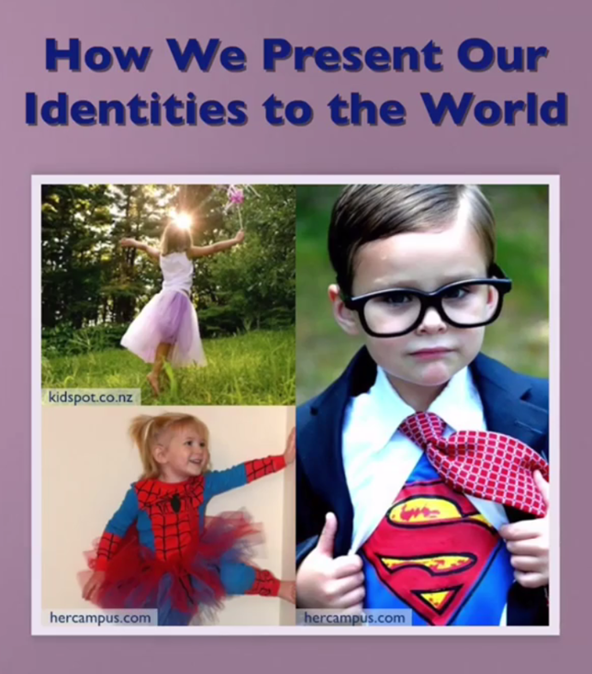

Slide 12
3. Types of identities
Psychological identities: how we perceive ourselves, mentally and emotionally.
Individual identities: who we think we are at our core.
Social identities: how we portray ourselves in a social situation.
Collective identities: groups that we feel we belong to.
Cultural identities: cultural groups that we feel we belong to.

Slide 13
3A. Types of identities: Multiple identities
Previous research said: each individual has a single, static identity.
Current research says: each individual has multiple identities and chooses which one to use depending on the context

Slide 14
3B. Types of identities: Multiple identities
Over time, we add identities to our collective group of identities
We tap into different identities depending on the situations that we’re in
We have identities within us that are contradictory
Narrative of self: a story that we tell ourselves, internally that helps connect and hold our multiple identities together.

Slide 15
3C. Types of identities: Multiple identities
Primary identity: the set of values, beliefs and experiences that we feel defines us as an individual, this identity in fact doesn’t change significantly over time.
Situational identities: identities that we use depending on the context that we’re in
factors:
covert and overt prestige
ingroup and outgroup
saving face

Slide 16
4. Identity formation
Researchers used to believe: once we reached adulthood, our identity was set in stone
Researchers now believe: identity is a dynamic entity that changes with new life experiences
Identity formation is an ongoing, lifelong process

Slide 17
4A. Identity formation:
Individual control over identity
Agency: the degree of control that we have over how we present our identities to the world
Agentive: something we do have control over
Non-agentive: something we don’t have control over

Slide 18
4B. Identity formation:
Individual control over identity
Symbolic capital: the prestige that individuals get based on how they present themselves
Symbolic violence: the negative repercussions that individuals face based on how they present themselves
Either may result from strategic choices or non-agentive means

Slide 19
4C. Identity formation:
Cultural identity
Based upon the cultural group to which an individual belongs
Members of the group share:
a common language
a common set of values/beliefs
Members of the groups might share:
a common ethnic background
a common geographic origin

Slide 20
4D. Identity formation:
Multiple cultural identities
One cultural group = one cultural identity
Multiple cultural groups = multiple cultural identities
More people are now moving from one culture to another
More people are developing multiple cultural identities

Slide 21
4E. Identity formation:
Multiple cultural identities
Old perspective: if you had two cultural identities, you were “torn between two worlds”
New perspective: we can flip back and forth from one cultural identity to another based on our cultural context

Slide 22
4F. Identity formation:
Multiple cultural identities
Don’t assume that your first cultural identity is going to be your primary cultural identity
When you shift between different cultural identities, you’re also shifting in terms of power and prestige

Slide 23
5. How language and identity intersect
Language helps us externally project our identities
Language helps us internally shape our identities
Language used to talk about identity
Language used to project identity

Slide 24
5A. How language and identity intersect: Language used to talk about identity
Group labelling:
ingroup (I, we) vs. outgroup (you, them)
the terms used to label various groups may carry positive or negative connotations
politics and power – natives: Indian, native peoples, first nations, indigenous, aboriginal

Slide 25
5B. How language and identity intersect: Language used to talk about identity
Naming: how we choose to identify our children, ourselves, our family and our friends
given name, family name
family name, given name
single name
many names to capture the entire family history
naming children after someone
nicknames
patronomics: “the son of…”, “the daughter of…”

Slide 26
5C. How language and identity intersect: Language used to talk about identity
Making introductions
1. symmetrical introduction (equal in power):
“Bob, this is alice. Alice, this is bob.”
2. asymmetrical introduction (power differential):
“bob, this is dr. jones. Dr. Jones, this is bob.”
you can signal the power relationship between yourself and other people.
First names: equal in power
titles and last names: puts others above yourself
mix of both: asymmetrical power relationship

Slide 27
5D. How language and identity intersect: Language used to talk about identity
Grammatical forms
vocative forms: used to call out to someone:
no power distance – first name: “hey bob!”
high power distance – last names “mr. jones!”
low power distance – (child) “hey kid!” “hey you!”
Pronouns:
use pronouns to signal social distance
use pronouns to indicate group membership

Slide 28
5E. How language and identity intersect: Language used to project identity
Style and style shifting
informal/casual language
formal language
slang
long vs. short words
style shifting: choosing to speak formally or informally based on how you want to be perceived n a particular context

Slide 29
5F. How language and identity intersect: Language used to project identity
Convergence: attuning your style of language use to a group in order to fit in
Linguistic maintenance: maintaining your language style in order to reinforce lack of membership in a group
Linguistic divergence: exaggerating your language style in order to strongly reinforce lack of membership in a group

Slide 30
5G. How language and identity intersect: Language used to project identity
Dialect: a version of a standard language
Idiolect: your own unique use of language that is developed over time
Dialect levelling: learning the standard language in order to fit in with a group that uses that standard language
Accent reduction: learning how to use a specific language with native pronunciation

Slide 31
5H. How language and identity intersect: Language used to project identity
Multiple language identities:
Spanish language identity vs. English language identity
dialect language identity vs. standard language identity
Language loss and identity:
when we lose a language, you lose the identity that goes with that language

Slide 32
Putting it into practice
1.Which identities do you have?
Which cultural identities?
Which linguistic identities?
2. analyze your language use.
How do you talk about identity?
How do you use language to project your identity?

