Slide 1
BSSb1194 Earth is trying to kill us
Jakub DrmolA

Slide 2
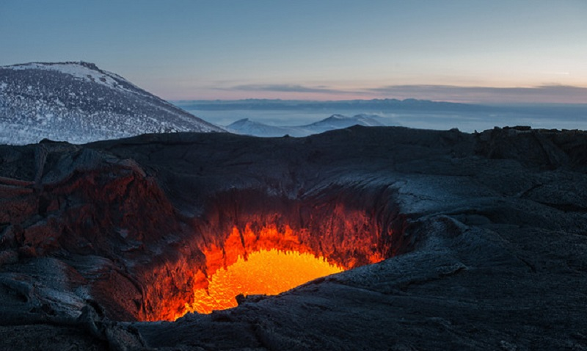

Slide 3
Volcanoes
- Santorini, ~1600BC
probably caused collapse of Minoan civilization
- Laki, 1783
25+% of Iceland dead from poison gas
- Tambora, 1815
“year without summer” -> famines
10-50 thousand direct casualties
- Krakatoa, 1883
40-200 thousand direct casualties

Slide 4
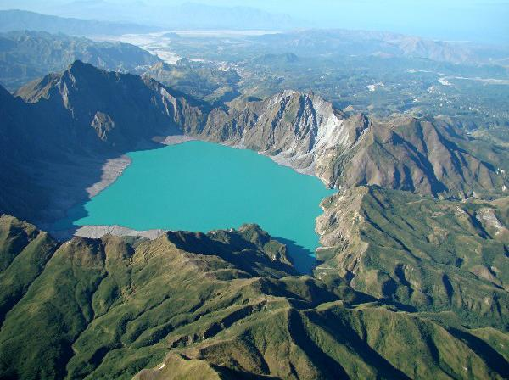

Slide 5
Volcanoes - effects
pyroclastic flows, mudflows, rocks and ash
inhaling toxic gases and ash
earthquakes and tsunamis
climate impact
short regional greenhouse effect
acid rains, ozone depletion
cooling from aerosols (albedo)
long-term CO2 warming
but also bring resources to the surface
release of CO2 can reverse runaway global cooling

Slide 6
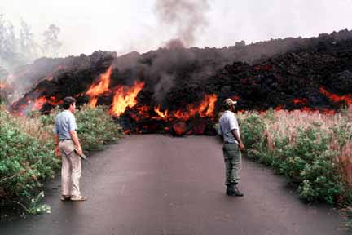

Slide 7
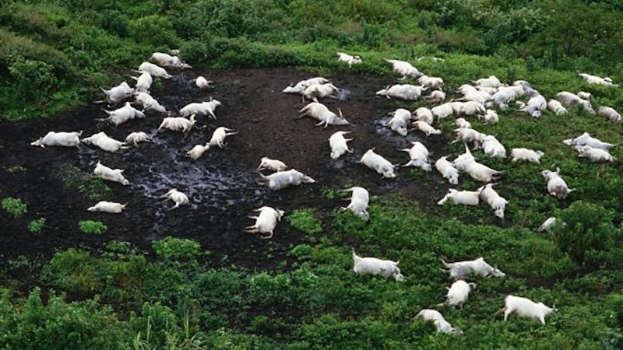

Slide 8
Limnic eruptions
- aka “lake turnovers”
- Lake Nyos, 1986
Cameroon, 1700 dead
- Lake Kivu, not yet
DRC/Rwanda border, potentially up to a million

Slide 9
Large Igneous Provinces
massive lava outflows
most common cause of mass extinctions
can last up to millions of years
e.g. Siberian Traps, Deccan Traps
we are “due” for one (15 mil. years)

Slide 10
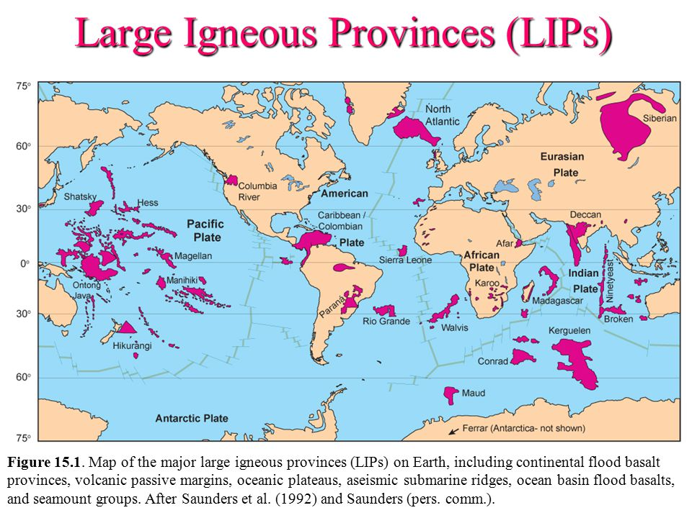

Slide 11
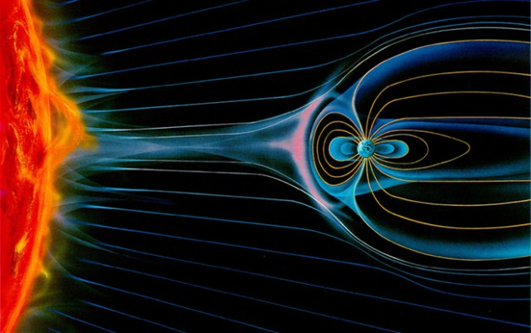

Slide 12
Geomagnetic reversal
- magnetic poles move constantly
- magnetic poles reverse at “random” intervals
couple hundred of thousands of year on average
- it usually takes 1000s of years
during which the magnetic field is weak
- observations suggest we might be heading for one
consequences?

Slide 13
Earthquakes
- Haiti, 2010
100-200 000 casualties
- China, 1976
200-600 000 casualties
- China, 1556
0.5-1 million casualties
- around 20 earthquakes with around 100k or more

Slide 14
Earthquakes - effects
- collapse of buildings, rock and mud slides
- fires and floods from damaged infrastructure

Slide 15
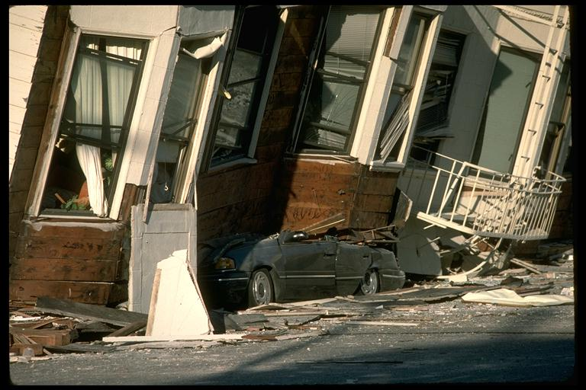

Slide 16
Tsunamis
- generally a secondary effect
of eruptions, earthquakes, impacts, rockslides
- 2011, Japan
Fukushima meltdown
- 2004, Indian Ocean
280 000 dead, the worst recent disaster
probably deadliest tsunami in history
- 1908, Italy
80-100 000 dead

Slide 17
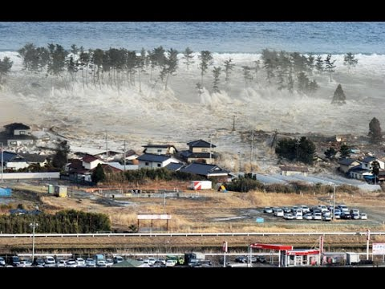

Slide 18
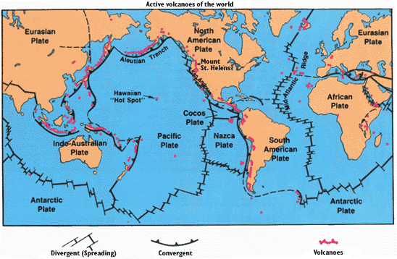

Slide 19
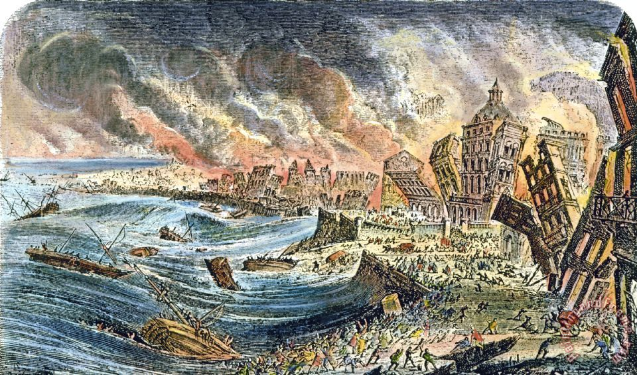

Slide 20
Cultural impact
- 1755, Lisbon
collapsed buildings, tsunami, fires
up to 100 000 casualties
devastating for Portugal economically and politically
impetus for Enlightement, religion and philosophy

