Slide 1
Ending Civil Wars
Dr. Marek Rybář
CDSn4002 Political Violence
Spring 2022

Slide 2
Introduction
unlike interstate conflicts, civil wars rarely end in negotiated settlement
most internal wars ended with the extermination, expulsion, or capitulation of the losing side
Why are warring sides in civil wars typically unable to reach a settlement without a third-party intervention?

Slide 3
Interstate and Civil Wars
credible guarantees on the terms of the settlement are nearly impossible to arrange by the combatants themselves
Barbara Walter (1997) argues that credible guarantees on the terms of the settlement are nearly impossible to arrange by the combatants themselves
the key difference between interstate and civil wars negotiations is that adversaries in a civil war cannot retain separate, independent armed forces if they agree to settle
this difference fundamentally alters incentives to accept any peace treaty and makes it difficult for groups to cooperate

Slide 4
Interstate and Civil Wars
states in the international system have a number of military and economic strategies to encourage cooperation:
early warning systems, monitoring and verification procedures, building military defenses, forge external alliances, set up buffer zones etc.
crucially, even if the war is renewed, states with strong defences and active forces would not be worse off than before the peace settlement
none of these strategies is available to groups fighting civil wars

Slide 5
Interstate and Civil Wars
if they wish to cooperate, they must disband their forces and thus relinquish their only remaining means for protection
in other words, settlement can leave a group far worse off than it would have been had it simply continued to fight
third-party guarantees can facilitate settlement by changing the level of insecurity
they can guarantee that groups will be protected, and terms will be fulfilled

Slide 6
Interstate and Civil Wars
to be credible, a guarantee must fulfill at least three basic conditions:
1. the outside state must have a self-interest in upholding its promise (old colonial ties, strategic interests, economic investments etc.)
2. the guarantor must be willing to use force if necessary (sufficient military capacities)
3. the intervening force should be able to signal resolve (strategic placement of outside forces, strong military presence without having to send for additional forces)

Slide 7
Insufficient alternative explanations
the skills of the mediator,
wars where the stakes are easy to divide (secessionist wars),
the stakes of war (the more can be won, the less likely a settlement is)
analyzing the civil wars in 1940-1990, Walter (1997) finds strong support for the credible commitment argument:
once adversaries agreed to negotiate, every case where a third party stepped in to guarantee a treaty resulted in a successful settlement

Slide 8
Peacekeeping an its effects
we also need to know if peace is more likely to last in cases where peacekeepers are present than where they are absent? i.e. Does peacekeeping help maintain peace in post-civil war settings?
peacekeepers tend to be sent to more difficult cases of civil war conflicts
they rarely go where war has ended in a decisive outcome but rather try to maintain peace where both sides have the capacity to disrupt it
peacekeeping is also less likely where a peace treaty has been signed indicating the combatants' commitment to peace

Slide 9
Peacekeeping an its effects
different types of peacekeeping:
observer missions (small in size, unarmed)
traditional peacekeeping missions (larger, lightly armed military units authorized to use force only in self-defense)
multidimensional peacekeeping missions (supplement traditional missions with large civilian components to monitor elections, train police, monitor human rights)
enforcement missions (better armed, mandated to impose peace by force, do not necessarily require the consent of the warring parties)

Slide 10
Peacekeeping an its effects
Virginia Fortna (2004): intervention by the international community helps maintain peace
peacekeeping works, especially after the Cold War (when most of the peacekeeping missions have been deployed)
it does not guarantee the lasting peace in every case, but it tends to make peace more likely to last, and to last longer
all four types of mission have decreased the risk of another war
traditional peacekeeping missions and observer missions have been the most successful
despite a number of fiascoes in the early and mid-1990s, peacekeeping is an effective conflict management tool

Slide 11
Consequences of Civil War Settlements
there has been a clear policy preference for settling civil wars through negotiated settlements
the core recommendation is to employ third-party resources to halt the violence and preserve the combatants
however, some authors argue that allowing wars to reach their “natural” conclusion enhances the likelihood of a durable peace and effective postwar reconstruction
they believe that outside intervention may block the transformative effects of both decisive victory and exhaustion of the warring parties

Slide 12
Civil War Termination
three ideal typical terminations of civil war conflicts:
negotiated settlement, in which neither side admits defeat and the combatants agree to end the violence and accept common terms on how to govern together
a ceasefire/stalemate: parties end violence but there is no attempt to achieve agreement on postwar power sharing
victory, meaning one side explicitly acknowledges defeat and surrenders

Slide 13
Consequences of Civil War Settlements
how do different termination types influence postwar outcomes?
is it true, that if the former combatants are given a voice in the post-settlement development, renewed violence can be averted?
Monica Duffy Toft (2010) analyzes all civil wars in 1940-2007 and shows that incidence of negotiated settlements substantially increased in the 1990s
there are a number of arguments for ending civil wars through negotiated settlement, the most powerful of which is that negotiated settlements reduce the number of deaths compared to victories

Slide 14
Consequences of Civil War Settlements
if a civil war’s “costs” are measured narrowly in terms of life, negotiations to halt the violence would spare lives, and thus reduce the war’s costs
however, even if negotiated settlements may save lives, it is also true that combatants have strong incentives to avoid sharing power in a new government
moreover, combatants are just as likely to use an armistice as an opportunity to recover and rearm in preparation for a future fight
negotiated settlements may have an increased likelihood of saving lives in the short term, but an equally increased likelihood of costing even more lives in the long run

Slide 15
Consequences of Civil War Settlements
wars ending in victory were nearly twice as likely to remain settled than those concluded through negotiated settlement or a cease-fire/stalemate
victory reduces the likelihood of civil war recurrence by 24 percent, relative to all other types of civil war termination
conversely, negotiated settlements increase the chances of recurrence by 27 percent, relative to all other types

Slide 16
Consequences of Civil War Settlements
the empirical evidence does not support the normative argument that negotiated settlements save lives
wars following these failed settlements are significantly more deadly
if war recurrence represents a high cost, then negotiated settlements appear to be costlier than allowing the combatants to fight until one side emerges victorious

Slide 17
Consequences of Civil War Settlements
negotiated settlements may not be the best way to increase the prospects for greater democratization following a civil war: negotiated settlements are associated with higher authoritarianism over time
o summarize, Toft finds out that
1. civil wars ending in negotiated settlements are much more likely to recur,
2. negotiated settlements are no more likely to lead to democracy than other types of settlements, and
3. economic growth trends do not seem to be correlated with the type of civil war termination

Slide 18
Why are negotiated settlements problematic?
most of the negotiated settlements include extensive provisions for establishing executive offices, legislatures, free and fair elections, and judiciaries
however, the means and methods to adapt and reinstitutionalize the military is given only secondary consideration
while negotiated settlements are good at providing benefits, they are less effective in following through on their threats and are therefore not self-sustaining

Slide 19
Why are negotiated settlements problematic?
In contrast, when governments achieve victory, the military is left intact
as are the other branches of government (the government retains the capacity to repress or harm the population)
when rebels win, they are in a position not only to harm (or threaten to harm) their populations but also to benefit them
rebels often need to bolster the legitimacy of their win: allowing greater liberalization of the political system is an effective means of doing so

Slide 20
What explains the patterns of civil war termination?
three distinct time periods can be detected in 1946-2013:
during the Cold War, most civil wars ended in victory by one side
with the end of the Cold War, many more civil wars ended in negotiated settlements
furthermore, the total number of civil war terminations rose between 1990 and 2001 (including the many wars that died out in low activity)
since 9/11 fewer civil wars have ended per year
there are still many negotiated settlements, but the proportion of wars ending in compromise as opposed to military victory has declined

Slide 21
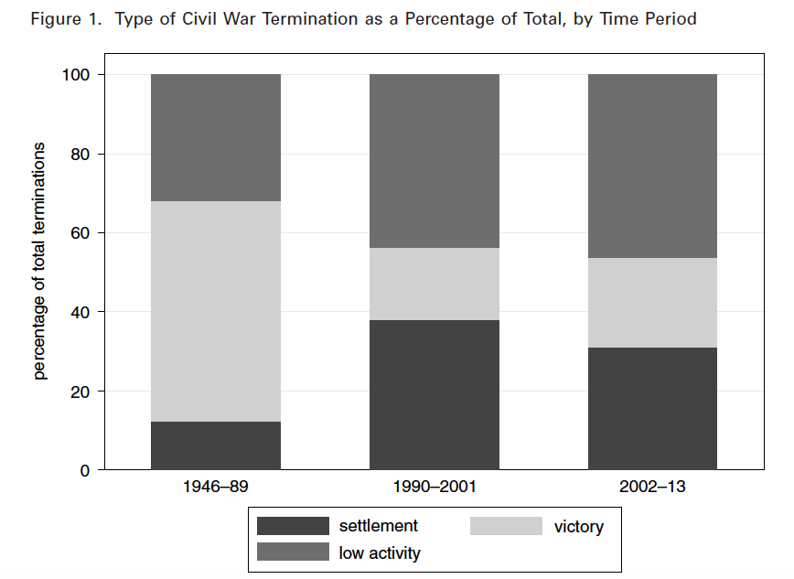

Slide 22
What explains the patterns of civil war termination?
Morjé Howard and Stark (2018) argue causes at the level of the international system account for the observed variation:
the international political environment (both its material and ideational components) gives rise to NORMS, i.e. clusters of ideas of appropriate behavior
these norms than shape different types of outcomes, including how civil wars end
in the bipolar Cold War setting, fighting to the finish was the most acceptable way to end the civil war (in line with zero-sum character of the Cold War)

Slide 23
What explains the patterns of civil war termination?
after the collapse of the Soviet Union, the US and its allies chose not to seek complete defeat and instead favored negotiated solution
(even when that meant an inclusion of anti-US elements in the new government)
such an ideational shift was possible due to the absence of major threats and the quest for democratization prevalent in that period
since 9/11, however, competing ideas of war on terror, and non-negotiation with terrorists challenge the norms of negotiated settlements

Slide 24
What explains the patterns of civil war termination?
disillusionment with the quest for externally assisted democracy produced by the new threat of terrorism and the failures of regime change in Iraq, Afghanistan and elsewhere
the main effect on civil wars have been a decrease in all types of terminations and fewer negotiated settlements in civil wars that include actors labeled as terrorist groups
there has been no complete shift, however, we see normative trends in the US and the UN Security Council of the acceptance of the appropriateness of non-negotiation with terrorists, and the quest not for democracy but stabilization

