Slide 1
Counterterrorism and counterinsurgency
CDSn4002 Political Violence
Spring 2022
Dr. Marek Rybář

Slide 2
What is counterterrorism?
in contrast to terrorism, the term counterterrorism remains significantly under-theorized
it refers to multiple strategies that states use to fight terrorist threats
what does it mean when terrorist groups experience leadership decapitation?
tactics which are designed to kill or capture the key leader or leaders of a terrorist group play a prominent role in the counterterrorism strategies of many states
their intention is to disrupt the terrorist group’s organizational routine and deter others from assuming power

Slide 3
Leadership Decapitation
proponents of decapitation cite cases in which the tactic has contributed to the organizational collapse of terrorist groups:
the PKK
the Shining Path
critics point out examples in which it has increased and intensified terrorist activity
also claim that it is morally wrong and
warn of a backlash effect (that leadership decapitation is likely to increase the number of recruits)

Slide 4
What are the Effects of Leadership Decapitation?
decapitation means that a terrorist group’s leader was either killed or captured
Price (2012):
argues that leadership decapitation significantly increases the mortality rate of terrorist groups
analyzes the effects of leadership decapitation on the mortality rate of 207 terrorist groups from 1970 to 2008
How to assess the effects of decapitation?
e.g. the number, frequency, or lethality of attacks: previous research finds no effect of leadership decapitation

Slide 5
The Effects of Leadership Decapitation
Price evaluates the effects of decapitation on the duration of terrorist groups
two conditions must be met if leadership decapitation is to be an effective counterterrorism policy:
1. terrorist group leaders need to be important to the overall success of the organization, and 2. leadership succession must be difficult
terrorist groups have unique organizational characteristics that increase the influence of their leaders and make leadership succession complicated, because they are violent, clandestine, and values-based organizations

Slide 6
Violent, Clandestine, and Values-Based Organizations
they depend on their leaders more than other organizations that lack all three characteristics
violent organizations are more cohesive and often led by charismatic leaders
lack of formalization and institutionalization in terrorist organizations increases the level of uncertainty, which complicates leadership succession and causes organizational instability
a terrorist group "died" when it was inactive for two years (i.e. committed no violent attack) since the group’s last attack

Slide 7
The Empirical Results
1. decapitated terrorist groups have a significantly higher mortality rate than nondecapitated groups; however, there is no guarantee that organizational death will be immediate; only 30% of decapitated groups ended within two years of losing their leader
2. the earlier leadership decapitation occurs in a terrorist group’s life cycle, the greater the effect: Killing or capturing a terrorist leader in the first year of the group’s existence makes the group more than 8 times as likely to end than a nondecapitated group
3. capturing, killing (or both) significantly increase the mortality rate of terrorist groups

Slide 8
The Empirical Results
4. any type of leadership change, not just decapitation, increases the mortality rate of terrorist groups, i.e. states may not have to kill or capture a leader to hasten the group’s demise
5. group size does not affect terrorist group duration: smaller groups are just as durable as larger groups
6. religious terrorist groups were less resilient and easier to destroy than nationalist groups following leadership decapitation
does the same logic apply to decapitation of the other militant organizations?

Slide 9
Leadership Decapitation and Insurgency
Johnston (2012) argues that decapitation is likely to help states’ overall efforts against militant organizations
however, other factors also matter greatly in most cases
decapitation is more likely to help states achieve their objectives as an operational component within an integrated campaign strategy than as a stand-alone strategy against insurgent and terrorist organizations
his analysis focuses on attempted removals of insurgent leaders in counterinsurgency campaigns; “leader” is defined as the most powerful figure or figures in an insurgent organization

Slide 10
Analytical focus
the main question concerns the effect of leadership decapitation on counterinsurgency campaign outcomes and dynamics
collection of data on attempts to kill or capture insurgent leaders:
46 out of 118 attempts (39%) resulted in the removal of a top-level insurgent leader,
90 counterinsurgency campaigns from 1975 to 2003, containing 928 campaign-year observations

Slide 11
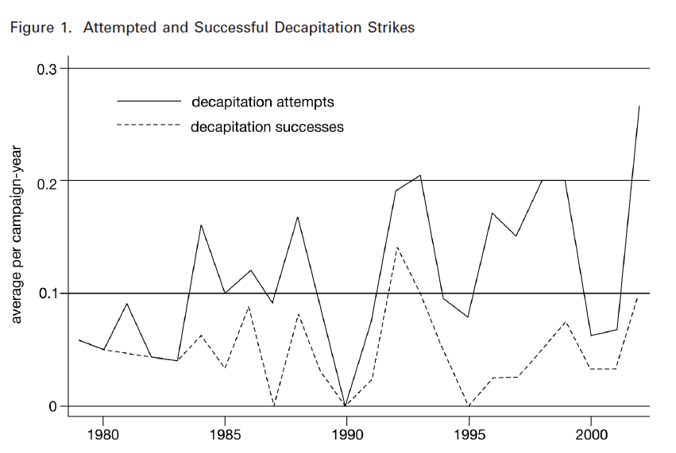

Slide 12
The results
governments are more likely to win when they successfully target militant leaders
regardless of whether a government’s adversary is a state, a terrorist organization, or a guerrilla insurgency
leadership decapitation has substantial causal effects on campaign outcomes: removing militant leaders increases counterinsurgents’ chances of achieving quick, successful campaign terminations
leadership decapitation also reduces conflict violence and is associated with fewer insurgent attacks

Slide 13
A universal strategy?
Is leadership decapitation more or less effective against some types of insurgencies than others?
ideological conflicts are fought over how polities should be governed, whereas identity conflicts usually involve at least one party that views itself as fundamentally different from the other and is fighting to pursue some form of self-determination
no evidence that would suggest a differentiated impact of leadership decapitation on the two types of insurgencies
killing insurgent leaders is likely to be more effective than capturing them:
operations that resulted in the capture of militant leaders are also effective, but these results are smaller and statistically insignificant

Slide 14
Counterterrorism and Regime Type
in regimes that rely less on popular support, such as authoritarian regimes, coercion is expected to produce deterrence effects (that is, reduce the duration of terrorist groups)
however, coercive responses to terrorism tend to be counterproductive in democracies
they reduce the probability of negotiated settlements, but increase the likelihood of group victory
authors' empirical analysis rests on examining 539 groups for the 1976–2006 period, supports their main hypotheses

Slide 15
Harsh Government Responses to Terrorism
holding suspects without charging them,
assassinating suspected terrorists,
curbing civil freedoms, or
imposing retribution on alleged sponsors
they contradict the fundamental values of democratic regimes
backlashes are particularly likely if counter-terrorist measures do not discriminate between supporters of terrorist organizations and innocent citizens

Slide 16
Why are Democracies Different?
1. the use of harsh policies reduces local communities’ co-operation with government authorities
2. harsh counter-terrorism policies can increase popular sympathy for the group’s cause and spur recruitment for terrorist organizations
3. democratic states’ use of repression will jeopardize their ability to combat terrorism more generally: use of coercive measures threatens the electoral survival of leaders - and leadership turnover may result in changes to counter-terrorism policies that can subsequently reduce the government’s effectiveness in combating terrorist groups

Slide 17
Recap
in democracies, limited and selective counter terrorism strategies have the highest potential for success
iron-fist strategies can have negative consequences even in non-democratic states, especially in the long run:
they may successfully end a terrorist campaign in the affected country but produce an exodus into other states (from Chechnya to other republics)
Indiscriminate repression, while successful against terrorist groups in the short term, may also lead to widespread opposition and eventual rebellion against authoritarian regimes in the long run

Slide 18
The New Counterterrorism? (Kurtulus)
four dimensions of new counterterrorism
1. discursive transformation of narratives related to fighting terrorism:
during the first decade of the 21st century, counterterrorism discourses of modern democracies have increasingly acquired an ideological outlook
the necessity of a religious or secular ideology, on the basis of which a justification can be made and legitimacy acquired
in the US and Israel, the ideological framework of counterterrorism discourses acquired a specifically religious outlook (the presence and importance of the radical religious right)

Slide 19
The New Counterterrorism?
2. normalization of extra-judicial means
the creation of overt or covert extrajurisdictional domains that are unregulated by the human rights law of democratic states
the acceptance and legitimization of torture
a widespread use of extra-judicial killings as an acceptable method of eliminating terrorist suspects

Slide 20
The New Counterterrorism?
3. Increased Lethality of Counterterrorism Tactics
an increasingly large number of innocent civilians are becoming victims of often imprecise and disproportionately high levels of force used by counterterrorism agencies
a method of targeted assassinations in the wars in Afghanistan, Iraq, Lebanon, and Gaza and during the counterterrorism operations in Yemen, Pakistan, and Somalia led to a large number of casualties among unarmed civilians

Slide 21
The New Counterterrorism?
4. horizontal and networked organizational structure of new counterterrorism
Al Qaeda (new terrorism in general) regarded as horizontally networked terrorist activities that can only be countered by a similar network of counterterrorism agencies
a. the extraordinary rendition program: a policy where individuals known to be members or affiliates of terrorist organizations are seized and covertly transferred to a third country detention facility for debriefing
the process is extrajudicial, done in secret, and typically not carried out exclusively by U.S. personnel
b. the outsourcing and privatization of counterterrorism-related activities weakens hierarchical institutional structures (that are based on vertical principal-agent relationships), transparency, and democratic accountability

