Slide 1
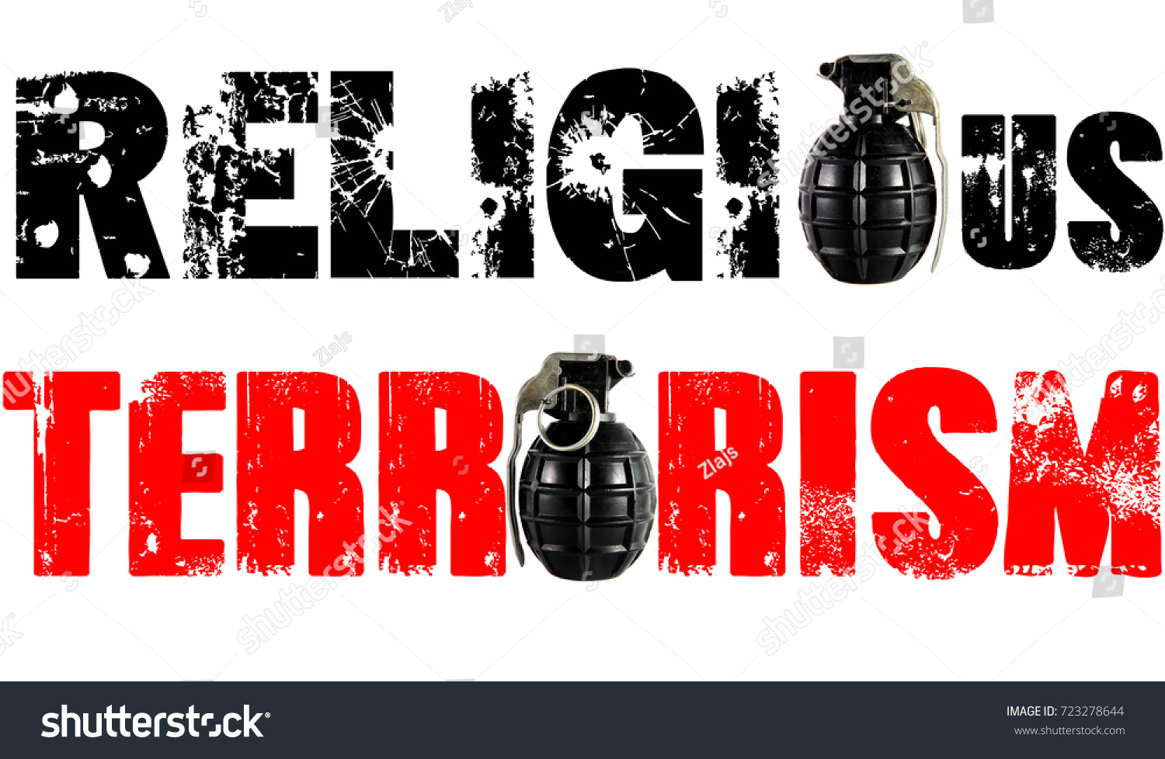
The role of social encouragement, religion and terrorism
Political Violence CDSn4002
Masaryk University, Spring 2022

Slide 2
Changing Status of International Islamist Terrorism
we are living in an era of a declining importance and relevance of international terrorism
GTI (2021) reports that far-right terrorism has increased dramatically in the last five years and may well represent a more dangerous version of terrorism in many Western democracies
al-Qaeda and the Islamic State still relevant, but increasingly local/national phenomena
Al-Qaeda has disintegrated and has no central command or ideology
The Islamic State is doing better but also searches for unstable or ungoverned places where it can operate
unlikely that local activities can appeal across countries and continents

Slide 3
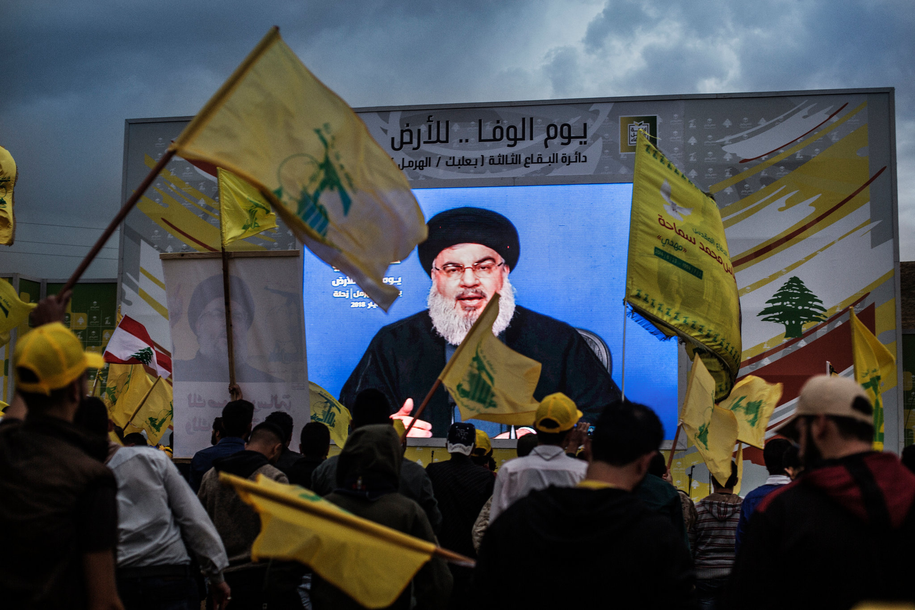
With so many angry people in the world, why there are so few resilient terrorist organizations?
Eli Berman: Radical, Religious, and Violent
drawing on the history of the Taliban, Hamas, and Hezbollah to explain the sensitivity of terrorist groups to defection and information leaks, arguing that this is the central organizational problem that terrorists face
radical religious communities of different faiths are similar to each other in their daily lives:
they share generous mutual aid networks and the norms that distance community members from mainstream culture and market economies

Slide 4
The Political Economy of Religious Radicalism
theses seemingly counterproductive social norms are in fact critical to the survival of a community based on mutual aid
radical Islamic communities:
although their religious practices are diverse and different from those of either radical religious Christians or radical religious Jews,
They share a common pattern of well-organized mutual aid within communities as well as norms that distance their members from mainstream culture and markets

Slide 5

Why would anyone choose to submit to a life with poor outside options?
(That’s the logic of sacrifice)
by limiting outside options, one incurs a cost, which signals to a community that they can be trusted
that signal, in turn, makes them an attractive member of some sort of collective production cooperative
Usually that cooperative production activity is benign—mutual aid—but if a need or opportunity arises, religious radicals sometimes press the advantage that their loyal networks provide to be effective at coordinated violence

Slide 6
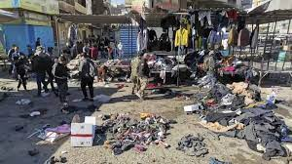
Suicide attacks
the single best predictor of suicide attacks has little to do with theology
it is the “hardness” of the target that matters—how difficult it is to destroy
As governments present terrorists with better and better defended (i.e., harder) targets, terrorists respond by switching to the tactic that is the most difficult to defend against: the suicide attack
Suicide attacks come at a high cost for the terrorist organization—the certain loss of the attacker—so terrorists almost always use less costly tactics when the chosen target can be destroyed without losing the attacker in a suicide attack

Slide 7
Taliban
Only organizations with high defection constraints can aspire to profit from controlling trade routes (their major source of income)
securing trade routes in lawless places like Afghanistan was particularly sensitive to defection, since no contract with subordinates can be enforced through the legal system
Loyalty is critical, and is threatened by low defection constraints
only an organization that can convince potential clients that its own members will remain loyal when the temptation to defect is high will be able to succeed at the business of controlling trade routes for profit

Slide 8
The economic club argument
radical religious groups, or sects, operate as economic clubs:
They collectively provide both spiritual services and an entire array of concrete social services through mutual aid systems
To protect that mutual aid club against shirkers, members require sacrifices of each other as demonstrations of commitment
Religious prohibitions also help reduce shirking among members by distancing them from market opportunities and strengthening collective activity

Slide 9
The economic club argument
Religious radicals are at the high-commitment, high-collective-activity end of a spectrum of religious denominations found in Judaism, Christianity, and Islam alike
That club logic also applies to communes, fraternities, gangs, and other nonreligious organizations
when radicals are subsidized, religiosity can increase quickly, allowing religious radicalization, as we saw in Afghanistan, Lebanon, Palestine, and possibly among Shiites in Iraq
the same increase in religiosity can occur when radicals become the principal providers of some basic public services, such as security or welfare services

Slide 10
Why are religious radicals such effective terrorists and insurgents?
a tiered membership structure (the Muslim Brotherhood, the Hamas)
Lower-tier members paid dues, held a membership card, and had access to the social service network and mosques
At higher tiers, more commitment was required, including an oath of allegiance, Koranic studies, and physical training
This structure allowed the organization to select suitable candidates among the large pool of lower tier members who sought services, then train and indoctrinate them.
Once suitably selected and prepared, higher-tier members could be entrusted with more sensitive jobs.
That organizational base, built on the social service provision network, would prove critical in surviving the next, more severe, round of repression

Slide 11
The role of social service provision
the more individuals the social service provision network comes into contact with, the more opportunities it has to find an individual predisposed to having high commitment as an operative or attacker
The two social service providers, Hamas and Hezbollah, are clearly more lethal than the other terrorist groups
None of the other (analyzed) organizations have a social service provision function
Social service provision is a key indicator of the ability of terrorists to be lethal, as the logic of clubs and defection constraints implies

Slide 12

Violence against women and local population: Defection prevention?
The need to control defection provides a possible explanation for seemingly gratuitous insult, violence, and destruction
if the troops establish a reputation for cruelty to women and the local population, their outside option of fraternizing is severely undermined
this in turn strengthens the ties among combatants, making defections less likely

Slide 13
Recap
the explanation has nothing to do with the spiritual or theological content of religion
It emphasizes mundane aspects of radical religious communities, like trust between members as well as social service provision
Successful nonreligious violent groups have also sprung from social service provision organizations
A violent organization that is religious is the Japanese Aum Shinrikyo cult of the 1990s, the only terrorists to ever stage a biological weapons attack
It had all the characteristics of a club: sacrifices, prohibitions, and mutual aid, a full-fledged commune

Slide 14
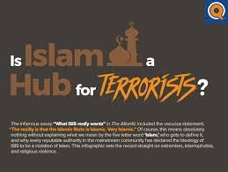
Discourse on “Islamic terrorism”
an academic consensus that the goals and concerns are political and nationalist in the traditional sense,
the use of religious language and symbols is instrumental rather than primary
Islamist discourse, although often expressed in religious terms, is a form of secular or nationalist protest at external and internal domination and forms of exclusion
to al-Qaeda, religion matters, but mainly in the context of national resistance to foreign occupation
Al-Qaeda is less a transnational network of like-ideologues than a cross-national military alliance of national liberation movements working together against what they see as imperial threat

Slide 15
Discourse on “Islamic terrorism”
What are the political functions and ideological consequences of the particular forms of representation articulated by the discourse on Islamist terrorism?
such discourse functions as a "symbolic technology" aimed at:
structuring the accepted knowledge,
providing legitimate policy responses,
excluding and de-legitimizing alternative knowledge,
naturalizing a particular political and social order,
and constructing and maintaining a dominant (hegemonic) discourse

Slide 16
Discourse on “Islamic terrorism”
Jackson’s discourse analysis of “Islamic terrorism”:
series of core labels that are often vaguely defined, yet culturally loaded and highly flexible:
'the Islamic world', 'the West', 'the 'political Islam', 'Islamism', 'extremism', 'radicalism', 'religious terrorism', 'jihadists', 'Wahhabis', 'moderates', 'global jihadist’ etc.
Jackson argues that the most important functions of the Western discourse of 'Islamic terrorism' is to construct and maintain national identity, through the articulation of a contrasting negative "other”

Slide 17
Discourse on “Islamic terrorism”
by denying demands of insurgent groups, demonizing them as fanatics, and essentializing them as violent, irrational, savage and fanatical, the 'Islamic terrorism' discourse normalizes and legitimizes set of coercive and punitive counter-terrorism strategies
it simultaneously makes non-violent alternatives such compromise and reform appear inconceivable and nonsensical
in addition, by locating of contemporary terrorism in religious extremism, the discourse works to deny and obscure its political origins and the possibility it is a response to specific Western policies

Slide 18

Ethical dimension of the discourse
examine also the ethical normative consequences of discourse:
the 'Islamic terrorism' discourse may be harmful to community relations, public morality and the search for effective, proportionate and legitimate responses to terrorist acts
increasing levels of islamophobia across the Western world
increasing acceptance of non-standard interrogation techniques (basically torturing terrorists)

Slide 19
Conclusion
the aim of such discourse analysis is not to assert that the threat of terrorism does not exist, nor is it to claim there is no link between religion and terrorism
it is to draw attention to the contestable and politicized character of the dominant narratives, i.e. the ways in which Islamic terrorism is interpreted and socially constructed as an existential threat
discourses are never completely hegemonic and there is always room for counter-hegemonic struggle and subversive forms of knowledge

