Slide 1
Myanmar – democratisation and conflict
Věra Stojarová

Slide 2
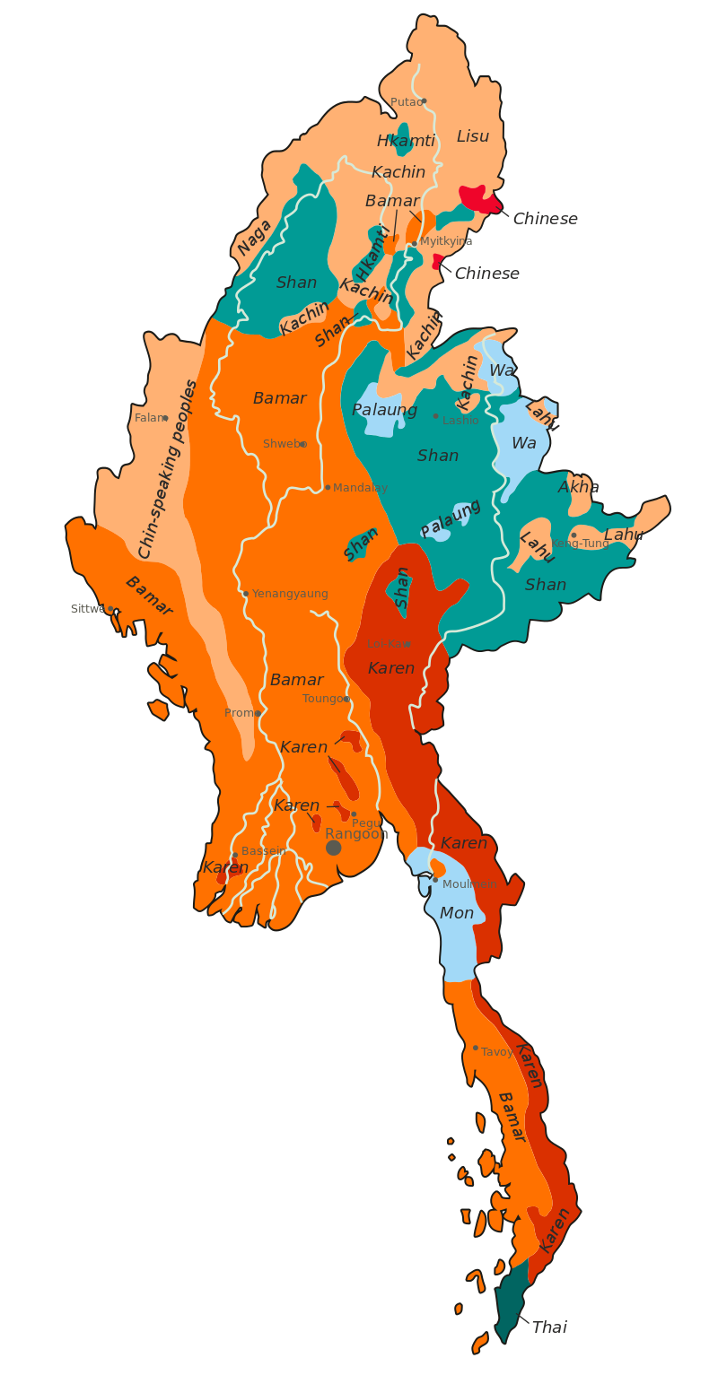
Ethnic and language diversity
with 135 distinct ethnic groups
These are grouped into eight "major national ethnic races":
The "major national ethnic races" are grouped primarily according to region rather than linguistic or ethnic affiliation
No official statistics, rather estimates
Majority BAMAR – 68 %, speak the only official language Burmese
1989 – from Burma to Myanmar – more inclusive

Slide 3
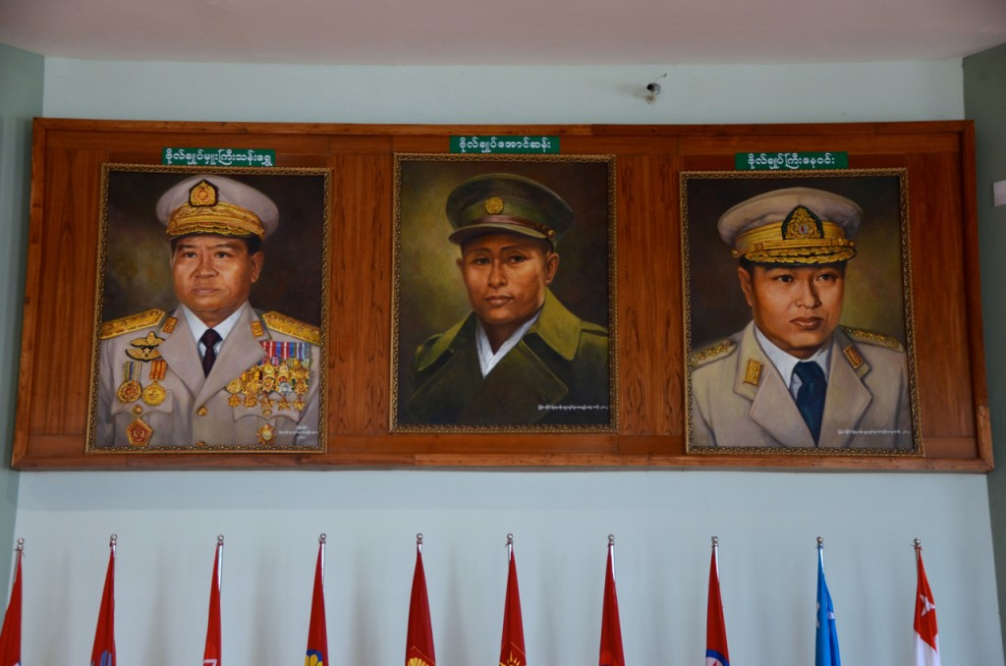
Timeline
Post-independence conflict 1948-62
Ne-Win era – first generation junta 1962-88
8888 uprising
Second generation junta 1988-2011
2007 saffron revolution
2011-2021 democratisation
2012-15 quasi civilian government
2015 first democratic elections, NLD national reconciliation government
2021 coup and violence

Slide 4
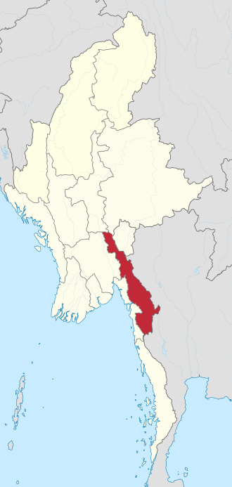
Prior independence
British colony
Japanese invasion 1942
Karen national union – loyal to Britain, Christian
Burmese national union – for independence, Buddhist
Majority of Karens in the army disproportionally to the percentage of the population – Karenisation of the army
1948 independence, since then civil war and Karens fight for independence, one of the longest running civil war

Slide 5
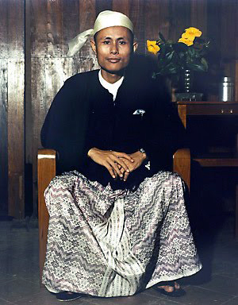
Aung San – Father of the nation
Struggled for Burma´s independence
Assasinated 6 months before independence
Founder of Communist Party and Socialist Party
Founder of Myanmar armed forces

Slide 6
Post-independence conflict 1948-62
Communist party of Burma –independence of Burma
vs. Karen Nationalists - Independent state governed by Karen people

Slide 7
1962 -1988 military junta – Ne Win 26 year dictatorship
General Ne win ousted parliament and replaced with military rule
New rebel factions
In 1967 riots between Bamar and Chinese communities
Private property confiscated by the government
the Burmese Socialist Programme Party (BSPP) - govern the country under a one-party system
one of the least developed countries in the world

Slide 8
Burmese way of socialism
an amalgam of Buddhist and Marxist logic, folklore, nationalism, militarism and xenophobia
three-month political indoctrination and basic military training
nationalisation of industry
Rejection of foreigners
Private property seized
Burma’s own communists criminalised leaving only one game in town for the new single-party state: the Burma Socialist Programme Party.

Slide 9
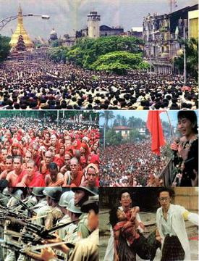
8888 uprising (8th August 1988)
On 12 March 1988 student demonstrations spread into the country calling for multiparty system
military coup d'état on 18 September 1988, miliary retaking the power
State Law and Order Restoration Council (SLORC)
violent suppression
Aung San Suu Kyi emerged from the 8888 Uprising as a symbol of Myanmar's pro-democracy movement, leading the country's largest opposition party, the National League for Democracy (NLD).
The military junta arranged a general election in 1990, in which the NLD won a majority of the vote. However, the military junta refused to recognise the results and instead placed Aung San Suu Kyi under house arrest

Slide 10
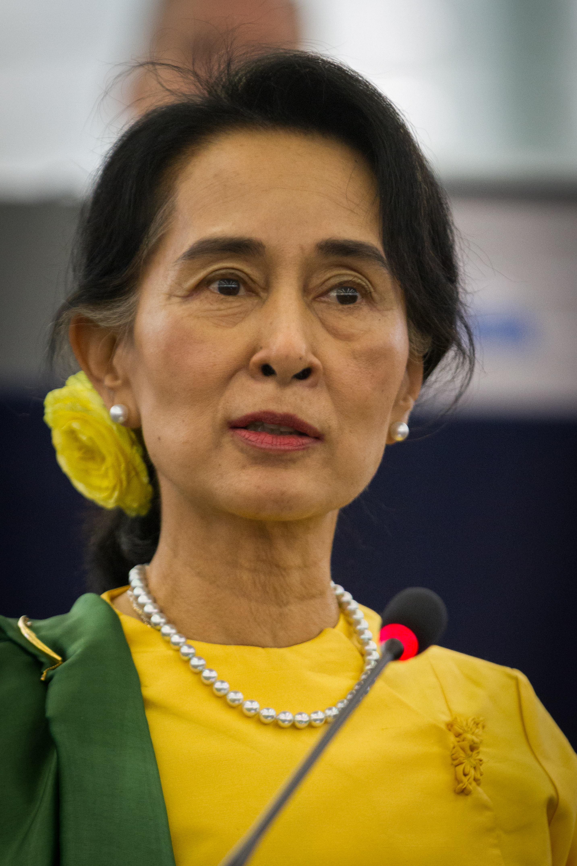
Aung San Su Kyi
The youngest daughter of the Father of the nation Aung San
World´s most prominent political prisoner
Under house arrest for over 15 years
1991 Nobel Peace Price
Husband and children – foreign citizens
Since 2010 MP
2015 prime minister (banned from becoming a president)
Genocide of Rohyngia people
Refusal to acknowledge the massacres
2021 coup d´etat, Aung San Su kyi arrested

Slide 11
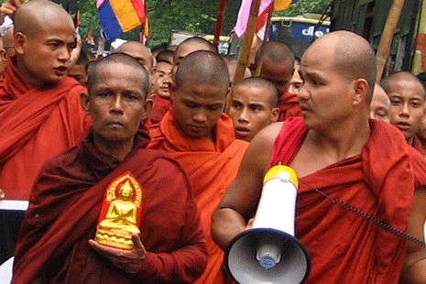
Rule of the generals 1988-2011
the State Peace and Development Council (SPDC), which consisted of eleven senior military officers.
1990s weakened ethnic insurgent groups
2006 large-scale military offensive against the the Karen National Liberation Army (KNLA). approximately half a million people were displaced
2007 Saffron Revolution - hundreds of thousands of monks protested against the military junta's rule, and called for free elections, minority rights and the release of political prisoners

Slide 12
2011-2021 heading towards democracy???
2011 constitution and political reforms including releasing political prisoners, still under military control
2015 first free elections
2015 peace conferences - However, these efforts were criticised for not addressing the main proposals made by ceasefire groups, and for excluding the country's largest insurgent groups which were still active.
25 % of the military in the parliament reserve
Since 2016, Rohingya minority, ethnic cleansing

Slide 13
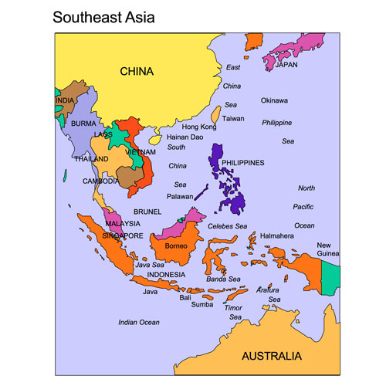
Foreign involvement
The People's Republic of China - its close relations with both the Myanmar government and insurgent groups , China openly supported the Communist Party of Burma
India- India and Myanmar share a strategic military relationship due to the overlapping insurgency in northeast India The two countries' armies have conducted joint operations against insurgents at their border since the 1990s. India has been the only country to forcefully repatriate Rohingya refugees back to Myanmar despite global outcry.
Pakistan -Rohingya claim to have links to private donors and receive training in Saudi Arabia and Pakistan
Thailand had been a vocal supporter of various insurgent groups. since 1995, the Thai government secured its border with Myanmar and stopped all logistical support going through Thailand after they signed a major economic deal with Myanmar.
United States - Starting in 1951, the CIA began aiding Kuomintang soldiers that fled to Myanmar from China
Arms suppliers, foreign fighters

Slide 14
Internet in Myanmar
Limiting access to internet, control of internet
Banning the websites of opossition groups
Prison sentences for violators
With internet on walkies talkies – availability, high prices
Internet censorship reduced in 2011
February 2021 social media banned, internet cuttings, arrest of social influencers
mobile internet shut down in march 2021

Slide 15
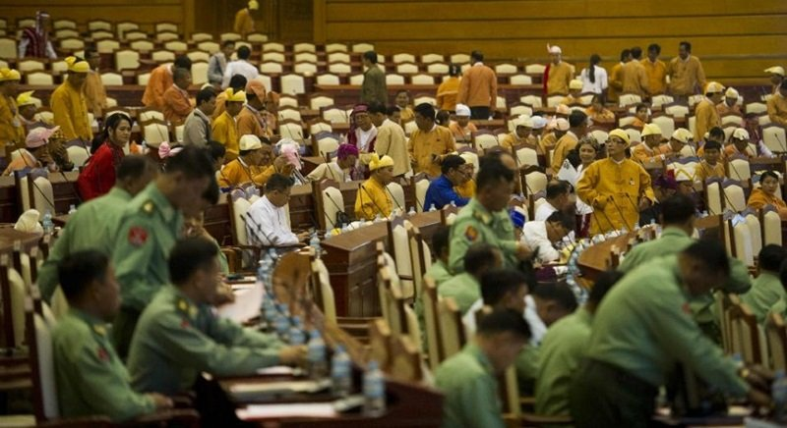
Democratisation in Myanmar???
From closed to free market economy
From one party to multiparty system
Illiberal democracy
Battle between elected officials and appointed military officers
2008 constitution supports neither liberal values nor democratic culture
Parliament executes legislative power
Crucial executive and judicial power remains in the hands of the military
Popular participation absent in the political proces
Democratisation not advancing
Civilian control over military prerequisite to the democratisation in Myanmar

Slide 16
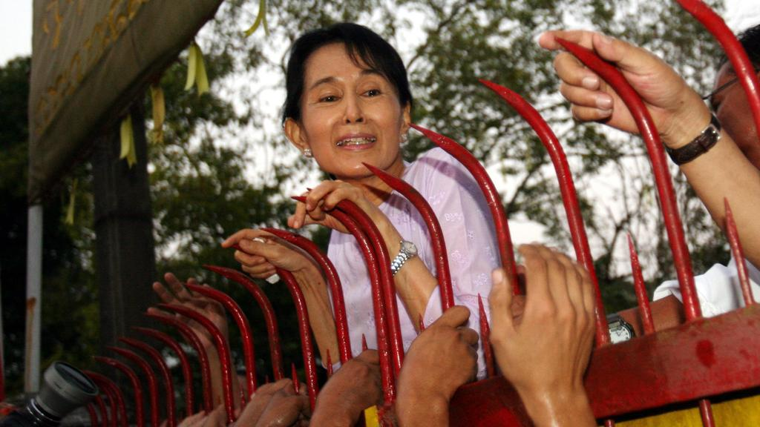
Democratisation??
2011 President U Thein Sein moved the military junta to a hybrid civil-military administration model.
policy reforms such as releasing political prisoners and opening the economy by adjusting the foreign exchange rates and allowing the entry of (wholesale) foreign banks.
Thein Sein’s administration failed to win domestic legitimacy, due to the deficits in its accountability, policy credibility and regulatory transparency.
Aung San Suu Kyi was released from her house arrest on 30 November 2010 and led to the victory of NLD in 2015 – most trusted leader in the Myanmar society

Slide 17
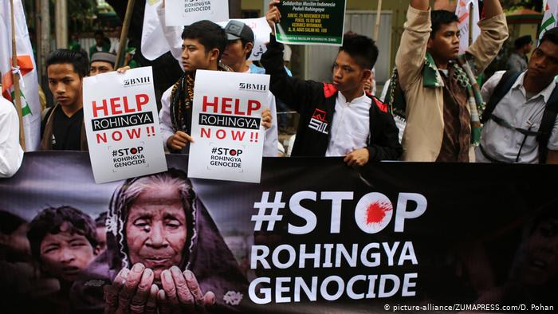
NLD in power
Having campaigned on a nationalist platform
failure to address the citizenship rights of the Burmese Muslim and Rohingya
failure to decisively address the humanitarian crisis in Rakhine State
enormous reputational and moral damage internationally

Slide 18
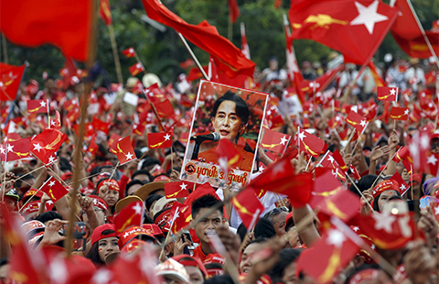
NLD 2015 electoral strategy
a. Using the charismatic image of Aung San Suu Kyi as a major policy “product” of the NLD;
b. Ousting native Muslim candidates from the party in order to please ultranationalists and populists;
c. Positioning the party as the key to influencing national policy—not the individual candidate’s ability, character or capacity;
d. Using a door-to-door campaign strategy borrowed from Australian and New Zealand election campaign models; and
e. Campaigning on a platform of amending the 2008 Constitution, instituting federal democracy, pursuing national reconciliation, and embracing an anticorruption policy.

Slide 19
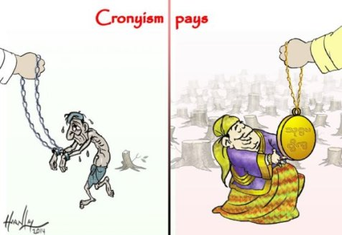
2015-2021
all of the political parties are currently formed and led by Yangon elites, with the support of, or active involvement of, ex-generals aided by business tycoons or former cronies
the political parties have never released their financial statements, budgets or policies for either their party or the national budgets.
The political parties are competing for political power on the basis of rent seeking, populism and ultra-nationalism rather than meritocracy, accountability, strategy, policy competition and ethical debates.
As a result, the political parties’ official policies are so similar to each other that there are no obvious policy choices, strategies or outcome differences visible to the voting public.

Slide 20
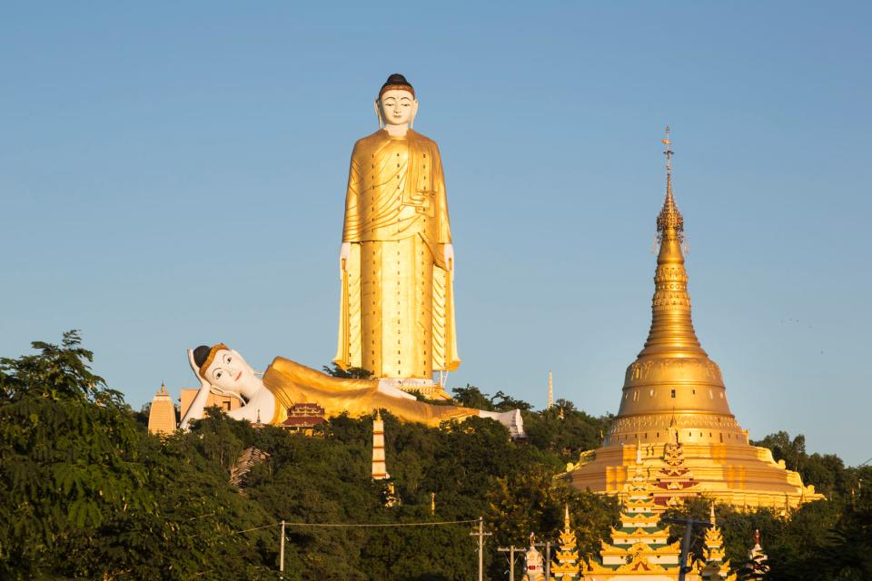
Democratisation process
Government appeal on populism and nationalism
Administration has not sought secular state/separation between religion and state (special status of Buddhism under constitution)
Crony business model – wealthy supporters of the military
Lack of trust
Minority rights have not advanced and the federal aspirations of ethnic groups who are majorities in some States have not been realised.
Democratisation in the form of free elections and partial freedom of the media has taken place; however, democratic values, civil liberty, minority rights, and religious tolerance are far from being embedded in political or public life.

Slide 21
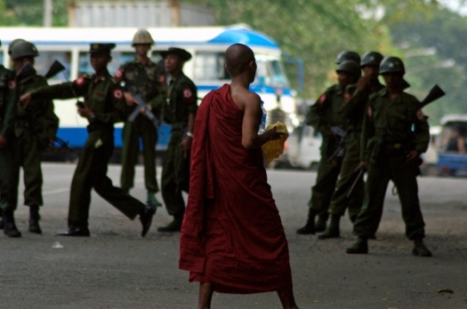
Reasons for democratic deficit
institutional capacity and ability of the NLD’s transitional management has been limited and inadequate
the utter reliance on a 73-year-old individual who is apparently making most of the policy decisions of the state.
the State Counsellor’s government has become an instrument of a political system that allows the military to take the driver’s seat and the NLD the passenger seat. Myanmar effectively has two governments, with two ministries for international or foreign affairs, two ministries for government administration, and two ministries for the President. At the same time, a political legitimacy struggle is taking place among the 93 registered political parties in urban areas and the ethnocentric politicians (including the 22 ethnic armed groups) in frontier areas
the collapse in public trust at all levels of the state
the mismanagement of the crisis in Rakhine State
the people of Myanmar remain unsatisfied with the country’s economic growth

Slide 22
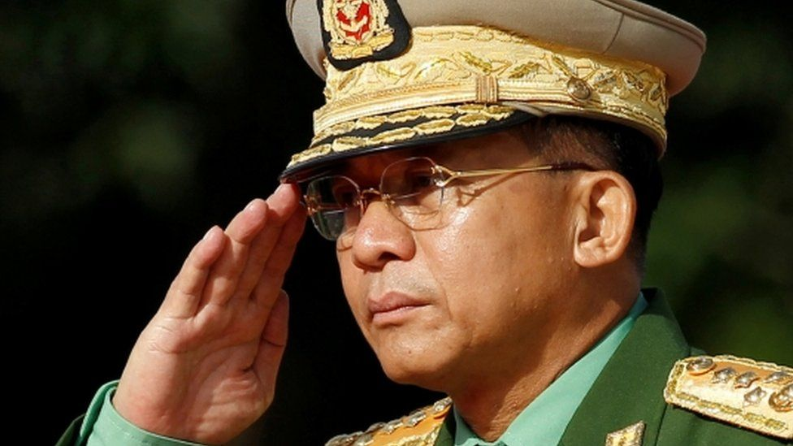
2021 coup
Elections 2020 – NLD landslide victory, military not happy
Min Aung Hlaing – commander in chief (the most wanted man)
Parliament overthrown in a military coup d etat
Aung San Su Kyi arrested, protests
Military crackdown
Around 800 people killed, close to 4 ths. Imprisoned, approx. 20ths displaced
ASEAN envoi not allowed
https://www.aljazeera.com/news/2021/5/8/myanmar-junta-says-no-asean-envoy-visit-until-stability-restored ( 2 min, military crack down on ethnic rebels)
Several insurgents groups restored fight against the government (Karen, Kachin)
https://www.youtube.com/watch?v=uhOV4fVJVAg ( Myanmar coup explained 8 min)
https://www.youtube.com/watch?v=iuINrF4ycyI (military in politics 48 min)

Slide 23
Sources
Naing Ko Ko. Democratisation in Myanmar – glue or gloss? At https://www.kas.de/c/document_library/get_file?uuid=3d07eb88-d4f1-de81-40d1-032ec67a3cb8&groupId=288143

