Slide 1
Inequality and labour market
Tomáš Doseděl
dosedel@fss.muni.cz
ESOn4022: Inequality and Society

Slide 2
Basic concepts of the class analysis
Social class: a group of people dealing with similar living conditions, acting in a similar way
Classic approach: condition = position on the labor market (Marx, Weber)
Innovation: not only the economic aspects of life but also education and connections (Bourdieu)
Concepts of capital: economic, cultural, social

Slide 3
Basic concepts of the class analysis
EGP scheme:
Employers
Employees
Service contract
Labour contract
Mixed contract
Self-employed

Slide 4
Basic concepts of the class analysis
EGP/ESeC scheme:
Employers
Employees
Service contract
Labour contract
Mixed contract
Self-employed
Deductive approach:
we have information about the structure of the labor market, classes are theoretically constructed, people are divided into prepared classes.

Slide 5
Great British Class Survey
Social capital
Economic capital
Cultural capital
7 social classes

Slide 6
Great British Class Survey
Social capital
Economic capital
Cultural capital
7 social classes
Inductive approach:
we have information about people, we divide them into groups, which are internally homogenous and externally heterogeneous

Slide 7
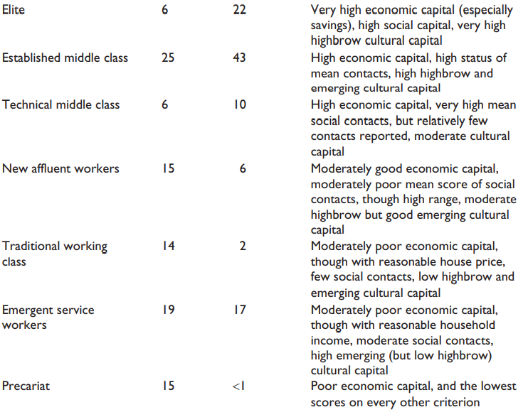
Great British Class Survey

Slide 8
Guy Standing: The Precariat
Precarious work is characterised by the insecurities:
employer (agency work, Bogus self-employment)
duration of the contract (temporality, occasionality)
health and social security (health insurance, vacation, pension)
representation (unions, law…)
Citizens × Denizens

Slide 9
Guy Standing: The Precariat
Precarious work is characterised by the insecurities:
employer (agency work, Bogus self-employment)
duration of the contract (temporality, occasionality)
health and social security (health insurance, vacation, pension)
representation (unions, law…)
Citizens × Denizens
Class scheme
Elite
Salariat
Proficians
Proletariat
Precariat

Slide 10
On the way to flexible jobs…
Since 1970s
Set of economic and social crisis
The second crisis of modernity (Wagner)
Dismantling of large organizations and…
… demand for flexibilisation of both suppliers and workforce

Slide 11
On the way to flexible jobs…
Different concepts:
flexible
atypical
non-standard
flexploitating
precarious
In the EU (ILO):
20 % employees work part-time
11 % employees have fixed-term contract
2.4 % employees have contract shorter than 3 month

Slide 12
Criticisms of Precariat
FTPC (as an ideal) was rather exceptional in the history of humankind
the life experience of the precariat members is not different from that of the working-class members
precariat, is a standard work experience of employees in the Global South

Slide 13
Who are the members of Precariat?
The differences from the FTPC
Part-time, Fixed-term, Agency work, Bogus self-employment
CONS: is every part-time necessary precarious?

Slide 14
Who are the members of Precariat?
The differences from the FTPC
Part-time, Fixed-term, Agency work, Bogus self-employment
CONS: is every part-time necessary precarious?
Social characteristics of employment
Health insurance, vacation, collective negotiation, unionization
CONS: no such information in usual surveys

Slide 15
Who are the members of Precariat?
The differences from the FTPC
Part-time, Fixed-term, Agency work, Bogus self-employment
CONS: is every part-time necessary precarious?
Social characteristics of employment
Health insurance, vacation, collective negotiation, unionization
CONS: no such information in usual surveys
Self-evaluation of the employees
Do you feel any form of insecurity connected with your employment?
CONS: coping mechanism

Slide 16
Who are the members of Precariat?
The differences from the FTPC
Part-time, Fixed-term, Agency work, Bogus self-employment
Social characteristics of employment
Health insurance, vacation, collective negotiation, unionization
Self-evaluation of the employees
Do you feel any form of insecurities connected with your employment?
Russia (Shkaratan and Gasiukova 2015): 27 % • UK (Savage et al 2013): 15 % (Great British Class Survey) • Czechia (Prokop et al 2019): 18 % • Spain (De La Poza 2020): 39 %

Slide 17
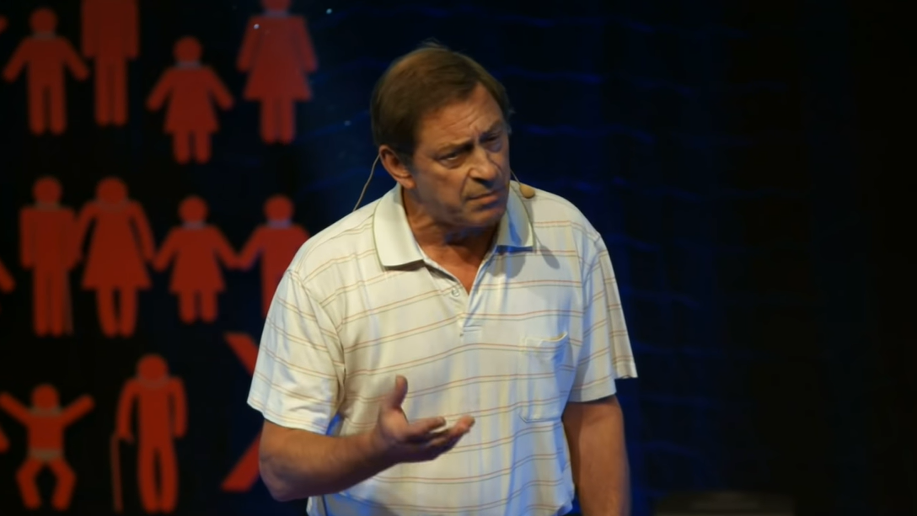
TEDx: Guy Standing
https://youtu.be/nnYhZCUYOxs

Slide 18
Precarious questions
(Operationalization of the Precariat)
Is the work insecurity experience the same for all kinds of employees?
Does it form the same value change and agency?

