Slide 1
Inequality of globalization and technological turn
ESOn4022: Inequality and Society
Tomáš Doseděl
dosedel@fss.muni.cz
www.fss.muni.cz

Slide 2
Return to Education
Both social-stratification and economic theories prove the importance of education for a (labor market) success
Higher educated peoplw are able to work with higher efficiency
Therefore, the employers should prirotize them in the recruitment process

Slide 3
Historical outline
1960^{s}: Blau Duncan model of status attainment
1970^{s}: inflation of credentials
1980^{s}: technological change
1990^{s}: polarization hypotheses
2000^{s}: routine biased technological change
2010^{s}: ???

Slide 4
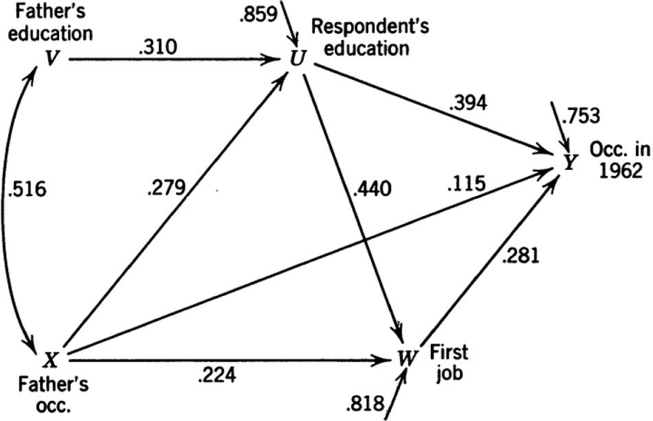
1960^{s}: Blau Duncan

Slide 5
1970^{s}: Inflation of Credentials
In 1970s, (western) universities undergone the first educational expansion
(cultural and sexual revolution, feminism, hippies, Vietnam war…)
Traditional scholars worried, whether the inflation of credentials will or will not occure
Randal Collins: The Credential Society
Bourdieu, Passeron, Beck

Slide 6
Inflation of Education
If there is a
surplus of some goods
on the market,
its price
decrease

Slide 7
Inflation of Education
If there is a
surplus of university educated
on the labor market,
its price
decrease

Slide 8
Something is rotten in the state of Denmark
In 1980s, there is still no substantial inflation of university education, despite the share of university educated people more than doubled
How is it possible?

Slide 9
Technological change
Explanation: new technologies (computers) occured in the labor market
Higher qualification is needed to handle the computer (university)
The labor market is biased by the technological change to reward higher education (skill-biased technological change, SBTC)

Slide 10
Technological change
skill-biased technological change, SBTC
Employees with higher skills are rewarded in the labor market (employment security, higher renumeration), but
People with low qualification are excluded from the labor market (globalization, outsourcing into developing countries, international transport…)

Slide 11
Something is rotten in the state of Denmark
In 1990s, people with low qualification are still present on the (European) labor markets
Literally everyone can handle a computer, there is no need to pay for a university educated employee
How is it possible?

Slide 12
Polarization hypothesis
Higher qualified employees are renumarated for their skills
As the higher classes are getting richer, there is rising need for the service workers (gardneners, masseurs, au-pairs, nurses, messengers…)
The labor market is polarizing – the renumeration rise is visible in the top and in the bottom of the educational hierarchy

Slide 13
Something is rotten in the state of Denmark
In 2000s, the occupations in the middle of the educational hierarchy are inexplicably disappearing
(secretaries, bank clerks)
How is it possible?

Slide 14
Routinization
Routine-biased technological change (RBTC)
Labor market renumerate the people with non-routine occupations
Routine work can be easily replaced by machines
Task-biased technological change (TBTC)

Slide 15
Routinization
Secretary = computer with Word and Outlook
Bank clerk = internet banking
Factory operator = robot, cobot
…
https://www.youtube.com/watch?v=sjAZGUcjrP8

Slide 16
Technological turn
2010s: the rise of artificial intelligence
Even the tasks considered as highly qualified and non-routine can be suddenly performer by computers
Car driving, legal advisement, journalist work, medicine

Slide 17
Technological turn
In the first time in the history of mankind the technological change destroys the occupation for all educational groups and do not create new occupations
What is the future role of education?

