Slide 1
Inequality – development in CEE countries
Laura Fónadová

Slide 2
Introduction
Contemporary European societies are undergoing a process of continual transformation, including substantial changes in the dynamics of labour markets.
The special case: Social change and the transformation of the social structure in Central and Eastern Europe after the 1989 transition.

Slide 3
CEE - Before the transition in 1989
The defining characteristic of socialist countries was state ownership of the means of production.
On average, 90 percent of the labor force was employed by the state and most income was paid by the state.
„Over-protection“ of workers with permanent contracts.
In some countries private enterpreneurship was allowed (Poland, Yugoslavia, Bulgaria and Hungary)

Slide 4
Features of socialist economies
Absence of property incomes
Small gaps between average pay of non-manual and manual workers
Low direct taxes
However, total tax burden was high
Greater importance of income redistribution
High family allowances relative to wages
The Gini coefficient was around 22 like in the very egalitarian Nordic countries

Slide 5
Level of income inequality from 1989 CEE countries
In: Nina Bandelj and Matthew C. Mahutga. Social Forces, July 2010, Vol. 88, No. 5.

Slide 6
Three main social trends of the transition towards post-industrial, knowledge-based service economy:
changes in the labour structure and in employment relations;
demographic changes and changes in family and household composition;
the individualization of responsibilities and the monetisation of economic and social relations.

Slide 7
Employment structure of CEE countries

Slide 8
For further and current empirical data:
https://data.worldbank.org/indicator/SL.IND.EMPL.ZS?end=2019&locations=CZ-OE-EU&name_desc=false&start=1991&view=chart

Slide 9
Social risks
A social risk could be defined as the probability that people experience a welfare loss during the course of their lives as a consequence of social and economic changes (Yang, 2014).
In: Jongmin YANG (2014). Welfare States' Policy Response to New Social Risk: Sequence Analysis for Welfare Policy. Development and Society, Vol. 43, No. 2, pp. 269-296.

Slide 10
Classification of social risks
(Esping-Andersen, 1999)
Please name them:
Class-based risks (people in lower social strata, spatial dimensions)
Life-course risks (typically in early or later life period)
Intergenerational risk (the reproduction of social disadvantages)
Notes:
Threats of unemployment
three different types of social risks can be identified in Western.
While class-based risks are primarily concerned with the unequal distribution of risks between social classes, life-course risks involve the uneven distribution of risks over the life of the individual.
Intergenerational risks, by contrast, are more directly concerned with the intergenerational transmission and inheritance of chances.
Ad 1) an example of class-based risks is the threat of uncertainty faced by people in poorer/lower social strata owing to their low qualification/obsolete skills/low level of human capital.
Ad 2) Whereas life-course risks include growing threat caused by some life events or occured in certain period of life.

Slide 11
The individualisation of responsibilities and monetisation of economic and social relations
On the one hand, individualisation in the management of own life has given to citizens more power to run their own hapiness. On the other hand, some conditions following the transition has limited the possibilities of the individual’s real success – new vulnerable groups.
Monetisation:
Social and economic relations translated into clear monetary terms – all subject to market forces.

Slide 12
Comparison between Old Social Risks and New Social Risks (Yang, 2014)

Slide 13
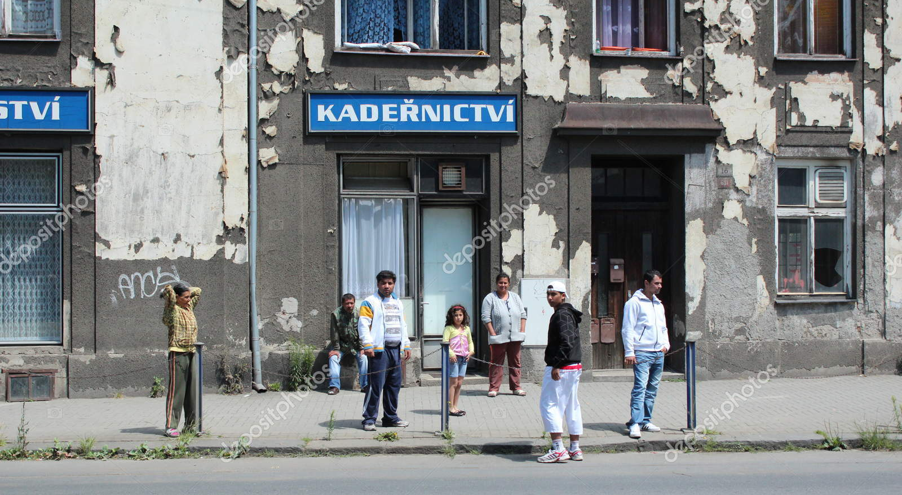
Social chances of the Roma in the Czech Republic
Notes:
According to what we know from the analysis and studies about the situation of the Roma in the CR, be a Roma (or to born into the Roma family) likely means social handicap for future life. Mentioned researches and studies show that Roma population in the Czech Republic faces systematic disadvantages in several areas. The most serious disadvantage is the one in the labor market. One of the main reasons leading to this situation is the low educational level Roma people attain.
Several reports of EU institutions and organizations refer to the continuing discrimination against Roma children in the Czech Republic’s education system.

Slide 14
Number of the Roma in CR and SR comparison between Cenzus and estimates
 | Data from Cenzus | Share of population | Qualified estimates | Share of population
Czech Republic | 33 000 (1991) 11 746 (2001) 13 150 (2011) | 0.3 % 0.1 % | 140 000 - 300 000 | 1.41 % - 2.9 %
Slovakia | 80 627 (1991) 89 920 (2001) 105 700 (2011) | 1.7 % - 2% | 480 000 - 520 000 | 9-10 %
Who states Roma mother tongues in the last Czech cenzus (2011): 40 370 (of which 5000 as single, the rest in combination mainly with the Czech or Slovak).
Notes:
Qualified estimates, however, show that there are many more Roma people than reported in the Czech population, and the data from the census therefore do not represent the overal Roma population. This table shows that the estimates of the number of Roma in comparison with census data considerably differ. Such a phenomenon can be observed across most European countries.
However, these estimates typically focus on areas with higher spatial concentration of the Roma population, which means that only the Roma people living in concentrated areas are accounted for. But it is known that a considerable fraction of the Roma population includes those who have assimilated, whose number is even more difficult to estimate.
It is known that the current Roma population in the Czech Republic shows a remarkable diversity. The difference can be seen from several aspects: the language, the customs, the econocmic activities and lifestyles.
This demonstrates the problem of defining who is Roma and who is not. A concept of an ethnic group.
14

Slide 15
The question of ethnic identification:
The discrepancy between:
Those who consider themselves to be Roma
Those who are considered as Roma by others.
The boundary of ethnicity is fuzzy, the classification depends on who does it.
Question: What can we consider as criteria for ethnicity?
Notes:
Various authors and expert estimates point out against the cenzus data that they not represent the total Roma population or that the official demographic data underestimate the size of the Roma population. Thus, we see that people who do not identify themselves as Roma, are still classified as by others (experts or researchers).
Problems with the definition of who and based on what criteria identify as Roma.
3. Groupness – „býti skupinou“: „This means thinking of ethnicity,race, and nation not in terms of substantial groups or entities,
but in terms of practical categories, cultural idioms, cognitive schemas, discursive frames,
organizational routines, institutional forms, political projects, and contingent events.“

Slide 16
Three different system of classification
Self-identification by respondents
Classificaton by experts who deal with the Roma (teachers, officials, social workers, policmen etc.)
Classificaton by social researchers/interviewers – based on judgemnet „on-the-fly“.
The question of external, third party identification (TPI)
Notes:
The boundary of ethnicity is fuzzy, the classificaton depends on who does it.
All of them are real.
2. The Roma are those who need special attention, assistance or special policy instrument. People who are classified as Roma in this way tend to be related to a social or welfare problem. Moreover such definition mostly conflates poverty and Roma ethnicity.
3. More proper for detecting the assimilated or those Roma who live in consolidated conditions.
16

Slide 17
Census Data 2011 - Czech Republic
Gender | Non-Roma population | Roma nationality | Romanes | Roma Nat+tongue
men | 49,0 | 52,9 | 51,3 | 52,3
women | 51,1 | 47,1 | 48,7 | 47,7
 | 100,0 | 100,0 | 100,0 | 100,0
Average age
men | 39,0 | 26,6 | 31,4 | 31,3
women | 42,0 | 24,6 | 32,5 | 31,5
population | 40,5 | 25,7 | 31,9 | 31,4
Average number of children | 1,57 | 2,14 | 2,70 | 2,68
Marital status
single | 39,9 | 71,3 | 59,5 | 59,7
married | 42,4 | 20,1 | 27,1 | 28,0
divorced | 10,3 | 6,6 | 9,5 | 8,6
widowed | 7,3 | 2,1 | 3,9 | 3,6
Total | 100,0 | 100,0 | 100,0 | 100,0
Educational attainment
Less than 9th grade | 0,8 | 8,1 | 13,8 | 13,2
Primary | 18,0 | 53,4 | 65,8 | 59,3
Vocational training | 34,9 | 16,3 | 15,0 | 16,0
Secondary (with GCSE) | 33,0 | 12,1 | 4,0 | 6,5
Tertiary | 13,2 | 10,1 | 1,4 | 5,0
Total
Source of data: Czech Statistical Office (CZSO)

Slide 18
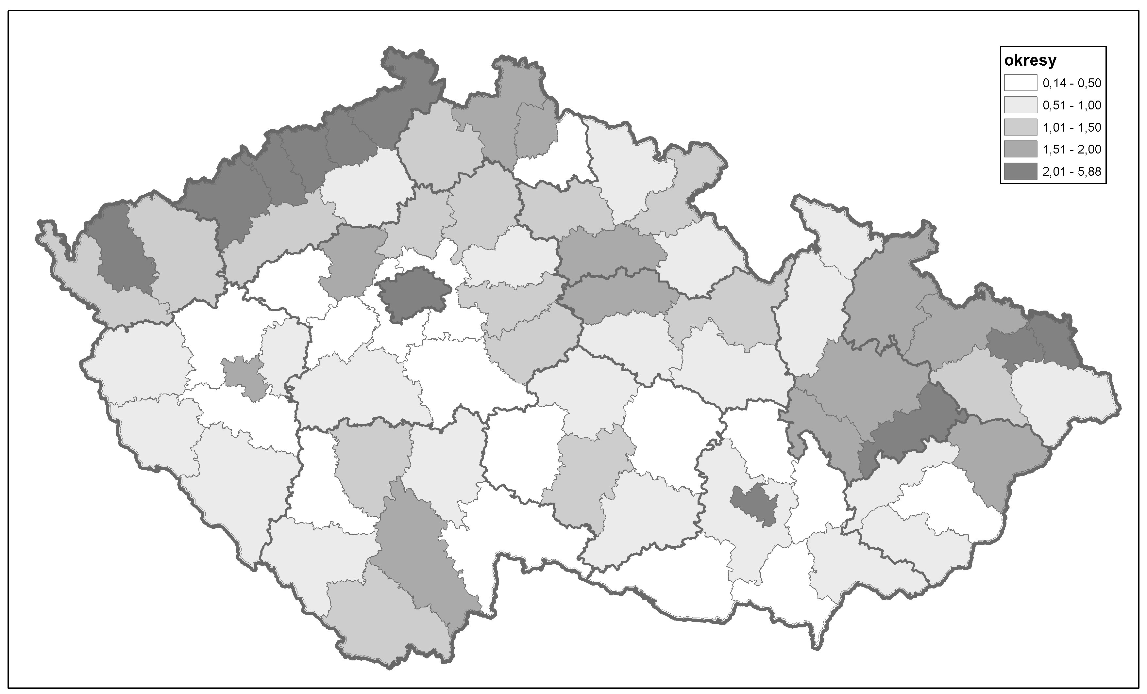
Distribution of the Roma population in the CR by districts – Cenzus 11
districts
Source: CZSO

Slide 19
© Jindřich Štreit

Slide 20
© Jindřich Štreit

Slide 21
© Jindřich Štreit

Slide 22
In the CR we clearly identify
Lower economic activity rate of Roma population
The Czech Roma often live concentrated – such areas labelled as ghettos
Low socio-economic status of the Roma – extent of dependency on social allowances/benefits.
The overall inferior social status of the Roma in Czech society.
Significantly lower school success of the Roma (especially from socially excluded localities) than that of the whole Czech population.
In Czech society, the topic of ethnicity and educational inequality is relevant almost exclusively to the Roma. Other ethnic minorities, such as Slovaks, Ukrainians, Vietnamese, and Russians, show a much smaller ethnicity effect as a determinant of educational inequalities compared to the Roma.
Notes:
The situation of a person in the labor market is immediately reflected in the quality of life or the living standard of his family. Regarding the standard of living of the Roma, one of its key indicators is the rate of dependency on social allowances/benefits. This rate varies around one fifth of all households in localities with lower proportion of Roma population up to two-thirds of all households dependent on social benefits in areas with a higher proportion of Roma population.
Low socio-economic status of Roma people reinforces the negative stereotypes majority population holds towards Roma people and that mass media significantly boost up (for example, recent media discourse on “inadaptable members”).
22

Slide 23
Equal access to education
Czech educational system makes reference to disadvantaged children (Education Act, 2004):
with disabilities, physical handicap or socially disadvantaged.
These categories of children have the right to adequate education, school counseling and school counseling facilities.
Notes:
Although, at first glance it might seem obvious that there are no barriers in the access to education or discriminatory behavior against selected groups of pupils in the Czech educational system, the opposite is true.

Slide 24
Basic features of Czech public educational system (basic level)
Decentralization of education - majority of standard basic schools are maintained by local municipalities
Free syllabus and output regulation
From 2020 there has been a change: funding based on the number of hours taught/number of pupils (previously normative funding – based only on the number of pupils).
Free school choice
Diversified school structure – especially in larger cities contributes to the ethnic segregation of schools or classes (a phenomenon known as "white flight")
The Czech educational system continues in maintaining segregational tendencies. See the report (2019) of the Office of the Government of the CR:
http://www.romea.cz/en/news/czech/czech-government-agency-for-social-inclusion-publishes-analysis-of-segregation-in-primary-schools?fbclid=IwAR2CXIjF4s0iIgxLKolSBv4tnro_DOEW8ALHWrR9SG2BuFogJeV0ADD7QeQ#.XeIH8o-0Nbg.facebook

Slide 25
Inequalities in public education
The school performance of children and chances for further education are/is determined by early school choice to a greater extent than in OECD countries – the effect is multiplied in the case of children from Roma family background.
Diversified school structure with free choice of school – especially in larger cities contributes to the ethnic segregation of schools or classes (a phenomenon known as "white flight"):
1. „The Nestlings“ (Ptáčata, document of the Czech public TV, 2010–2020)
http://www.ceskatelevize.cz/porady/10267754387-ptacata-aneb-nejsme-zadna-becka/4238-ptacata/
2. The Czech version of the Class Of (2014):
http://www.ceskatelevize.cz/porady/10719503009-trida-8-a/313294340250001/
Notes:
It is an example of the class at an elementary school here in Brno which was created after the non-Roma parents signed a petition in which they demanded that their children should not be put into the same class with the Roma children.
Afterwards based on this real case the document was created.
Intro from 1:41.
http://www.ceskatelevize.cz/porady/10267754387-ptacata-aneb-nejsme-zadna-becka/bonus/990-trailer/
http://www.ceskatelevize.cz/porady/10719503009-trida-8-a/video/ 1:30

Slide 26
Example of ethnic differentiation among primary schools (in Brno)

Slide 27
Measures to combat unequal chances in primary education – in the CR
the abolishment of special schools (in 2005 in the CR), removing formal barriers to continuing education at high school of any type for pupils coming from any type of primary school institution
the establishment of new positions of pedagogical teaching assistants;
the establishment of preparatory classes and courses necessary to even up or complement education
the policy of inclusion (in the CR from 2016)
compulsory preschool for five-year-olds (in the CR 2017)
Do you know other examples of policies for improving equity in education?

Slide 28
Causes – institutional level
The Czech Republic belongs in European milieu to those countries, where social origin of an individual strongly influences his/her educational attainment (OECD, 2018).
Consequently, the issue of relationship between ethnicity and educational inequalities (chances) is almost exclusively relevant to Roma minority and it can be already found at the level of primary education.
The segregation tendencies of the Czech educational system are pointed out even in some official (government-issued) documents ⇒ According to these official estimates in the school year 2016/17 a quarter of all Roma pupils were educated in primary schools with 50% or more enrolled Roma pupils, (Report on the Status of the Roma Minority…, 2017: 30).

Slide 29
The main problems on the side of actors
the transition between the pre-primary and the 1st level of elementary (primary/basic) education;
the transition between primary and lower secondary levels of education (the second stage is accompanied by a major outflow of Roma pupils); which influences
limited chances of attainment upper secondary/tertiary education

Slide 30
Inequalities in public education
Questions at the end:
How to eliminate disadvanteges in education?
How can be the results (success) of the implementation of inclusive measures reliably demonstrated?
How to stopping or reversing the negative trend of growing school segregation?
Notes:
Some research studies point to the fact that the Czech school system can not adequately compensate for the different skills that stem from different social backgrounds (Matějů, Straková, 2006). If we also take into account the fact that the free choice for a school forms - especially in larger cities - an ethnically segmented educational market where local hierarchy of schools exists and leads to pupils’ selection, we are faced to a deeper dilemma regarding the possibility to find general effective tools of inclusive policies. It points to the real key players who are the parents and their rational learning/educational strategies.

Slide 31
No Data – No Progress
„Hard-to-survey“ population (Font, Mendez, 2013; Kappelhof, 2015).
Initiatives of the European Union, as well as national governments to improve the collection of data relating to Roma.
Governments should collect ethnic data and use it for the purposes of inclusion policies
http://www.opensocietyfoundations.org/sites/default/files/no-data-no-progress-20100628.pdf

Slide 32
https://ec.europa.eu/info/policies/justice-and-fundamental-rights/combatting-discrimination/equality-data-collection_en

Slide 33
The new empowering politics of the welfare state
A new political economy of skill formation would, represent a useful policy instrument, but this would still not be enough to ensure adaptation and coverage in a more insecure labour market.
Welfare policies as ‘’institutional complementaries’’ of market system.
A redefinition of the main redistributive priorities of the welfare state necessary and with it a recalibration of its main norms, institutional structures, and functions → the introduction of new and more specific policy instruments and political discourses.
«Social investement».
(Source: Cerami, 2008)

Slide 34
References
Cerami, A. (2008) „New Social Risks in Central and Eastern Europe.“ Sociologicky časopis/Czech Sociological Review, Vol. 44, No. 6: 1089–1110.
Kahanec, M., Guzi, M., Martišková, M., and Siebertová, Z. (2014). “Slovakia and the Czech Republic: Inequalities and Convergences after the Velvet Divorce.” In Nolan, B., Salverda, W., Checchi, D., Marx, I. (et al.): Changing Inequalities and Societal Impacts in Rich Countries – Thirty Countries' Experiences. Oxford: Oxford University Press, pp. 569-592.
Yang, Jongmin (2014). „Welfare States' Policy Response to New Social Risk: Sequence Analysis for Welfare Policy.“ Development and Society, Vol. 43, No. 2: pp. 269-296.

Slide 35
Thank you for your attention!
Contact: laura @econ.muni.cz
35

