Slide 1
Crises, coercion, bargaining
IREn5012 International Sanctions
dr. Martin Chovančík

Slide 2
Departing debate
Who is the most typical target of sanctions?
Are sanctions just a form of economic warfare?
How does one measure whether sanctions are “just”?
What’s the alternative to using sanctions?
If you see this sign – it’s your time to take over the conversation ☺

Slide 3
Contents
Crises and common denominators
Coercive diplomacy aims
Coercion degrees
Graduated response
Combining instruments
Bargaining theory
Strategic interaction

Slide 4
Crisis diplomacy vs. coercive diplomacy
Crises:
Time-sensitive (eliminates instruments such as arbitration/adjudication )
Likely escalation or increase of losses
Coercive diplomacy
may or may not have such a time element
is preceded by regular diplomacy, dissonance, or even latent conflict
i.e. coercive diplomacy may be a state of affairs outside of crisis

Slide 5
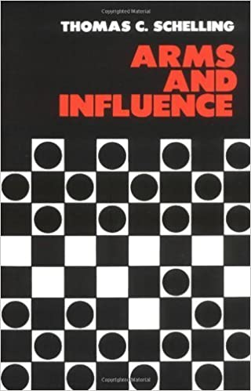
What’s coercion
Deterrence – discourage, seek inaction in target’s sought and intended steps
Compellence – force to take initiative, take unplanned action desired by the sender (including cessation) (the slippery slope of compliance)
Compellence easier than deterrence (expected utility)? Give examples of both. Which is more prevalent?
Or is it? (prospect theory) – different risk aversion
Prospect theory leads us to conclude that the adversary is more likely to opt for the sure bet of compliance in deterrence situations and will tend to choose the risky gamble of defiance in compellence situations (Schaub 2004)

Slide 6
Coercion degree?
Deterrence
Compellence
May be indefinite
Time may be less important
Less specific demands
Less targeted knowledge required
One cannot know the full reasons for refraining from action on the part of the target
Less likely to escalate to conflict
Finite and concrete
Time is crucial
Very specific demands
More targeted knowledge required
Compellence requires concrete action to be taken, identifiable and traceable to threat
More likely to escalate into conflict

Slide 7
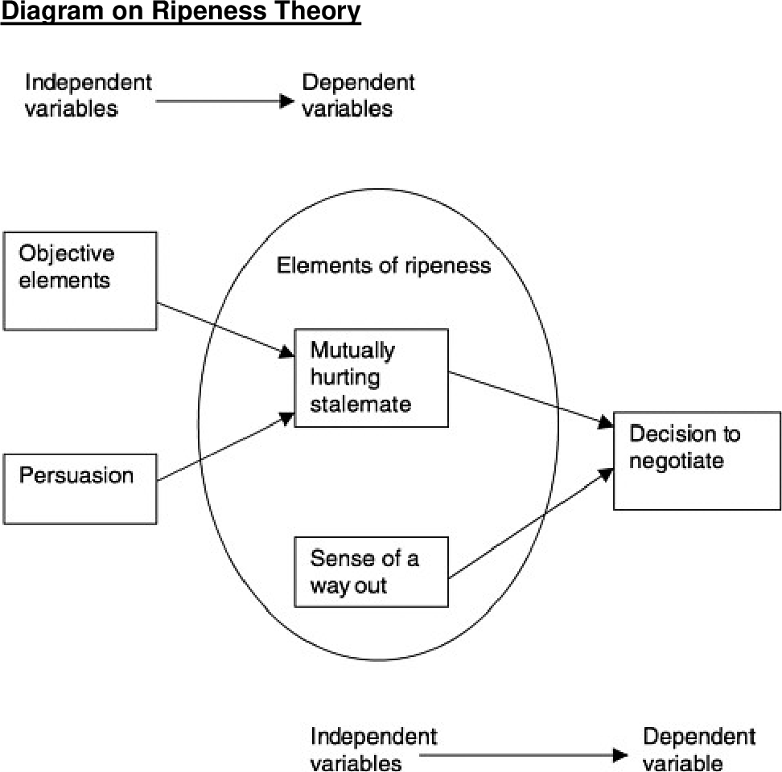
Sanctions and crises
economic factors influence the incentive structure of belligerents and provide resources to finance armed conflict
they contribute to the initiation, perpetuation or termination of armed conflict
amid negotiations/mediations economic instruments can serve to entice, constrain, or coerce actors
the capability of influence stems from third-party leverage in negotiations

Slide 8
Stepping up pressure
Wennmann 2007 (Money matters)

Slide 9
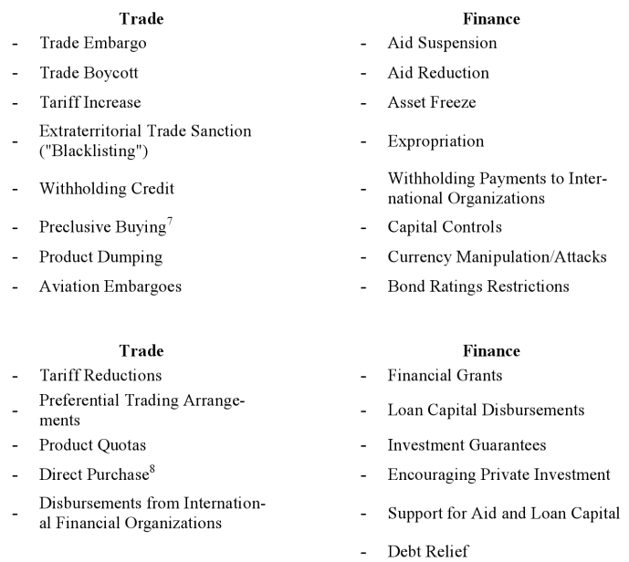
Flip side of the coercion coin

Slide 10
Persuassion
Combination of:
Suassion – dissuasion
Incentives – discentives
Interruption of customary trade/exchange WITH a demand or reprimand is considered a sanction (compare slashing of aid from UK budget to cessation of military aid from US to Pakistan)
Give examples of how incentives are used to achieve the same result as sanctions
How easy is it to combine the two?

Slide 11
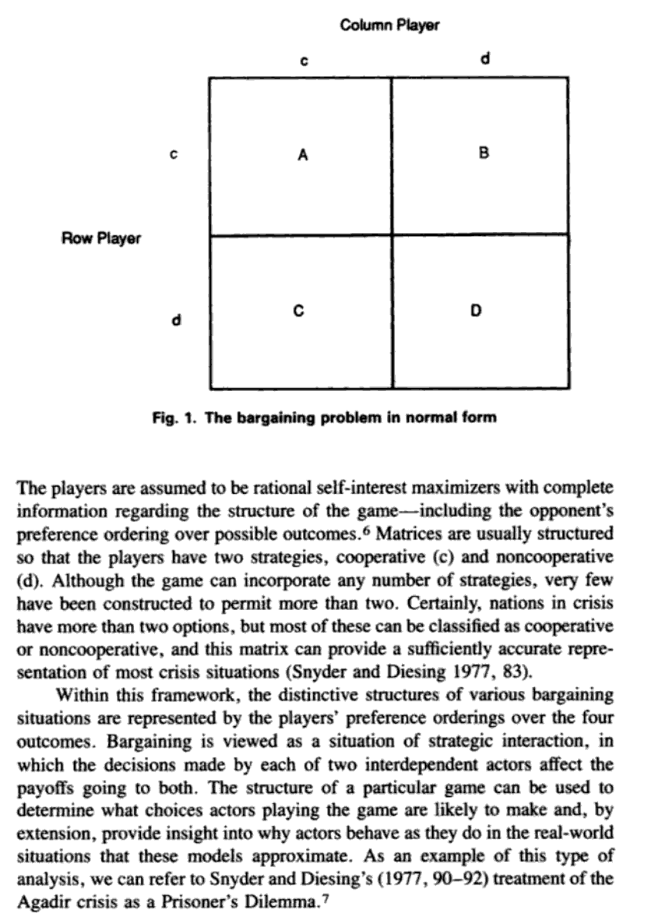
Bargaining theory and strategic interaction
Subset of game theory
Cost-benefit calculation
Rational actors
Payoff matrices
Note the strategic interaction
Does the target care primarily about the sender’s demands in relation to sanctions? Or not?
Morgan 1994: 17

Slide 12
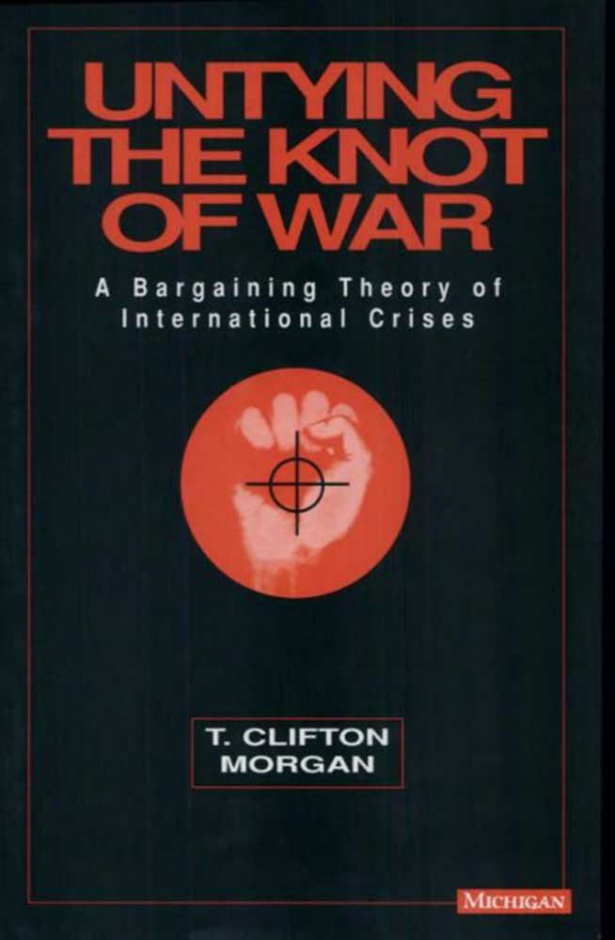
Strategic interaction and “normalizing”?
Normalizing – creating or shaping universally acceptable behavior
If targets can anticipate the cost of sanctions, those that would capitulate in the face of sanctions might do so when sanctions are threatened but before they are imposed. (Morgan 2015)
“Each appears to pay close attention to its own costs—targets are more likely to acquiesce to a threat when their expected costs are high, and senders are very good at designing sanctions that are costly to the target but not to themselves” (Morgan 2015:749)
Same Morgan, but 1994

