Slide 1
Sanctions and negotiation
IREn5012 International Sanctions
dr. Martin Chovančík

Slide 2
Contents
Sanctions as a push to negotiations
Negotiation as the key goal of sanctions
MHS, MEO, WO, and preparedness refresher
Coerce, constrain, signal
Leverage in negotiation and mediation
Setting boundaries with sanctions
Threat of sanctions

Slide 3
Departing debate
Do sanctions lead to negotiation/mediation?
Threaten, apply, or amend? What happens to partiality?
What happens to main party constituencies? Think hardliners.
Is there really a balance with incentivization? What about durability?
If you see this sign – it’s your time to take over the conversation ☺

Slide 4
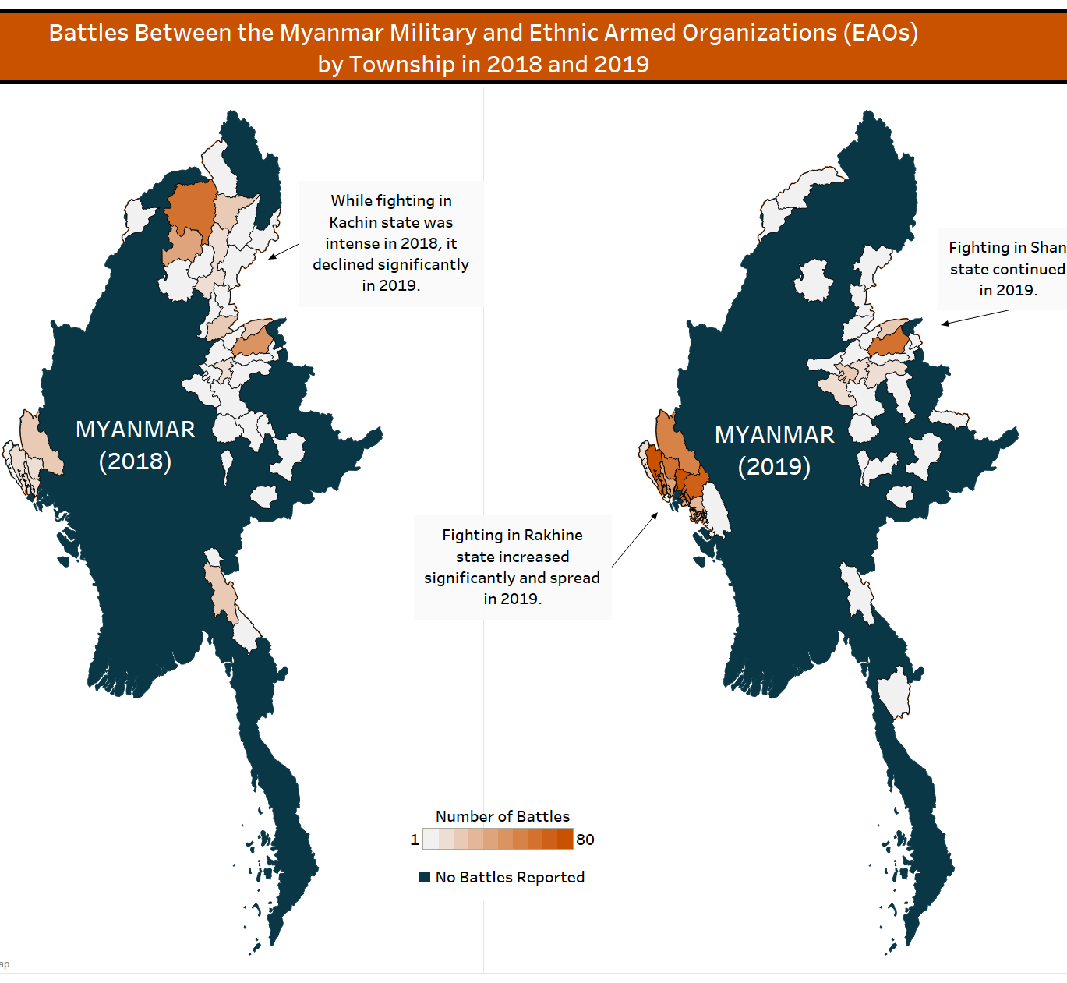
Let’s look at a case – Myanmar today
Should there be stricter sanctions on the Tatmadaw?
What type?
Who should be the sender and what should be the demand?
What would stricter sanctions on Tatmadaw lead to?
Internationally (think China)
Internally (think internal conflicts, HR)
https://youtu.be/p5DPpQjEAYE

Slide 5
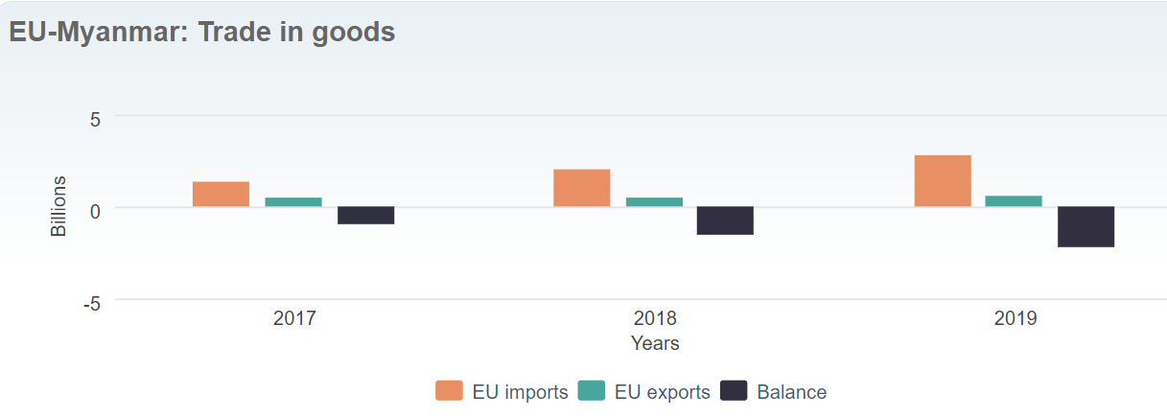
Myanmar evolving regime Myanmar is in GSP (Generalised Scheme of Preferences) under EBA EBA preferences can be removed if beneficiary countries fail to respect core human rights and labour rights. https://ec.europa.eu/trade
Last week, the EU said it was suspending development funds to Myanmar, although it has so far declined to freeze trade preferences to one of Asia’s poorest countries for fear of hitting mainly female workers in the textile sector.
The EU’s expected new sanctions, which are under preparation this week, follow a U.S. decision last month to target the military and their business interests.
https://www.reuters.com/article/us-myanmar-politics-eu-idUSKBN2B01D1
In 2019:
Total trade between the two partners equalled €3.4 billion.
The EU ranked as the third biggest trade partner of Myanmar (after China and Thailand), accounting for 11% of the country’s total trade. Myanmar is the EU’s 69th largest trading partner (accounting for 0.1% of the EU’s total trade).
The EU imported goods worth €2.8 billion from Myanmar. The key EU imports from Myanmar are dominated by textiles, footwear and agricultural products.
The EU exported goods worth almost €609 million to Myanmar. The key EU exports to Myanmar are dominated by machinery, transport equipment and chemicals.
Can negotiation of the Tatmadaw and exile government be forced/encouraged by sanctions?

Slide 6
Sanctions and getting to negotiation
Ripeness (Zartman) and Readiness theories (Pruitt, Olczak)
MHS
Mutually Hurting Stalemate
push factor to negotiations
WO
Way out
opening allowing for negotiations
MEO
Mutually Enticing Opportunity
pull factor to achieve negotiated settlement

Slide 7
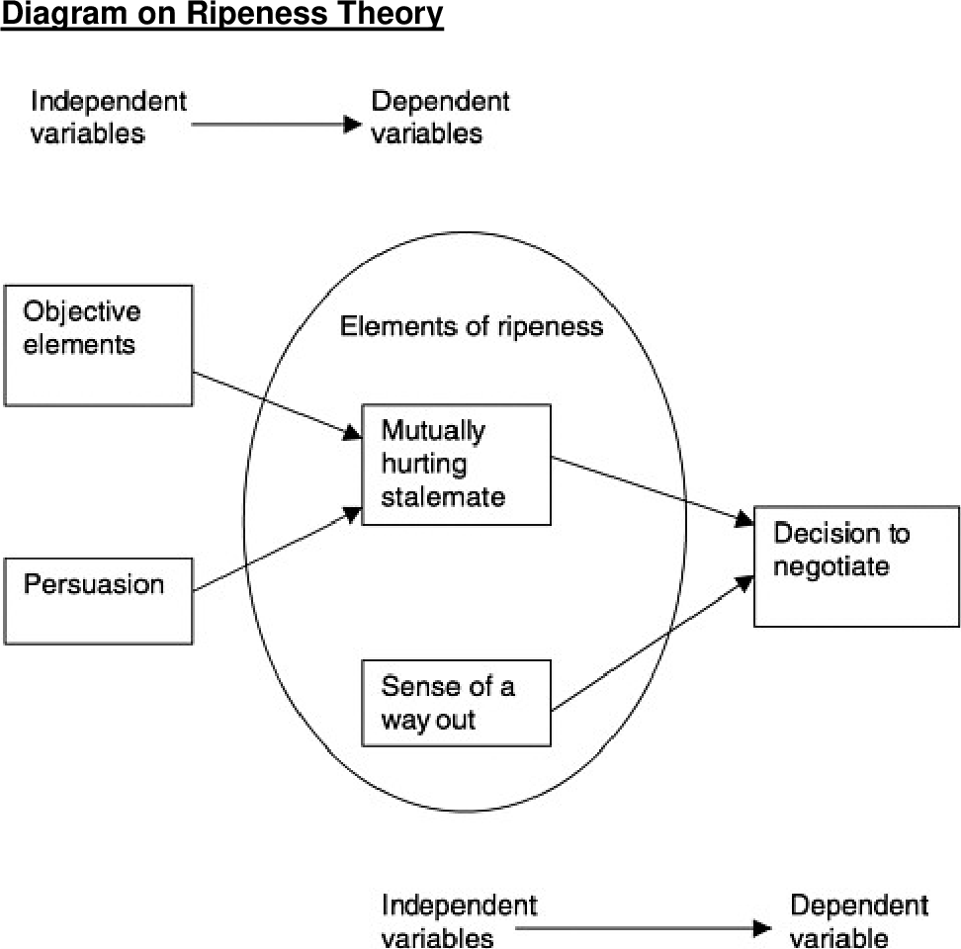
Sanctions and crises
economic factors influence the incentive and payoff structure of parties and provide resources to finance armed conflict
they contribute to the initiation, perpetuation or termination of negotiations
amid negotiations/mediations economic instruments can serve to entice, constrain, or coerce actors
the capability of influence stems from third-party leverage in negotiations

Slide 8
Sanctions and negotiation
In negotiations sanctions serve especially:
Threaten to punish non-cooperation
Prevent stalling the process
Prevent undermining talks
Lifting is an important instrument
Compliance checks and guarantees
Stated purpose?
“In view of the absence of progress towards democratization and of the violation of human rights in Myanmar/Burma” (EU Myanmar sanctions)
To entice the Taliban’s participation in talks, in June 2011 the Security Council split the 1267 sanctions regime, creating a new regime specifically for Afghanistan and transferring listed Taliban representatives into this new regime. At the same time, the Security Council, at the initiative of the US and with the support of all its permanent members, began de-listing certain Taliban representatives based on specific criteria, including participation in reconciliation talks. As a result, between 2010 and 2014, 36 de-listings were made. The de-listings gave momentum to the talks, although they could not prevent their eventual collapse in 2014. (Biersteker et. Al 2019)

Slide 9
How far? Coerce, constrain, signal
Differing effects on negotiation
Based on the last lecture – sort the impact of each “level” on negotiations
Sanctions can move between the levels by virtue of enforcement and monitoring (not only design)
Example?
Coerce (Compel) (Deter)
Constrain
Signal
Giumelli 2013

Slide 10
Imposing sanctions and the process
NEGOTIATION / SANCTION | PRIOR | DURING | AFTER (Success)
COERCE | Is it really a push for negotiations or acquiescence? Typical: deadlining | High relevance topic Typical: immovable and immutable subject of talks | Durable but contentious outcome Typical: Staged lifting, snapback clauses
CONSTRAIN | Creating WO and incentivization Typical: resource limitation | Modifying payoff structures Typical: target alteration, leeway in modifying | Conducive to cooperation Typical: modular removal with some retention
SIGNAL | Passive pressure and stigmatization Typical: boundary setting | Relevant signaling of sought direction Typical: tool for exclusion and normalization | Changing landscape with horizontal sanctions Typical: easy lifting with non-automatic snapbacks
Coerce (Compel) (Deter)
Constrain
Signal

Slide 11
Non-negotiation?
How do horizontal regimes (i.e. global regimes vs. terrorism support, HR violations, exploitation etc.) interact with negotiation?
What if lifting sanctions is a condition to initiate negotiations?
Such as Iran-USA?
What sort of sanction are the recent Chinese steps vs. Australia? How to discern a demand in retaliatory/punishing measures?

