Slide 1
Sanctions targeting and logics
IREn5012 International Sanctions
dr. Martin Chovančík

Slide 2
Contents
Targeting and smartening
Sanction logics
Regime types and logics
Targeting by regimes
Sanctions trap

Slide 3
Departing debate
Based on your readings for the two weeks:
What does smartening involve?
What sense did you get for the crucial identified pitfalls during the first wave of smartening? Early 2000s.
What seem to be the “hot” challenges today?
What does a sanctions pressure point (i.e. coercive) usually hope to achieve – think of the mechanism/logic (i.e. pressure leaders to change their policy? Or change allegiance? Or build public resistance?)
What does regime type have to do with it? And why?
If you see this sign – it’s your time to take over the conversation ☺

Slide 4
Smartening = targeting?
need for a disaggregated approach
deconstruction of sanctions packaging
2000 watershed report “Fowler report”
naming presidents by name,
naming officials by name
providing concrete evidence
violations as well as money trails
recommendations not implemented at outset…
targeted measures provide increased challenges to implementation
monitoring
national implementation
enforcement
legal recourse and loopholes
e.g. –dual-use goods
goods need to be inspected vs. denied flat out
legislation adapted and domestically enforced by limited capacity regimes
specialized investigate teams for monitoring
mandated taskforces

Slide 5
Smartening
pre-assessment
tailoring
most direct pain for political gain
least amount of collateral damage
time limited
targeting
government (whole, individuals, groups: police, military…)
non-governmental forces (whole, individuals, wings)
adaptation of regime composition
reactionary capability
inherent bargaining chip maneuverability
“listing” and subsequent (de)listings
not only persons but specific commodities/goods
interpretation of vague Resolution language for national implementation
enforcement and monitoring updates

Slide 6
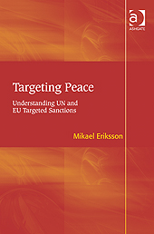
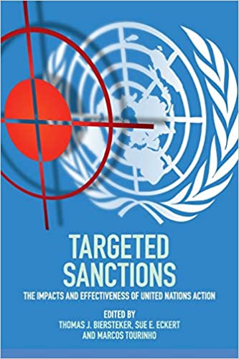
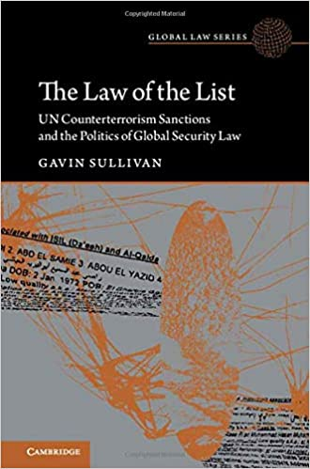
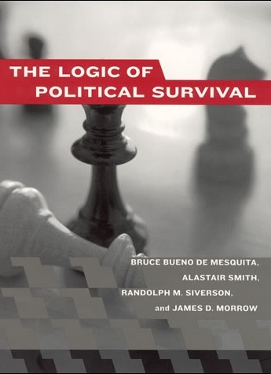
Sanctions targeting

Slide 7
If targeting and smartening is prevalent (humanization of sanctions) what does that mean for coercive capability?

Slide 8
Naïve theory
pressure on population
demand for new institutions/mechanisms to rectify situation
manipulation of said institutions to benefit from the support of powerful domestic groups
white minority protection from sanctions effects
Rhodesia + South Africa

Slide 9
Sanctions pressure translation theory
broad targets within society all have means of pressure
the wealthy bribe; students riot; workers strike; mobs demonstrate; and the military coup (Huntington 1968)
means of pressure may therefore be manifested in all targets
however regime type and target type (state / non-state) influence the real-world capabilities of pressure translation
regime type
open system +
closed systems -
target type
state +
non-state -
divide and conquer
sanctions, much like punishment by warfare targeting civilians, aim to divide
the elite from the masses
the leadership from its direct support

Slide 10
Problems with naïve theory
high domestic price
high unintended impacts
inflexibility
regime-dependent translation
regime might even benefit from maintaining sanctions (rally around the flag)
counter-integrationist - isolationist
vilification of international community
compellence less likely
disproven by empirical knowledge

Slide 11
How sanctions (should) coerce
losing the benefit of cooperation
1. naïve theory
pain = gain
however - costs incurred by state need not be equated to costs incurred by leaders
still a strong approach in the USA
2. destabilization
for coercion to work, the political stability of the target should suffer more from coming under pressure than from conceding
targeting becomes crucial
selection of most directly translating pain to gain targets
cost!
success more at 2,4% GDP decrease
failure average 1% decrease
3. denial
4. targeting

Slide 12
Sanctions logic
regime change
pressure population = pressure on leaders
NAIVE
pressure institutions = pressure on leaders
DESTABILIZATION
pressure individuals = leadership
TARGETING SUPPORT
deny sources for continuing behavior
DENIAL
policy concessions

Slide 13
Destabilization
destabilization requires that the opposition in the target actor feels a common cause with the sender (fifth column)
otherwise the threshold of coinciding internal support for sender demands is unachievably high
i.e. collective deprivation of more than “panem et circenses”
although link between economic hardship – frustration – aggression they are not necessarily in line with sender demands
rather than thinking about the good of the state or the community more broadly, individuals look to their closest units to sustain them
if support does not exist – destabilization is problematic
economic hardship can be “blamed on sanction senders” (rally around the flag effect)
Cuba, Iraq 1990s
destabilization – ideal targets – weaker autocracies, where repressive measures aren’t completely forbidding of opposition action
neither strong autocracies NOR democracies are ideal for destabilization

Slide 14
Destabilization
destabilizing leaders
the mere existence of the sanctions option – induces compliance to international norms from specific types of leaders
namely democratic, or unstable authoritarian
the threat or imposition of sanctions creates a new bargaining zone, where leaders are more likely to agree to partial concessions whose destabilization effect is lesser than that of continuing/increasing sanctions
democracies, and less so small economies + multilateral sanctions – create the optimal combination for coercion success
change of power leads to increased sanctions lifting

Slide 15
Destabilization
aiming for pain by the application of pressure, population not the only intermediary actor
longer economic sanctions regimes disproportionately hurt the opposition rather than the elite
they provide pretext for more repressive measures
tighter control of previously open resources (distribution) (Zimbabwe)
political reform toward openness can be halted and reversed (Panama)
dissuasion of FDI, global trade, institutional assistance, development programmes
increased necessity of military intervention to counter negative effects, which compound original motive to apply sanctions

Slide 16
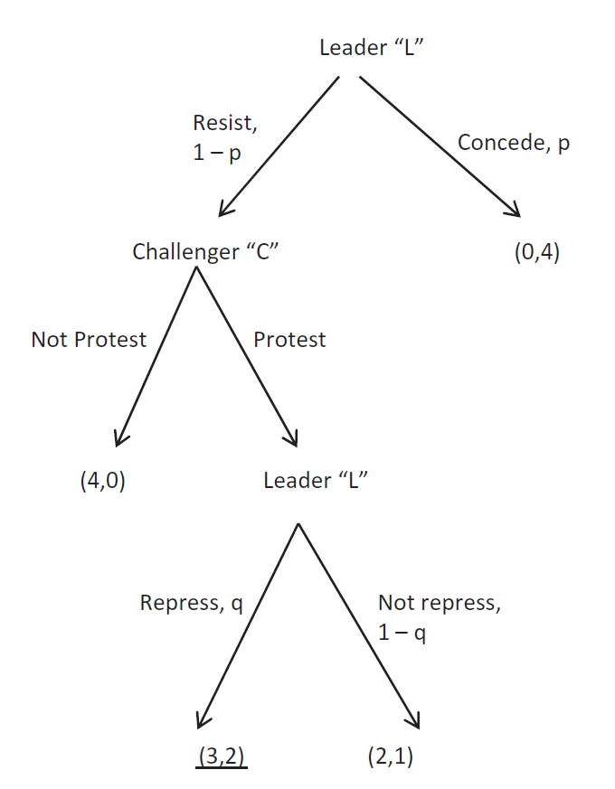
Regimes and coercive sanctions
“Because targeted sanctions seek to impose concentrated costs, they have a higher probability of actually weakening the leadership when compared to conventional sanctions. This probability is higher in authoritarian regimes because in these polities the winning coalition is rewarded primarily with private goods, which implies a concentrated perception of realized or potential costs.” (assigned text Carneiro, p.572)

Slide 17
Selectorate theory
Marinov
deMesquita
Drezner

Slide 18
The sanctions trap
presumption of gradual increase in sanctions
sending weak measures creates “lock-in syndrome” low credibility signaling measure is NOT met with concessions in target
sender then HAS TO either increase pressure
OR lose credibility and erode tool
OR opt for military solution
when low-sender-cost sanctions are chosen as the initial response to a crisis, there is a danger that the target of the sanctions will interpret this as a sign of weakness on the part of the sender (of sender as such or commitment)
this can increase the probability of repression, escalation, or extortion as it emboldens the target against acquiescing to the sender’s demand

Slide 19
EU, US, UK sanctions on China Mar. 22
GMA and EU Human rights regime in action
For EU first new HR sanctions on china since 1989
March 30, the Biden administration declared that China has engaged in "genocide and crimes against humanity," citing Beijing's "mass detention" of the Uyghurs, as well as evidence of forced sterilization, rape, torture, and forced labor. A week earlier, on March 22, the Biden administration—in conjunction with the European Union, the United Kingdom, and Canada—imposed economic sanctions on top Chinese officials over the persecution of the Uyghur people.
This leaves us with the effects of the remaining two on design and impact –
3. TARGETING SUPPORT
4. DENIAL

Slide 20
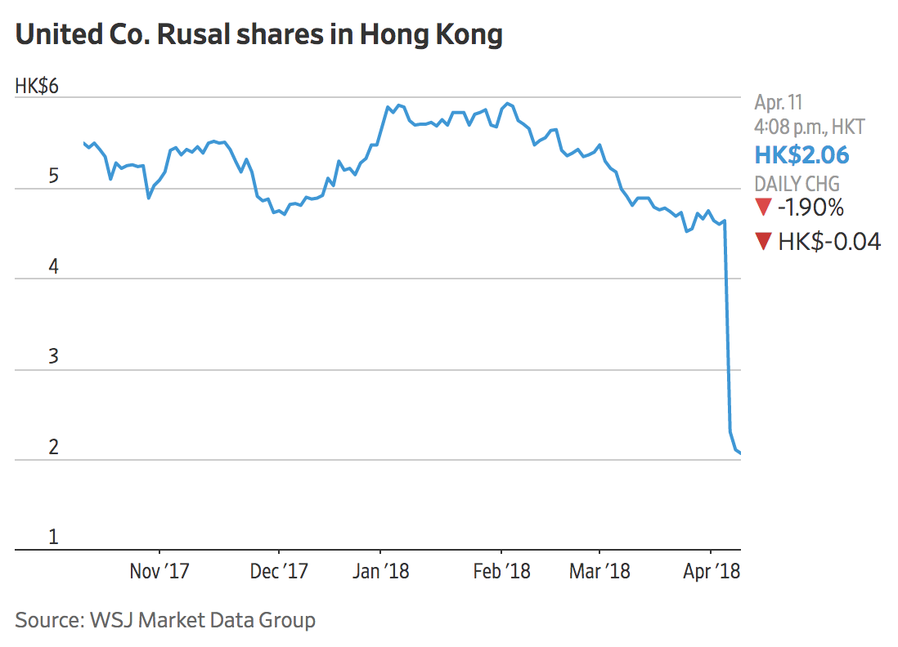
Impact on design
Myanmar sanctions?
US, UK added major military run conglomerates to sanctions list (soldiers are being sold stocks now to continue financing)
EU has added individuals
China+Russia have blocked UN arms embargo vote (coup=major cabinet reshuffle)
Russia has stated sanctions will cause civil war
So what about the Russia sanctions?
Weak or strong at the outset?
What’s the logic?

