Slide 1
Settler Colonies
Bartoňová, Diviš

Slide 2
Structure
Introduction
South Africa
Algeria
Present day effects of settler colonialism
Conclusion

Slide 3
Introduction
“Settler colonialism was colonization in which settlers neither exterminate nor assimilate the indigenes.”
settler colonialism = when an exogenous entity permanently settles in a new location and enjoys a privileged position over the indigenous population
the word “settler” masks violence, discrimination, genocide
indegenous communities transformed, marginalized or were displaced

Slide 4
Colonisation of South Africa

Slide 5
Colonization
Portuguese 1488 Cape of Good Hope
Dutch since 17th century challenged the “Portuguese sea” with the British
1657 nine Dutch men granted land, Dutch East India Company
end of 17th century = full settler colonization (growing wheat, tending vineyards, grazing sheep and cattle)
chiefdoms decimated, indigenous people often killed, women into servitude, or living under conditions close to serfdom
continuous expansion
British

Slide 6
British Colony
1806 Napoleonic Wars the Cape seized as a strategic base to protect developing empire in India
thus change in administration language, currency
better conditions for indegenous: possible to choose employer, own land, move more freely
Colonialism of a Special Type - the oppressors and the oppressed living side by side
“Non-White South Africa is the colony of White South Africa itself.”

Slide 7
The Union of the South Africa
1910: independent from Britain
official languages = Dutch (1925 Afrikaans), English
“native question”
white minority rules, new constitution excluded Blacks from power
Blacks by administration forced to work for whites
separation of workers, overall separation
certain jobs reserved for whites
urban residential space segregated
Blacks: armed rural revolt, strikes, and mass mobilization
Feb 1920: over 70 000 gold miners halted production - low wages, inflation
1948: apartheid government elected

Slide 8
Apartheid
National Party
various laws accepted:
non-whites excluded from full citizenship, from owning or leasing land, businesses
laws against purchasing or renting homes except of specific areas (10%)
ID cards showing race + controls
laws affecting the mixed-marriage couples
universities prohibited to accept Blacks + ethnic universities
hotels, trains, restaurants, buses etc. segregated
skilled jobs reserved for whites
reserves: lack of industry, communications, power resources, malnutrition, diseases
Blacks to towns: new law only 72 hours without a job
60s - 80s harsh removals, 3,5 million put into reserves without anything

Slide 9
economic gap between wealthy few (white) and poor non-whites larger than anywhere in the world
Nelson Mandela: joined national government, fought for black minority
imprisoned for 27 years
UN: acts against humanity, 1973 apartheid denounced, 1977 embargo on weapons
economy in recession, inflation, skilled whites emigrated, last white racial domination on the continent - global focus, resentment
1978 National party: reforms needed to appease the world
end of social segregation, skilled jobs, interracial marriages, possible to strike
but schools remain segregated, poverty remains, politics in hands of whites, political prisoners

Slide 10
80s: US and GB pressure to sanction SA; USA Comprehensive Anti-Apartheid Act (bans new investments, loans, air links, import of commodities), other countries join
1983 new constitution (Blacks no power) - United Democratic Front (over 500 community groups) - many strikes, boycotts - 1986 state of emergency - campaign to eliminate all opposition - Black townships watched by police, thousands killed, abused, rigid censorship
strikes continue, economy falls, inflation
whites: Blacks should be incorporated into the political system, talks with imprisoned Mandela
Botha steps down as a party leader and president, de Klerk: programme of radical change 1990
Mandela released, apartheid laws lifted
after 1994: non racist, non-sexist democracy, Mandela 1st Black president

Slide 11
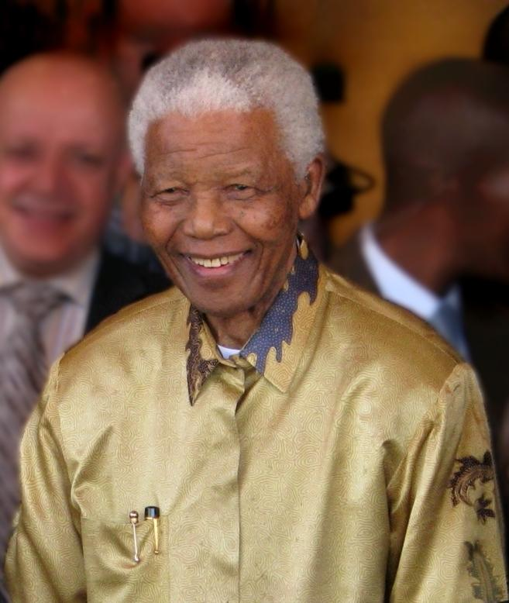

Slide 12
Colonisation of Algeria

Slide 13
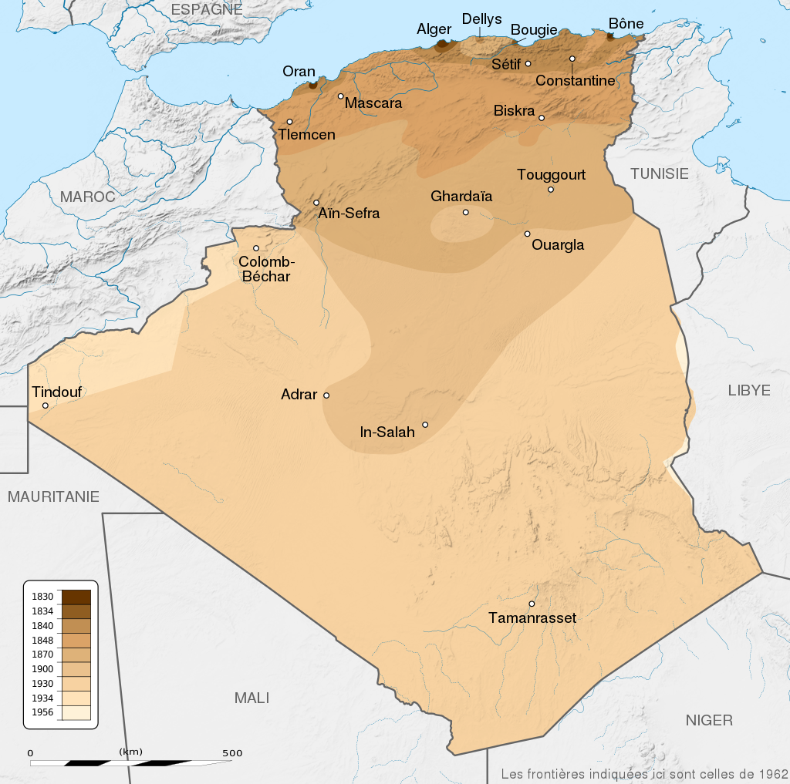

Slide 14
The colonisation process
On December 1, 1830, King Louis-Philippe named Duc de Rovigo as head of military staff in Algeria
De Rovigo took control of Bône and initiated colonisation of the land
In 1833 he was replaced by Marshal Bugeaud
In 1834 France annexed the occupied territories as a colony
After the occupation of Algiers, a company was formed to to acquire agricultural land and to subsidize its settlement by European farmers
Big potential for the production of cotton

Slide 15
The capture of Constantine
The biggest opposition was lead by Ahmad bin Muhammad in the bey of Constantine
French failed in several attempts to gain some of the bey’s territories through negotiation
Invasion force, led by Bertrand Clauzel, had to retreat from Constantine in 1836 in humiliation and defeat
The French captured Constantine under Sylvain Charles Valée the following year

Slide 16
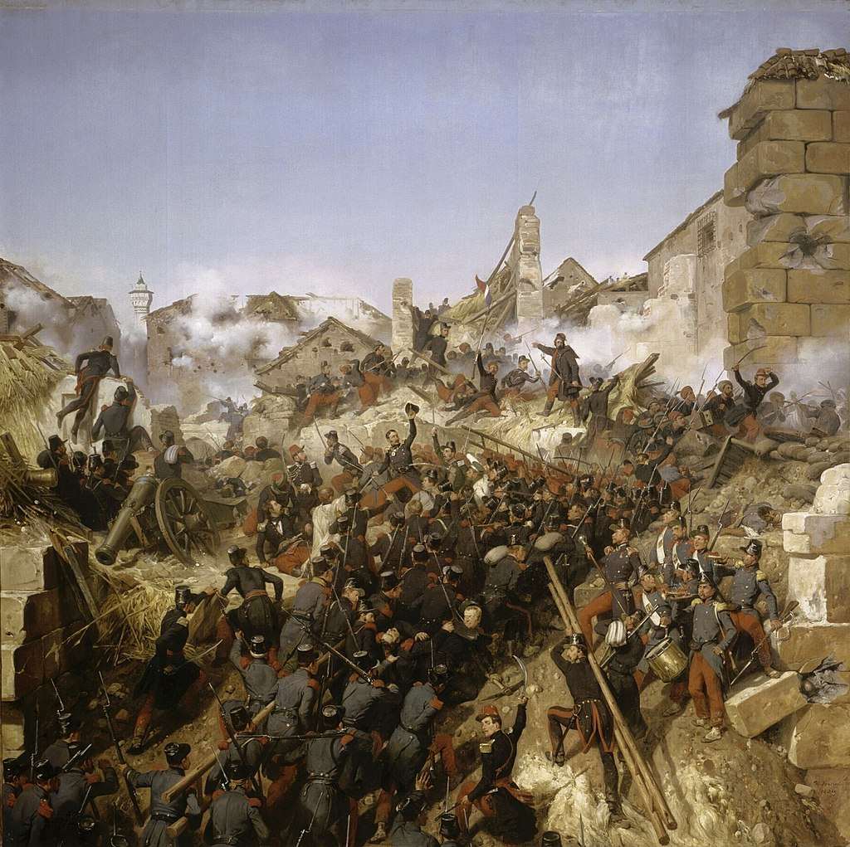

Slide 17
Emir Abd al Qadir
Muhyi ad Din launched attacks against the French at Oran in 1832
In the same year, jihad was declared and to lead it tribal elders chose Muhyi ad Din’s son Emir Abd al Qadir
Abd al Qadir set about building a territorial Muslim state
By 1839, he controlled more than two-thirds of Algeria
Abd al Qadir fought battles across Algeria with French forces and although his forces were defeated by the French in 1836, Abd al Qadir negotiated a favourable peace treaty the next year
The treaty of Tafna defined the territory under his control
The French broke the treaty by occupying Constantine
Abd al Qadir in his response destroyed the French settlements on the Mitidja Plain and he even advanced to the outskirts of Algiers

Slide 18
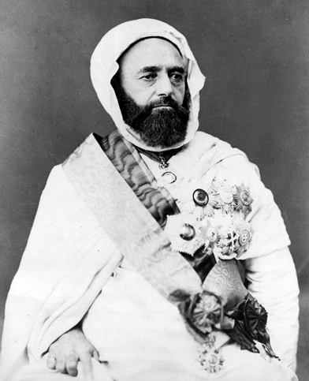

Slide 19
After 1840 until Bugeaud had at his disposal 108,000 men, which was at that time one-third of the French army
In 1847 Emir Abd al Qadir surrendered and was imprisoned in France until 1852
After that Abd al Qadir moved to Damascus
During anti-christian riots in 1860, he sheltered many Christians at his own house, for which he was celebrated all around the Europe and was given many awards
By 1875, the French occupation was completed
The war killed approximately 825,000 indigenous Algerians since 1830

Slide 20
French colonial policy in Algeria
Within the first three decades of the conquest, between 500,000 and 1,000,000 Algerians, out of a total of 3 million, were killed by the French due to war, massacres, disease, and famine
Atrocities committed by the French include bombing and killing of unarmed civilians, rape, torture, executions through “death flights”, burial alive, thefts and pillaging
Up to 2 million Algerian civilians were deported in internment camps
During the Pacification of Algeria French forces engaged in a scorched earth policy

Slide 21
“All populations who do not accept our conditions must be despoiled. Everything must be seized, devastated, without age or sex distinction: grass must not grow any more where the French army has set foot. Who wants the end wants the means, whatever may say our philanthropists? I personally warn all good soldiers whom I have the honour to lead that if they happen to bring me a living Arab, they will receive a beating with the flat of the saber. This is how, my dear friend, we must make war against Arabs: kill all men over the age of fifteen, take all their women and children, load them onto naval vessels, send them to the Marquesas Islands or elsewhere. In one word, annihilate everything that will not crawl beneath our feet like dogs.”
Lieutenant-colonel Lucien de Montagnac, 15 March 1843

Slide 22
“We make war much more barbaric than the Arabs themselves […] it is for their part that civilization is situated.”
Alexis de Tocqueville on the french conquest of Algeria

Slide 23
The colonisation of Algeria lead to the extermination of a third of the population
Tribes that were considered too troublesome were banned
Some took refuge in Tunisia, Morocco and Syria or were deported to New Caledonia or Guyana
French forces also engaged in wholesale massacres of entire tribes
500 men, women and children of the El Oufia tribe were killed in one night
Up to 700 members of the Ouled Rhia tribe were killed by suffocation in a cave

Slide 24
The road to independence
From May 8 to June 26, 1945, the French carried out the Sétif and Guelma massacre, in which at least 30,000 Algerian Muslims were killed
The French colonial military and police suppressed the rebellion, and then carried out a series of reprisals against Muslim civilians
The army then carried out executions of Muslim rural communities
Less accessible villages were bombed by French aircraft, cruiser Duguay-Trouin shelled Kherrata
The dead bodies in Guelma were buried in mass graves, but they were later dug up and burned in Héliopolis

Slide 25
During the Algerian War the French delibetarely used illegal methods against the Algerians, including beatings, torture by electroshock, waterboarding, burns, and rape
Prisoners were locked up without food in small cells, buried alive, thrown from helicopters to their death or into the sea with concrete on their feet
Approximately 150 000 harkis were killed in 1962 during the immediate aftermath of the war by the new FML government

Slide 26
Current aftermath
In 2017, President Emmanuel Macron described France’s colonization of Algeria as a “crime against humanity”
“It’s truly barbarous and it’s part of a past that we need to confront by apologizing to those against whom we committed these acts.”
Emmanuel Macron, 2017
In 2018 France officially admitted that torture was systematic and routine

Slide 27
Long-term effects of settler colonialism
religion
language
culture ties
new types of crops
the overall development
disease
overall instability
racism and the idea of supremacy
vulnerability to neo-colonialism
border disputes

Slide 28
“The impacts of colonialism were similar, regardless of the specific colonizer: disease; destruction of indigenous social, political, and economic structures; repression; exploitation; land displacement; and land degradation.”
Campbell et al., 2010, p. 37

Slide 29
Sources
South Africa. Britannica. [Accessed 24 March 2022]
PAPPÉ, I, 2015. Israel and South Africa. The Many Faces of Apartheid. London. [Accessed 24 March 2022]
COOMBES, A. E., 2006. Rethinking Settler Colonialism. Manchester University Press.
CALDWELL, M., 2017. The Effects of Colonization. How it Happened and How it Still Continues. [online] Medium. Available at: <https://medium.com/@megancaldwell62/the-effects-of-colonization-how-it-happened-and-how-it-still-continues-b463350d1ac5> [Accessed 27 March 2022].
ENCYKLOPEDIE, 2022. Francouzské Alžírsko. [online] Available at: <https://wikijii.com/wiki/french_algeria> [Accessed 25 March 2022].
TAKEUCHI, S. African Land Reform Under Economic Liberalisation. Springer. Tokyo. 2022. [Accessed 26 March 2022]

