Slide 1
Recent Development Kuciak, 2020 Election, COVID-19
Peter Spáč

Slide 2
Support of SMER-SD (2012-2016)

Slide 3
2016 General Election

Slide 4
New Government
Decline of SMER-SD excluded the scenario of a one-party government
Two scenarios:
SMER-SD + several partners
Grand coalition without SMER-SD
Final outcome:
SMER-SD, SNS, Most-Hid, Network
Fico as the PM for the third time
Network collapsed shortly after that and part of its MPs went to Most
“The barrier against extremism”

Slide 5
Acceptance of the government SMER-SD, SNS, Most-Hid, Network
 | Acceptable | Not acceptable | Do not know
SMER-SD | 85 | 11 | 3
SNS | 60 | 29 | 12
Most-Hid | 39 | 47 | 13
Network | 36 | 45 | 18
KDH | 31 | 53 | 16
We are Family | 23 | 62 | 15
LSNS | 19 | 71 | 10
SaS | 19 | 77 | 4
SMK | 16 | 84 | 0
OLaNO | 13 | 84 | 3
Non voters | 30 | 45 | 25
All | 39 | 47 | 14

Slide 7
The Breaking Point in February 2018
Murder of investigative journalist J. Kuciak and his fiancée M. Kušnírová at their home
Tremendous consequences:
Public impact comparable to November 1989
Mass demonstrations around the whole country
Shifts in public opinions
Personal earthquake in the government
Negative effect primarily on SMER-SD

Slide 8
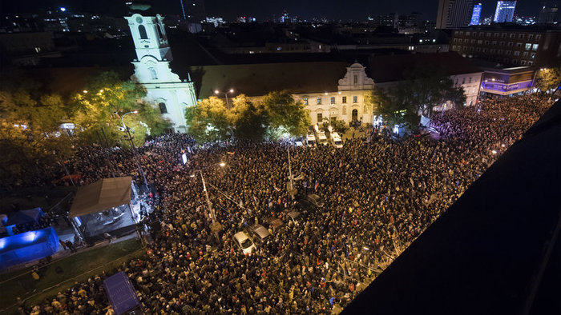
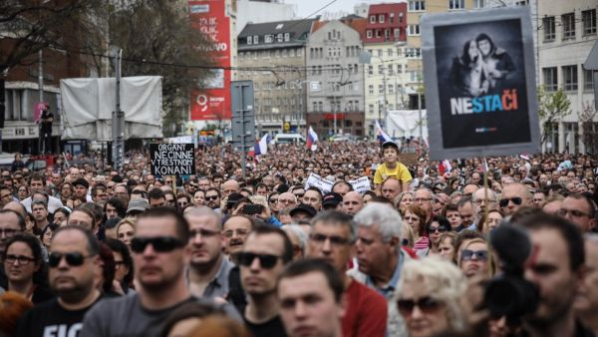
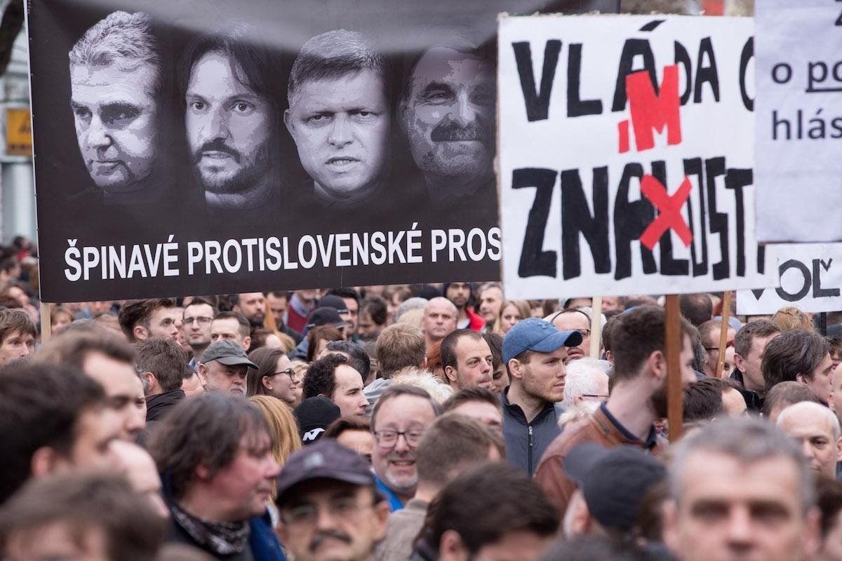
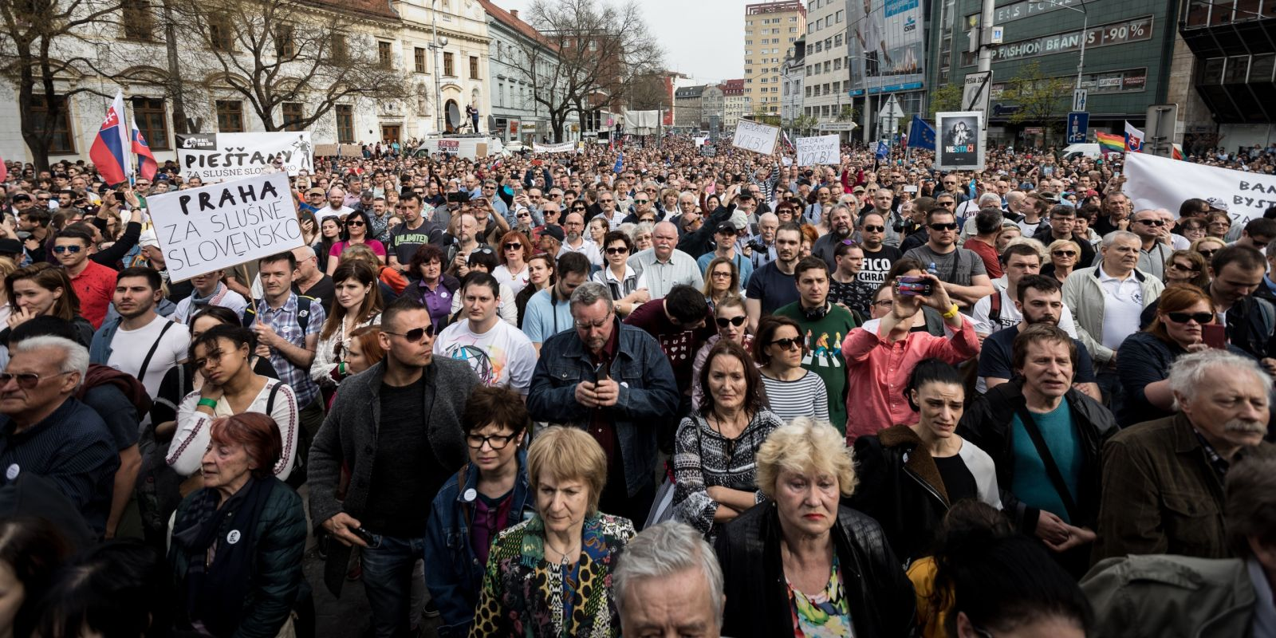

Slide 9
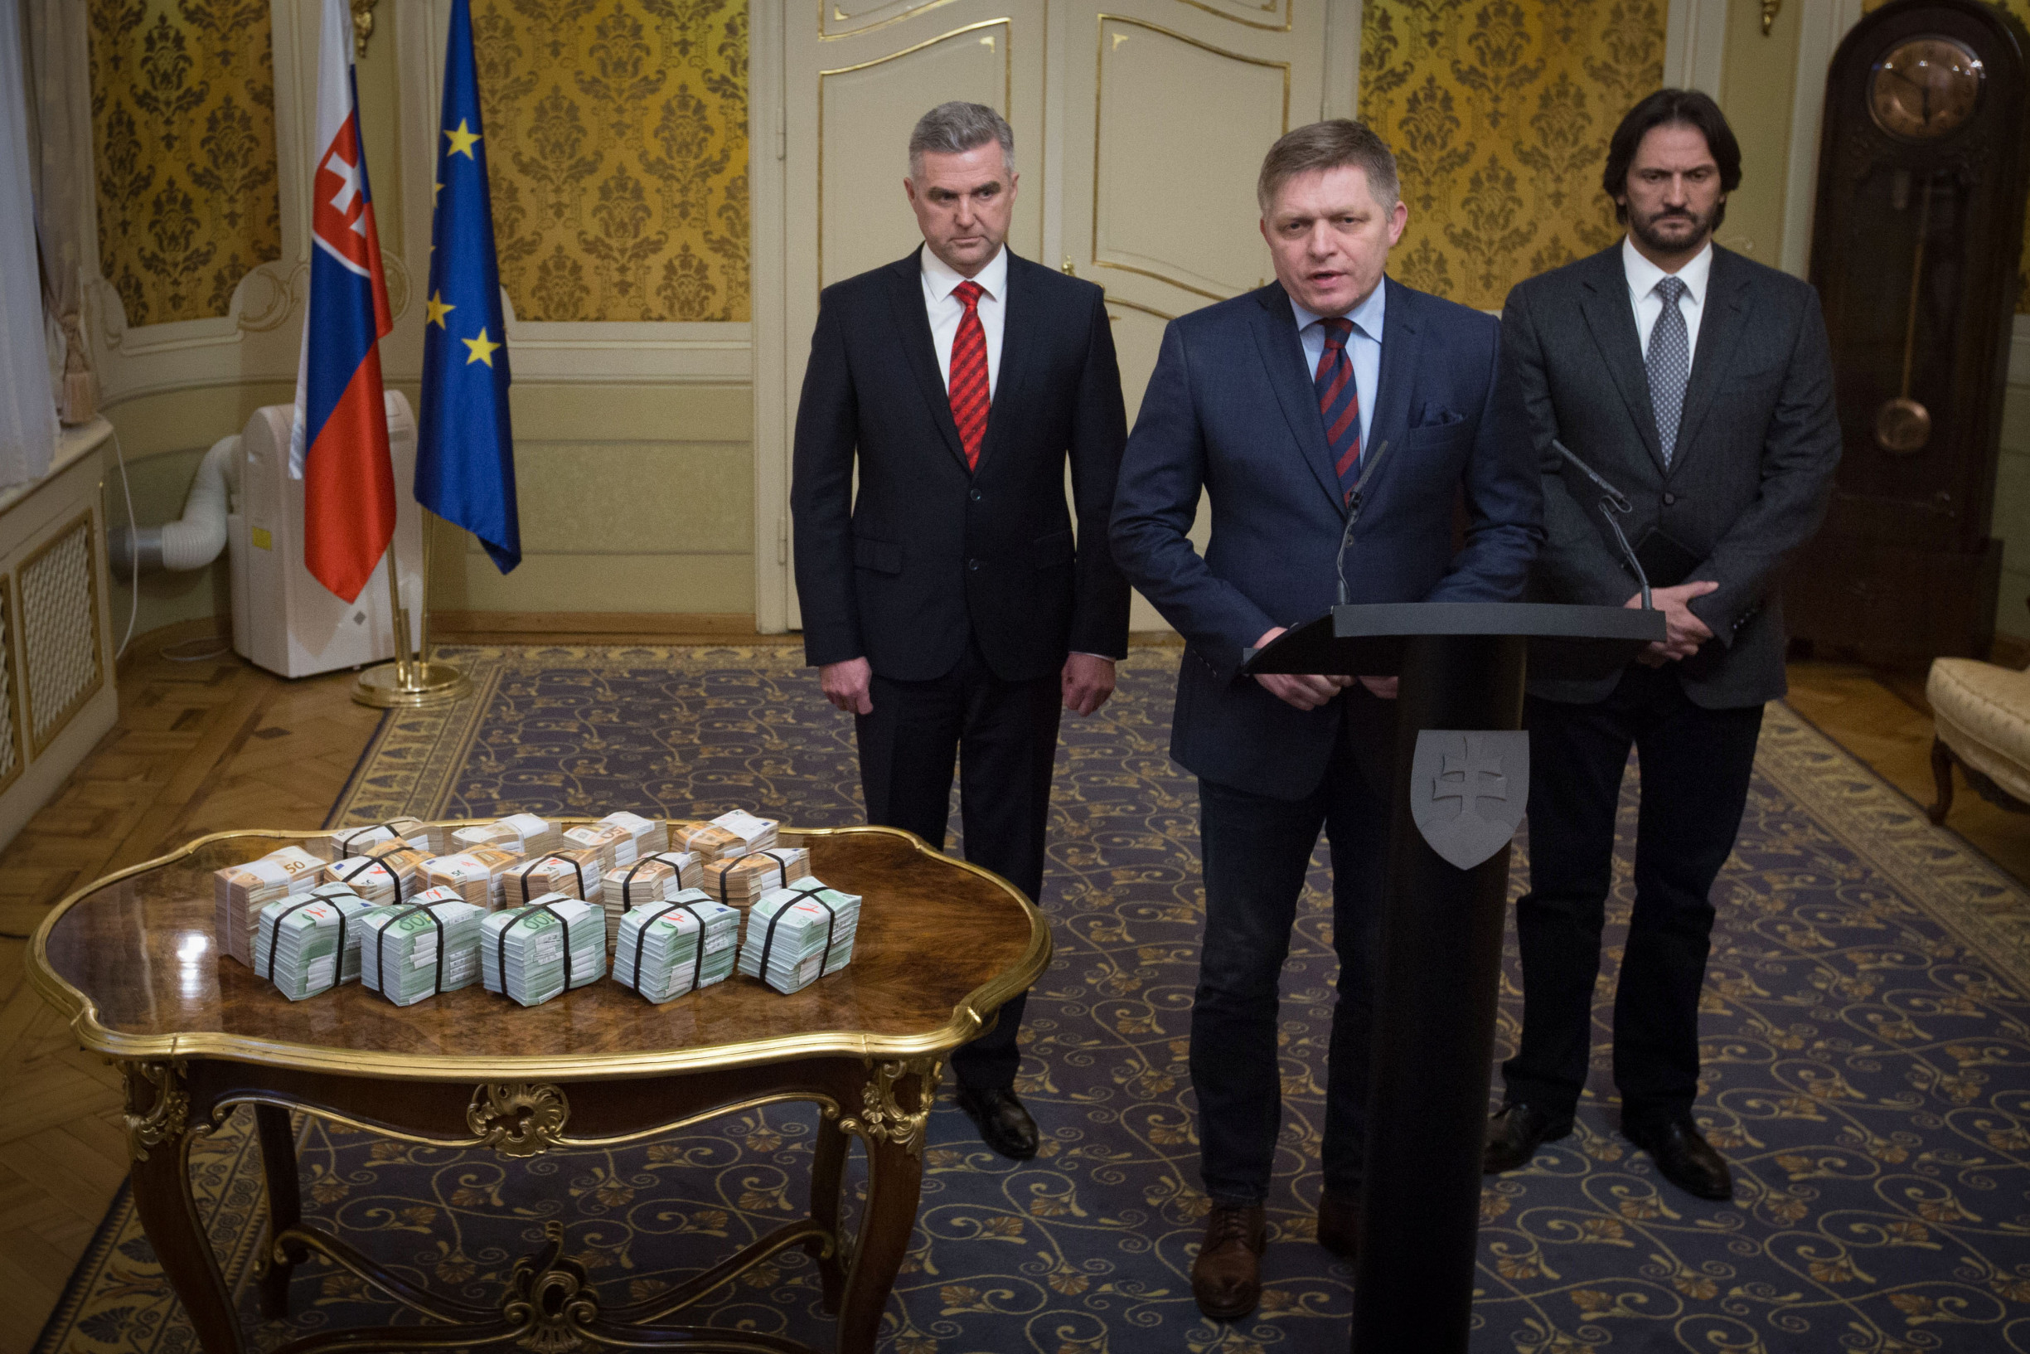

Slide 10
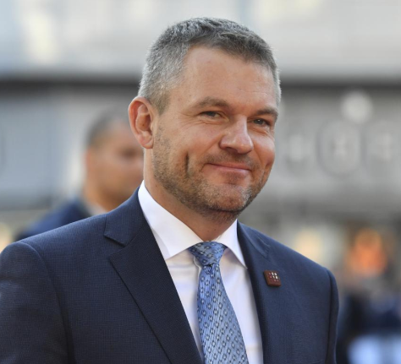
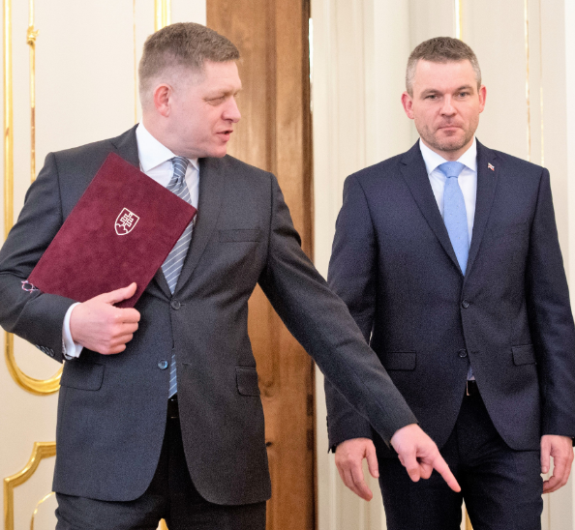
Personal Consequences
Various prominent officials forced to step down
PM Fico
Minister of Interior Kaliňák
President of the Slovak Police Force Gašpar
Peter Pellegrini as the new PM (SMER-SD)
Fico remained SMER-SD leader
The General Attorney promised to unleash “hell”

Slide 11
Support of SMER-SD

Slide 12
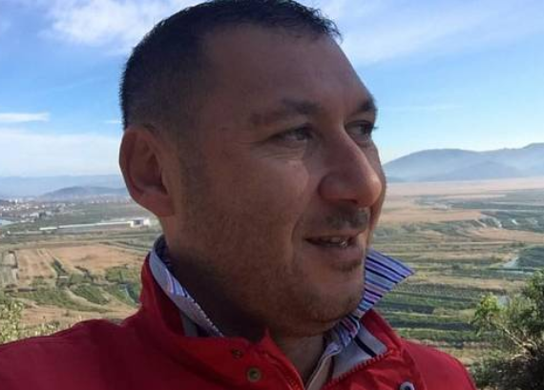
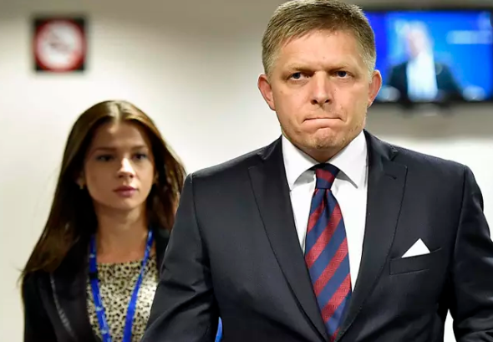
Investigation (1)
The Italian scenario

Slide 13
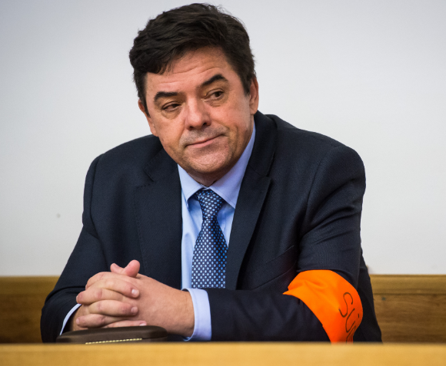
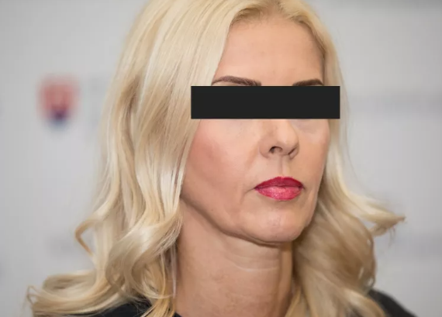
Investigation (2)
The Kočner network scenario
Murder as revenge
Network of judges granting him protection
Threema

Slide 14
New parties in the opposition
Progressive Slovakia (centre-left and liberal)
Together – Civic Democracy (centre-right)
Successful cooperation in 2018 local and 2019 EP and presidential election
For the People:
Established by Andrej Kiska after finishing his mandate
More conservative leaning

Slide 15
Four Months Before 2020 Election
Party | Votes in % | Votes - Threshold | Projected Seats
SMER-SD | 20.0 | 15.0 | 36
PS – Together | 11.7 | 4.7 | 21
For the People | 10.6 | 5.6 | 19
LSNS | 10.3 | 5.3 | 19
We are Family | 7.0 | 2.0 | 13
SNS | 6.8 | 1.8 | 13
KDH | 5.7 | 0.7 | 10
OLaNO | 5.7 | 0.7 | 10
SaS | 5.0 | 0.0 | 9
Most-Hid | 4.1 | -0.9 | 0
Survey by Focus Agency, October 30 – November 6, N = 1,020

Slide 16
Integration Attempts
“Democratic” opposition:
PS-Together, For the People, OLaNO, SaS, KDH
Separate line of KDH
For the People only accepted a cooperation of all parties or nothing
as a result, all parties continued alone (and PS-Together as a coalition)
„If there are too many parties just above the threshold, it is naive to expect that voters will coordinate their behavior to save all of them”
Peter Spáč, 11.11.2019
(https://dennikn.sk/1647669/volby-2020-nerozhodnu-vitazi-ale-porazeni/)

Slide 17
Further Integration Attempts
Hungarian parties:
Both Most-Hid and SMK (now as MKO-MKS) below the threshold
Too many Hungarian parties for a single Hungarian minority
Initial hope to cooperate ended without any result
Far right and protest parties:
LSNS and the newly emerged Homeland
Kotleba and Harabin scored 530,000 votes in 2019 presidential election (roughly ¼ of all votes)
Discussions on integration failed

Slide 18
Main Topics in the Campaign
The 2018 murder
Second anniversary only a few days before the election
Corruption, scandals of SMER-SD, linkages to Kočner
Rise of LSNS and extremism in general
Unsuccessful attempt to bring back “old” topics, e.g. immigrants

Slide 21
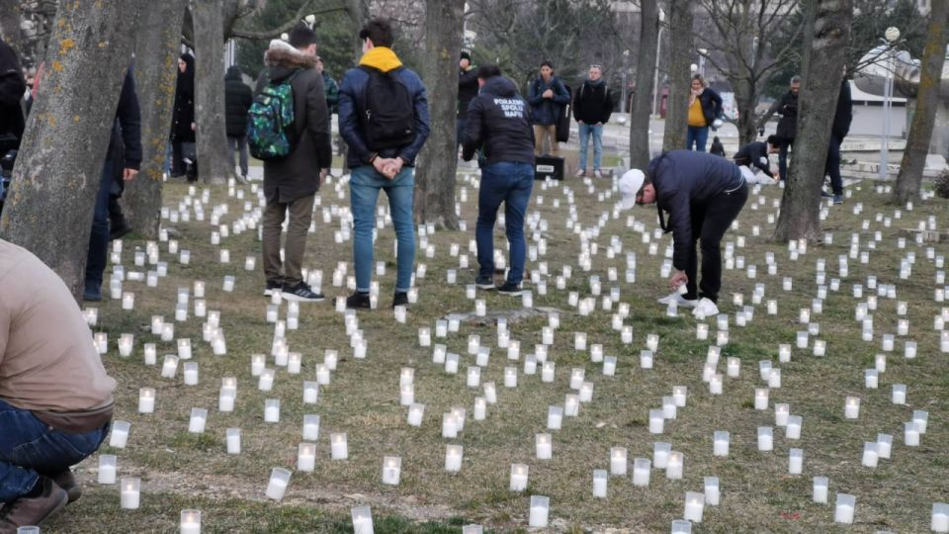
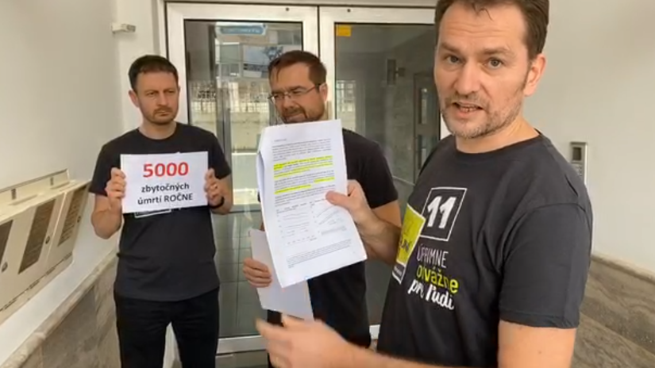
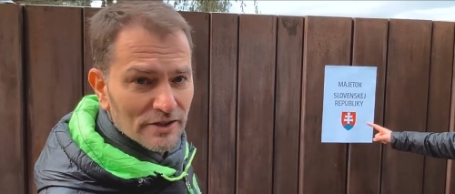

Slide 22
Expert Evaluation of the Campaign (N = 56)

Slide 23
Few Days Before the Election
SMER and SNS announced vast social benefits before the election
13th pension
Doubling of child allowances
Abolishment of highway tolls
The parliament passed only the pensions
SMER-SD, SNS, LSNS, We are Family

Slide 24
2020 general election

Slide 25
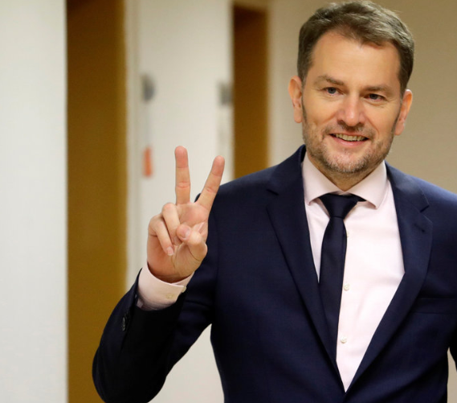
New Government
OLaNO, We are Family, SaS, For the People
PM Matovič
95 MPs (90 required to amend the Constitution)
Question of stability and survival

Slide 26
Potential clashes
OLaNO:
Largest governing party, 53 MPs
Previous record of low stability
Anti-corrupt voter’s attitudes vs. Christian activists among MPs
Conservatives vs. liberals in the government
Two minor parties (For the People and SaS) weakened
Andrej Kiska retired from his party and politics

Slide 27
Anti-corrupt activities
“Mani pulite” in a Slovak way
Numerous arrests of prominent figures
Judges, people in business, attorneys, police leadership
Many already confessed they had committed crimes
Uncovering a huge corruption network allegedly linked to previous governing parties
Unleashed fantasy of police name generators:
Storm, Tempest, Judas, Babylon, Purgatory, God Mills…

Slide 28
COVID-19
Spread of pandemic during the first days of the new government
First positive test on March 6
Quick response similarly to other European countries
Borders, lockdown, closure of schools, facemasks…
Spring to summer 2020:
Great success in terms of numbers:
Low number of cases
Extremely low numbers of casualties
Before summer – weakening of adopted anti-pandemic restrictions

Slide 29
1st Wave of COVID-19

Slide 30
6 June 2020 – Borders re-opening

Slide 31
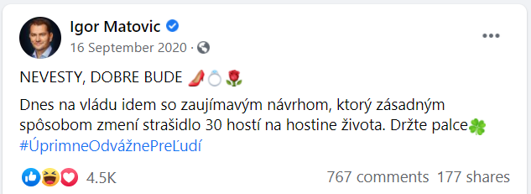
1st Wave of COVID-19 + Summer 2020

Slide 32
2nd Wave of COVID-19 – Cumulative Cases

Slide 33
2nd Wave of COVID-19 – Cumulative Deaths

Slide 34
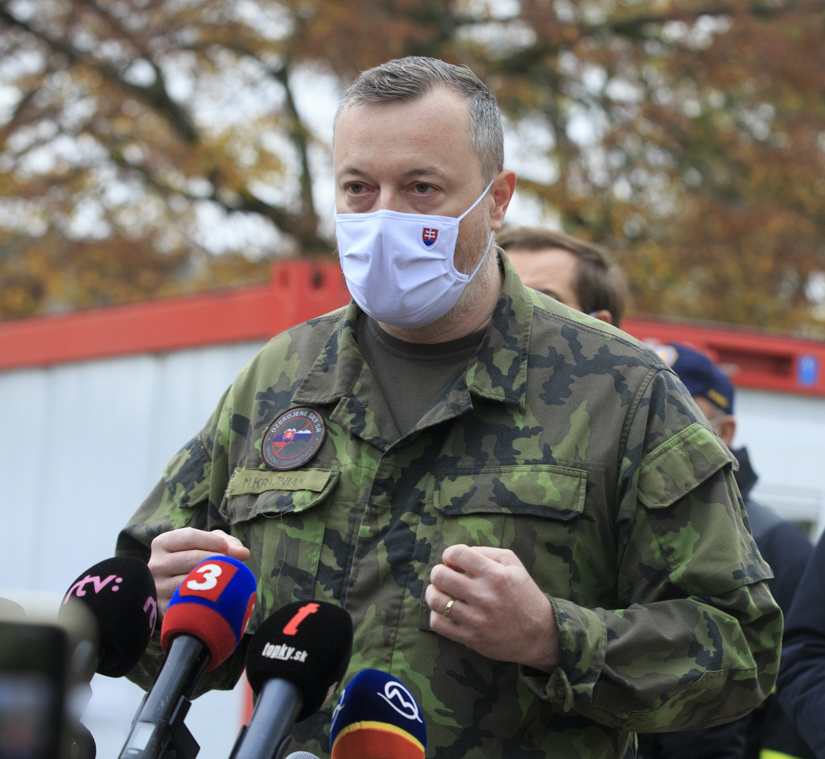
Atomic Weapon against COVID-19
Nationwide testing
Strongly supported by Prime Minister
‘The pass to freedom’
Held on October 31 – November 1
More than 3.6 million people tested
One per cent positives
Discrepancies over interpretation of its effects
Further rounds of testing in selected regions

Slide 35
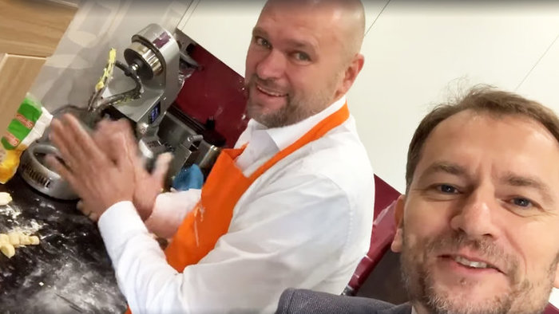
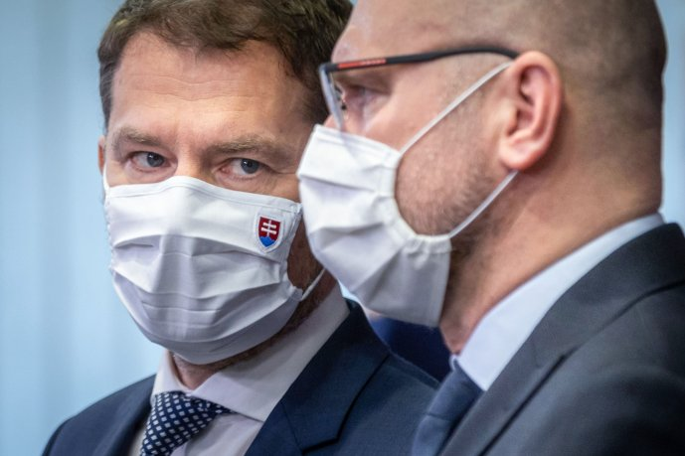
Rising conflicts in the government
Prime Minister Matovič v. SaS leader Sulík
Topics:
Level of restrictions
Nationwide testing
Antigen tests purchase
Constant tensions between OLaNO and SaS
Enhanced by public opinion development

Slide 36
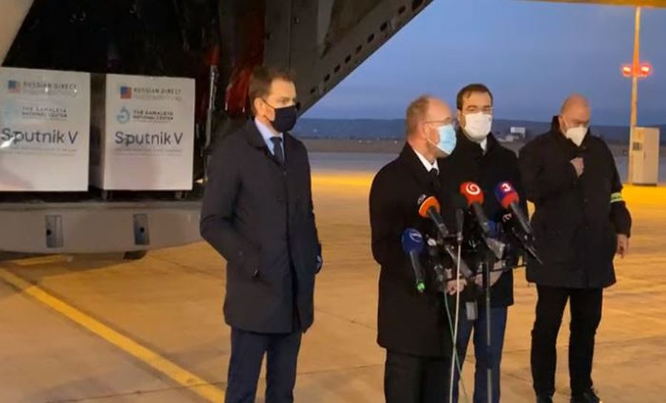
Government Crisis in March 2021
Escalation of previous development
Communication of PM – Facebook politics
Matovič v. Sulík
Atomic weapon v. reality
Purchase of unauthorized Sputnik V vaccine as the trigger

Slide 37
Government Crisis in March 2021
SaS and For the People demanded Matovič to resign
Various firmness of such demands – SaS v. For the People
A series of resignations of several members of the government
All ministers of SaS (including Sulík), one minister of For the People
One resignation from We are Family which remains a mystery
Matovič facing risk of losing majority in parliament
For the People facing risk of complete disintegration

Slide 38
Government Crisis in March 2021
Main scenarios:
SaS leaves the government (80)
SaS and For the People leave the government (70)
‘Reconstruction’ of the government:
Matovič ends as PM and switches office with Minister of Finance
SaS and For the People ministers return back to their offices
The resignation of the minister of We are Family still remains a mystery
Improving COVID-19 statistics as a factor?

Slide 39
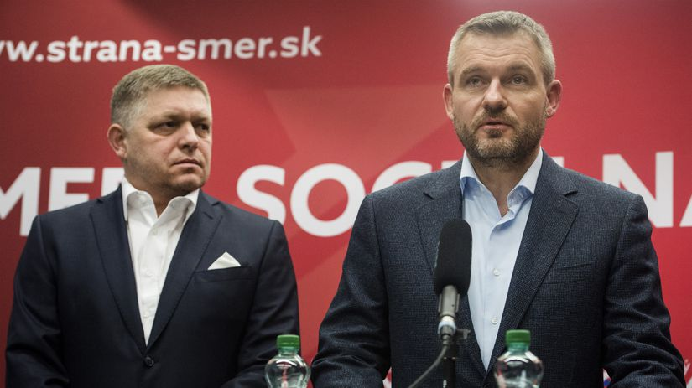
Dynamic Development in Opposition
Voice – Social Democracy:
Splinter party from SMER-SD
Leader Peter Pellegrini
Support of 20-25 per cent of voters
Hidden strategy?
SMER-SD:
Fico’s unchallenged leadership
Sharp decline of support
New position of a small party

Slide 40
Referendum 2021?
Referendum for early election
Non-partisan initiative fully organized by political parties
SMER-SD, Voice, SNS
Negative record of such referendums v. discontent in the society
COVID-19 restrictions, economic impact of the pandemic
Death of previous Police President
In April 2021 SMER-SD announced it gathered enough signatures
Constitutional Court declared early election referendum as violating the constitution → president refused to call the referendum

Slide 41
Most Recent Development
Voice – Social Democracy vs. Smer – Social Democracy
Changes in public support
Friends or enemies?
Shift of SMER to far right after pandemic
Russian assault on Ukraine
Initial support for refugees transformed into polarized society
Various reactions of relevant parties

