Slide 1
From Velvet Revolution to Velvet Divorce
POLb1135 Slovak Politics

Slide 2
Communist Regime in Czechoslovakia
Rigid nature of the regime
The impact of normalization
No political liberalization (unlike Poland or Hungary)
Absence of dialogue between the regime and the opposition

Slide 3


Slide 4
Second half of the 1980s
Rising discontent in the society
The regime as a set of compulsory rituals without legitimacy
Candle demonstration (1988) in Bratislava
  First mass demonstration against the regime
  Organized by catholic dissent
  Request for respecting the citizen freedoms
  Suppressed by police and state forces

Slide 5
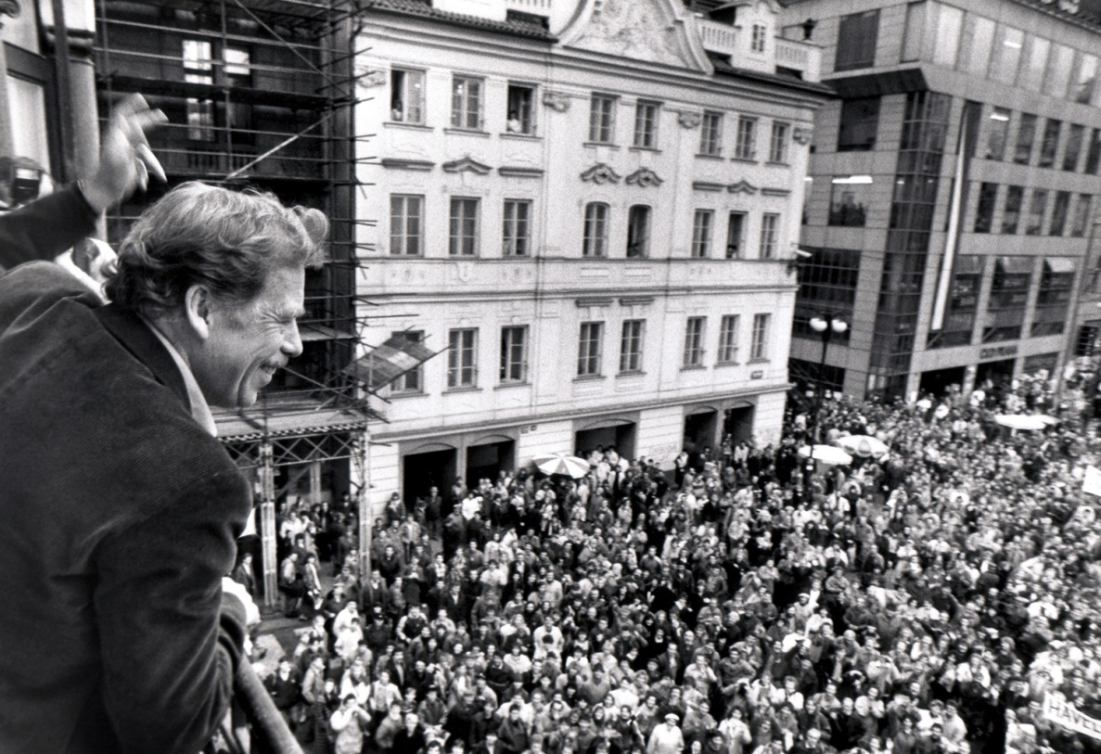
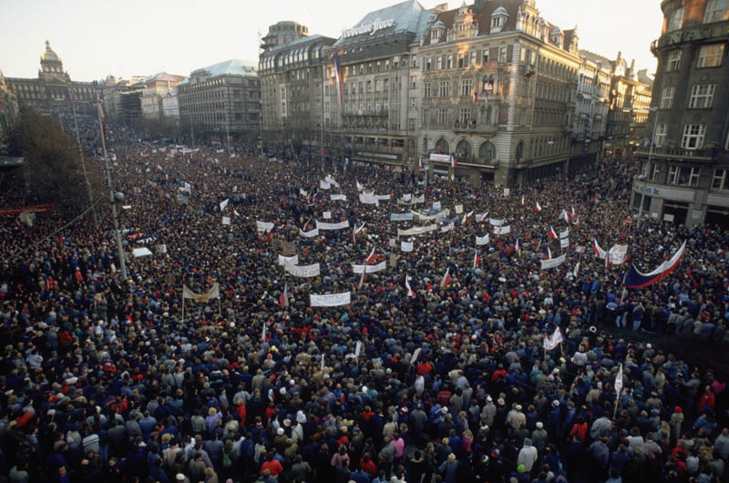
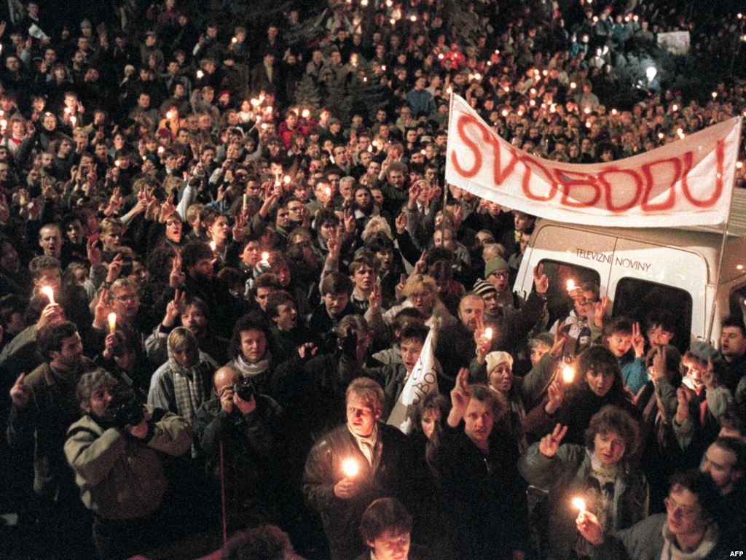
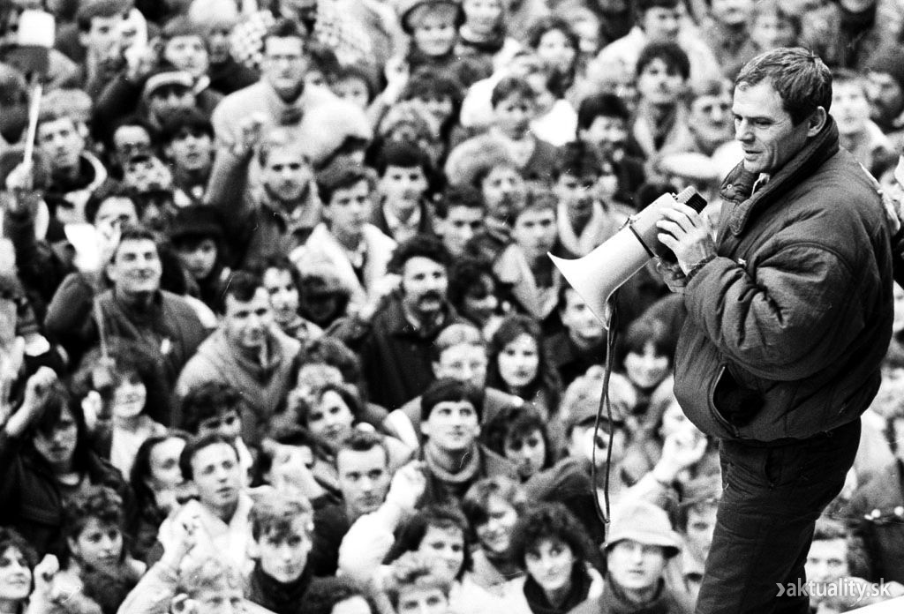

Slide 6
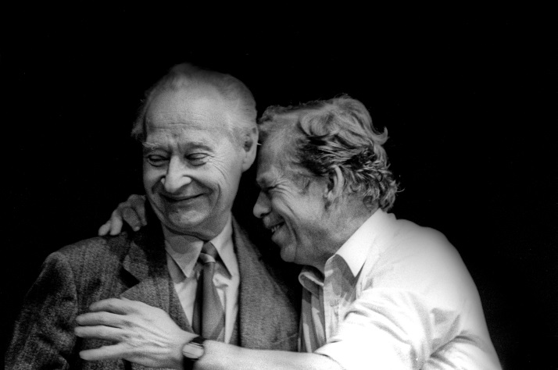
November 1989
Mass demonstrations against the ruling regime
Creation of two main dissent movements:
  Civic Forum (OF) – Czech Republic
  Public Against Violence (VPN) – Slovakia
Regime forced to enter discussions with the opposition
Evident inability of KSC to react to the new situation

Slide 7
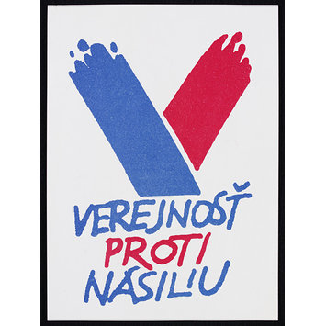
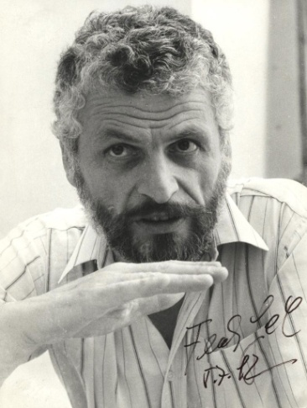
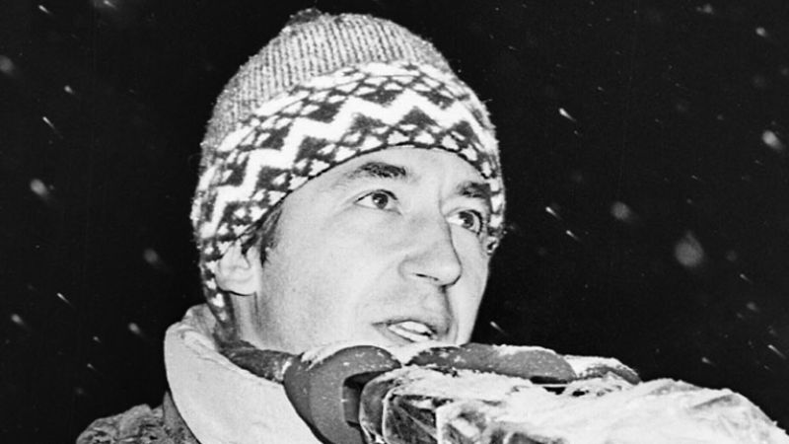
Public Against Violence
Slovak dissent movement
Leaders – Fedor Gál, Ján Budaj
Comparison with Czech OF:
  Higher support towards non-political politics
  Less pragmatic than OF
  Lesser interest in gaining political positions
  Primary aim to control and not to directly rule

Slide 8
Reconstruction of the Government(s)
A Game of Thrones in Czechoslovakia
Proof of differences between OF and VPN
Petr Pithart as Prime Minister of Czech government
Slovak government:
  9 non-partisans, 6 communists, only 1 person from VPN
  Prime Minister – Milan Čič – Minister of Justice in 1988-89

Slide 9
Change of Tactics in 1990
VPN understood its mistake when it was too late:
  End of euphoria from November 1989
  Dubček not elected as president
Unsuccessful efforts of VPN to gain positions:
  Slovak parliament refused to elect Budaj as its chairman and kept this post for communist official Rudolf Schuster
  After that VPN did not even try to get the office of Slovak Prime Minister

Slide 10
Crisis of VPN in 1990
In spring 1990 the support of VPN declined to 10%
Reaction – adding communists on candidate lists:
  Dubček, Čič, Schuster, Čalfa, Kováč
  VPN thus legitimized their political careers in the post 1989 situation
This pragmatic step helped VPN to win elections 1990

Slide 11
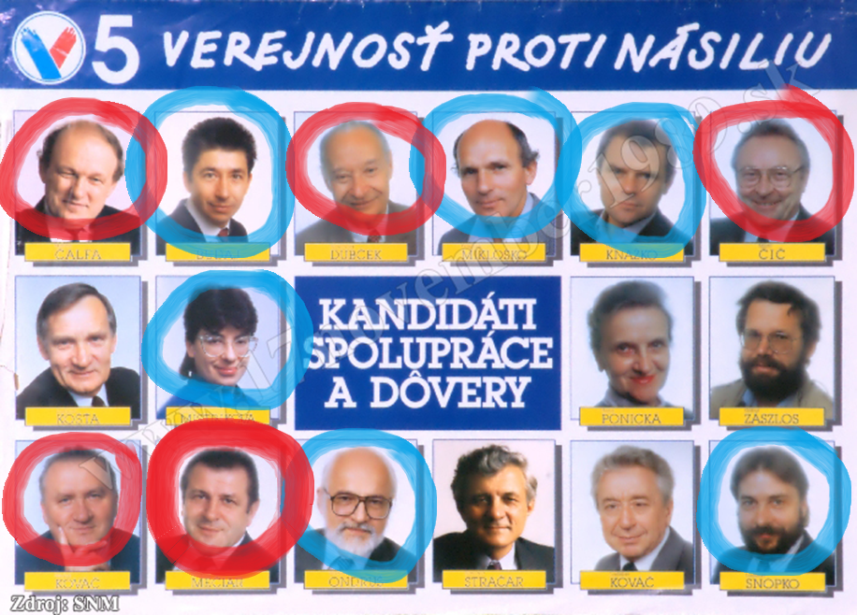

Slide 12
Slovak Party System After 1989
Restoration of party plurality
The main rivals of 1989
Historical parties
New parties

Slide 13


Fate of KSC and KSS
What happened to them?
  a) changed the name and transformed to social democracy
  b) changed the name and remained the same
  c) kept the same name and ideology
  d) lived long and prospered

Slide 14
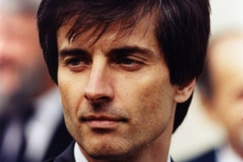
Rivals of 1989
Communists (KSS):
  Cooperation with KSC until elections 1990
  Transformation to social democracy → 1991 – Party of the Democratic Left (SDL)
  Leader – Peter Weiss
VPN:
  Originally right-winged and liberal
  Dissent movement

Slide 15
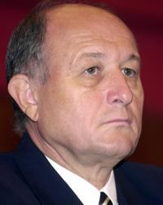
Historical parties
Slovak National Party (SNS):
  Official claims of its rich history
  Very questionable historical link
  Strong stress on the position of Slovakia
Democratic Party (DS):
  Weak historical link
  Civic, right-wing orientation
  Remained without bigger support

Slide 16
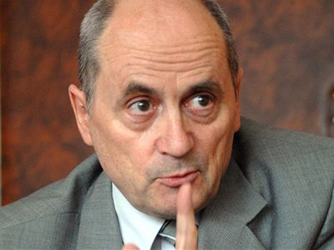
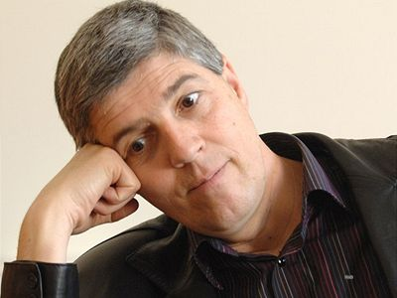
New Parties
Christian-Democratic Movement (KDH):
  Christian and conservative values
  Catholic dissent
  Leader – Ján Čarnogurský
Hungarian parties:
  Smaller parties
  Support by ethnic Hungarians
  Mutual cooperation

Slide 17
1990 Election
Party | Votes (in %) | Seats
VPN | 29,4 | 48
KDH | 19,2 | 31
SNS | 13,9 | 22
KSC / KSS | 13,4 | 22
Hungarian parties | 8,7 | 14
DS | 4,4 | 7
Green party | 3,5 | 6
Others | 7,6 | 0
 |  | 150

Slide 18
Government after 1990 election
Officially center-right government
Prime Minister – Vladimír Mečiar (VPN)
Impact of previous personal changes in VPN:
  Most executive posts of VPN gained by former communists
  Internal tension about the character of economic reform
Conflict between VPN’s liberal leadership and Mečiar → new Prime Minister Čarnogurský

Slide 19
Party System in 1990 - 1992
Intensive dynamics
Low stability of party system
Secessions and emergence of new parties
Most parties affected by these trends (VPN, KDH, KSS-SDL, SNS)
New parties ended as marginal – with only one crucial exemption

Slide 20

Birth of a new star
Escalation of conflict in VPN
Party of two faces – liberals vs. former communists
1991 – Mečiar creates Movement for a Democratic Slovakia (HZDS)
  Slower economic reform
  Populism
  Nationalism
Overwhelming support of Mečiar in society (80-90 %)

Slide 21
Let’s Move on to Czechoslovakia

Slide 22
Czechoslovakia after 1989
November 1989 opened discussions about the character of the state
Different ideas about:
  The role of federation and of both republics
  The speed and shape of the economic reform
December 31, 1992 – end of the game

Slide 23
Two Isolated Party Systems
Most parties operated within their „national“ borders
Communists:
  Together in elections 1990
  Czech hardliners vs. Slovak reformists
  Dissolution into two separate parties in 1991
Unsuccessful efforts to make party links:
  Greens, Christian Democrats, Social Democrats
  Czech Civic Democratic Party (ODS) and elections 1992

Slide 24
The Hyphen War (spring 1990)
Conflict about the name of the federation
Slovaks wanted to add a hyphen → Czecho-Slovak Republic
Czechs refused this because of its usage in 1938-1939
Hyphen:
  Symbol of equity between nations for Slovaks
  Reminiscence of a negative experience for Czechs
Final solution – Czech and Slovak Federal Republic (CSFR)

Slide 25
Slovak Parties and Czechoslovakia
Diverse ideas about the statehood
Independence was not a goal shortly after 1989
After elections 1990:
  Stronger position of Slovakia within the state (VPN)
  Confederation – to grant Slovakia a sole chair and a star in the European Union (KDH)
  Independence (SNS)

Slide 26
Discussions about the CSFR
Aims of Slovak governing parties:
  Stronger position of Slovak political institutions
  Stronger republics within a weaker federation
Beginning of 1992 – agreement in Milovy:
  Compromise between Czechs and Slovaks
  A weaker form of federation
  Led to split of KDH → Slovakia refused the agreement
Mečiar and HZDS took the lead as protectors of Slovak nation and its interests

Slide 27
Last Federal Election (June 1992)
HZDS offered five scenarios to its voters:
  Federation
  Confederation
  Union
  „Benelux“ model
  Independence
Election results:
  Success of HZDS (and Czech ODS of Václav Klaus)
  Failure of pro-federal parties

Slide 28
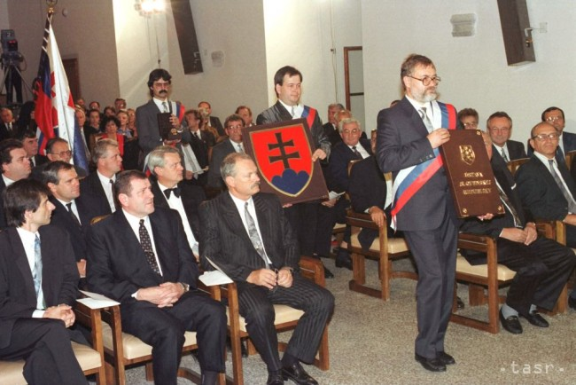
End of the Federation
Declaration of Independence of the Slovak Nation:
  July 1992 (shortly after the elections)
  Appointed by the Slovak parliament
  Proclamation of sovereignty of Slovakia
Constitution of the Slovak Republic:
  September 1992
Both KDH and the Hungarian parties voted against or did not vote at all

Slide 29
End of the Federation
Debates after elections 1992 between HZDS and ODS
Important feature – political leaders refused to enter federal government
25.11.1992 – Federal Assembly approved the Constitutional law 542/1992
Alternative ideas or a referendum were rejected
1993 – Czech Republic and Slovakia

Slide 30
The People’s Choice?
Survey in 1993 - if referendum would be held (ČSFR):
  29 % for split
  50 % for federation
In later years the split gained a more positive stance
Survey in 2012 – split of ČSFR (Czech Republic):
  37 % for
  36 % against
  27 % do not know

Slide 31
Survey in Slovakia in 2007 about the restoration of a common state with the Czechs:

Slide 32
What has Changed?
Typical issues of arguments between Czechs and Slovaks before 1993
  The flow of public money
  Who allowed communists to rule since 1948
  Who is the strongest nationalist

Slide 33
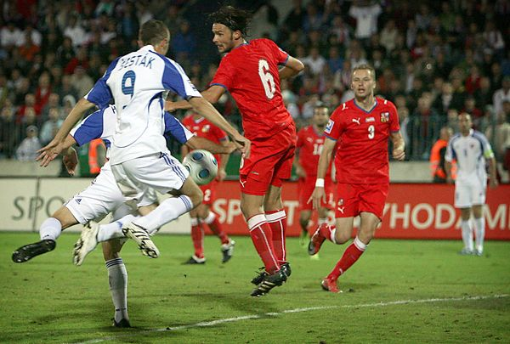
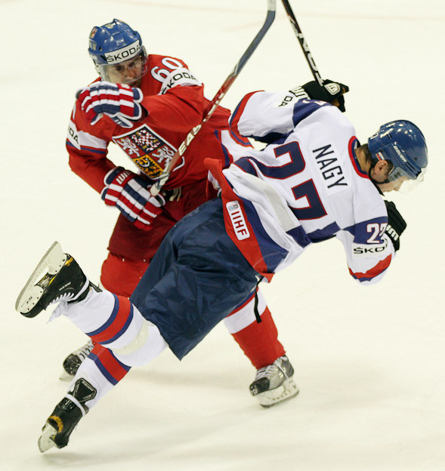
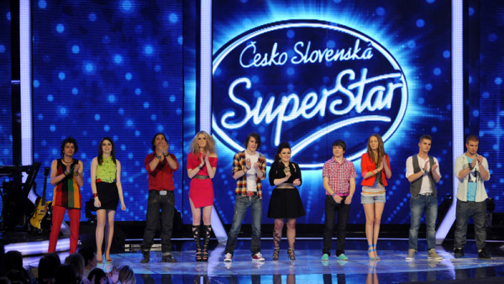
And now…

Slide 34
Legacy of 1989 - 1992
Vladimír Mečiar labeled himself as the founder of Slovakia
Parties that voted against the split of federation got an image of those who „did not want this state“
Need to find a new target for Slovak nationalists

