Slide 1
Party System of the New Millennium
POLb1135 Slovak Politics

Slide 2
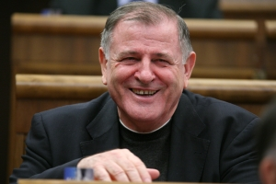
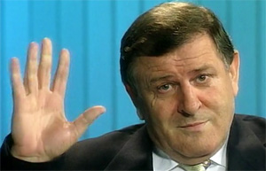
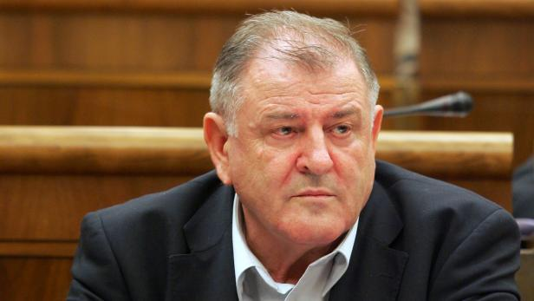
The fate of Mečiar

Slide 3
1998 Election
Party | Votes (in %) | Seats
HZDS | 27,0 | 43
SDK | 26,3 | 42
SDL | 14,7 | 23
SMK | 9,1 | 15
SNS | 9,1 | 14
SOP | 8,0 | 13
ZRS | 1,3 | 0
Others | 5,8 | 0
 |  | 150

Slide 4
Governments after 1998
Years | Prime Minister | Members | Ideology
1998 – 2002 | Dzurinda I | SDK, SDL, SMK, SOP (4) | From left to right
2002 – 2006 | Dzurinda II | SDKU, SMK, KDH, ANO (4) | Right
2006 – 2010 | Fico I | SMER, SNS, HZDS (3) | From left to right
2010 – 2012 | Radičová | SDKU, SaS, Most, KDH (4) | Right
2012 – 2016 | Fico II | SMER (1) | Left
2016 - 2020 | Fico III / Pellegrini | SMER, SNS, Most (3) | From left to right

Slide 5
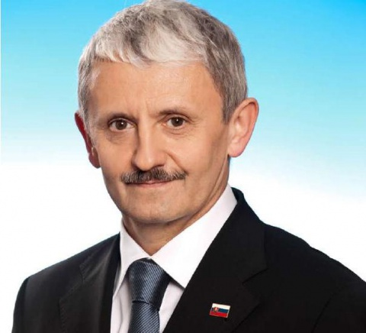
Government 1998 - 2002
Prime Minister – Mikuláš Dzurinda
High number of members – 4 vs. 10
Main task – to restore the country after Mečiar’s era:
Return to liberal democratic regime
Retrieval of the Slovakia’s international image
Economic reforms, salvation of banks

Slide 6
Low Stability of Governmental Parties
Affected all parties except the Hungarians (SMK)
Centre-right alliance SDK:
2000 – Dzurinda establishes Slovak Democratic and Christian Union (SDKU)
Only Christian Democrats (KDH) survived
Collapse of the left (SDL, SOP):
Negatively affected by the unpopular economic policy
SOP leader Schuster elected for president in 1999
SDL leading figure Fico left his party and establishes a new one

Slide 7
Opposition
Maintained several changes
HZDS:
Hard adaptation on oppositional role
Non-constructive opposition work
Stabilization after return of Mečiar to active politics
SNS:
Post-electoral destabilization
Division into 2 parties and interim marginalization

Slide 8
Opposition – New Parties
Smer (Direction), 1999:
Created by ex-SDL official Robert Fico
Refused the left-right division
Project of the third way
Strong populism, criticism of both eras – Mečiar’s and Dzurinda’s
Alliance of the New Citizen (ANO), 2001:
Created by media magnate Pavol Rusko
The Slovak „Berlusconi“
Populism, centre-right liberal values

Slide 9
Perception of Prime Ministers (2001)
 | Both positive | Mečiar + Dzurinda - | Mečiar - Dzurinda + | Both negative | Do not know
HZDS | 5,2 | 88,1 | 0,0 | 2,2 | 4,5
SNS | 1,0 | 57,3 | 6,3 | 20,8 | 14,6
SDKU | 4,0 | 3,0 | 81,2 | 3,0 | 8,9
SMK | 1,4 | 2,1 | 59,3 | 20,7 | 16,4
KDH | 7,4 | 5,6 | 29,6 | 29,6 | 27,8
ANO | 0,0 | 15,3 | 20,8 | 55,6 | 8,3
SMER | 1,9 | 24,1 | 17,5 | 42,9 | 26,5
Non-voters | 1,2 | 14,7 | 13,5 | 44,1 | 13,7
Undecided | 1,5 | 14,2 | 16,1 | 38,7 | 29,5

Slide 10
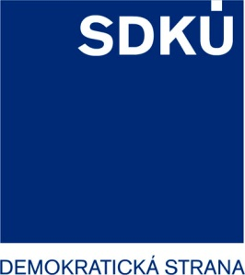
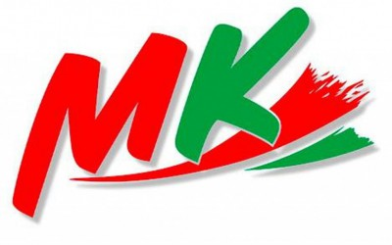
The „Map“ of the Party System in 2002

Slide 11
2002 Election – Crisis of the Left
Party | Votes (in %) | Seats
HZDS | 19,5 | 36
SDKU | 15,1 | 28
SMER | 13,5 | 25
SMK | 11,2 | 20
KDH | 8,3 | 15
ANO | 8,0 | 15
KSS | 6,3 | 11
SDL + SOP | 1,4 | 0
Others | 7,1 | 0
 |  | 150

Slide 12
Government 2002 - 2006
Dzurinda remained Prime Minister
No leftist parties
End of the integration process – EU, NATO (2004)
Unpopular economic reforms – taxes, healthcare, social system
Since 2003 a minority government

Slide 13
Restoration of the Left (SMER)
Shift from populism to social democracy (SMER-SD)
2003-2004 – SMER absorbed smaller leftist parties
Strong criticism of governmental reforms
Huge rise of popularity

Slide 14
To the EU! But Not With Bare Asses…

Slide 15
People deserve securities

Slide 17
 |  | 2002 | 2004 | 2006 | 2008 | 2010 | 2012
Gender | Men | 54.9 | 56.5 | 49.3 | 35.8 | 39.3 | 41.3
 | Women | 45.1 | 43.5 | 50.7 | 64.2 | 60.7 | 58.7
Age | 18 - 24 | 19.9 | 10 | 7.3 | 2.3 | 4.6 | 2.8
 | 25 - 34 | 25.7 | 24.3 | 20.3 | 8.4 | 8.2 | 8.8
 | 35 - 44 | 28.8 | 15 | 16.5 | 9.9 | 6.8 | 13.4
 | 45 - 59 | 19.9 | 32.1 | 32 | 32.4 | 35.1 | 30
 | 60 and more | 5.8 | 18.6 | 23.8 | 47 | 45.3 | 45
Education | Primary | 17.3 | 12.5 | 18.6 | 16.1 | 17.3 | 16.6
 | Lower secondary | 39.1 | 34 | 35.3 | 35.4 | 31.1 | 30.6
 | Higher secondary | 33.8 | 43.1 | 36.1 | 37.2 | 41.4 | 41.6
 | University | 9.8 | 10.4 | 10 | 11.2 | 10.1 | 11.2
Left-Right | Left | 31.1 | 42.9 | 46.6 | 62.5 | 64.6 | 58.4
 | Centre | 54.4 | 47.9 | 44.2 | 32.6 | 30.5 | 30.7
 | Right | 14.4 | 9.3 | 9.2 | 4.9 | 4.9 | 10.9
Income | Low | 34.5 | 31.6 | 17.8 |  | 19.9 | 35.6
 | Middle | 59.5 | 59.2 | 61.7 |  | 47.1 | 50
 | High | 5.9 | 9.2 | 20.4 |  | 33 | 14.4

Slide 18
2006 Election – The New Leader
Party | Votes (in %) | Seats
Smer | 29,1 | 50
SDKÚ | 18,4 | 31
SNS | 11,7 | 20
SMK | 11,7 | 20
HZDS | 8,8 | 15
KDH | 8,3 | 14
ANO | 1,4 | 0
Others | 12,0 | 0
 |  | 150

Slide 19
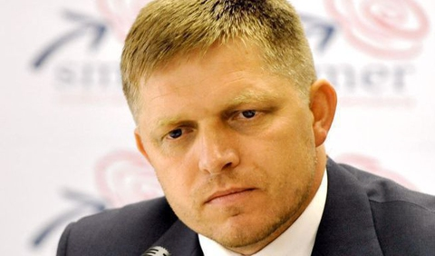
Government 2006-10
Prime Minister – Robert Fico
Return to ideological heterogeneity:
Smer - social democrats
SNS - radical right
HZDS – vague
Analogies with Mečiar’s government 1994-98:
Total dominance of the strongest party
Numerous scandals, problematic style of politics
Prime Minister as a dividing line in the party system

Slide 20
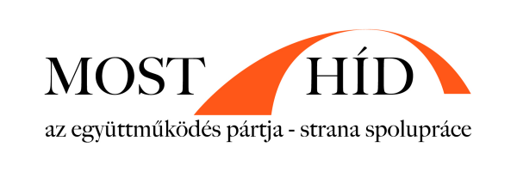
Changes in the Centre-Right after 2006
Most-Híd (The Bridge):
Created by former leader of SMK Béla Bugár
Project of Hungarian and Slovak cooperation
Replaced the position of SMK
Freedom and Solidarity (SaS):
Created by entrepreneur Richard Sulík
Liberal, libertarian and post-materialistic
Together with SDKU and KDH these parties declared not to cooperate with SMER after elections 2010 → sign of polarization

Slide 21
For future generations!

Slide 22
The „map“ of the party system in 2010

Slide 23
2010 Election – HZDS is Out
Party | Votes (in %) | Seats
Smer | 34,8 | 62
SDKÚ | 15,4 | 28
SaS | 12,1 | 22
KDH | 8,5 | 15
Most-Híd | 8,1 | 14
SNS | 5,1 | 9
HZDS | 4,3 | 0
Others | 11,6 | 0
 |  | 150

Slide 24
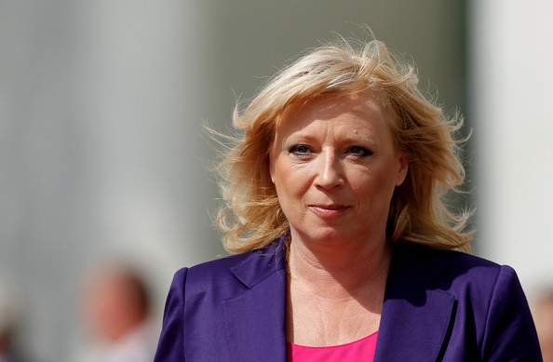
Government 2010-2012
Prime Minister – Iveta Radičová
Members – SDKU, SaS, Most-Hid, KDH
2011 – the EFSF vote:
SaS refusal to vote for the rescue mechanism
EFSF vote joined with the vote of confidence → end of the government
→ Collapse of the right

Slide 25
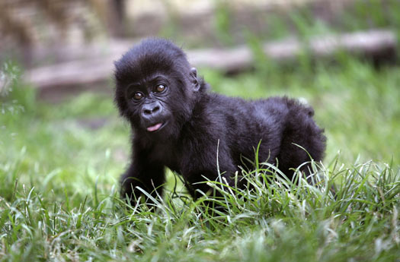
Before 2012 Elections
Frustration of centre-right voters
The Gorilla case:
Revealed strong corrupt ties between politics and financial groups
Biggest negative impact on SDKU
Ordinary People and Independent Personalities (OLaNO):
Populist „party“, four members only
Forum for independent candidates
Vast criticism of existing parties and corruption

Slide 26
2012 Election – A one man show
Party | Votes (in %) | Seats
Smer | 44,4 | 83
KDH | 8,8 | 16
OLaNO | 8,6 | 16
Most-Híd | 6,9 | 13
SDKU | 6,1 (- 9,3) | 11
SaS | 5,9 (- 6,2) | 11
Others | 19,4 | 0
 |  | 150

Slide 27
Government 2012-16
A one party government
Prime Minister – Robert Fico
No coalition partners → full responsibility
Social democracy with far right appeals

Slide 29
2016 Election – Earthquake
Party | Votes (in %) | Votes vs. 2012 | Seats
Smer | 28,3 | - 16,1 | 49
SaS | 12,1 | + 6,2 | 21
OLaNO | 11,0 | + 2,5 | 19
SNS | 8,6 | + 4,1 | 15
LSNS | 8,0 | + 6,5 | 14
We are Family | 6,6 | - | 11
Most-Hid | 6,5 | - 0,4 | 11
#SIET | 5,6 | - | 10
 |  |  | 150

Slide 30
2016 Election
Huge decline of SMER
Disappointment for #SIET
New protest parties in parliament:
We are Family – populist
LSNS – extreme right
New government – SMER, nationalist SNS and Hungarian Most

Slide 33
Governments after 1998
Years | Prime Minister | Consequences
1998 – 2002 | Dzurinda I | Collapse of the left
2002 – 2006 | Dzurinda II | Restoration of the left
2006 – 2010 | Fico I | New dividing line in party system
2010 – 2012 | Radičová | Crisis of the right
2012 – 2016 | Fico II | Political earthquake
2016 - 2020 | Fico III / Pellegrini | See lecture on 2020 election

