Slide 1
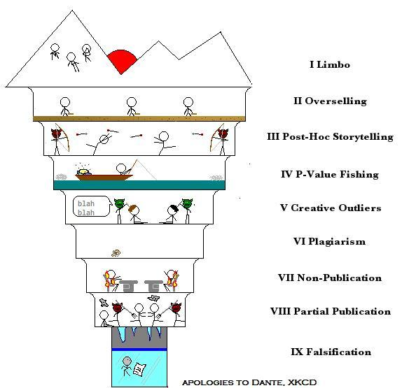
Good Research Practices
Edita Chvojková
Petr Palíšek

Slide 2
The crew (with Daniel Lakens)

Slide 3
… feat. baron HARKonnen

Slide 4
Organization of the course - PAQ
Why this weird timetable?
Do I need to be here?
Do I need to read the whole book?

Slide 5
Organization of the course - PAQ
Why this weird timetable?
We also need to do research sometime. And you can benefit from a steep learning curve and being done half-semester.
Do I need to be here?
We don't really care, but if you don't show up for a quiz, there's no possibility to sit it later.
Do I need to read the whole book?
Yes.

Slide 6
Organization of the course - PAQ
Why this weird timetable?
We also need to do research sometime. And you can benefit from a steep learning curve and being done half-semester.
Do I need to be here?
We don't really care, but if you don't show up for a quiz, there's no possibility to sit it later.
Do I need to read the whole book?
Yes. In fact, you need to read a bit more than the book.

Slide 7
week | seminar | lecture | assignments
1 Feb 17, 22 | none | The Sins of Corruptibility & Bean Counting
2 Feb 24, 22 | Retraction Watch & How not to fall a victim | The Sin of Bias | Quiz 1
3 Mar 3, 22 | Preregistrations, Registered reports and other saving graces | The Sin of Unreliability | GA 1
4 Mar 10, 22 | Guest: Ethics & GRP + CryptoBias | The Sin of Hidden flexibility | Quiz 2
5 Mar 17, 22 | Guest: GRP in qualitative research + Theory building | The Sin of Data Hoarding | GA 2
6 Mar 24, 22 | Data & Registration Repositories | The Sin of Internment | Quiz 3
7 Mar 31, 22 | Voices against Good Research Practices | Redemption
8 Apr 7, 22 | Guest: The redeemed sinner | none | Final assignment

Slide 8
Schedule
Contents of modules may slightly change
We are negotiating a guest appearence by an Australian open science activist and academic iconoclast
Stay tuned! And check out the interactive canvas in IS

Slide 9
Communication in the course
this is an English-taught course, open to international students,
this is also a platform for open communication and debate,
and a low-key simulation of what you may experience when you decide to study at a university abroad.
We understand that some of you may not feel comfortable with speaking English. However, if you wish to study abroad or even attend conferences, you'd eventually need to. So don't worry about your mistakes and just try to get the message through. You will NEVER be graded on your language skills, given that you are able to get the message through. However, you will get feedback on the quality of your writing in the assignments.

Slide 10
Grading
not an easy course!
however, your chances of passing are high, since we do not give a final grade!
10-point grading scheme
late submissions possible; a penalty (1p/day) applies when you do not provide a reasonable explanation beforehand
4 types of assignments:
Quiz (Q)
Group assignment (GA)
Individual assignment (preregistration/registered-report)
Newsflash! (a week in the world of GRP)

Slide 11
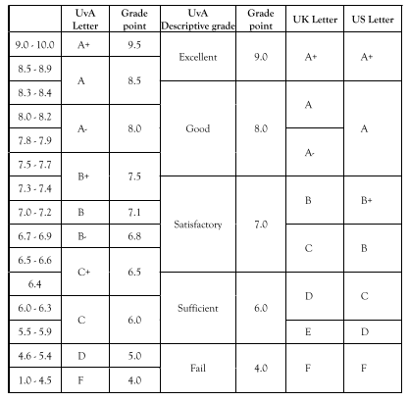

Slide 12
Quizzes
there will be three quizzes altogether
the quizzes are NOT OPEN BOOK, just paper-pencil
composed of from two to several open-ended questions
the purpose of the quizzes is to check whether you read & understood the literature
you will be told what you will be quizzed on (usually the book)
you WILL NOT be tested on encyclopaedic knowledge
The MEDIAN grade for quizzed counts

Slide 13
Group assignments
Further details are in the interactive syllabus – groups of 4-5.
Read two articles and write a short blogpost about your position.
Briefly comment on a study of your choice with regards to its research practices – is it good, bad, or okay?

Slide 14
Final Individual Assignment
Preregistration or registered report
Choose one that fits you best
You are encouraged to (pre)register your thesis!
Deadline may be set individually so that you can profit the most from this assignment (e.g., if you don't have a thesis topic yet)

Slide 15
Newsflash! - the week in the world of GRP
Good news – Newsflash is not graded!
Every week at the seminar you can briefly share the interested info you gathered on your scientifically relevant Twitter, or via other media!
This way we can all learn about interesting new things!

Slide 16
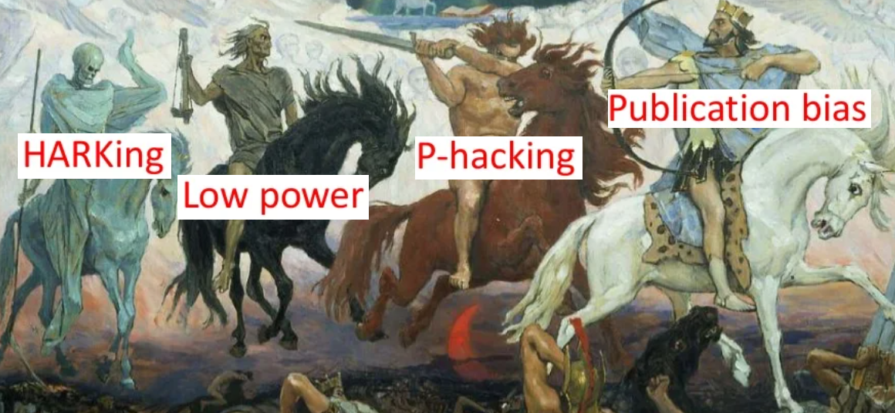
Shall we roll?

