Slide 1
Youth and online risks
Hana Macháčková

Slide 2
Risks online
The question of online risks salient from many perspectives:
Research
Policy
Law
Daily praxis
prevention and intervention efforts
Public concern

Slide 3
Online risks
Important – differentiation of risk and harm
Risk – probability to encounter something negative
Harm – actual (long- and short- term) harm from the experience
What does it say about the nature of the incident?
Important – taking into account individual and social factors
And other factors (EST)

Slide 4
Online risks – individual factors
Risk – who is prone to encounter more risks?
Inevitably connected with higher internet use
Personal traits – e.g., sensation seeking
Who is capable to efficiently deal with the risk - on the level of the prevention and coping?
vulnerability, resilience and coping styles
„new factor“ - digital skills

Slide 5
Online risks – social factors
Social environment affects the individual factors + the predictors of risks + the outcomes of the incident (harm)
Example – quality of family relationships
School/community
Social environment and its affordances

Slide 6
Online risks – other factors
Cultural/country level
Policies + legal system
Intervention programs + education

Slide 7
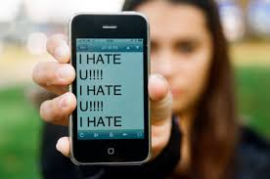
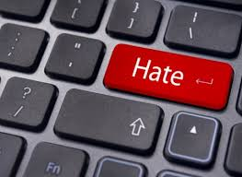
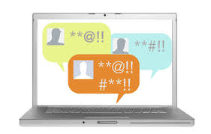
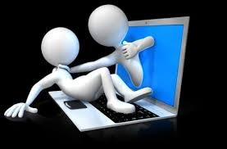
Selected risk: Aggression online
Seemingly ubiquitous
Everyday experience?
Discussions: increased hostility, prejudices,
intolerance, aggressivity…

Slide 8
Aggression
Broad and complex term
Aggression is….“any form of behavior directed toward the goal of harming or injuring another living being who is motivated to avoid such treatment“ (Baron & Richardson, 2004, p.7)
It can take many forms:
Direct/nondirect
Verbal/physical/sexual….
Interpersonal/intergoup
Etc.
Online / offline

Slide 9
Aggression online
Various types
Mirroring offline ones
Cyberbullying, online harassment, cyberhate, cybercrime, cyberterrorism…
We will focus on cyberbullying among youth

Slide 10
Aggression online
Various types
Mirroring offline ones?
Cyberbullying, online harassment, cyberhate, cybercrime, cyberterrorism…
Interconnection with offline life
Extension, augmentation, blending…

Slide 11
Overlap of online and offline aggression
Most studies report substantial overlap , 60-90%
Gradinger, Strohmeier, & Spiel, 2009; Hinduja & Patchin, 2012 ; Jose, Kljakovic, Scheib, & Notter, 2012; Juvonen & Gross, 2008; Salmivalli & Pöyhönen, 2012; Smith et al., 2008; Waasdorp & Bradshaw, 2015
EU Kids Online IV: 79% victims of cybeaggression also victims of offline aggression

Slide 12
Overlap of online and offline aggression
Explanation?
One incident in more environemnts
Vulnerability and susceptibility to aggression
Suggestion: „…view of cyberbullying as a form of bullying, in line with other forms such as verbal, physical, and indirect/relational bullying.“ (Olweus & Limber, 2018)

Slide 13
Aggression online
Various types
Mirroring offline ones?
Cyberbullying, online harassment, cyberhate, cybercrime, cyberterrorism…
Interconnection with offline life
Extension, augmentation, blending…
Cyberspace: Important aspect of everyday life
„virtual“ but „real“
Cyberspace: specific social environment

Slide 14
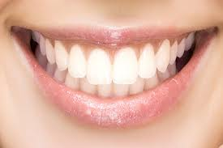
Differences from offline environment(s)
Computer-mediated communication (CMC)
Text, visuality, hypertexts
A/synchronic communication
Absence of many cues
Currently, more rich (emoji, audio-visual cues etc.)
„say it with gif“, memes
LOL

Slide 15
Differences from offline environment(s)
Control of self-expressions
Asynchronous communication
Visuals (graphs), hyperlinks
No others clues (gestures, posture, voice, speach)
The lack of cues as a source of misunderstandings
BUT, they may pose a barrier in communication offline
Distance, anonymity, invisibility….
Storing, sharing, spreading
Materials and information
24/7 accessibility
countries with high internet penetration
Digital divide

Slide 16
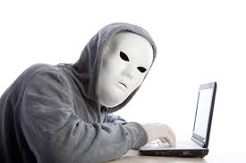
Online disinhibition effect (Suler, 2004)
Anonymity, invisibility, asynchronicity, solipstic introjection, dissociative imagination, minimization of status and authority
Toxic and benign
hostillity x self-disclosure and support
Developed before web2.0
Anonymity???

Slide 17
Online disinhibition effect (Suler, 2004)
Anonymity, invisibility, asynchronicity, solipstic introjection, dissociative imagination, minimization of status and authority
Toxic and benign
hostillity x self-disclosure and support
Developed before web2.0
Anonymity???
Still applicable
Social vs.
technical

Slide 18
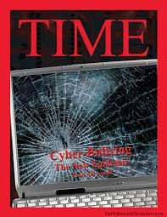
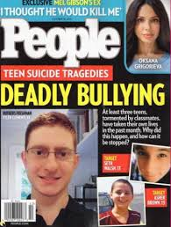
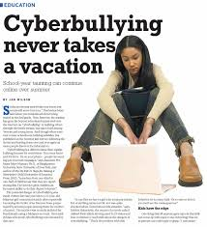
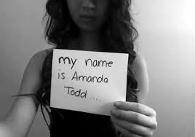
Cyberbullying and online aggression (harassment)
Cyberbullying: do you know the term?
Highly medialized
Contrast with empirical evidence

Slide 19
Cyberbullying and online aggression (harassment)
Cyberbullying: do you know the term?
Highly medialized
Contrast with empirical evidence
Kowalski et al. (2014): 10% - 40%
Also 3% - 70%

Slide 20
Cyberbullying and online aggression (harassment)
Definition of school bullying (Olweus, 1991) – criteria of
1) Intentional, causing harm
2) Repetitive
3) Power imbalance
Also many forms:
Overt/covert
Relational/Social/Physical
Physical/verbal attacks, degradation/humiliation, blackmailing, destroying things, social exclusion, ignoring…

Slide 21
Cyberbullying and online aggression (harassment)
Cyberbullying: intentional and aggressive act carried out through electronic media, which may be repetitive in nature (Nocentini et al., 2010; Tokunaga, 2010)
What are the forms here?
Verbal attacks, insults, threats, gossips…
Spreading of personal and sensitive information
Without consent
Identity theft
Social exclusion, ostracism
Publishing of harmful audiovisual material (changed)
Happy slapping
...

Slide 22
Cyberbullying and online aggression (harassment)
We are talking about cyberbullying if the aggressive attacks :
are conducted via internet or mobile phones
are intentionally harmful (conducted by individual or group)
and are harmful for victim
are repeated (however….)
there is power imbalance – the victims can‘t easily defend themselves

Slide 23
Cyberbullying and online aggression (harassment)
We are talking about cyberbullying if the aggressive attacks :
are conducted via internet or mobile phones
are intentionally harmful (conducted by individual or group)
and are harmful for victim
are repeated (however….)
there is power imbalance – the victims can‘t easily defend themselves
Harm is not always present!
Difficulties of harm assessment

Slide 24
Cyberbullying and online aggression (harassment)
We are talking about cyberbullying if the aggressive attacks :
are conducted via internet or mobile phones
are intentionally harmful (conducted by individual or group)
and are harmful for victim
are repeated (however….)
there is power imbalance – the victims can‘t easily defend themselves
Repetition: problematic online
„once published, always online“
Important in messaging (email, phones…)

Slide 25
Cyberbullying and online aggression (harassment)
We are talking about cyberbullying if the aggressive attacks :
are conducted via internet or mobile phones
are intentionally harmful (conducted by individual or group)
and are harmful for victim
are repeated (however….)
there is power imbalance – the victims can‘t easily defend themselves
Digital skills?
Always online
Aggressors‘ anonymity (not so common)

Slide 26
Cyberbullying and online aggression (harassment)
We are talking about cyberbullying if the aggressive attacks :
are conducted via internet or mobile phones
are intentionally harmful (conducted by individual or group)
and are harmful for victim
are repeated (however….)
there is power imbalance – the victims can‘t easily defend themselves
If these criteria are not fullfilled:
online aggression/harassment

Slide 27
Cyberbullying and online aggression (harassment)
„New bottle, old wine“?
What is „new“?
No time/space limits – no escape
Distance – the victim does not have to be present (adding comments, likes, spreading of information….)
Wide audience - potential
Spreading and sharing – easy and fast, unlimited
No control over the content
Can be „hidden“ – out of control of adults

Slide 28
Cyberbullying and online aggression (harassment)
Cyberbullying: detrimental effect on victims
Similar to offline bullying
Including:
Problem behaviors
Emotional problems (depression, anxiety, suicidal thougths)
Social problems
Lower self-esteem
Helplessness
Academic problems
Etc.

Slide 29
Cyberbullying and online aggression (harassment)
The impact depends on the severity of the attacks
- important to distinguish cyberbullying and harassment!
CB could be more harmful then offline
Especially cases of public forms, and especially including audiovisual materials (Sticca & Perren, 2013)
Depends on the interconnection with offline bullying
- usually connected („double whammies“)
Also depends on coping with cyberbullying

Slide 30
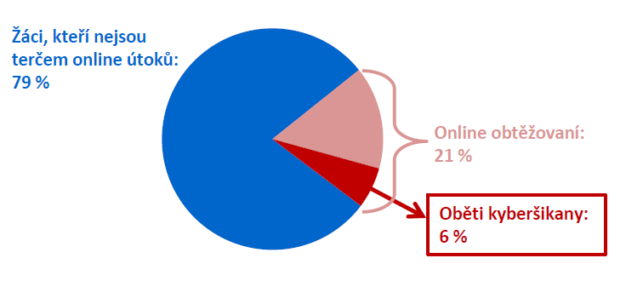
Cyberbullying and online aggression (harassment)
The impact depends on the severity of the attacks
- important to distinguish cyberbullying and harassment!
Could be more harmful then offline
Especially cases of public forms, and especially including audiovisual materials (Sticca & Perren, 2013)
Differences in prevalences and impact
Cyberbullying: less common, but more severe
Czech project: 79% no victimization
21% aggression
http://irtis.fss.muni.cz/wp-content/uploads/2013/06/COST_CZ_report_II_CJ.pdf
6% CB victims

Slide 31
Cyberbullying and online aggression (harassment)
The impact depends on the severity of the attacks
- important to distinguish cyberbullying and harassment!
Could be more harmful then offline
Especially cases of public forms, and especially including audiovisual materials (Sticca & Perren, 2013)
Depends on the interconnection with offline bullying
- usually connected („double whammies“)
Also depends on coping with cyberbullying

Slide 32
Cyberbullying and online aggression (harassment)
Coping with cyberbullying
Many different strategies
Emotion/problem focused
Mal/adaptive?
Similar to offline responses
new – „technological coping“
Question of effectiveneess in coping with online attacks

Slide 33
Cyberbullying and online aggression (harassment)
Outcome also depends on the context
Including responses of others – the audience
Bystanders in cyberbullying
much more common than victimization
EU Kids Online – 47%

Slide 34
Cyberbullying and online aggression (harassment)
What can they do? (online and offline)
Support the victim: emotionaly, advice provision, confrontation of aggressor…
Reinforce the bully: joining in, reposts, sharing, likes, comments…
Passivity: most common
Helpful:
decreases impact, can stop the attacks, help to cope

Slide 35
Cyberbullying and online aggression (harassment)
What can they do? (online and offline)
Support the victim: emotionaly, advice provision, confrontation of aggressor…
Reinforce the bully: joining in, reposts, sharing, likes, comments…
Passivity: most common
Increases the impact, especially when wide audience, causes of repetiveness…

Slide 36
Cyberbullying and online aggression (harassment)
What can they do? (online and offline)
Support the victim: emotionaly, advice provision, confrontation of aggressor…
Reinforce the bully: joining in, reposts, sharing, likes, comments…
Passivity: most common
Harmless? No
Increases impact, may be interpreted as silent approval by both victim and aggressor
Metadata: visits, views…

Slide 37
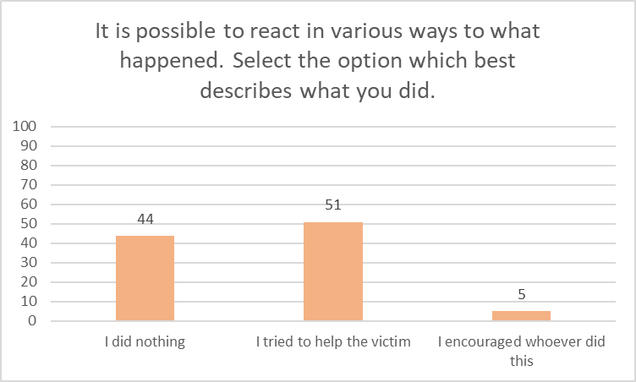
EU Kids Online

Slide 38
Cyberbullying and online aggression (harassment)
Who helps victim?
Empathy, prosocial behavior, norms, relationship with the victim…
Who reinforces bully?
Low empathy (affective), aggressive beliefs, relationship with aggressor…
Who stays passive???
Despite common antibullying norms

Slide 39
Cyberbullying and online aggression (harassment)
What is „new“? – Context
Specific communication and environment
Distance
Lack of cues
Wide audience

Slide 40
Cyberbullying and online aggression (harassment)
Latané & Darley (1970)

Slide 41
Cyberbullying and online aggression (harassment)
Attention and distractions

Slide 42
Cyberbullying and online aggression (harassment)
Complicated assessment, „just a joke“, not serious

Slide 43
Cyberbullying and online aggression (harassment)
Wide audience, who (where) is victim, ongoing event?

Slide 44
Cyberbullying and online aggression (harassment)
Assessment, self-efficacy, own victimization, aggravation of problem?

