Slide 1
Financial Exclusion and Poor
Lecture 6

Slide 2
Introduction
There is a growing recognition across the EU that having access to a bank account and the financial services that banks and other financial institutions provide, including credit facilities, is, in many countries, a necessary condition for social inclusion. (European Commission Employment, Social Affairs and Equal Opportunities Social Situation Observatory – Living Conditions and Income Distribution 2010, p.3)
People who have difficulty in obtaining a bank account or access to credit, therefore, tend to be those who are out of work or who have particularly low levels of income, which are independent causes of social exclusion.

Slide 3
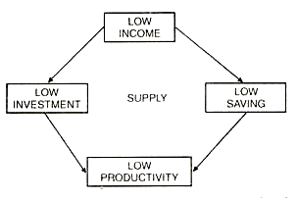
Financial exclusion
Financial exclusion is a broad term for the barriers faced by the poor
It is defined as “those processes that serve to prevent certain social groups and individuals from gaining access to the financial system” (Leyshon and Thrift, 1995)
However, financial inclusion is one of the powerful weapons in poverty irradiation

Slide 4
Forms of financial exclusion
Access exclusion: the restriction of access through the processes of risk management
eg. Repaying capacity, permanent income
(2) Condition exclusion: where the conditions attached to financial products make them inappropriate for the needs of some people
eg. Asking guarantors, bonds/surety
(3) Price exclusion: where some people can only gain access to financial products at prices they cannot afford
eg. high interests and instalments
(4) Marketing exclusion: whereby some people are effectively excluded by targeting marketing and sales
eg. loans and credit card promotions
(5) Self-exclusion: people may decide that there is little point applying for a formal financial product because they believe they would be refused
eg. fear for debt, religious and cultural norms Anana Shuka

Slide 5
Financial inclusion/exclusion in the global context
the Asian system offered universal participation in which the government performed a major role by directing credit at low but stable rates of return.
European countries tended to offer a “range of functionally distinct institutions” that was tailored to meet diverse needs; some were scaled to cater to nation-wide demands while others were simply to meet local needs.
The US used to have a system in which banks were local and segmented with near universal participation, and
Countries in Latin America used have universal banking in urban areas and informal financial arrangements in rural areas.
However, all these diverse models of banking which were unique to their environments are now being replaced by a homogeneous system as a result of financial globalization that caters to the upscale segment.

Slide 6
As financial institutions focus on attracting desirable upscale customers by offering them low or zero fees for service, the poor customers are left with costly and limited services.
Furthermore, the cross-subsidies between elite customers and other customers which allowed banks to offer small but similar financial services are being eliminated. Because banks now compete globally for elite customers, they no longer offer subsidies to lower-balance or riskier clientele.
The end result of all these transitions is a larger number of households becoming unbanked (“those who are unable to establish or maintain bank accounts” (Dymski, 2005, p. 125) and an ever clearer division between the financially included and the financially excluded.

Slide 7
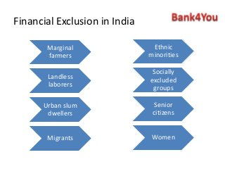

Slide 8
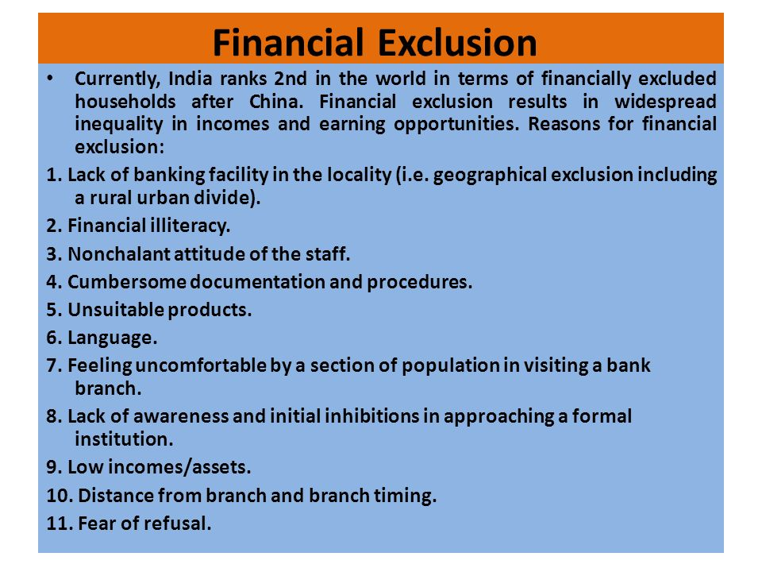

Slide 9
Financial exclusion in Europe
Carbo et al. (2007) indicate,
the widespread liberalization of the financial industry has drastically increased “intensification of bank competition”
Liberalization policy has deregulated the banking and financial market, which create benefits to rich class
That challenged the standard of justice in financial practices
Carbo et al. (2007) observed that financial exclusion is “invariable experienced by the poorer members of society” even though they are in developed countries.
The percentage of the adult population, in Europe, who do not have bank accounting, for example is stunning: 22.4 percent in Italy, 17.9 percent in Greece, 16.8 percent in Ireland, 16.7 percent in Portugal, 13.5 percent in Austria and 10.5 percent in the UK. Between 14% and 18% in the Czech Republic, Ireland, Latvia, Lithuania, Poland and Slovakia

Slide 10
Consequences of financial exclusion
The lack of access or not having a bank account makes it difficult for the poor
  to receive income and to make payment,
  to receive credit that they really need to help them navigate the financial crises
  It also reduces saving habits, financial literacy and management skills
As a result, the poor resort to alternatives to the traditional financial institutions such as
  money-lenders
  payday loans
  pawnshops that charge very high rates.
  inability to obtain insurance coverage.

Slide 11
Different approaches to combat the problem of financial exclusion
These approaches have travelled under such different names as
  social investment programs
  micro-finance programs
  community finance, and
  community development
the government of the UK stimulates local enterprises and reduce dependency on state support through: promoting community development and finance programs (CDFI) to provide credit to poor communities, and grant-funding community

Slide 12
Assignment 01
With reference to the Grameen Bank Micro Finance system, evaluate the importance of the role of micro finance as social entrepreneurship in poverty irradiation (Marks 20)
Pay attention to following thing
1. Read on Grammen Bank system (the bank of poor)
2.Aims and objectives of GB and the way how it operates
3. Discuss how it has changed saving, investment and consumer behaviours of poor
4. How GB has organized poor for income generating and entrepreneur activities
Length- maximum 10 pages
Submission date 12th April
Individual task

Slide 13
Assignment 2
Group activity
Interview 5 to 10 poor people in your area and analyze the characteristics of their poverty
Introduce a suitable social entrepreneurship model/s to irradiate their poverty
(marks 30)
Results should be presented in the class using power point presentation. Everybody has to contribute to the project and present the outcomes
Presentation will be on 27th April

